Slide 1


Slide 2
Background
Established in the 2008 Farm Bill to promote and encourage economic development
Authorized at an initial $30 million/year level
Reauthorized in the 2018 Farm Bill through 2023 at an annual funding level of $33 million
Independent Federal Agency – Federal-State partnership
Aligns agency activities and investments with States’ priorities

Slide 3
Background (Continued)
Covers counties in seven states not currently served by the Appalachian Regional Commission (ARC) and/or the Delta Regional Authority (DRA)
Seven states, 431 counties, 145 of those are persistent poverty counties
Mission is to build sustainable communities and strengthen economic growth across the Southeast Region
Unable to form during earlier years due to the lack of appointment of a Federal Cochairperson

Slide 4
2008 Farm Bill
One of three commissions created
  Southeast Crescent Regional Commission
  Southwest Border Regional Commission – not currently active
  Northern Border Regional Commission
All three share common authorizing language modeled after the ARC structure
Service areas and authorities are defined in statute and can only be amended or modified through congressional action

Slide 5
Southeast Crescent Regional Commission (SCRC) States
Alabama
Georgia
Florida
Mississippi
North Carolina
South Carolina
Virginia

Slide 6
Appalachian Region
  Alabama
  Georgia
  Mississippi
  North Carolina
  South Carolina
  Virginia
Delta Region
  Alabama
  Mississippi
Florida is currently the only state in the SCRC that is not currently in the DRA and/or ARC.

Slide 7
Composition
Federal and State Members
  Federal Cochairperson to be appointed by the President, by and with the advice and consent of the Senate
  The Governor of each participating State in the region
Alternate Members
  Alternate Federal Cochairperson
  State Alternates
CoChairpersons
  Federal Cochairperson
  State Cochairperson

Slide 8
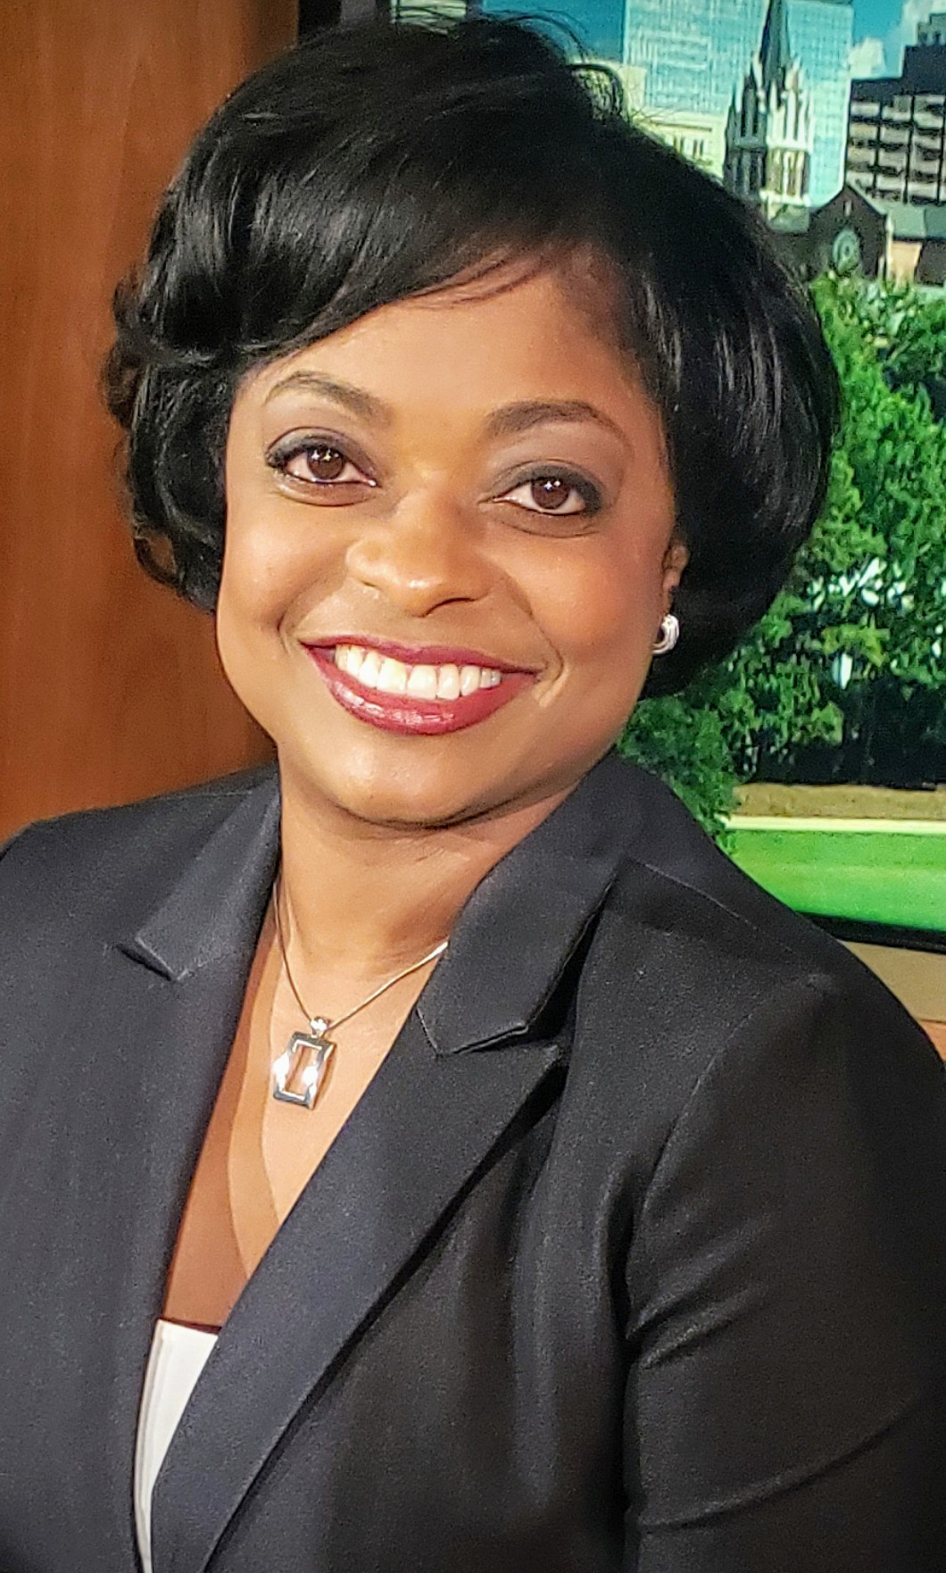
On December 8, 2021, the U.S. Senate confirmed Dr. Jennifer Clyburn Reed, the SCRC’s first Federal Cochairperson, thereby allowing the SCRC to convene and begin other activities.

Slide 9
Program Administration in Alabama
Governor Kay Ivey – State Member
Alabama Department of Economic and Community Affairs – Administering Agency
Director Kenneth W. Boswell, ADECA – State Alternate Member
Crystal G. Talley, ADECA – SCRC Program Manager

Slide 10
Recent Activities
First Governors Quorum meeting on April 1, 2022
Elected 2022 States’ Cochairperson, Governor of South Carolina, Henry McMaster
Certified FY 2022 States’ Funding Allocation
Designated Counties as Attainment, Transitional, or Distressed

Slide 11
Authorized and Appropriated
Authorized Funding
  FY2010 – FY2018 - $30 million
  FY2019 – FY2022 - $33 million
Appropriated Funding
  FY2010 – FY2020 - $250,000
  FY2021 - $1 million
  FY2022 - $10 million
    FY2022 - $5 million
    Infrastructure Investment and Jobs Act - $5 million

Slide 12
2022 Allocation Formula
Distressed Population – 45%
Equality Factor – 25%
Distressed County Area – 25%
Population Factor – 5%

Slide 13
Allocation by State
FY2022 $10 Million
State | Amount | Percentage
Alabama | $507,402.19 | 5.07%
Florida | $1,591,550.37 | 15.92%
Georgia | $3,168,327.28 | 31.68%
Mississippi | $1,193,725.46 | 11.94%
North Carolina | $1,810,701.90 | 18.11%
South Carolina | $1,104,970.88 | 11.05%
Virginia | $623,321.92 | 6.23%

Slide 14
County Designations
Distressed counties are the most economically depressed counties. They rank in the lowest 25% of the nation’s counties. Match 20%
Transitional counties are transitioning between strong and weak economies. They make up the largest economic status designation. These counties rank between the lowest 25% and the highest 25% of the nation’s counties. Match 50%
Attainment counties are the economically strongest counties. They rank in the highest 25% of the nation’s counties.

Slide 15
Alabama SCRC Counties
Autauga
Baldwin
Coffee
Covington
Crenshaw
Dale
Geneva
Henry
Houston
Lee
Mobile
Montgomery
Pike

Slide 16
Alabama Economic Status FY 2022
Transitional
  Autauga
  Baldwin
  Coffee
  Crenshaw
  Dale
  Henry
  Houston
  Lee
  Mobile
  Montgomery
Distressed
  Covington
  Geneva
  Pike

Slide 17
SCRC invests in the region’s economic future through a grant program, publishing research, and income-producing learning experiences – all to help communities seize opportunities, address economic disparity and advance prosperity.

Slide 18
Potential Projects
Transportation
Basic Public Infrastructure
Telecommunications
Renewable and Alternative Energy
Skill Development, Entrepreneurship, and Business Development
Basic Health Care
Tourism and Recreation Aligned with Economic Development Goals
Grow the Capacity for Successful Community Economic Development Goals

Slide 19
Information and Next Steps
Headquarters in Columbia, SC
Website www.scrc.gov
Development of the SCRC 5 Year Plan
Development of State economic and infrastructure development plan
Up for reauthorization in FY2023
Currently developing bylaws
Hiring for the position of Chief-of-staff
Potential for $7 million for FY2023

Slide 20
Survey https://www.surveymonkey.com/r/PXL35HC. It can also be accessed from the official SCRC webpage at scrc.gov.

Slide 21
Contact Information
Crystal G. Talley,
Community Services Unit Chief
crystal.talley@adeca.alabama.gov
(334) 353-2630
Cleandra Dixon,
Program Supervisor
cleandra.dixon@adeca.alabama.gov
(334) 353-2909

