Slide 1
ADECA’s Emergency SOLUTIONS GRANTS Program
PY2023 Compliance Workshop
Notes:
Welcome to ADECA’s Emergency Solutions Grant Program Compliance Workshop for Program Year 2023. I’m Dave Veatch, ADECA’s ESG Program Supervisor for the State of Alabama.
Please know that all slides and speaker notes, as well as a video recording of this workshop will be made available on ADECA’s website.

Slide 2
CONTACT INFORMATION
Community and Economic Development Division
Kathleen Rasmussen, Division Chief
kathleen.rasmussen@adeca.alabama.gov
334-353-0323
Trent Williams, Special Programs Unit Chief
trent.williams@adeca.alabama.gov
334-353-3409
Notes:
Within ADECA is the Community and Economic Development Division which is headed by the Division Chief Kathleen Rasmussen. My direct supervisor is Trent Williams, the Special Programs Unit Chief.

Slide 3
CONTACT INFORMATION
Dave Veatch, ESG Program Supervisor
dave.veatch@adeca.alabama.gov
334-353-0288
Marie Anderson, ESG Program Manager
marie.anderson@adeca.alabama.gov
334-242-0398
Joseph Ponder, ESG Program Manager
joseph.ponder@adeca.alabama.gov
334-242-5384
Notes:
The ESG Unit consists of myself as the ESG Program Manager and the two ESG Program Specialists, Marie Anderson and Joseph Ponder.

Slide 4
ADECA’s ESg WEB PAGE
adeca.alabama.gov/esg/
Application Manual
Implementation Manual
Notes:
Here is the web address for the ESG section of ADECA. This is the main page for ESG. On the left hand side you will see links to the Application and Implementation pages. This is where you will find further information and templates for the various Certifications, Budgets, Invoicing and other documents you will need during the administration of your Emergency Solutions Grant.
The purpose of this Workshop is to take you through the processes and steps for compliance with the Federal and State Rules and Regulations that govern the program.

Slide 5
LETTER OF Conditional Commitment Documents
Notes:
Those applicants who were awarded funding this year have received a Letter of Conditional Commitment. This letter is to inform an entity that their application was chosen for funding and that before the funds can be released, there are a number of start up documents which must be submitted to our office.
Once all documents have been reviewed and accepted, ADECA will send the entity the Grant Agreement to sign and return to our office. Once the signed Agreement has been received, ADECA will issue a Notice of Removal of Grant Conditions stating you can begin to draw down the grant funds. Requests for Reimbursements can not be submitted until you have received this notice.
Again all start up document forms are available on ADECA’s ESG web page.

Slide 6
Budget Forms
List of Second-tier Subrecipients
Subrecipient Administration
Certification Form
Notes:
Going through the list of these documents, you’ll see that some of them are self-explanatory.
The Certification form you see listed here documents the persons authorized to sign budgets and requests for payments. Signatures appearing on budgets and requests for payment must be identical to the signatures on this form. Please pay careful attention to this form, because there are two parts; one for authorizing the person who can sign Requests for Reimbursement, and one for who can sign budgets. This can be the same person, you’ll just have to have that person sign both parts.

Slide 7
Form W-9
Program Correspondence
Environmental Forms
State of Alabama Disclosure Statement Form
Notes:
The Environmental forms you see listed here will be discussed in more detail in just a moment by our Engineer, Chris Perkins. Chris conducts the review of these forms.
The State of Alabama Disclosure Statement is only required if the subrecipient is a nonprofit agency. If the subrecipient is a local unit of government, this form is not required.

Slide 8
Copy of deeds, mortgages, and appraisals
Certification of Local Government Approval – must be signed by the chief elected official of the local unit of gov’t
Certification of building use
Schedule of expenditures
Notes:
If emergency shelter funds will be used to rehab or convert an existing facility or if a facility or portions of the facility will be used as match, then copies of deeds, mortgages or appraisals will be required.
If an agency will provide emergency shelter activities, the Certification of Local Government Approval for Nonprofit Organizations Receiving ESG Funds from State Grantees form must be submitted. Multiple agencies may be listed on the same form. This form must be signed by the chief elected official of the local unit of government. This form is required when funds are in the emergency shelter line item, even if there are no shelters in the service area.
Certification of building use is required when emergency shelter funds will be used to rehab or convert a facility for use as an emergency shelter. We can discuss this individually if it applies to your program.
A schedule of expenditures estimates the cumulative percent of funds to be drawn down with each invoice submission and a corresponding date. Remember to take note of the period of performance in your Grant Agreement when making your schedule.
During the course of administering your Grant, review the Schedule with each invoice submission and revise as necessary.
Your adherence to the Schedule reflects planning and administrative capacity. These criteria are considered when applications are reviewed.

Slide 9
Certificate of Compliance with the Beason-Hammon Act
Copy of E-Verify Memorandum of Understanding
Certifications by the Chief Executive Officer or the Authorized Official
Notes:
Certificate of Compliance with the Beason-Hammon Act and the E-Verify Memo only apply if the subrecipient is a private nonprofit organization. You must submit the original Certificate of Compliance.
Local units of government should submit the Certifications by the Chief Elected Official (Chief Executive Officer) and nonprofit subrecipients should submit the Certifications by the Authorized Official.
Invoices can not be paid without a current sam.gov registration. Check the expiration date of your registration before you submit each invoice.

Slide 10
Written Standards/Policies and Procedures
Certification of Compliance with the Conflicts of Interest Policy
Certification of Compliance with the Confidentiality Policy
Current SAM.gov registration
Notes:
You must submit your written Policies and Procedures. In just a moment we’ll talk about the specific clauses which must be included with your Policies and Procedures.
The two Certifications listed here are found on our website.
Your invoices won’t be paid if we don’t have a copy of a current SAM.gov registration. Be mindful of the expiration date and make sure we have a current registration on file.

Slide 11
Copy of CoC’s Coordinated Assessment Procedures
Certification of Election to Charge 10% Federal De Minimis Indirect Cost Rate
Notes:
These are the last two start up documents listed on the standard Letter of Conditional Commitment. However, for various reasons, an LCC may be tailored to a specific entity, if further documentation was needed, so be sure to check yours for any additionally requested information.
Now, I’d like for our Engineer Chris Perkins talk to you in more detail about the Environmental Review.

Slide 12
Alabama ESG Program Environmental Compliance
Chris Perkins, PE
CED Engineer / Environmental Specialist
334-353-1028
christopher.perkins@adeca.alabama.gov
Notes:
Hi. My name is Chris Perkins, and I am the Engineer and Environmental Specialist for the Community and Economic Development Division of Alabama’s Department of Economic and Community Affairs. The following covers the Environmental Review Basics for ESG projects. My contact information is shown here. Feel free to contact me by email or phone; I will do all that I can to help answer any questions that you may have.

Slide 13
Sub-recipient Responsibilities
Chief Elected Official = Certifying Officer (Localities Only)
Designate Environmental Review Officer
Responsible for conducting Environmental Review
May be an employee of the locality or contracted
Must follow proper procurement procedures
Not required for Non-Profits
Environmental Review Officer’s Duties
Create an Environmental Review Record (ERR)
Classify Activities Correctly
Conduct Review
Complete Public Notification Correctly (if required)
Submit Required Documentation
Notes:
You as the sub-recipient have certain responsibilities that you are required to meet.
HUD mandates that the Certifying Officer assume the role of the Responsible Federal Official. The Certifying Officer would be the Chief Elected Official of a City or Town (for example, the Mayor) or the Chairperson of a County Commission. He or she would represent the Responsible Entity in court.
This authority can be reassigned to someone else provided a Delegation of Authority form is completed and submitted to ADECA.
The Certifying Officer also designates an Environmental Review Officer.
This person is responsible for actually conducting the Environmental Review.
He or she may be an employee of the locality or a contracted individual.
All proper procurement procedures must be followed in securing this person.
Non-profits do not have to formally appoint an Environmental Review Officer, ADECA conducts the review for them.

Slide 14
Activity Classifications
58.34
Exempt
58.35
Categorically Excluded
Subject to 58.5
Not Subject to 58.5
58.36
Environmental Assessment
58.37
Environmental Impact Statement
Notes:
The required level of review is determined by the activities to be undertaken in a project. Those activities can be separated into one of four levels. They are Exempt, Categorically Excluded, Environmental Assessment and Environmental Impact Statement. The Categorically Excluded level of review does have 2 sublevels; <click> they are Subject to and Not Subject to the regulations found at 58.5.

Slide 15
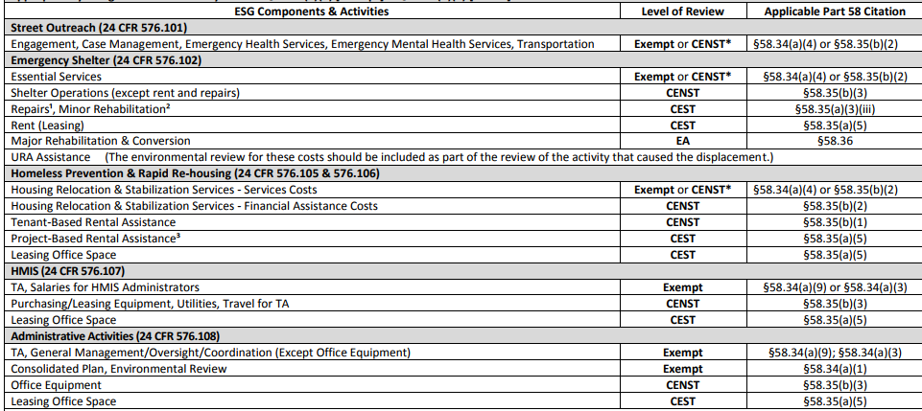
Classifying Your Project
5 Major Components in ESG
Street Outreach
Emergency Shelter
Homeless Prevention & Rapid Re-Housing
HMIS
Administrative Activities
Each Component has associated activities
Level of Review based off of these activities
Notes:
There are 5 major components in ESG. They are Street Outreach, Emergency Shelter, Homeless Prevention & Rapid Re-Housing, HMIS and Administrative Activities. Each of these components allows for certain types of activities to be conducted and each of these allowed activities has a level of review assigned to it. <click>
Here is a sample of the Levels of Environmental Review for ESG Components chart available on ADECA’s ESG website. Please refer to the complete chart when making your determination in classifying your activities. Let’s take a look at a few examples.
Under the Emergency Shelter Component <click> the activity of paying Rent or Leasing requires that the <click> Categorically Excluded Subject to Level of Review be conducted.
Under the HMIS Component <click>, the activity of providing Technical Assistance and/or paying for HMIS Administrators Salaries <click> requires that the Exempt Level of Review be conducted.
When you have multiple activities select the highest or the deepest, most stringent level of review for your project. For example, if you project has the two activities mentioned before, you’d select the CEST level of review.

Slide 16
Getting Started
Two Types
Non-Profit Organizations
Local Units of Government
https://adeca.alabama.gov/cdbg/training/
Environmental Review starts at 2:23:00
Notes:
There are typically 2 types of organizations that receive ESG funds. They are Non-Profits and Local Units of Government. The major difference between the 2, at least concerning the Environmental Review process, is who is responsible for conducting the Review.
In the case of Non-Profits, ADECA is responsible for conducting the review. As for Local Units of Government, well, they are responsible for conducting their own review.
Now, the fact that ADECA is responsible for conducting the reviews for Non-Profits does not absolve them from all the paperwork, we still need some basic information in order to conduct the review properly.

Slide 17
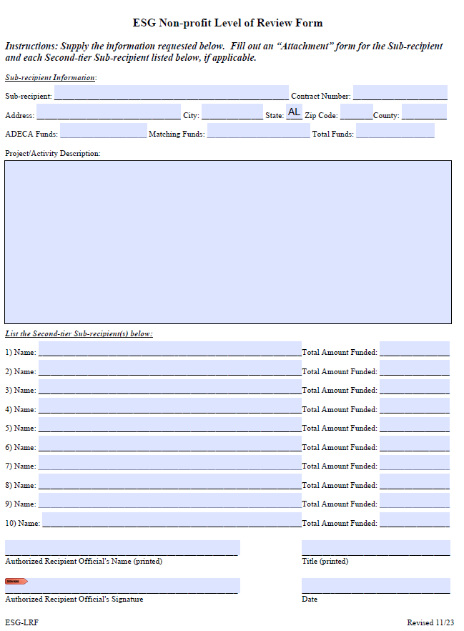
Conducting the Review
Non-Profit Organizations
Complete the Non-profit Level of Review Form
Complete the Sub-recipient Information
Include Complete Funding Totals
Include a Complete Project Description
Ensure the Proper Signature
Notes:
Non-profit Organizations must complete a Non-Profit Level of Review form first. A Level of Review form Attachment must also be completed by yourself and each of the 2nd tier sub-recipients, if there are any.
Now, the ESG Non-Profit Level of Review form is to be completed by the Sub-recipient. The funding totals reported on this form should be for the entire project. It should also include a complete project description for the sub-recipient and all 2nd tier sub-recipients. In other words, an aggregated list of all the proposed activities. This form should be signed by the Authorized Responsible Entity (that is the CEO, president or the like) of the sub-recipient.

Slide 18
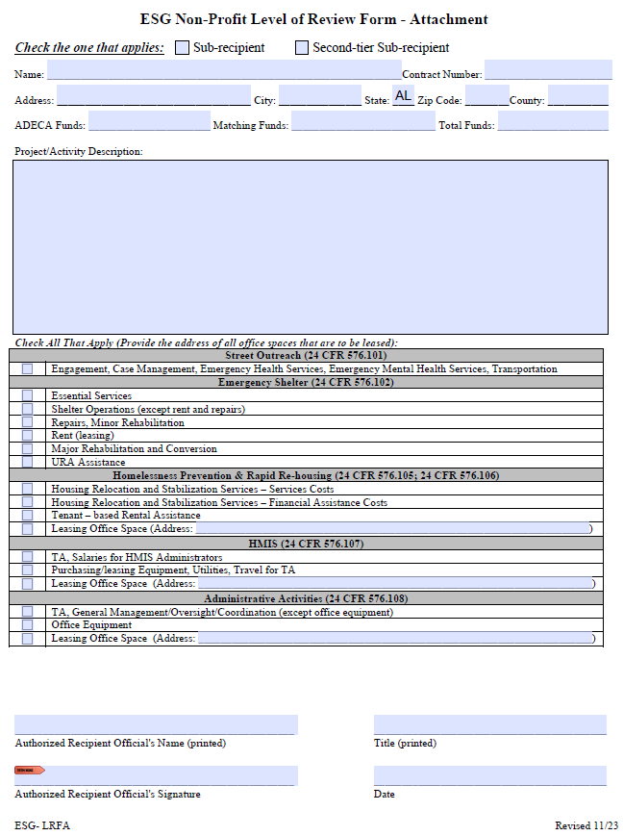
Conducting the Review
Non-Profit Organizations
Complete a Non-profit Level of Review Form Attachment (1 for you and 1 for each 2nd tier recipient)
Check the Sub-recipient/Second-tier Sub-recipient Box and Include that Recipient’s Information
Include Individual Funding total
Include Individual Project Description based on chart selections
Ensure Proper Signature
Submit to ADECA
Notes:
An Attachment form must be completed by each sub-recipient and each 2nd tier sub-recipient. On the Attachment form, indicate if you are a Sub-recipient or a 2nd tier sub-recipient and provide the information requested. The funding amount reported on this form should be for only the one organization and should match what is given on the Level of Review form. The project description should include only those applicable activities for this Organization. In other words, the only activities that should be given are the ones that were selected in the chart on the bottom of the form.
The attachment form should be signed by the Authorized Responsible Entity (that is the CEO, President or the like) of the Organization it was prepared for.
When you have all of the forms back from all the organizations, submit the entire package to ADECA. Once I receive it, I will actually perform your Environmental Reviews. Upon their completion I will issue your Notices of Removal of Grant Conditions and submit them to Shonda. She will take it from there.

Slide 19
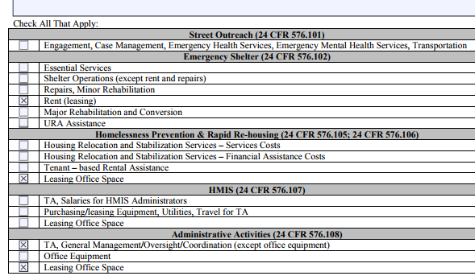
Project Descriptions
Notes:
When providing the project description, I find that the easiest method is to simply use the terminology that HUD has already provided. For example, this Attachment has activities under the Components of Emergency Shelter <click>, Homelessness Prevention & Rapid Re-Housing <click> and Administrative Activities <click> selected. So the simplest project description would be the following <click>:
This is how I would write my project description.
Please note that when selecting rent or leasing activities, include the addresses of the leased spaces.

Slide 20
Conducting the Review
Units of Local Government
CDBG Environmental Review requirements govern
Environmental Review Guide and CDBG Environmental Review Website (Google search ADECA Environmental)
When the Review is completed, submit required info to ADECA
Notes:
For Units of Local Government, you’re not that lucky. You are responsible for conducting your own review. The same process that ADECA’s CDBG program uses governs your Environmental Review. Use the Environmental Review Guide and the other information located on the CDBG environmental webpage to complete your review. The easiest way to locate the page is to do a Google search for ADECA Environmental. The last part of this video includes a guided tour of the basics of environmental reviews so keep watching.
Once you have successfully completed your review, and submitted the correct information, I will issue the Notice of Removal of Grant Conditions and submit them to Shonda at which time she will take over.

Slide 21
Additional Information
ADECA Environmental Review website: http://adeca.alabama.gov/Divisions/ced/cdp/Pages/Environmental.aspx
HUD webinars: https://www.hudexchange.info/environmental-review/environmental-review-training/
HUD Web-Based Instructional System for Environmental Review (WISER): https://www.hudexchange.info/trainings/wiser/?utm_source=HUD+Exchange+Mailing+List&utm_campaign=9f0713617d-WISER_Training_Modules_2017_12_01&utm_medium=email&utm_term=0_f32b935a5f-9f0713617d-19295981
HUD Related Federal Laws & Authorities: https://www.hudexchange.info/environmental-review/federal-related-laws-and-authorities
Notes:
You can find additional information on conducting environmental reviews at the web addresses shown here.

Slide 22
Thank You
Chris Perkins, PE
CED Engineer / Environmental Specialist
334-353-1028
christopher.perkins@adeca.alabama.gov
Notes:
If you have questions concerning anything that was presented, please don’t hesitate to contact me at the address or phone number provided. Thank You.

Slide 23
CENTRALIZED/COORDINATED ASSESSMENT SYSTEM (CAS)
Must be used by each ESG service provider
Should include information on how to seek assistance from each ESG service provider
Should decrease wait time to receive ESG assistance
Case managers should be knowledgeable of all local service providers even if they aren’t a part of the CAS
Notes:
Subrecipients and each second-tier subrecipient must use the CENTRALIZED/COORDINATED ASSESSMENT SYSTEM (CAS) that corresponds with their local Continuum of Care.
Implementation of the CAS Should include information on how to seek assistance from each ESG service provider.
The CAS should decrease wait time to receive ESG assistance.
And case managers should be knowledgeable of all local service providers even if they aren’t a part of the CAS.

Slide 24
E-VERIFY (for nonprofit Subrecipients only)
Must be enrolled in the E-Verify program maintained by the U.S. Dept. of Homeland Security. *Only required if agency has one or more paid employees – submit entire MOU.
Enrollment is available at: (http://immigration.alabama.gov)
Notes:
After enrolling in E-Verify, print and submit the entirety of your E-verify Memorandum of Understanding.
The website for enrollment is listed here.

Slide 25
Policies & Procedures
Notes:
Each subrecipient must develop policies and procedures for its ESG program. The policies must include the clauses and criteria listed on the following slides. All second-tier subrecipients are required to follow the policies and procedures developed by the Grant holding Subrecipient. When your Grant is monitored by our staff, your Policies and Procedures will be a part of that review.

Slide 26
Eligibility
Coordination of services
Determining and Prioritizing which eligible families and individuals will receive HP or RR.
Notes:
Policies must be applied consistently with each program participant.
A listing of programs with which ESG services must be coordinated can be found on the ADECA ESG webpage under the section labeled “Application Form”

Slide 27
Length of time assistance will be provided
How the amount of assistance will be adjusted over time
Program participants’ share in costs (rent/utilities), if any
Type, amount, and duration of housing stabilization and relocation services to be provided
Targeting/providing essential services related to street outreach
Notes:
The Policies and Procedures need to detail specifics about the assistance that will be provided including duration, monetary amount, shared costs. This also includes the Street Outreach activity.

Slide 28
Admission, diversion, referral, and discharge by emergency shelters assisted under ESG
Length of stay
Safety and shelter needs of special populations
Persons/families with the highest barriers to housing and are likely to be homeless the longest
Notes:
They will also need to lay out the case work processes and information to be documented.

Slide 29
Process for assessing, prioritizing, and reassessing program participants’ needs for essential services related to emergency shelter
Policy against involuntary family separation for emergency shelter providers
Access to the ESG program for persons of limited English proficiency
Terminating assistance – grievance procedures
Notes:
Once assistance ends for a program participant for whatever reason, a letter should be sent to the participant explaining that assistance has ended.
State the reason why assistance has ended and the effective date of the end of the assistance.
A copy of the letter should be placed in the participant’s file.

Slide 30
Language that supports fair housing practices
Written non-discrimination and Equal Opportunity Policy
Language that addresses equal access to HUD-assisted or insured housing regardless of sexual orientation, gender identity, or marital status
Language that prohibits inquiries on sexual orientation or gender identity for the purpose of determining eligibility of assistance
Policy regarding conflicts of interest
Policy regarding confidentiality of information
Drug-Free Workplace Policy
Notes:
Your Policies and Procedures will also need to have in place various clauses that cover nondiscrimination standards, as well as policies regarding confidentiality and conflicts of interest.

Slide 31
Emergency Transfer Plan
24 CFR 5.2005(e)
Tenants receiving rental assistance who are victims of domestic violence, dating violence, sexual assault, or stalking qualify for an emergency transfer if the tenant expressly requests the transfer; and
The tenant reasonably believes there is a threat of imminent harm from further violence if the tenant remains within the same dwelling unit that they currently occupy; or
The sexual assault of the tenant occurred on the premises during the 90-calendar-day period preceding the date of the request for transfer.
Notes:
The subrecipients Policies and Procedures must also contain an Emergency Transfer Plan. The plan must be developed for each subrecipient that administers ESG rental assistance. Once the applicable plan is developed in accordance with this section, the subrecipients that administer ESG rental assistance must implement the plan in accordance with the CFR.
(a) The emergency transfer plan must provide that a tenant receiving rental assistance through, or residing in a unit subsidized under, a subrecipient who is a victim of domestic violence, dating violence, sexual assault, or stalking qualifies for an emergency transfer if:
(1) The tenant expressly requests the transfer; and
(a) The tenant reasonably believes there is a threat of imminent harm from further violence if the tenant remains within the same dwelling unit that the tenant is currently occupying; or
(b) In the case of a tenant who is a victim of sexual assault, either the tenant reasonably believes there is a threat of imminent harm from further violence if the tenant remains within the same dwelling unit that the tenant is currently occupying, or the sexual assault occurred on the premises during the 90-calendar-day period preceding the date of the request for transfer.

Slide 32
Emergency Transfer Plan
Detail the measure of priority given to tenants who qualify for a transfer under VAWA in relation to other categories of tenants seeking transfers and individuals seeking placement on waiting lists.
Must incorporate strict confidentiality measures to ensure that the subrecipient does not disclose the location of the dwelling unit of the tenant to a perpetrator.
Allow a tenant to make an internal emergency transfer when a safe unit is immediately available.
Notes:
The emergency transfer plan must detail the measure of any priority given to tenants who qualify for an emergency transfer under VAWA in relation to other categories of tenants seeking transfers and individuals seeking placement on waiting lists.
The emergency transfer plan must incorporate strict confidentiality measures to ensure that the subrecipient does not disclose the location of the dwelling unit of the tenant to a person who committed or threatened to commit an act of domestic violence, dating violence, sexual assault, or stalking against the tenant.
The emergency transfer plan must allow a tenant to make an internal emergency transfer under VAWA when a safe unit is immediately available.

Slide 33
Emergency Transfer Plan
Describe policies for assisting a tenant when a safe unit is not immediately available.
Ensure that requests for internal emergency transfers receive, at a minimum, any applicable additional priority provided to other types of emergency transfer requests.
Describe reasonable efforts the subrecipient will take to assist a tenant who wishes to make an external emergency transfer when a safe unit is not immediately available.
Include policies for assisting a tenant who is seeking an external emergency transfer into or out of the subrecipient’s program.
Notes:
The emergency transfer plan must describe policies for assisting a tenant in making an internal emergency transfer when a safe unit is not immediately available,
and these policies must ensure that requests for internal emergency transfers receive, at a minimum, any applicable additional priority that housing providers may already provide to other types of emergency transfer requests.
The emergency transfer plan must describe reasonable efforts the subrecipient will take to assist a tenant who wishes to make an external emergency transfer when a safe unit is not immediately available.
The plan must include policies for assisting a tenant who is seeking an external emergency transfer into or out of the subrecipient’s program.

Slide 34
Emergency Transfer Plan
Nothing may preclude a tenant from seeking an internal emergency transfer and an external emergency transfer concurrently if a safe unit is not immediately available.
Where applicable, the emergency transfer plan must describe policies for a tenant who has tenant-based rental assistance and who meets the requirements to move quickly with that assistance.
The emergency transfer plan may require documentation from a tenant seeking an emergency transfer.
Notes:
Nothing may preclude a tenant from seeking an internal emergency transfer and an external emergency transfer concurrently if a safe unit is not immediately available.
Where applicable, the emergency transfer plan must describe policies for a tenant who has tenant-based rental assistance and who meets the requirements to move quickly with that assistance.
The emergency transfer plan may require documentation from a tenant seeking an emergency transfer.

Slide 35
Emergency Transfer Plan
The subrecipient must make its emergency transfer plan available upon request and, when feasible, must make its plan publicly available.
The subrecipient must keep a record of all emergency transfers requested under its emergency transfer plan, and the outcomes of such requests, and retain these records for a period of three years.
Notes:
The subrecipient must make its emergency transfer plan available upon request and, when feasible, must make its plan publicly available.
The subrecipient must keep a record of all emergency transfers requested under its emergency transfer plan, and the outcomes of such requests, and retain these records for a period of three years.

Slide 36
Procurement
Informal Methods
Notes:
Each subrecipient should have documented procurement procedures that reflect applicable state, local, and tribal laws and regulations. The procurement procedures should conform to the guidance issued in 2 CFR 200.317-326.
Procurement must be conducted in a manner that provides full and open competition consistent with 2 CFR 200.
So long as the value of property or services does not exceed the Simplified Acquisition Threshold of $150,000, formal procurement methods are not required.
This next section covers both methods of Procurement, beginning with informal.

Slide 37
Micro-purchase procedures
Acquisition of supplies or services when the aggregate dollar amount does not exceed the micro-purchase threshold ($3,000)
Do not require competitive quotes if the price is reasonable
Should be distributed equitably among qualified suppliers
Notes:
One type of informal procurement are MICRO-PURCHASE PROCEDURES.
These are used when the aggregate dollar amount of acquisitions doesn’t exceed the micro-purchase threshold (which HUD currently has set at less than $3,000.)
In this method you should develop a list of qualified suppliers. If you think the price is reasonable, micro-purchases can be awarded without soliciting competitive quotes.
The agency must develop a written policy which explains how it will track its distributions.
To the maximum extent practicable, you must distribute micro-purchases equitably among qualified suppliers.

Slide 38
Small purchase procedures
Purchases that do not exceed the Simplified Acquisition Threshold ($150,000)
Obtain price/rate quotes from an adequate number of suppliers
Rate quotes available on our website
Solicit quotes from ADECA’s Office of Minority Business Enterprise
PMU-1 form must be completed and submitted to ADECA for single items over $5,000
Notes:
SMALL PURCHASE PROCEDURES are used to secure property, services and supplies that cost more than $3000, but do
not exceed the Simplified Acquisition Threshold – which is currently $150,000.
If small purchase procedures are used, price or rate quotations must be obtained from an adequate number of qualified
sources. (About 3 quotes is a good rule of thumb.)
Forms which can be used to document rate quotes are available on our website
You should solicit quotes from ADECA’s Office of Minority Business Enterprise & document how you did this
A PMU-1 form must be completed and submitted to ADECA for single items over $5,000

Slide 39
Procurement
Formal Methods
Notes:
When the value of property or services exceeds the Simplified Acquisition Threshold of $150,000, formal procurement methods are required.
There are two main types of formal procurement methods; Sealed Bids and Proposals.
There is a link to the State Bid Law on our website for those local units of government who will need to make purchases or lease materials, supplies, or equipment which costs $150,000 or more. It also lays out in more detail how to determine which of the two main types of formal methods to use.

Slide 40
Sealed Bids
Must be solicited from an adequate number of qualified sources
Invitation for bids must be publicly advertised
Invitation includes specifications
Bids opened publicly
Requires a firm fixed price contract
May utilize ADECA’s Office of Minority Business Enterprise
Notes:
Sealed Bids are a procurement method in which bids are publicly solicited and a firm fixed-price contract is awarded to the responsible bidder whose bid is the lowest in price. The sealed bids method is the preferred method for procuring construction.
Bids must be solicited from an adequate number of qualified sources, providing them sufficient response time prior to the date set for opening the bids
For local, and tribal governments, the invitation for bids must be publicly advertised;
It must include any specifications and pertinent attachments, and must define the items or services required.
The bids must be opened publicly at the time and place prescribed in the invitation for bids.
A firm fixed price contract award will be made in writing to the lowest bidder that is responsive and responsible.
You can make bidding opportunities open to small and minority businesses – you can take advantage of ADECA’s Office of Minority Business Enterprise.

Slide 41
Proposals
Request for proposals must be publicized and identify all evaluation factors
Proposals must be solicited from an adequate number of sources
Requires a written method for evaluation and selection
Notes:
The other formal method of procurement is Proposals, sometimes called Competitive Proposals. This is a procurement method in which either a fixed price or cost-reimbursement type contract is awarded. Proposals are generally used when conditions are not appropriate for the use of sealed bids. They are awarded in accordance with the following requirements:
Requests for proposals must be publicized and identify all evaluation factors.
Like sealed bids, Proposals must be solicited from an adequate number of sources.
This method requires a written method for evaluation and selection.

Slide 42
Proposals
Contracts must be awarded to the responsible firm whose proposal is most advantageous to the program considering price and other factors
May be used for qualifications-based procurement of architectural/engineering professional services
Notes:
Contracts must be awarded to the responsible firm whose proposal is most advantageous to the program considering price and other factors
Also proposals may be used for qualifications-based procurement of architectural or engineering professional services.

Slide 43
Procurement
Non-competitive
Notes:
There are specific circumstances in which noncompetitive procurement can be used.

Slide 44
Noncompetitive proposals
Item or service is only available from a single source
Urgent public need or emergency will not allow for a delay caused by advertising
Awarding agency authorizes a noncompetitive process
After solicitation of a number of sources, competition is determined inadequate
Notes:
Noncompetitive procurement can only be awarded if one or more of the following circumstances apply:
The item or service is only available from a single source
An urgent public need or emergency will not allow for a delay caused by advertising
The awarding agency authorizes a noncompetitive process
or
After a solicitation of a number of sources, the competition is determined inadequate
Contact ADECA before conducting this type of procurement

Slide 45
Invoices
Notes:
During the course of your Grant you will submit Requests for Reimbursement for the Grant activities you have conducted. Sometimes these are referred to as Requests for Payment or even drawdowns. For Subrecipients with Second Tier Subrecipients, all contracts between your entity and these Second Tier Subrecipients must be submitted to our offices.
This next section discusses the supporting documentation you will need to submit with your requests.
If this is the first time you have been directly awarded ESG funds, you will be required to submit all supporting documentation with each invoice.
Those who have been directly funded before only need to submit all supporting documentation the first time you are requesting reimbursement for each activity. For all other requests, you only need to submit the Invoice itself and the Invoice Documentation Cover Sheets

Slide 46
Supporting documentation
Invoice Documentation Cover Sheets
Summary Sheet of individual expenditures for each agency, listing:
Vendor
Date
Total invoice amount
Clearly delineate which expenditures are ESG or Match, and which expenditures are to be applied to which Program Activity (Admin, ES, SO, HMIS, HP, RR)Invoice Documentation Cover Sheets
Notes:
Invoice documentation cover sheets can be found on our website and breakdown the categories of expenses for each ESG activity such as Emergency Shelter or Rapid Rehousing.
You should include a Summary Sheet which totals the amount requested for reimbursement and submitted for match
The summary must include:
Vendors
Dates
Individual invoice amount
The amount to be reimbursed
In addition to ESG expenditures, provide documentation of expenditures for cash match
It’s not sufficient to say you received cash as a source of match– tell us how the cash was spent

Slide 47
Supporting documentation
Copies of:
Bills
Invoices
Contract/Agreement for Rental Assistance – signed by both client and landlord
Receipts or bank statements showing payments made
Notes:
Supporting documentation will include copies of:
Bills
Invoices
Contract/Agreement for Rental Assistance – signed by both client and landlord
and
Receipts or bank statements showing payments made

Slide 48
Supporting documentation
Timesheets showing actual time worked
Payroll to show wage/salary
Summary of duties/activities performed
Paystub or bank statements showing payments made
Notes:
Time sheets showing actual hours worked for salaries to be paid with ESG funds or used as match
For all salaries (except admin and some HMIS), services must be tied to specific program participants
You should attach daily summaries of activities to timesheets. Can use client numbers, HMIS numbers or file numbers to preserve confidentiality.
Prevention/re-housing documentation checklist – this must be submitted each time funds are requested for those activities

Slide 49
Supporting documentation
Program income (returned deposits/fees for service, if applicable)
Prevention/Re-housing Documentation Checklist and supporting documents
Notes:
Include any program income, such as returned deposits or fees for service.
Also on our website you will find a Homelessness Prevention and re-housing documentation checklist – this must be submitted each time funds are requested for those activities

Slide 50
Request for Reimbursement
Submit at least once per quarter, but no more than once per month (monthly preferred)
Can request an advance in anticipation of expenses
Should only request amount needed for expenditures
All advance funds must be spent within 30 days of deposit of the check from ADECA
Any unspent funds must be returned
Notes:
Invoices shall be submitted at least once per quarter, but no more than once per month per Grant.
However, we do prefer that you submit invoices on a monthly basis, especially if you are a newer ADECA Subgrantee.
If you do choose to wait longer than a month, PLEASE DO NOT submit multiple draws at once. If you are submitting for multiple months, do it in one all-encompassing request, not one for each month.
A subrecipient can request an advance in anticipation of expenses. In the event of advanced funds the following circumstances apply:
Only request amount needed for expenditures
All advance funds must be spent within 30 days of deposit of the check from ADECA
Any unspent funds must be returned
Subrecipients should keep a log to track the dates requests are received and paid

Slide 51
Request for Reimbursement
Address on Request for Payment, Certification Form, and in STAARS Vendor Payment System must be identical
STAARS info: https://comptroller.alabama.gov/
Signature on invoices and budgets must be identical to those on the Certification Form
Local unit of government subrecipients must pay second-tier subrecipients within 30 days of receipt of a completed reimbursement request
Notes:
Your entity’s address on the Request for Payment, the Certification Form, and in the STAARS Vendor Payment System must be identical.
Here is the web-address to enroll in STAARS: https://comptroller.alabama.gov/
The signature on Request for Payments and budgets must be identical to those on the Certification Form.
Local unit of government subrecipients must pay second-tier subrecipients within 30 days of receipt of a completed reimbursement request.
And once again, be sure before submitting, to check that your sam.gov registration is current.
This is also a good time to review if your Grant is on track with the schedule of expenditures you submitted at start-up.

Slide 52
Match
Notes:
Receipt of ESG funds requires a dollar for dollar match commitment. Match may be provided with cash or in-kind services. Local match must be applied to ESG-eligible activities. While second-tier subrecipients may provide matching funds, the subrecipient is ultimately responsible for meeting the local match requirement.

Slide 53
Subject to the same regulations and restrictions as the ESG funds
Must be eligible under the ESG program
Must be eligible for the ESG activity for which it is being used
Must have occurred within the Grant period of performance
Notes:
Match is subject to the same regulations and restrictions as the ESG funds.
Matching funds or services must be eligible under the ESG program, AND be eligible for the ESG activity for which it is being used. (In other words, Street Outreach services can not be applied as match to the Emergency Shelter activity. If Street Outreach is not one of your approved budgeted activities, then you can not apply Street Outreach services as Match to your ESG Grant.)
And of course the expense must have occurred within the Grant period of performance.

Slide 54
Can be obtained from any local, state, federal, or private source, except ESG
Other program regulations must not prohibit those funds from being used as match for ESG
If ESG is being used as match for another program, funding from that program cannot be used as match for ESG
Program income, if applicable, must be used as match
Notes:
Match can be obtained from any local, state, federal, or private source, except ESG. However, if other programs are used as match, the regulations of those programs must not prohibit those funds from being used as match for ESG.
If ESG is being used as match for another program, funding from that program cannot be used as match for ESG.
Program income, if applicable, must be used as match.

Slide 55
Services provided by individuals are valued at rates consistent with those ordinarily paid for similar work in the organization or by other local employers
If there are no similar rates, use the Federal minimum wage; do not use rates published by the Independent Sector. Must be documented.
Notes:
When valuing the services provided by individuals, use rates consistent with those ordinarily paid for similar work in the organization or by other local employers.
If there are no similar rates, use the Federal minimum wage; do not use rates published by the Independent Sector. Your method of determining this rate must be documented.
Each volunteers’ duties/position and the hourly rate applied as match will still have to be documented the same way as when requesting reimbursement for salaries or wages under ESG funds. Just a list of volunteers with no times in and out will not be acceptable as back up documentation. Each volunteer’s individual hours will need to be logged. Additionally, Each volunteer’s individual job description/duties will need to be listed in order to ensure the pay is consistent with the ordinary pay for similar work.
Donation rates provided by Goodwill or the Salvation Army are acceptable. If your rates appear questionable, we will contact you.

Slide 56
The value of any donated real property or equipment may be used as Match
Must use Fair Market value
Must be evidenced by a recorded deed or use restriction effective for at least 10 years after the donation date.
Property owned by the subrecipient may not be used as Match
Notes:
Noncash contributions such as the value of any equipment, goods or services could count as match only if the subrecipient or second-tier subrecipient had to pay for them with grant funds.
To determine the value of any donated material or building, or of any lease, you must use a method reasonably calculated to establish the fair market value.
To qualify as a donation for long-term use, the donation must be evidenced by a recorded deed or use restriction that is effective for at least 10 years after the donation date.
The value of a facility owned by the subrecipient or second-tier subrecipient may not be used as match for the ESG Program.

Slide 57
Indirect Costs
Notes:
ESG grant funds may be used to pay indirect costs in accordance with 2 CFR Part 200, as applicable. It is up to each entity to choose whether or not they will utilize indirect costs as part of their Grant.
ADECA will not negotiate indirect cost rates with subrecipients, but will accept a federally negotiated indirect cost rate or the 10% de minimis rate of the modified total direct cost (MTDC) as defined in 2 CFR 200.68.

Slide 58
Federally Negotiated Plan
In accordance with 2 CFR Part 200
Must submit copy of proposal to ADECA
10% de minimis
certification required
Notes:
There are two different types of Indirect Cost plans. The first is a Federally negotiated cost rate developed in accordance with 2 CFR Part 200, subpart E. To apply this rate a copy of the indirect cost rate proposal must be submitted to ADECA.
The second type is a 10% de minimis rate.
If requesting the 10% de minimis rate, subrecipients must submit a certification that the entity has never received a federally approved indirect cost rate.

Slide 59
Indirect Costs + Direct Costs = Total Costs
Total Costs must still be within total amount budgeted for that activity
Notes:
The indirect costs charged to an activity are added to the direct costs charged for that activity for the total costs. The Total Costs must still be within total amount budgeted for that activity.
Basically, the indirect costs are expenses that will come out of your budget and not a percentage added to your total Grant award.

Slide 60
Shelter Standards
Notes:
Emergency shelter facilities must meet local building standards, pass inspections, and meet the listed criteria established by HUD.
To quickly touch on some specifics, they include:

Slide 61
Lead-based paint regulations
Building is structurally sound
Energy Star and WaterSense products and appliances (for rehab or conversion projects)
ADA Accessibility
Adequate space and security
Interior air quality
Water supply
Notes:
All shelters and housing units occupied by ESG program participants are subject to the regulations under the Lead-Based Paint Poisoning Prevention Act, the Residential Lead-Based Paint Hazard Reduction Act of 1992, and 24 CFR part 35.
The shelter building must be structurally sound.
For rehab or conversion projects, you must use Energy Star and WaterSense products and appliances.
You must ensure the building meets ADA Accessibility standards, such as ramps, handrails in bathrooms, etc.
The shelter must provide each program participant with an acceptable place to sleep and adequate space and security for themselves and their belongings, such as lockers.
Each room or space within the shelter must have a natural or mechanical means of ventilation…
And a water supply free from contamination.

Slide 62
Sanitary facilities
Thermal environment
Illumination and electricity
Food preparation
Sanitary conditions
Fire safety
Notes:
Each program participant in the shelter must have access to sanitary facilities that are in proper operating condition, are private, and are adequate for personal cleanliness and the disposal of human waste.
The shelter must have any necessary heating and cooling facilities in proper operating condition.
They must have adequate natural or artificial illumination to permit normal indoor activities.
Food preparation areas, if any, must contain suitable space and equipment to store, prepare, and serve food in a safe and sanitary manner.
All of the shelter should be maintained in Sanitary condition.
There must be at least one working smoke detector in each occupied unit or public area of the shelter. Where possible, smoke detectors must be located near sleeping areas. The fire alarm system must be designed for hearing-impaired residents.
There must also be a second means of exiting the building in the event of a fire or another emergency.
For more specific information please see the Shelter Standards monitoring Checklist. All of our Monitoring checklists are available on our website.

Slide 63
HOMELESSNESS PREVENTION AND RAPID RE-HOUSING
Notes:
Now let’s discuss two closely related ESG activities: HOMELESSNESS PREVENTION AND RAPID RE-HOUSING

Slide 64
Participants must be assisted, as needed, in obtaining:
Supportive Services essential for independent living.
Mainstream Benefits like Medicaid, Supplemental Security Income, or TANF
Notes:
Participants must be assisted, as needed, in obtaining appropriate supportive services or services essential for independent living, including assistance in obtaining permanent housing, medical health treatment, mental health treatment, counseling, and supervision.
Participants must also be assisted, as needed, in obtaining mainstream benefits like Medicaid, Supplemental Security Income, or Temporary Assistance to Needy Families.

Slide 65
CASE MANAGEMENT
Participants are required to meet with case managers monthly (unless prohibited by laws regarding domestic violence issues)
Case manager must develop a housing stability plan to assist participants in retaining permanent housing after assistance ends
Notes:
An initial evaluation must be conducted to determine the eligibility of each individual or family for ESG assistance and the amount and types of assistance the individual or family needs to regain stability in permanent housing.
Program participants receiving homelessness prevention or rapid re-housing assistance are required to meet with a case manager not less than once per month, to assist the participant in ensuring long-term housing stability. (Victim service providers may be exempt.)
Case Managers must develop a plan to assist the program participant to retain permanent housing after the ESG assistance ends.
Case management services may be provided to someone who isn’t receiving rental or financial assistance, as long as the person is eligible to receive ESG assistance.
Rapid re-housing funds may be used to provide housing stability case management to homeless persons on the street or in shelter for up to 30 days.
If more than 30 days of case management is needed, it should be charged to emergency shelter or street outreach.

Slide 66
ELIGIBILITY – Homelessness Prevention
Meet criteria of “at-risk of homelessness,” categories 1, 2, or 3 or criteria of homeless definition categories 2, 3, or 4
Annual income below 30% of AMI at program entry
Annual income is based on CFR guidelines
Lacks support networks and financial resources to remain in housing
Re-evaluation at least once every 3 months
Notes:
For Eligibility under the Homelessness Prevention activity a person must meet one of the categories of the “at-risk of homelessness,” definition
or categories 2, 3, or 4 of the “homeless” definition.
Further criteria are:
The participant having an annual income below 30% of the Annual Median Income at program entry, and lacking support networks and financial resources to remain in housing.
Annual income is calculated based on guidelines found at 24 CFR 5.609, for both initial assessment and re-evaluation.
There is a link on our web page for HUD’s Income Limits.
Income limits are updated annually and you must use the most current limits
HUD has published an ESG income calculation worksheet. We recommend that you use it to calculate income
Income is calculated as the amount of income projected for the upcoming year
Participants must be re-evaluated at least once every 3 months.

Slide 67
ELIGIBILITY - Rapid Re-Housing
Meet criteria of category 1 or 4 of homeless definition
No income threshold at program entry
Lacks support networks and financial resources to obtain housing
Re-evaluation annually
Notes:
Rapid Rehousing assistance can be provided to individuals meeting Category 1 of the Homeless Definition.
If a person qualifies under category 4 because they are fleeing domestic violence, they must also meet the definition of category 1.
At program entry, there is no income threshold for eligibility.
The participant must lack support networks and financial resources to obtain housing.
Participants in Rapid Rehousing shall be re-evaluated annually.

Slide 68
re-evaluation For both Prevention and Re-housing
Annual income at or below 30% AMI
Lacks support networks and sufficient resources to retain housing
*Participants should report changes in income or circumstances
Notes:
When Re-evaluating program participants of both Homelessness Prevention and Rapid Re-housing, the following criteria is required for continued support:
Having an annual income at or below 30% AMI.
The participant must still lack support networks and sufficient resources to retain housing without ESG assistance.
*Participants should report changes in income or circumstances that affect their need for ESG assistance

Slide 69
RENTAL ASSISTANCE
Notes:
Now I will go over some of the general provisions for Rental Assistance.

Slide 70
Services must not exceed 24 months during any 3-year period.
Requires a legally-binding, written lease between the owner and participant (except for arrears only)
Unit must comply with Minimum Habitability Standards & Lead-Based Paint Regulations
Notes:
Services must not exceed 24 months during any 3-year period.
Rental Assistance requires a legally-binding, written lease between the owner and participant (except for arrears only assistance).
Rental payments must be paid directly to the housing owner, not the participant.
The housing unit must comply with Minimum Habitability Standards & Lead-Based Paint Regulations.

Slide 71
Only tenant-based rental assistance is eligible (participant selects housing)
Public housing or housing choice vouchers are ineligible for ESG assistance.
Rent can’t exceed the Fair Market Rent (FMR)
Rent must comply with HUD’s Rent Reasonableness Standards
FMR and Rent Reasonableness do not apply to payment of rental arrears
Notes:
The regulations list tenant-based and project-based based rental assistance. For the purpose of our program, only tenant-based rental assistance will be allowed. Public housing or housing choice vouchers are ineligible for ESG assistance.
Rent can not exceed the Fair Market Rent (FMR).
FMR is updated annually – you must use the most current rate.
Rent must comply with HUD’s Rent Reasonableness Standards.
*FMR and Rent Reasonableness do not apply to payment of rental arrears.
When completing the rent reasonableness form, be sure to compare units with the same number of bedrooms.
Once a unit meets rent reasonableness & fair market rent, ESG funds can be used to pay for utilities

Slide 72
ESG funds cannot be used to pay late fees generated after a person enters program
Mortgage payments are ineligible
Cannot use with other subsidies
except 6 months of arrears
Notes:
ESG funds cannot be used to pay late fees generated after a person enters into the program.
Mortgage payments are ineligible.
Rental Assistance cannot be used with other subsidies, except for with 6 months of arrears.

Slide 73
RENTAL ASSISTANCE Agreement
Notes:
Agencies providing assistance must enter into a rental assistance agreement with the landlord or owner to whom rental payments will be made.

Slide 74
Set forth terms under which rental assistance will be provided (includes requirements at §576.106)
Same due date, grace period, and penalty requirements as participant’s lease
Must state that tenant-based rental assistance will be provided
Required even if assistance is only for arrears
Notes:
The rental assistance agreement must set forth the terms under which rental assistance will be provided, such as the anticipated time period program participants will receive assistance.
The rental assistance agreement must contain the same payment due date, grace period, and late payment penalty requirements as the program participant's lease.
The agreement should specify the rental assistance is tenant-based.
A RENTAL ASSISTANCE AGREEMENT is required even if the assistance is only for arrears.

Slide 75
Agreement shall terminate if:
Program participant moves out of the unit
Lease terminates and is not renewed
Program participant becomes ineligible to receive ESG assistance
Notes:
The agreement shall terminate and no further rental assistance should be provided if:
The program participant moves out of the unit
The lease terminates and is not renewed
Or if
The program participant becomes ineligible to receive ESG assistance

Slide 76
During term of agreement, the owner must provide to the agency:
Any notice provided to the participant to vacate the housing unit
Any complaint used under state or local law to commence an eviction action
Notes:
During the term of agreement, the owner must provide to the agency:
Any notice provided to the participant to vacate the housing unit.
or
Any complaint used under state or local law to commence an eviction action.

Slide 77
Participant file documentation
Notes:
Records must be kept for each program participant served. The records must include:

Slide 78
Application date
Entry/exit from HMIS/Comparable Database
Identification
Eligibility (housing status and income)
Lack of resources, support networks, and alternate housing
Case management notes
Notes:
The Application date
The date of Entry and exit from HMIS or a Comparable Database
A copy of some form of Identification such as Driver’s License, Social Security card, etc.
Each client will be assigned an Identification number to be used in HMIS or Osnium.
The file must include documentation of what criteria was used to determine eligibility.
Document the initial and continued lack of resources, support networks, and alternate housing.
All files should contain detailed case management notes.

Slide 79
Coordination with other programs
Documentation that the same type of assistance is not being provided by other public sources
Housing Stability Plan
Type, amount, and length of assistance provided
Lease
Rental Assistance Agreement
Notes:
Record any Coordination with other programs.
Verification that the same type of assistance is not being provided by other public sources.
Include a Housing Stability Plan developed with the client.
Document the type, amount, and length of assistance provided
Also include in the file the lease between the client and landlord or homeowner and the…
Rental Assistance Agreement between your agency and the client.

Slide 80
Rent Reasonableness Checklist
Compliance with Fair Market Rent
Housing Habitability Standards Checklist
Lead-Based Paint Checklist
Lead-Based Paint Disclosure Form
Signed Termination/Grievance Policy
Notes:
There are a few other forms and checklists that need to be maintained in the client files. These can be found at the Implementation Manual page of the ESG website.
There are 2 links that provide guidance on Rent Reasonableness and Fair Market Rent – please read these before documenting the Rent Reasonableness form.
To calculate the amount of eligible utility allowance, use the PHA Utility Allowance for Rent Reasonableness Documentation.
The Housing Habitability Standards Checklist should be completed upon inspection. Inspections must be conducted upon initial occupancy and then on an annual basis for the term of ESG assistance.
After completion of the Lead-Based Paint Checklist, each participant assisted with Prevention or Re-housing assistance must sign a Lead-Based Paint Disclosure Form.
The participant should sign a form acknowledging that they have been made aware of the termination and grievance policies.

Slide 81
evidence of homeless status
Order of priority:
1. Third-party documentation, including written and source documentation, and HMIS records
2. Intake worker observations
3. Certification from persons seeking assistance
Notes:
For HOMELESSNESS PREVENTION AND RAPID RE-HOUSING, the recipient must maintain and follow written intake procedures to ensure compliance with the homeless definition. The procedures require documentation of the evidence relied upon to establish and verify homeless status.
The procedures must establish the order of priority for obtaining evidence. This order will be third-party documentation first, intake worker observations second, and certification from the person seeking assistance third.

Slide 82
Other requirements & regulations

Slide 83
RAPID RE-HOUSING
Rapid Re-housing is a model for helping people move from the streets or shelter to permanent housing - it was not intended for people exiting transitional housing (TH).
Using rapid re-housing funds to exit persons from TH should not be common practice or a core aspect of your program design.
Notes:
Rapid Re-housing is a model for helping people move from the streets or shelter to permanent housing - it was not intended for people exiting transitional housing (TH).
Using rapid re-housing funds to exit persons from TH should not be common practice or a core aspect of your program design.
However, this can be done on a case-by-case basis.
Using RRH funds to exit persons from TH should only be done when it is necessary to prevent the program participant from going back to the streets or emergency shelter.

Slide 84
HOMELESS PARTICIPATION
To the maximum extent possible, involve
homeless persons/families in ESG activities.
Document involvement
Notes:
To the maximum extent possible, involve homeless persons or families in constructing, renovating, maintaining, and operating facilities assisted under ESG, in providing services assisted under ESG, and in providing services for occupants of facilities assisted under ESG.
Document this involvement for later reporting.

Slide 85
RECORDKEEPING
Records will be reviewed during the onsite monitoring visit
Checklists available online
Site visit to 2nd Tier Shelter
Maintain records for 5 years after grant closeout
For grants involving renovation or conversion, maintain records for 10 years after grant closeout
Notes:
Records will be reviewed during the onsite monitoring visit. Please familiarize yourself with the checklists as they provide valuable information regarding compliance with the program rules. They also give you an indication of the information that will be reviewed during the monitoring visit.
The Monitoring visit will also include a site visit to at least one of the Emergency Shelters in operation under the Grant to review the habitability standards of the shelter.
We will contact you to schedule a monitoring visit when you have drawn 40% of the grant funds.
The subrecipient must periodically monitor each second-tier subrecipient.
Maintain records for 5 years after grant closeout
For grants involving renovation or conversion, maintain records for 10 years after grant closeout

Slide 86
REPORTING
HUD Form 60002
Submitted by April 15th annually
Reports number of new hires for construction grants
CAPER
Submitted by April 15th annually
Program participant data is uploaded directly from HMIS/comparable database to Sage
Information regarding expenditures is submitted separately via email to ADECA
Notes:
There will be reports required as part of your grant participation.
HUD Form 60002 reports the number of new hires for construction grants. This report shall be submitted by April 15th annually.
For the CAPER, program participant data is uploaded directly from HMIS or a comparable database to Sage. Information regarding expenditures is submitted separately via email to ADECA. This report shall be submitted by April 15th annually.

Slide 87
PERFORMANCE STANDARDS
Impact of ESG-funded grants
Number of persons served by ESG-funded grants
Number of program participants obtaining mainstream benefits
Notes:
At a minimum, subrecipients must document the:
The Impact of ESG-funded grants
The Number of persons served by ESG-funded grants
and
The Number of program participants obtaining mainstream benefits
Subrecipients may develop additional performance standards.
We will review your performance standards and supporting documentation during the monitoring visit and may request related documentation throughout the time period of your grant.

Slide 88
OUTCOME MEASURES
Will be determined by performance indicators
Develop measurable performance indicators
Should be specific to your geographic area/service area
Notes:
Outcome measures should correlate to the needs addressed in your application to assess the impact of your ESG program.
These will be determined by performance indicators. We encourage you to work with the CoC to develop the performance indicators. Because service areas and needs differ across the state, your outcome measures should be specific to your local area.

Slide 89
grant CLOSEOUT documents
Conditions of Grant Closeout Form
(Must be signed by the chief elected official/chief executive officer)
Subrecipient Budget/Final Financial Report
(Budgets from the second-tier subrecipients are not required)
If applicable, a property inventory log showing all property purchased with grant
Notes:
And finally, to closeout your grant, you will submit the following documentation.
A Conditions of Grant Closeout Form
(which must be signed by the chief elected official or chief executive officer)
A Subrecipient Budget/Final Financial Report
(Budgets from the second-tier subrecipients are not required)
And If applicable, a property inventory log showing all property purchased with grant

Slide 90
Questions?

