Slide 1
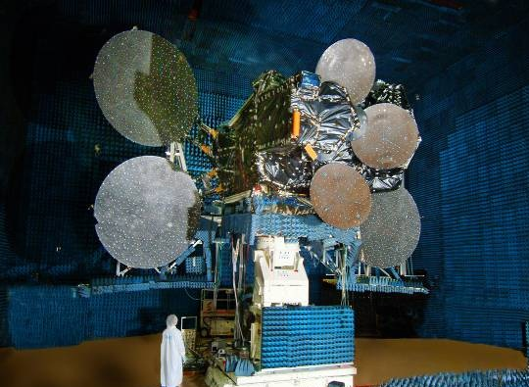
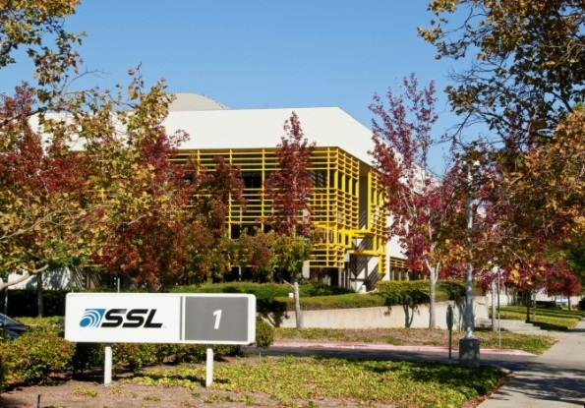
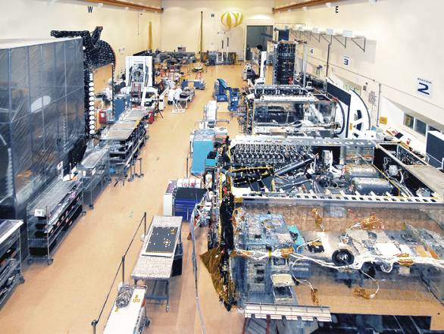
SSL —The World’s Leading Provider of Commercial Satellites
Industry leading GEO commercial backlog
Decades of hosted payload experience
Over 250 satellites built
21 GEO satellites in current backlog
19 LEO satellites in current backlog
82 GEO satellites currently on-orbit
Over 2200 on-orbit years experience
Workforce of ~2,600
Almost 60 years heritage of performance and reliability
New satellite awards since January 2010: 38 GEO and 19 LEO
Launches since January 2010: 32 GEO
22 March 2016 ▪ Overview

Slide 2
MDA

Slide 3
Satellite Assembly

Slide 4
Satellite Servicing

Slide 5
Persistent Platforms

Slide 6
Recycling

Slide 7
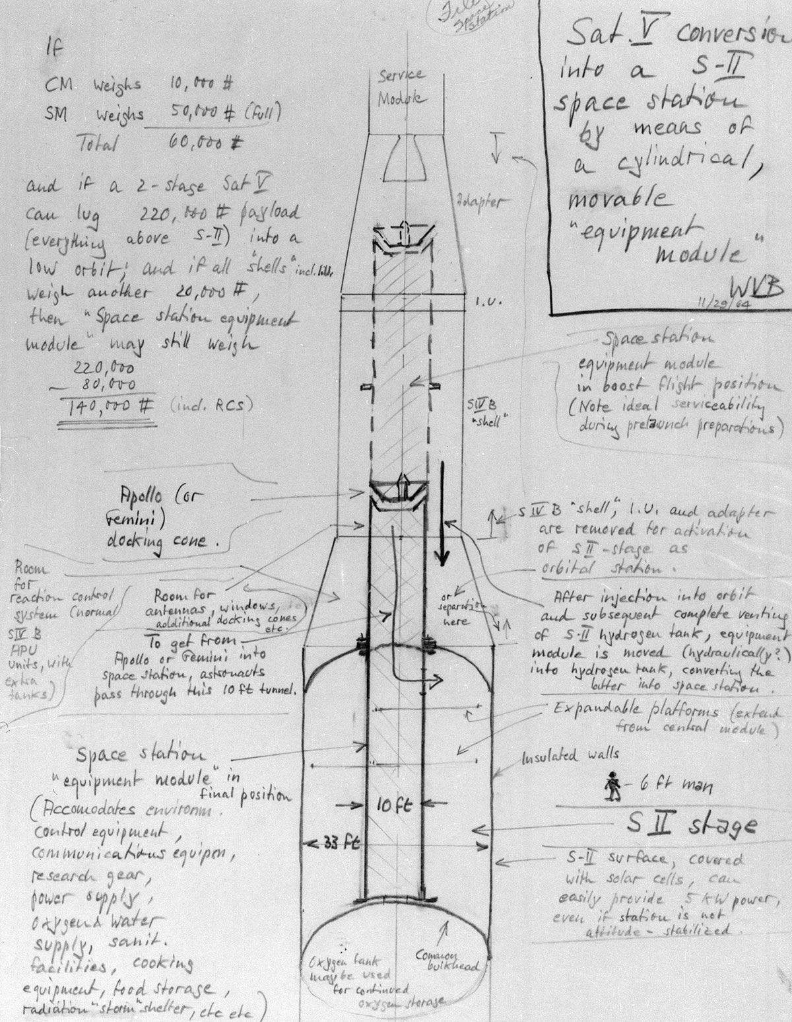

Slide 8
Repurposed Upper Stages

Slide 9
Space Lounge System

Slide 10
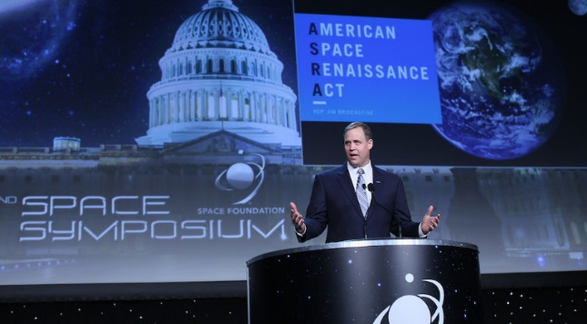
NASA and America Need Leadership

Slide 11
Be More Than a Spaceport

