Slide 1
Alabama ESG Program Environmental Compliance
Chris Perkins, PE
CED Engineer / Environmental Officer
334-353-1028
christopher.perkins@adeca.alabama.gov
Notes:
Hi. My name is Chris Perkins, and I am the Engineer and Environmental Officer for the Community and Economic Development Division of Alabama’s Department of Economic and Community Affairs. The following covers the Environmental Review Basics for ESG projects. My contact information is shown here. Feel free to contact me by email or phone; I will do all that I can to help answer any questions that you may have.

Slide 2
Sub-recipient Responsibilities
Chief Elected Official/CEO/President = Certifying Officer
Designate Environmental Review Officer
Responsible for conducting Environmental Review
May be an employee of the locality or contracted
Must follow proper procurement procedures
Not required for Non-Profits
Environmental Review Officer’s Duties
Create an Environmental Review Record (ERR)
Classify Activities Correctly
Conduct Review
Complete Public Notification Correctly (if required)
Submit Required Documentation
Notes:
You as the sub-recipient have certain responsibilities that you are required to meet.
HUD mandates that the Certifying Officer assume the role of the Responsible Federal Official. The Certifying Officer would be the Chief Elected Official of a City or Town (for example, the Mayor) or the Chairperson of a County Commission or the CEO/President of a Non-Profit organization. He or she would represent the Responsible Entity in court.
This authority can be reassigned to someone else provided a Delegation of Authority form is completed and submitted to ADECA.
The Certifying Officer also designates an Environmental Review Officer.
This person is responsible for actually conducting the Environmental Review.
He or she may be an employee of the locality or a contracted individual.
All proper procurement procedures must be followed in securing this person.
Non-profits do not have to formally appoint an Environmental Review Officer, ADECA conducts the review for them.

Slide 3
Activity Classifications
58.34
Exempt
58.35
Categorically Excluded
Subject to 58.5
Not Subject to 58.5
58.36
Environmental Assessment
58.37
Environmental Impact Statement
Notes:
The required level of review is determined by the activities to be undertaken in a project. Those activities can be separated into one of four levels. They are Exempt, Categorically Excluded, Environmental Assessment and Environmental Impact Statement. The Categorically Excluded level of review does have 2 sublevels; <click> they are Subject to and Not Subject to the regulations found at 58.5.

Slide 4
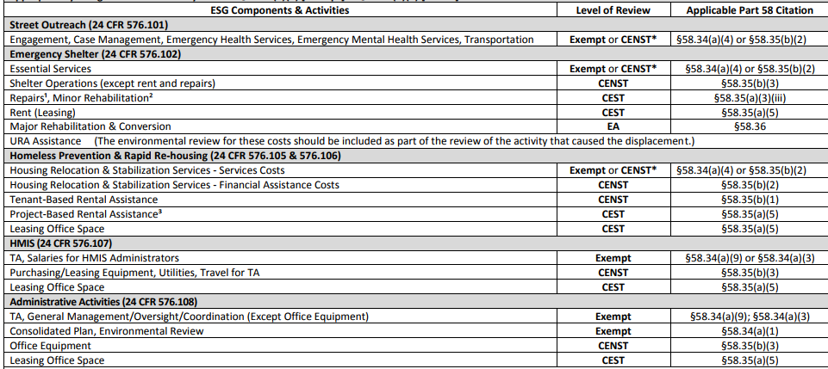
Classifying Your Project
5 Major Components in ESG
Street Outreach
Emergency Shelter
Homeless Prevention & Rapid Re-Housing
HMIS
Administrative Activities
Each Component has associated activities
Level of Review based off of these activities
Notes:
There are 5 major components in ESG. They are Street Outreach, Emergency Shelter, Homeless Prevention & Rapid Re-Housing, HMIS and Administrative Activities. Each of these components allows for certain types of activities to be conducted and each of these allowed activities has a level of review assigned to it. <click>
Here is a sample of the Levels of Environmental Review for ESG Components chart available on ADECA’s ESG website. Please refer to the complete chart when making your determination in classifying your activities. Let’s take a look at a few examples.
Under the Emergency Shelter Component <click> the activity of paying Rent or Leasing requires that the <click> Categorically Excluded Subject to Level of Review be conducted.
Under the HMIS Component <click>, the activity of providing Technical Assistance and/or paying for HMIS Administrators Salaries <click> requires that the Exempt Level of Review be conducted.
When you have multiple activities select the highest or the deepest, most stringent level of review for your project. For example, if you project has the two activities mentioned before, you’d select the CEST level of review.

Slide 5
Getting Started
Two Types
Non-Profit Organizations
Local Units of Government
https://adeca.alabama.gov/cdbg/training/
Environmental Review starts at 2:23:00
Notes:
There are typically 2 types of organizations that receive ESG funds. They are Non-Profits and Local Units of Government. The major difference between the 2, at least concerning the Environmental Review process, is who is responsible for conducting the Review.
In the case of Non-Profits, ADECA is responsible for conducting the review. As for Local Units of Government, well, they are responsible for conducting their own review.
Now, the fact that ADECA is responsible for conducting the reviews for Non-Profits does not absolve them from all the paperwork, we still need some basic information in order to conduct the review properly.

Slide 6
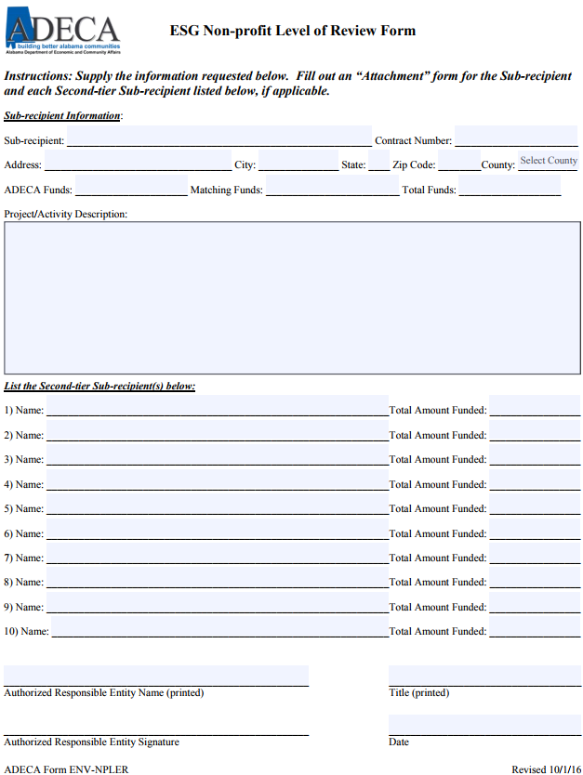
Conducting the Review
Non-Profit Organizations
Complete the Non-profit Level of Review Form
Complete the Sub-recipient Information
Include Complete Funding Totals
Include a Complete Project Description
Ensure the Proper Signature
Notes:
Non-profit Organizations must complete a Non-Profit Level of Review form first. A Level of Review form Attachment must also be completed by yourself and each of the 2nd tier sub-recipients, if there are any.
Now, the ESG Non-Profit Level of Review form is to be completed by the Sub-recipient. The funding totals reported on this form should be for the entire project. It should also include a complete project description for the sub-recipient and all 2nd tier sub-recipients. In other words, an aggregated list of all the proposed activities. This form should be signed by the Authorized Responsible Entity (that is the CEO, president or the like) of the sub-recipient.

Slide 7
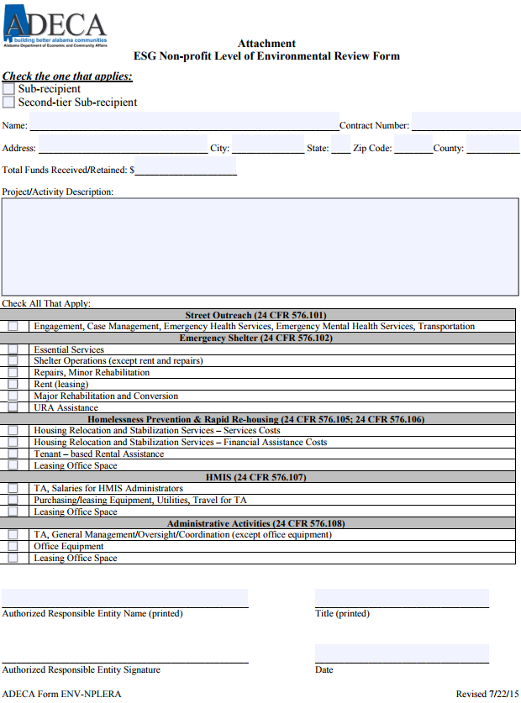
Conducting the Review
Non-Profit Organizations
Complete a Non-profit Level of Review Form Attachment (1 for you and 1 for each 2nd tier recipient)
Check the Sub-recipient/Second-tier Sub-recipient Box and Include that Recipient’s Information
Include Individual Funding total
Include Individual Project Description based on chart selections
Ensure Proper Signature
Submit to ADECA
Notes:
An Attachment form must be completed by each sub-recipient and each 2nd tier sub-recipient. On the Attachment form, indicate if you are a Sub-recipient or a 2nd tier sub-recipient and provide the information requested. The funding amount reported on this form should be for only the one organization and should match what is given on the Level of Review form. The project description should include only those applicable activities for this Organization. In other words, the only activities that should be given are the ones that were selected in the chart on the bottom of the form.
The attachment form should be signed by the Authorized Responsible Entity (that is the CEO, President or the like) of the Organization it was prepared for.
When you have all of the forms back from all the organizations, submit the entire package to ADECA. Once I receive it, I will actually perform your Environmental Reviews. Upon their completion I will issue your Notices of Removal of Grant Conditions and submit them to Shonda. She will take it from there.

Slide 8
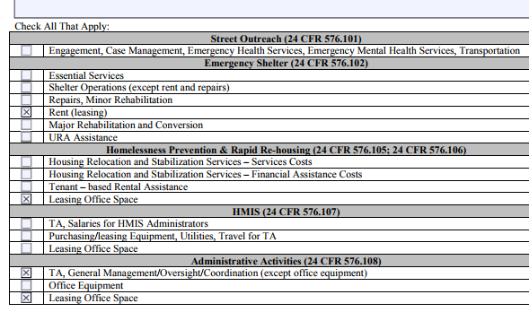
Project Descriptions
Notes:
When providing the project description, I find that the easiest method is to simply use the terminology that HUD has already provided. For example, this Attachment has activities under the Components of Emergency Shelter <click>, Homelessness Prevention & Rapid Re-Housing <click> and Administrative Activities <click> selected. So the simplest project description would be the following <click>:
This is how I would write my project description.
Please note that when selecting rent or leasing activities, include the addresses of the leased spaces.

Slide 9
Conducting the Review
Units of Local Government
CDBG Environmental Review requirements govern
Environmental Review Guide and CDBG Environmental Review Website (Google search ADECA Environmental)
When the Review is completed, submit required info to ADECA
Notes:
For Units of Local Government, you’re not that lucky. You are responsible for conducting your own review. The same process that ADECA’s CDBG program uses governs your Environmental Review. Use the Environmental Review Guide and the other information located on the CDBG environmental webpage to complete your review. The easiest way to locate the page is to do a Google search for ADECA Environmental. The last part of this video includes a guided tour of the basics of environmental reviews so keep watching.
Once you have successfully completed your review, and submitted the correct information, I will issue the Notice of Removal of Grant Conditions and submit them to Shonda at which time she will take over.

Slide 10
Additional Information
ADECA Environmental Review website: http://adeca.alabama.gov/Divisions/ced/cdp/Pages/Environmental.aspx
HUD webinars: https://www.hudexchange.info/environmental-review/environmental-review-training/
HUD Web-Based Instructional System for Environmental Review (WISER): https://www.hudexchange.info/trainings/wiser/?utm_source=HUD+Exchange+Mailing+List&utm_campaign=9f0713617d-WISER_Training_Modules_2017_12_01&utm_medium=email&utm_term=0_f32b935a5f-9f0713617d-19295981
HUD Related Federal Laws & Authorities: https://www.hudexchange.info/environmental-review/federal-related-laws-and-authorities
Notes:
You can find additional information on conducting environmental reviews at the web addresses shown here.

Slide 11
Thank You
Chris Perkins, PE
CED Engineer / Environmental Officer
334-353-1028
christopher.perkins@adeca.alabama.gov
Notes:
If you have questions concerning anything that was presented, please don’t hesitate to contact me at the address or phone number provided. Thank You.

