Slide 1
Environmental Review Process for CARES Act/COVID-19 Grants
Chris Perkins, PE
CED Engineer/Environmental Specialist
christopher.perkins@adeca.alabama.gov
334-353-1028

Slide 2
HUD Changes to the ER Process
Expanded Exempt Activities
Expanded CENST Activities
Expanded Imminent Threat Activities
See the CV Activities Chart (available on the CED Environmental website)

Slide 3
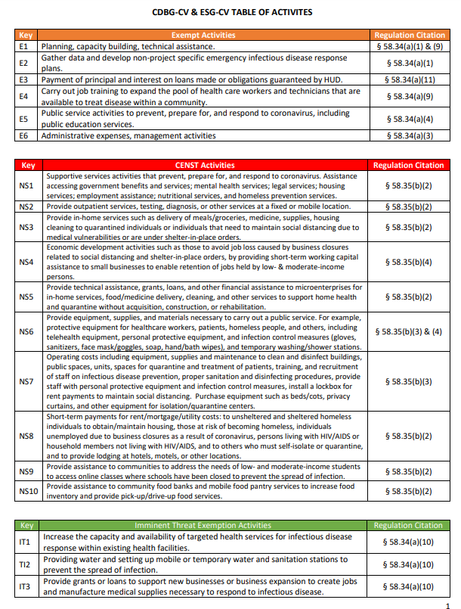
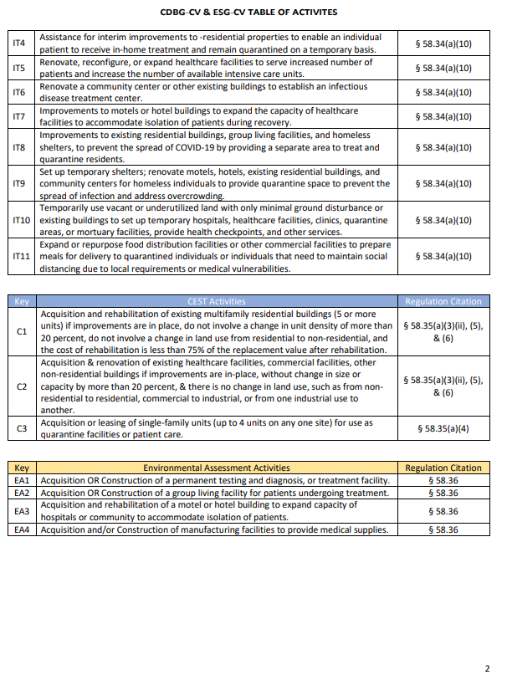

Slide 4
3 Types of Awarded Projects
ESG Non-Profit
ESG Localities (Towns, Cities, Counties)
CDBG Localities (Town, Cities, Counties)

Slide 5
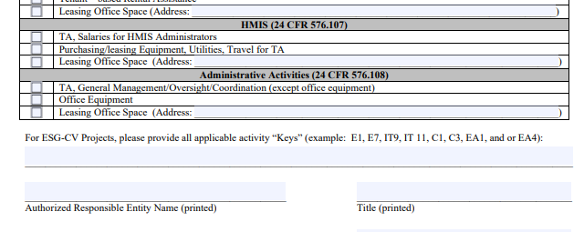
ESG Non-Profit Awardees
Proceed as normal.
New to the ESG-LRFA: CV Keys
Complete the ESG-LRF , Level of Review Form. Include every entity that is to receive funds.
Complete an ESG-LRFA, Level of Review Form Attachment for yourself and each entity that is to receive funds (Attachments should be signed by the Head of the entity).
Submit completed ESG-LRF and all ESG-LRFA’s to ADECA.
ADECA will complete the review and issue your release.

Slide 6
ESG Locality Awardees
Process will follow the standard review process with one exception…
Review the CV Activities Chart to determine if your activities fit into the expanded Exempt, CENST or Imminent Threat Exemptions activities list.
Conduct your review based on the required Level of Review and submit the required documents to ADECA.
ADECA will process your submittal and issue your release.

Slide 7
CDBG Locality Awardees
Process will follow the standard review process with one exception…
Review the CV Activities Chart to determine if your activities fit into the expanded Exempt, CENST or Imminent Threat Exemptions activities list.
Conduct your review based on the required Level of Review and submit the required documents to ADECA.
ADECA will process your submittal and issue your release.

Slide 8
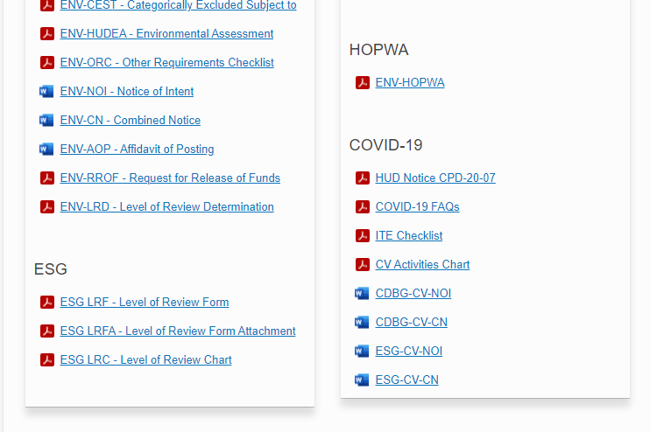
Locality Awardees
Pay special attention to the Public Notification forms (Notice of Intent and Combined Notice)

Slide 9
QUESTIONS???
THANKS

