Slide 1
Alabama Capital Projects Fund
Program Announcements
February 27, 2024

Slide 2
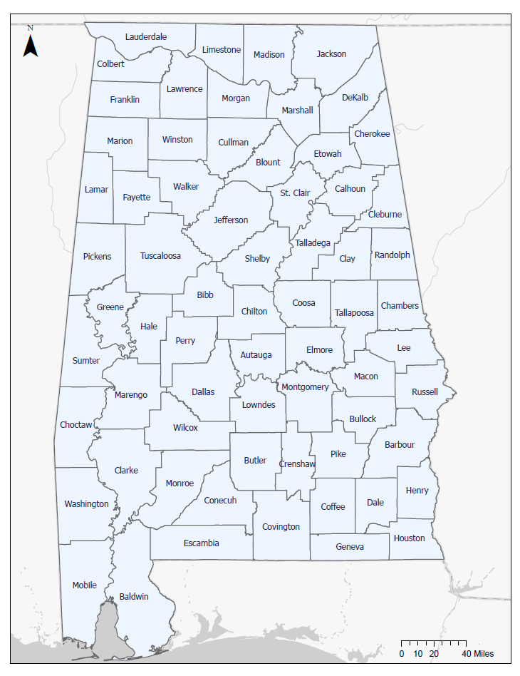
February 27, 2024 | 2

Slide 3
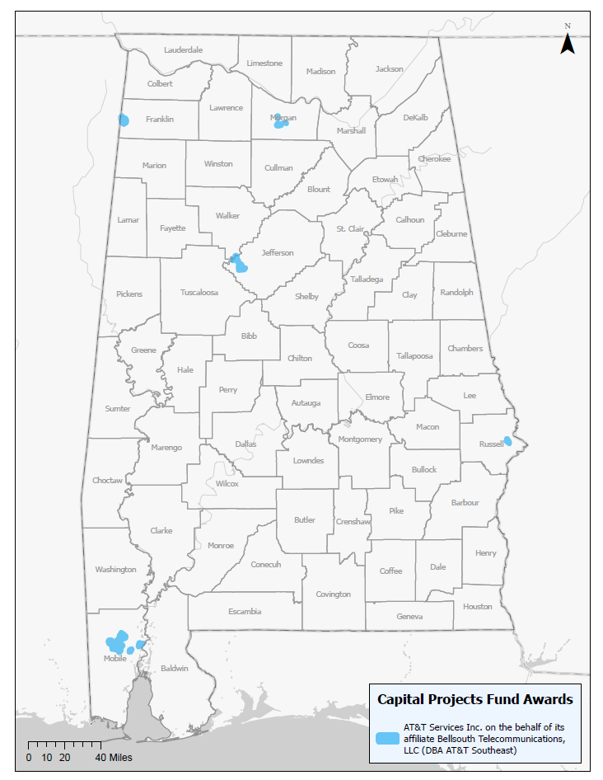
Alabama Capital Projects Fund
AT&T Services Inc. On behalf of its affiliate BellSouth Telecommunications, LLC (DBA AT&T Southeast)
Five projects serving portions of Jefferson, Franklin, Russell, Mobile, and Morgan Counties
Grant Amount: $6,978,222
Estimated Route Miles: 61
Estimated Number of Currently Unserved Households, Businesses, and Community Institutions With New Access to Highspeed Internet: 1,871
This project is being supported, in whole or in part, by federal award number CPFFN0162 awarded to the State of Alabama by the U.S. Department of the Treasury.
February 27, 2024 | 3

Slide 4
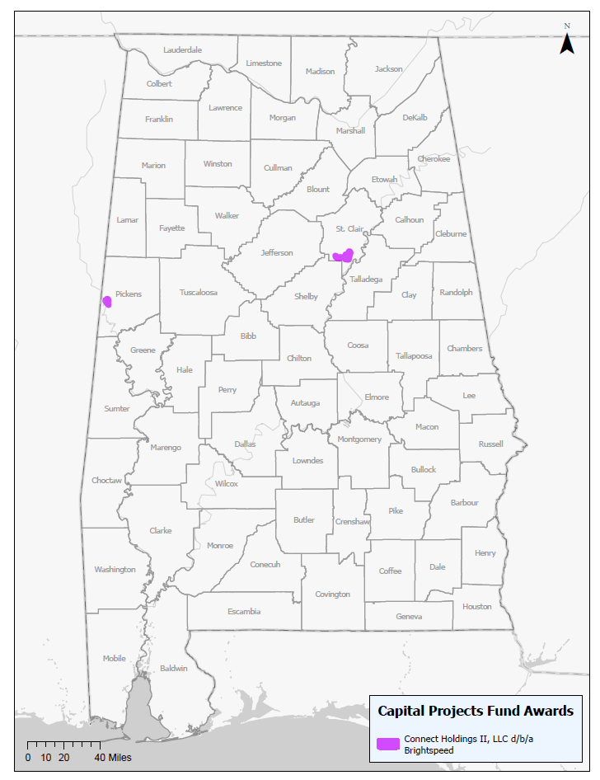
Alabama Capital Projects Fund
Connect Holding II LLC d/b/a Brightspeed
Two projects serving portions of St. Clair and Pickens Counties
Grant Amount: $388,061
Estimated Route Miles: 21
Estimated Number of Currently Unserved Households, Businesses, and Community Institutions With New Access to Highspeed Internet: 479
This project is being supported, in whole or in part, by federal award number CPFFN0162 awarded to the State of Alabama by the U.S. Department of the Treasury.
February 27, 2024 | 4

Slide 5
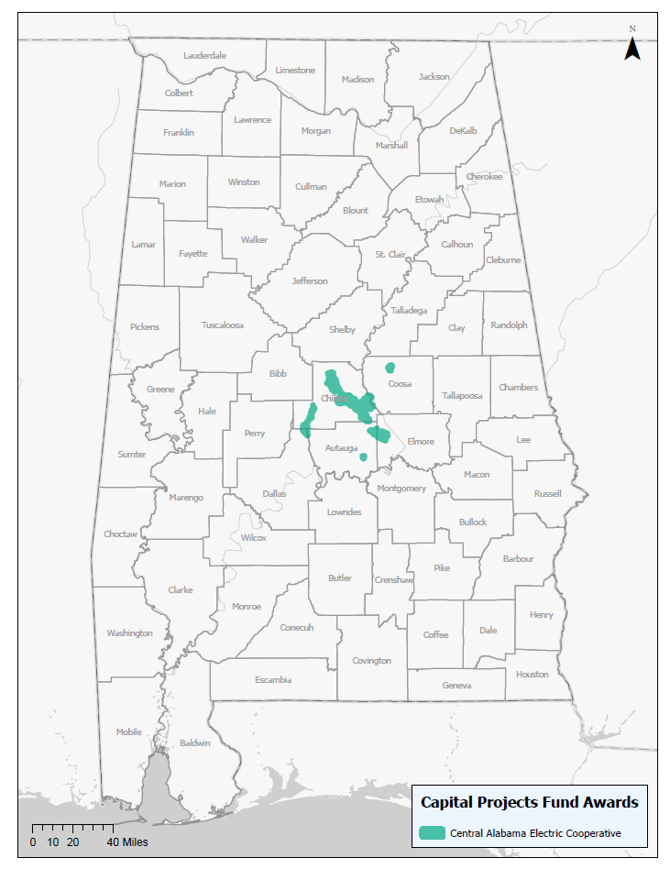
Alabama Capital Projects Fund
Central Alabama Electric Cooperative
Seven projects serving portions of Chilton, Autauga, Coosa, Dallas, and Elmore Counties
Grant Amount: $22,941,912
Estimated Route Miles: 300
Estimated Number of Currently Unserved Households, Businesses, and Community Institutions With New Access to Highspeed Internet: 6,338
This project is being supported, in whole or in part, by federal award number CPFFN0162 awarded to the State of Alabama by the U.S. Department of the Treasury.
February 27, 2024 | 5

Slide 6
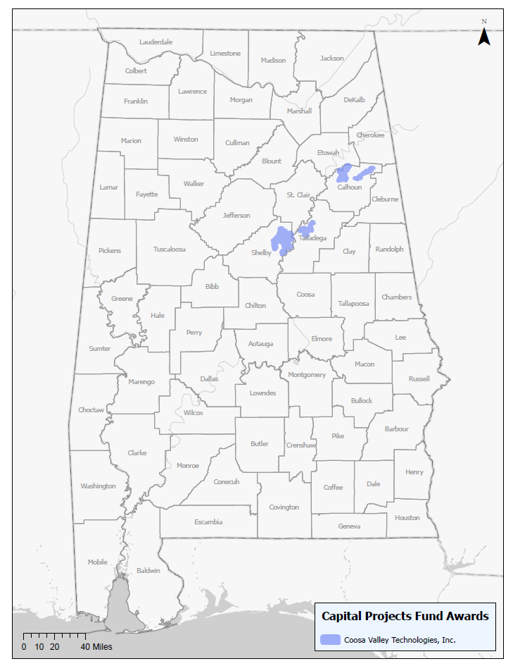
Alabama Capital Projects Fund
Coosa Valley Technologies
Six projects serving portions of Calhoun, Etowah, Talladega, and Shelby Counties
Grant Amount: $12,574,080
Estimated Route Miles: 199
Estimated Number of Currently Unserved Households, Businesses, and Community Institutions With New Access to Highspeed Internet: 974
This project is being supported, in whole or in part, by federal award number CPFFN0162 awarded to the State of Alabama by the U.S. Department of the Treasury.
February 27, 2024 | 6

Slide 7
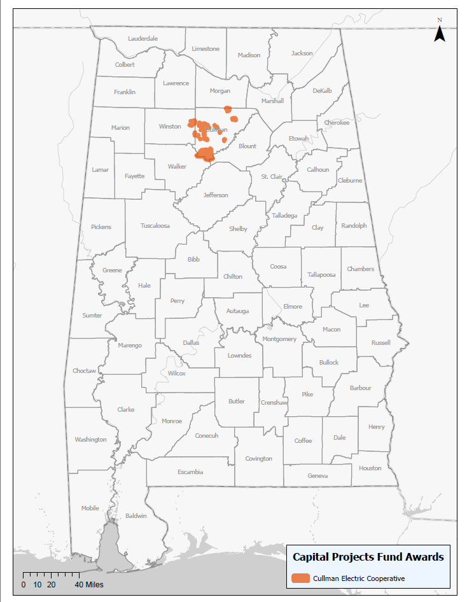
Alabama Capital Projects Fund
Cullman Electric Cooperative
One project serving portions of Cullman and Winston Counties
Grant Amount: $4,106,147
Estimated Route Miles: 96
Estimated Number of Currently Unserved Households, Businesses, and Community Institutions With New Access to Highspeed Internet: 1,979
This project is being supported, in whole or in part, by federal award number CPFFN0162 awarded to the State of Alabama by the U.S. Department of the Treasury.
February 27, 2024 | 7

Slide 8
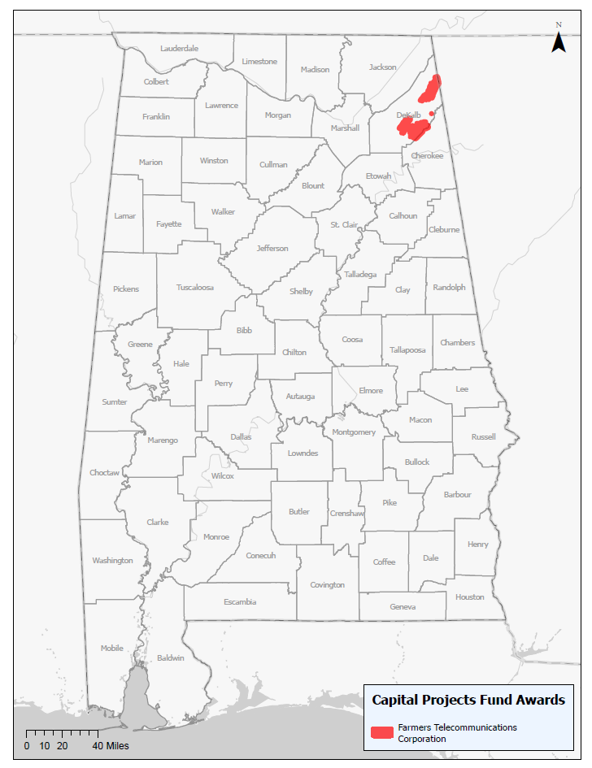
Alabama Capital Projects Fund
Farmers Telecommunications Corporation
Two projects serving portions of DeKalb County
Grant Amount: $7,299,652
Estimated Route Miles: 181
Estimated Number of Currently Unserved Households, Businesses, and Community Institutions With New Access to Highspeed Internet: 1,638
This project is being supported, in whole or in part, by federal award number CPFFN0162 awarded to the State of Alabama by the U.S. Department of the Treasury.
February 27, 2024 | 8

Slide 9
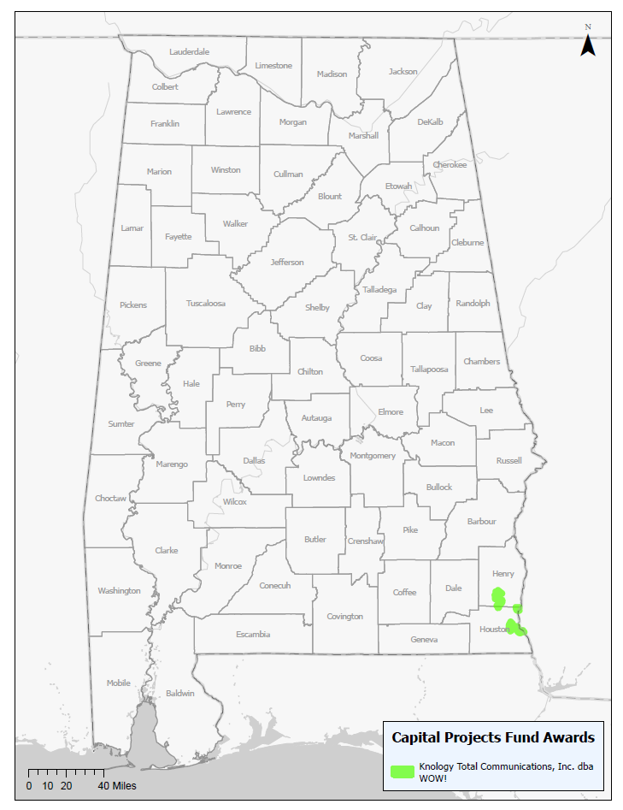
Alabama Capital Projects Fund
Knology Total Communications, Inc. d/b/a WOW!
One project serving portions of Henry and Houston Counties
Grant Amount: $2,393,194
Estimated Route Miles: 58
Estimated Number of Currently Unserved Households, Businesses, and Community Institutions With New Access to Highspeed Internet: 969
This project is being supported, in whole or in part, by federal award number CPFFN0162 awarded to the State of Alabama by the U.S. Department of the Treasury.
February 27, 2024 | 9

Slide 10
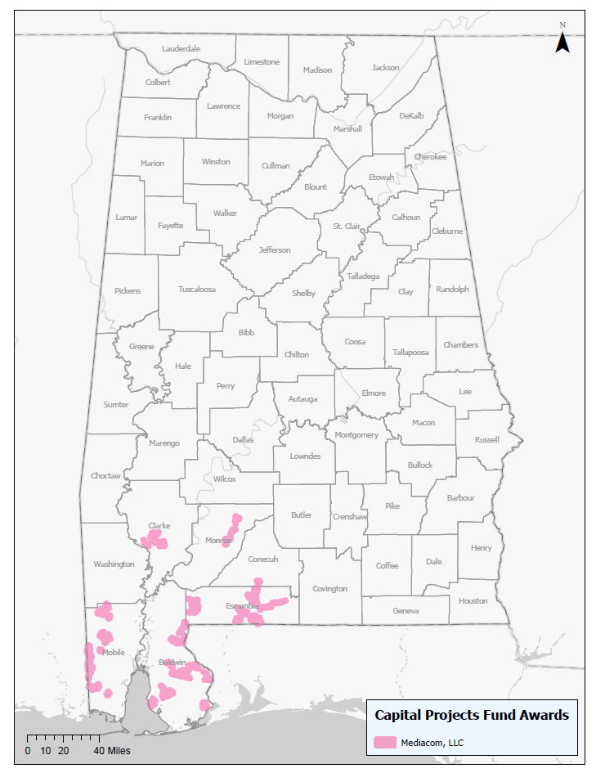
Alabama Capital Projects Fund
Mediacom LLC
Eight projects serving portions of Escambia, Mobile, Monroe, Baldwin, Clarke, and Conecuh Counties
Grant Amount: $22,800,429
Estimated Route Miles: 559
Estimated Number of Currently Unserved Households, Businesses, and Community Institutions With New Access to Highspeed Internet: 7,989
This project is being supported, in whole or in part, by federal award number CPFFN0162 awarded to the State of Alabama by the U.S. Department of the Treasury.
February 27, 2024 | 10

Slide 11
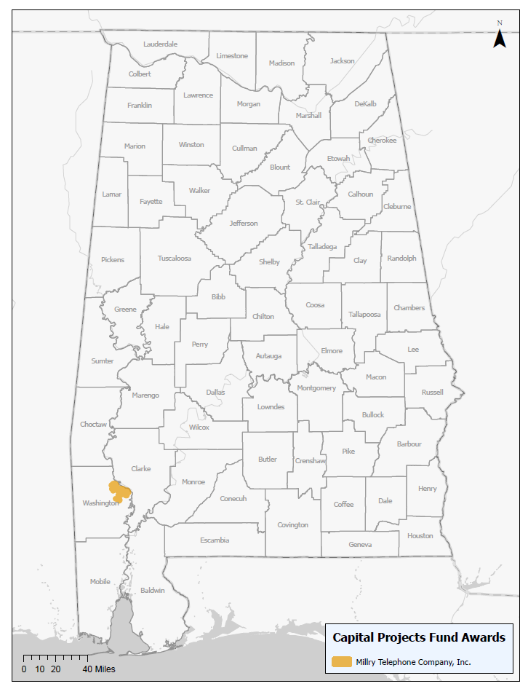
Alabama Capital Projects Fund
Millry Telephone Company, Inc
One project serving portions of Washington County
Grant Amount: $3,600,000
Estimated Route Miles: 61
Estimated Number of Currently Unserved Households, Businesses, and Community Institutions With New Access to Highspeed Internet: 988
This project is being supported, in whole or in part, by federal award number CPFFN0162 awarded to the State of Alabama by the U.S. Department of the Treasury.
February 27, 2024 | 11

Slide 12
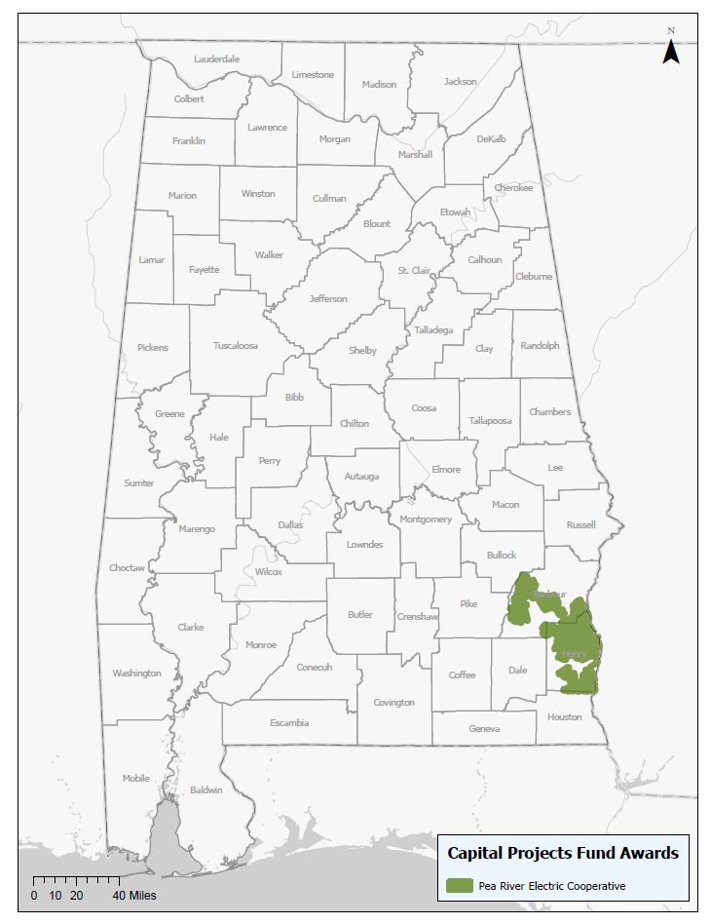
Alabama Capital Projects Fund
Pea River Electric Cooperative
One project serving portions of Barbour and Henry Counties
Grant Amount: $5,000,000
Estimated Route Miles: 507
Estimated Number of Currently Unserved Households, Businesses, and Community Institutions With New Access to Highspeed Internet: 1,529
This project is being supported, in whole or in part, by federal award number CPFFN0162 awarded to the State of Alabama by the U.S. Department of the Treasury.
February 27, 2024 | 12

Slide 13
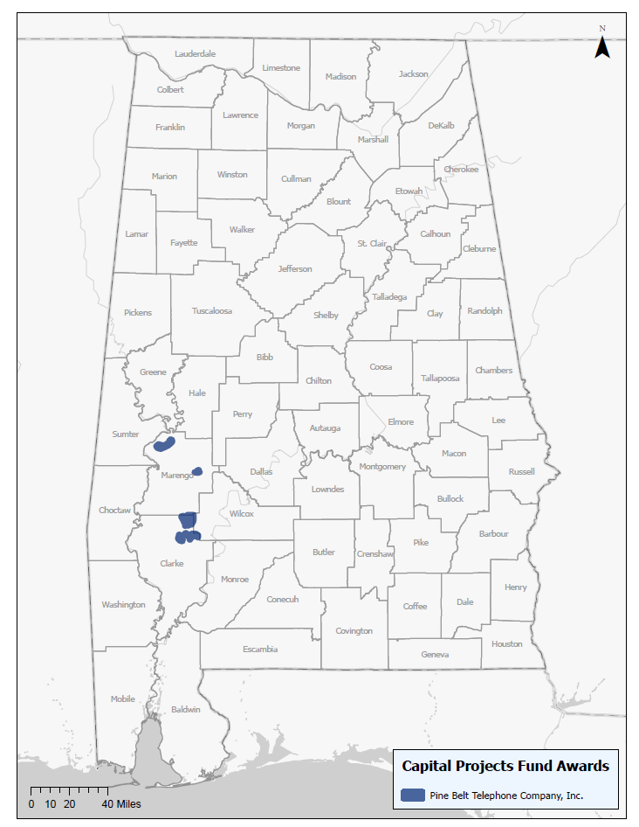
Alabama Capital Projects Fund
Pine Belt Telephone Company, Inc.
Four projects serving portions of Clarke and Marengo Counties
Grant Amount: $3,000,000
Estimated Route Miles: 143
Estimated Number of Currently Unserved Households, Businesses, and Community Institutions With New Access to Highspeed Internet: 483
This project is being supported, in whole or in part, by federal award number CPFFN0162 awarded to the State of Alabama by the U.S. Department of the Treasury.
February 27, 2024 | 13

Slide 14
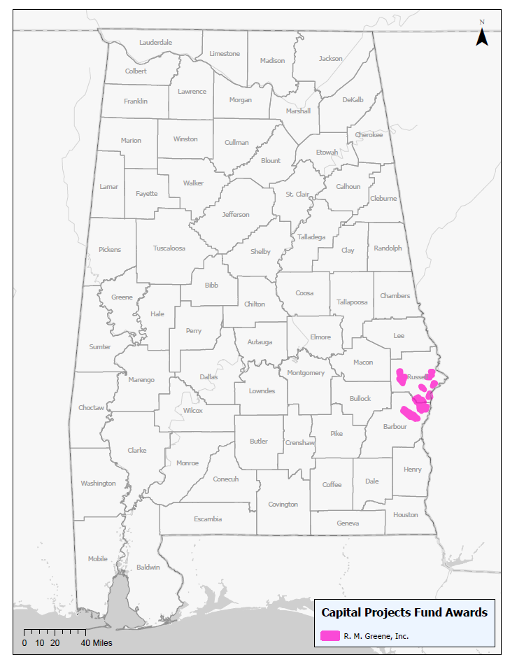
Alabama Capital Projects Fund
R. M. Greene, Inc.
One project serving portions of Barbour and Russell Counties
Grant Amount: $2,852,905
Estimated Route Miles: 104
Estimated Number of Currently Unserved Households, Businesses, and Community Institutions With New Access to Highspeed Internet: 682
This project is being supported, in whole or in part, by federal award number CPFFN0162 awarded to the State of Alabama by the U.S. Department of the Treasury.
February 27, 2024 | 14

Slide 15
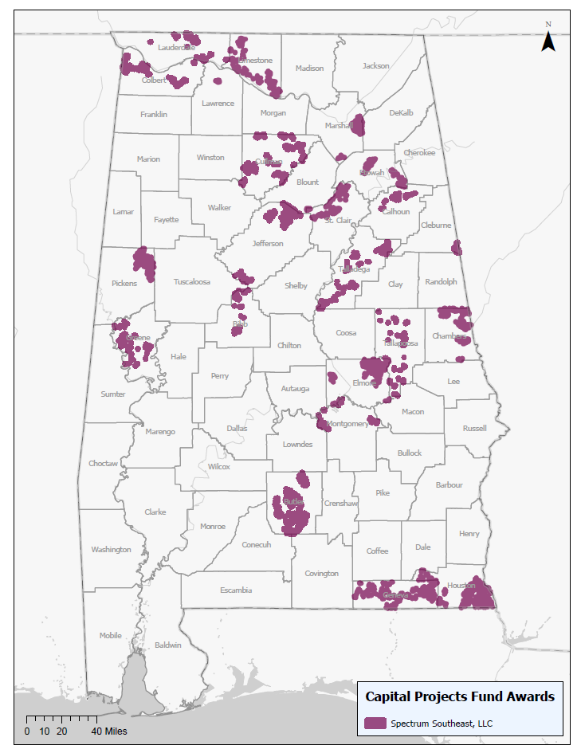
Alabama Capital Projects Fund
Spectrum Southeast, LLC
Twenty-three projects serving portions of Greene, Colbert, Elmore, Limestone, Bibb, Tuscaloosa, Geneva, Houston, Lawrence, Jefferson, Etowah, Calhoun, Lauderdale, St. Clair, Cullman, Morgan, Marshall, Cleburne, Butler, Pickens, Coosa, Talladega, Chambers, Montgomery and Tallapoosa Counties
Grant Amount: $44,838,167
Estimated Route Miles: 2,078
Estimated Number of Currently Unserved Households, Businesses, and Community Institutions With New Access to Highspeed Internet: 21,997
This project is being supported, in whole or in part, by federal award number CPFFN0162 awarded to the State of Alabama by the U.S. Department of the Treasury.
February 27, 2024 | 15

Slide 16
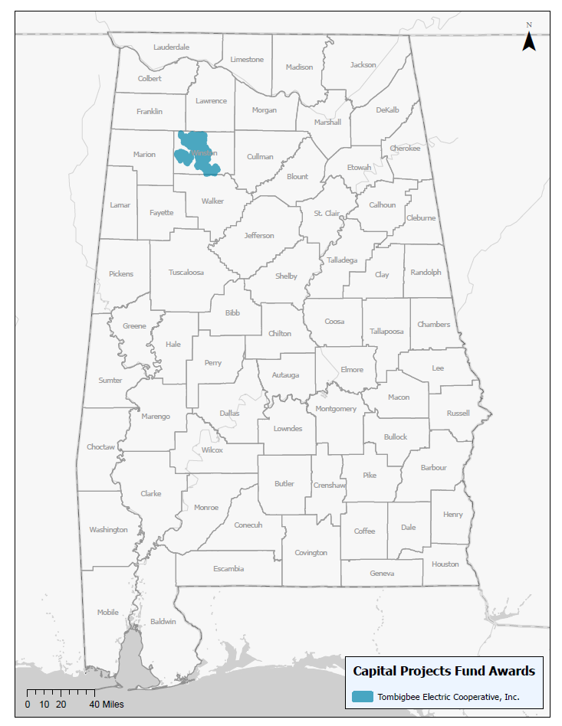
Alabama Capital Projects Fund
Tombigbee Electric Cooperative, Inc
One project serving portions of Winston County
Grant Amount: $2,780,632
Estimated Route Miles: 155
Estimated Number of Currently Unserved Households, Businesses, and Community Institutions With New Access to Highspeed Internet: 1,584
This project is being supported, in whole or in part, by federal award number CPFFN0162 awarded to the State of Alabama by the U.S. Department of the Treasury.
February 27, 2024 | 16

Slide 17
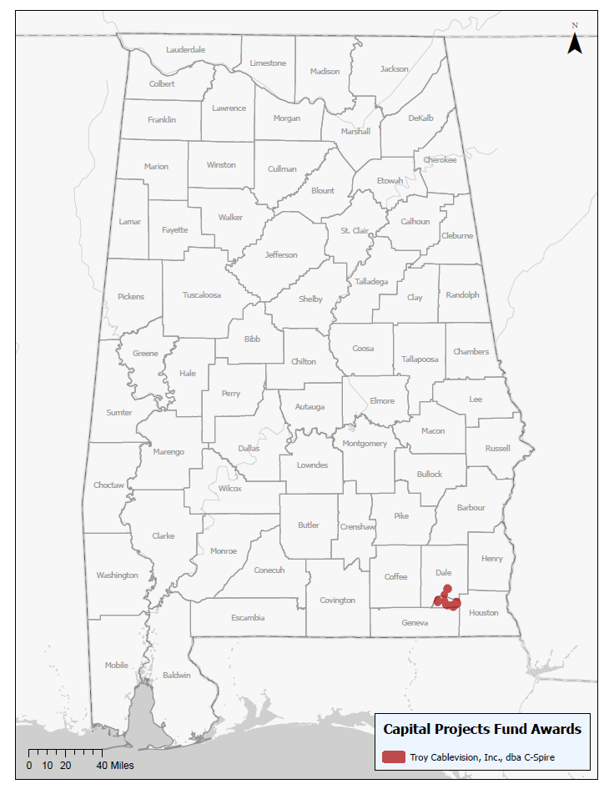
Alabama Capital Projects Fund
Troy Cablevision, Inc., dba C Spire
One project serving portions of Dale and Houston Counties
Grant Amount: $1,653,462
Estimated Route Miles: 75
Estimated Number of Currently Unserved Households, Businesses, and Community Institutions With New Access to Highspeed Internet: 694
This project is being supported, in whole or in part, by federal award number CPFFN0162 awarded to the State of Alabama by the U.S. Department of the Treasury.
February 27, 2024 | 17

Slide 18
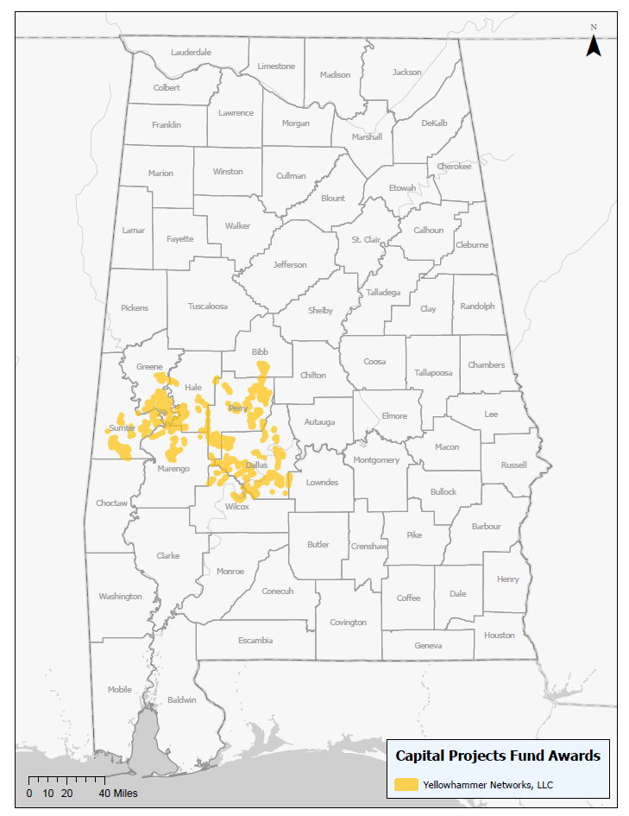
Alabama Capital Projects Fund
Yellowhammer Networks, LLC
Two projects serving portions of Greene, Marengo, Sumter, Bibb, Dallas, Hale, Lowndes, and Perry Counties
Grant Amount: $5,132,276
Estimated Route Miles: 830
Estimated Number of Currently Unserved Households, Businesses, and Community Institutions With New Access to Highspeed Internet: 3,698
This project is being supported, in whole or in part, by federal award number CPFFN0162 awarded to the State of Alabama by the U.S. Department of the Treasury.
February 27, 2024 | 18

Slide 19
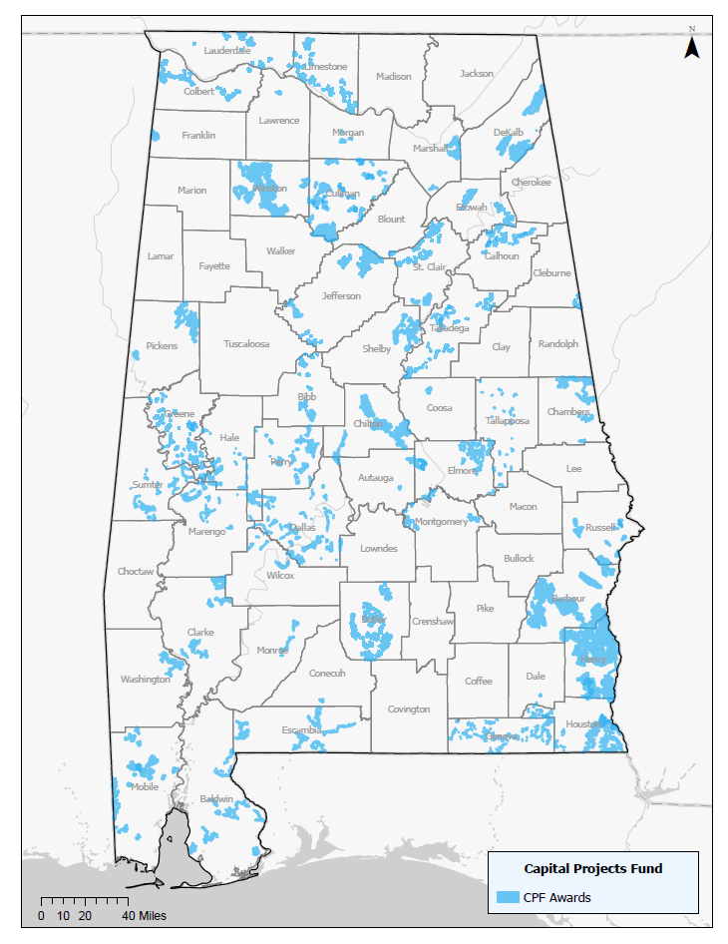
Alabama Capital Projects Fund
Funding
Sixty-six projects serving portions of 48 Counties throughout Alabama
Grant Amount: $148,339,141
Match Amount: $171,631,795
Estimated Route Miles: 5,429
Estimated Number of Currently Unserved Households, Businesses, and Community Institutions With New Access to Highspeed Internet: 53,892
This project is being supported, in whole or in part, by federal award number CPFFN0162 awarded to the State of Alabama by the U.S. Department of the Treasury.
February 27, 2024 | 19

Slide 20
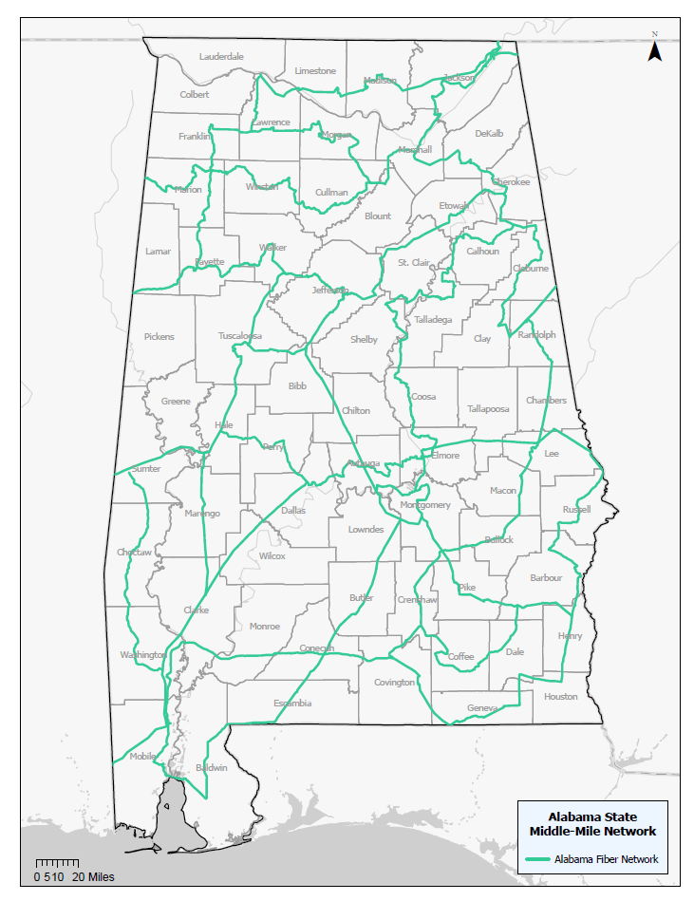
Alabama Statewide Middle-Mile Network (ASMMN) Grant Program
Funding
One project to serve 64 counties
Grant Amount: $82,450,000
Match Amount: $36,673,744
Estimated Route Miles: 3,000
This project is being supported, in whole or in part, by federal award number SLFRP2635 awarded to the State of Alabama by the U.S. Department of the Treasury.
February 27, 2024 | 20

Slide 21
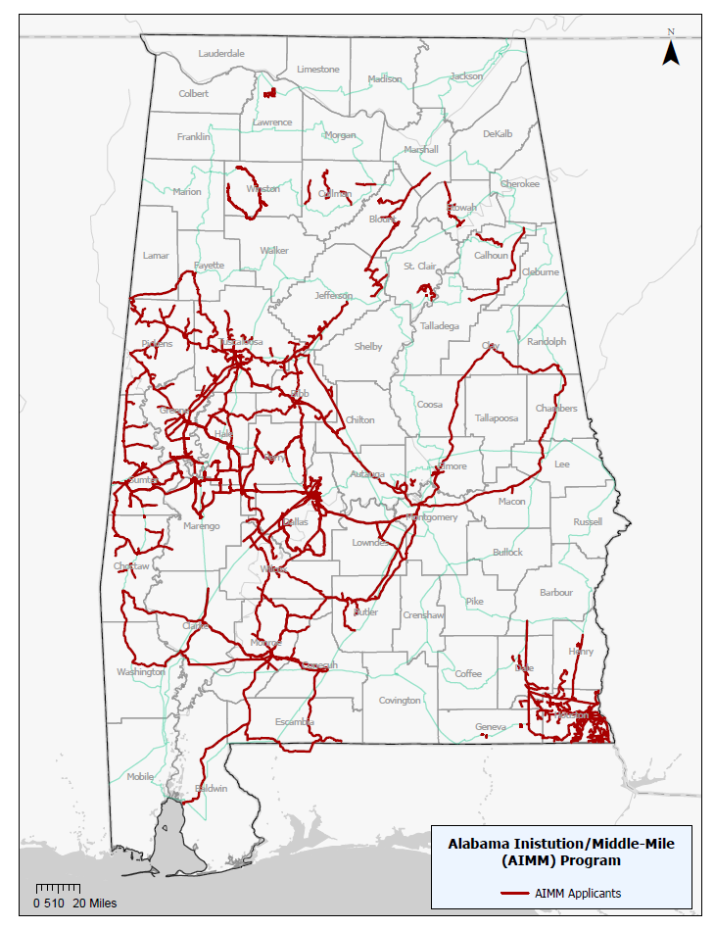
Alabama Anchor Institution/Middle-Mile (AIMM) Grant Program
Funding
21 projects awarded to 12 grantees
Grant Amount: $188,453,905
Match Amount: $58,109,315
Estimated Route Miles: 4,287.06
Estimated Anchor Institutions: 793
This project is being supported, in whole or in part, by federal award number SLFRP2635 awarded to the State of Alabama by the U.S. Department of the Treasury.
February 27, 2024 | 21

Slide 22
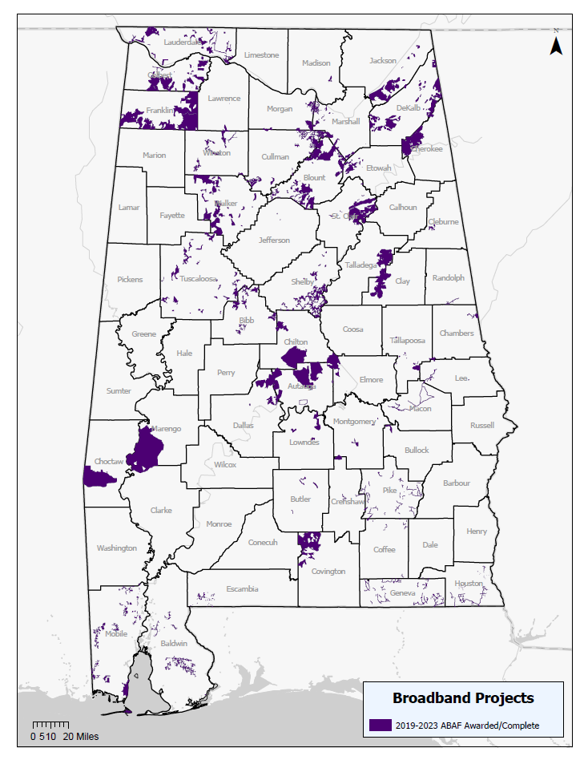
Alabama Broadband Accessibility Fund (ABAF)
Funding
In addition to the middle-mile projects already discussed, ADECA has administered the Alabama Broadband Accessibility Fund awarding 107 projects
Grant Amount: $82,069,667
Match Amount: $193,000,000
Estimated Number of Currently Unserved Households, Businesses, and Community Institutions With New Access to Highspeed Internet: 72,108
February 27, 2024 | 22

Slide 23
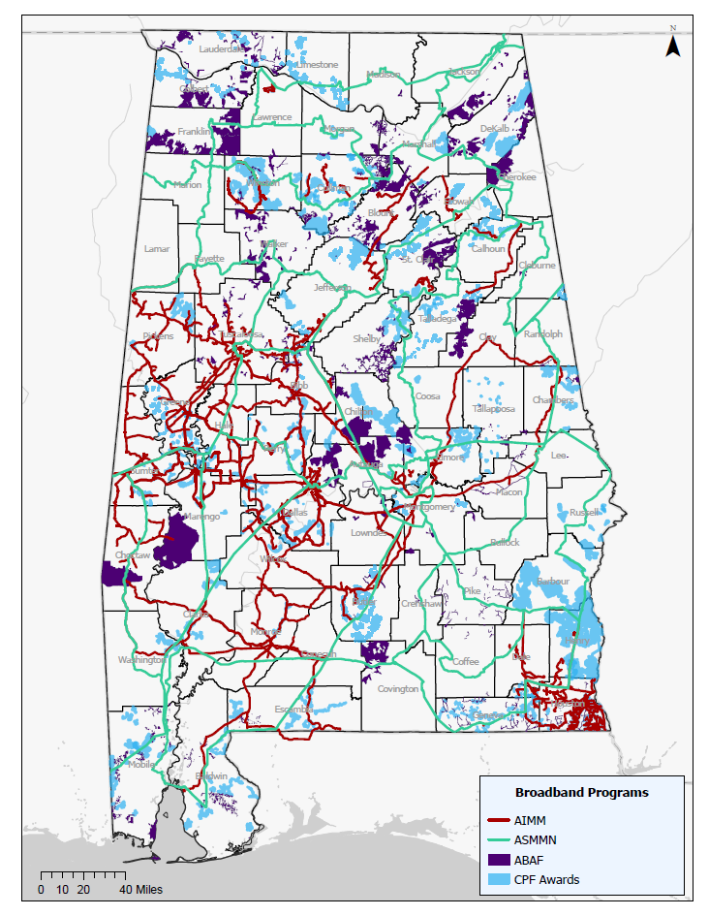
AIMM, ASMMN, ABAF, and CPF
Funding
In total, Alabama has awarded 195 middle-mile and last mile projects
Grant Amount: $501,312,714
Match Amount: $459,414,855
Estimated Number of Currently Unserved Households, Businesses, and Community Institutions With New Access to Highspeed Internet: 126,883
These projects are being supported, in whole or in part, by federal award numbers CPFFN0162 and SLFRP2635 awarded to the State of Alabama by the U.S. Department of the Treasury.
February 27, 2024 | 23

Slide 24
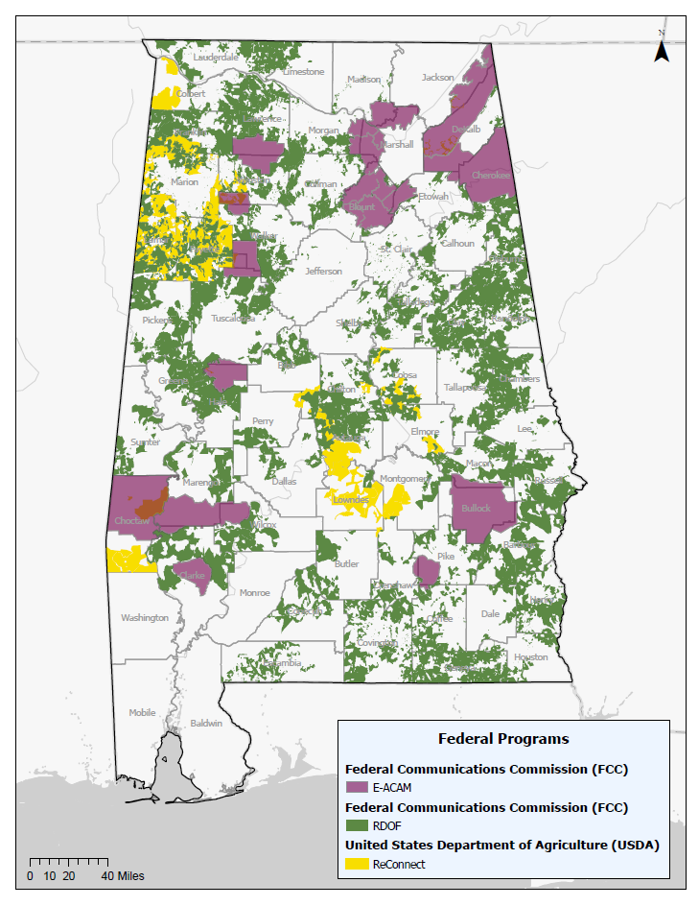
Federal Commitments for Broadband Deployment in Alabama
There are federal programs that have also made “enforceable commitments” for broadband deployment in Alabama. These areas are generally ineligible for other federal funds for broadband deployment.
These funds are administered by the federal entities that awarded them.
Federal Communication Commission (FCC) Rural Digital Opportunity Fund (RDOF) and Enhanced Alternative Connect America Cost Model (E-ACAM) commitments that prevent the use of CPF, or future BEAD funds.
U.S. Department of Agriculture (USDA) ReConnect commitments that prevent the use of CPF, or future BEAD funds.
February 27, 2024 | 24

Slide 25
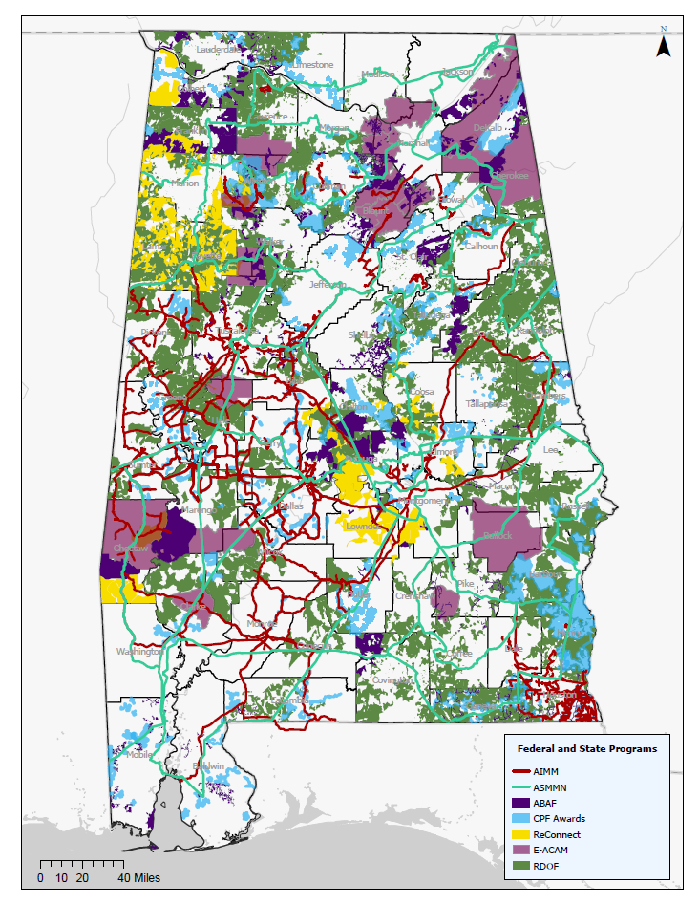
Federal and State Programs awarded broadband deployment projects throughout Alabama
As the map shows, there are many areas throughout Alabama that need connectivity.
We are proud of the work that has been done by our Legislature, under the leadership of Governor Kay Ivey to move the needle from being ranked as 47th in the nation for broadband connectivity to today’s ranking of 24th.
These projects are being supported, in whole or in part, by federal award numbers CPFFN0162 and SLFRP2635 awarded to the State of Alabama by the U.S. Department of the Treasury.
February 27, 2024 | 25

