Slide 1
Office of Minority Business Enterprise (OMBE)
Scott Stewart
scott.stewart@adeca.alabama.gov
P.O Box 5690
Montgomery, Alabama 36103-5690

Slide 2
NOTIFY ME!!!!

Slide 3
Additional Agencies to Notify or Acquire Information
ALDOT – Disadvantaged Business Enterprise Program (DBE)
P.O. Box 303050
Montgomery, Alabama 36130-3050
https://www.dot.state.al.us/programs/DBE.html
Shona Meadows – meadowss@dot.state.al.us
Alabama Small Business Development Center Network
Mr. Brian Davis, Director
PO Box 870396 Tuscaloosa, AL 35401
205-348-7621
aitc@ua.edu

Slide 4
Additional Agencies to Notify or Acquire Information
APEX ACCELERATOR formerly known as PTAC
Lindsay Frey – lindsey.frey@ua.edu
256-405-3477

Slide 5
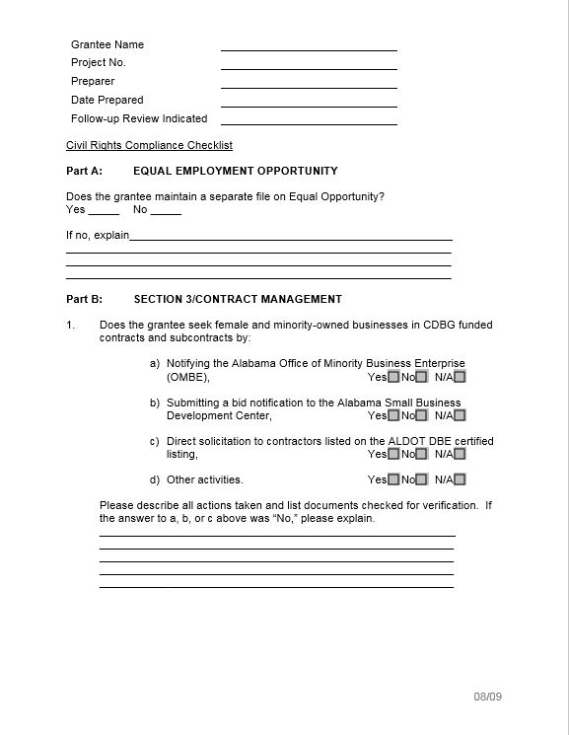

Slide 6
BENEFITS TO OMBE
Certified minority and woman owned businesses help the CDBG Program and CDBG funds help minority and woman owned businesses.
Large contractors are typically in need of minority and woman-owned sub-contractors on construction projects.
The more business that are on my OMBE list the more it helps you when trying to solicit minority and woman owned contractor participation on CDBG projects.

Slide 7
UTILIZATION OF OMBE
Receipt and distribution of RFQ/P’s and bid notifications.
What is done with the RFQ, RFP or bid notification?
Bid, RFP, & RFQ Information is sent to the certified businesses on the list I maintain.

Slide 8
Communication Process
Who – OMBE, Local Governments & Grant Administrators
What – Bid Opportunities
When – As soon as RFP/RFQ identified & not less than two weeks before the due date.

Slide 9
ADECA OMBE Application Process
An eligible business must be at least 51% owned and controlled by the minority or female owner(s).
https://adeca.alabama.gov/ombe/
Certification is issued for 2 years. Businesses can be recertified through affidavit process.

Slide 10
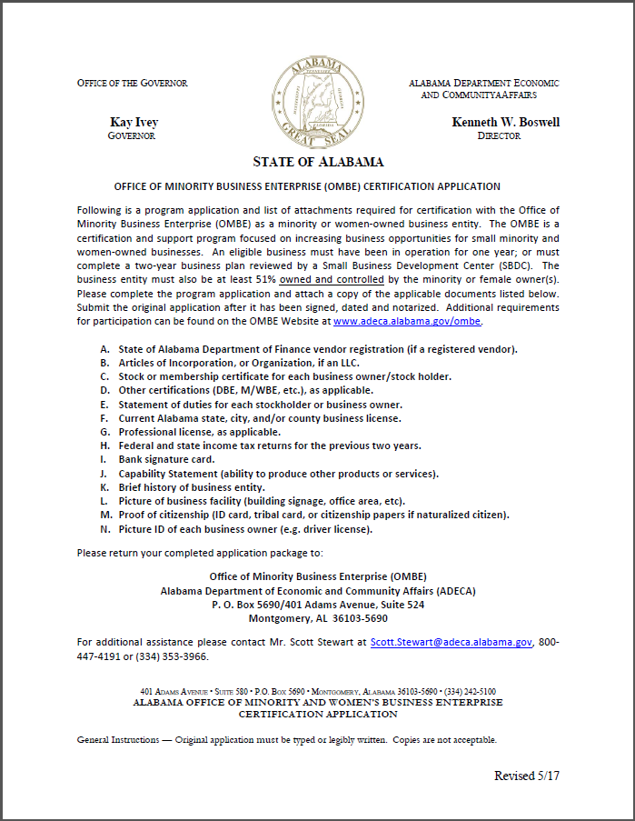

Slide 11
Thank You!

