Slide 1
CDBG Compliance Workshop
Financial Services
Jimmie Baker, Lisa North Pierson, and Jenna Hale

Slide 2
Budget Form
Changes to the budget form revised 12/23
Budget form is also used as a final expenditure report at closeout
Updated to reflect match sources
Cash or In-kind will now be listed per source
Select one: Local or Non-local
Non-local is any other federal or state funds
Shaded areas are fillable fields
Budget form must agree to Fund Usage Table in the application
Multi-year project requires multiple budgets

Slide 3
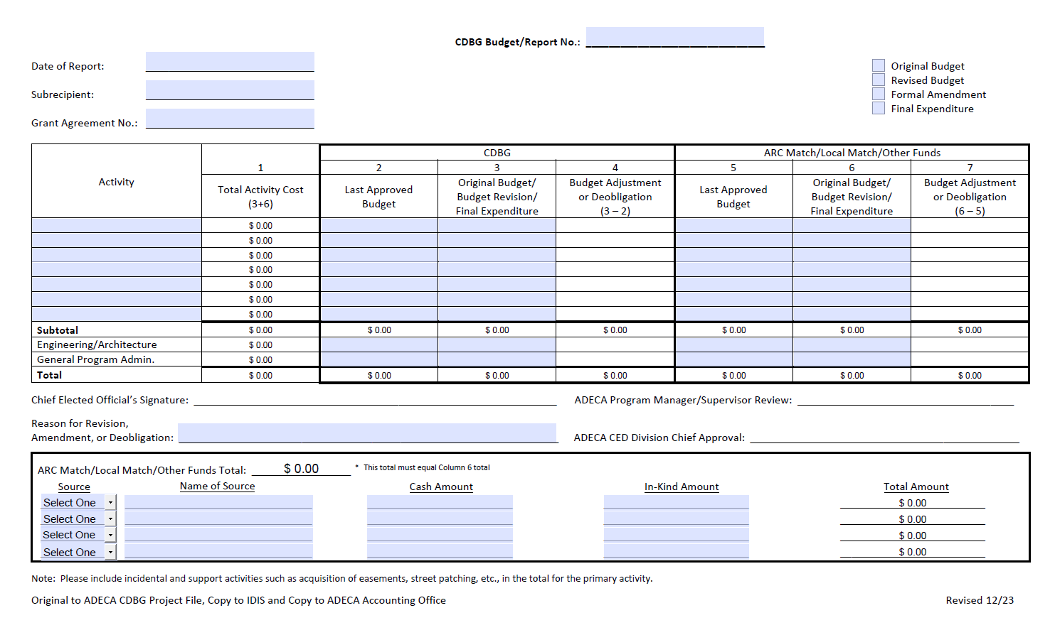

Slide 4
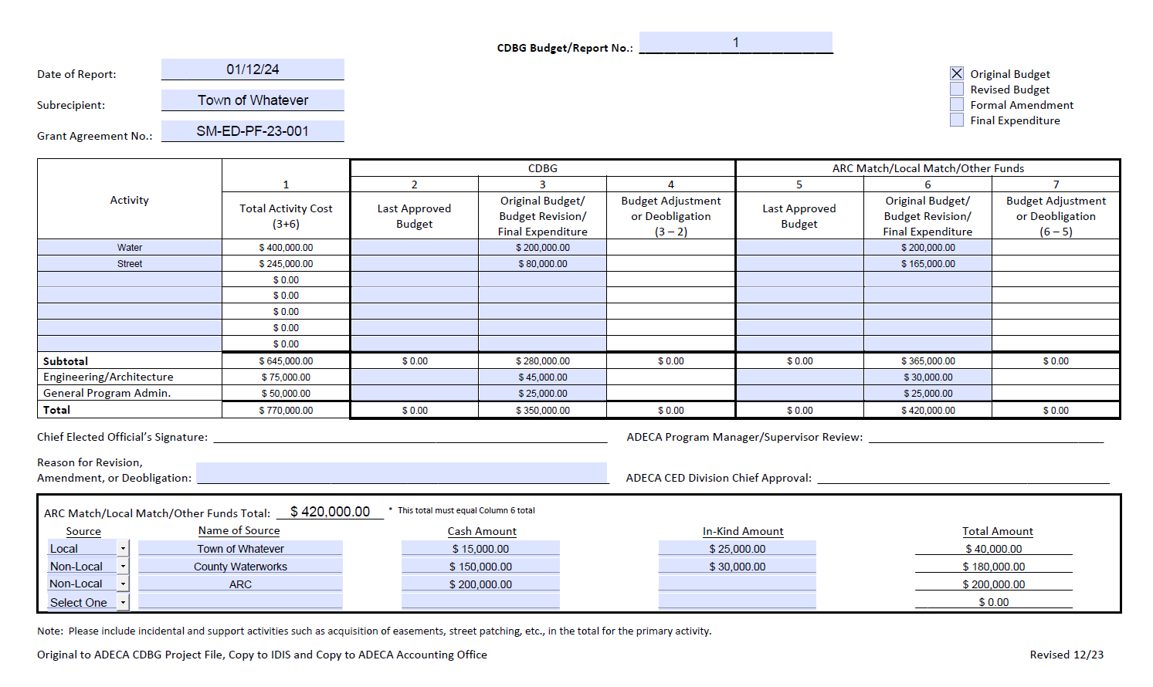

Slide 5
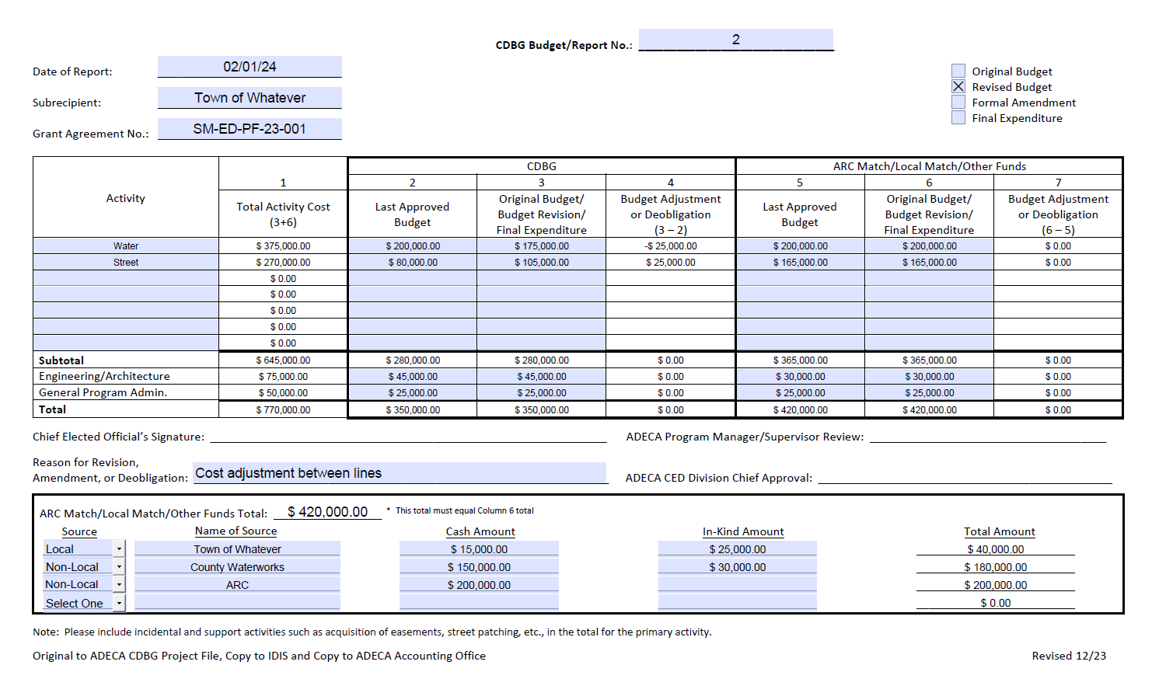

Slide 6
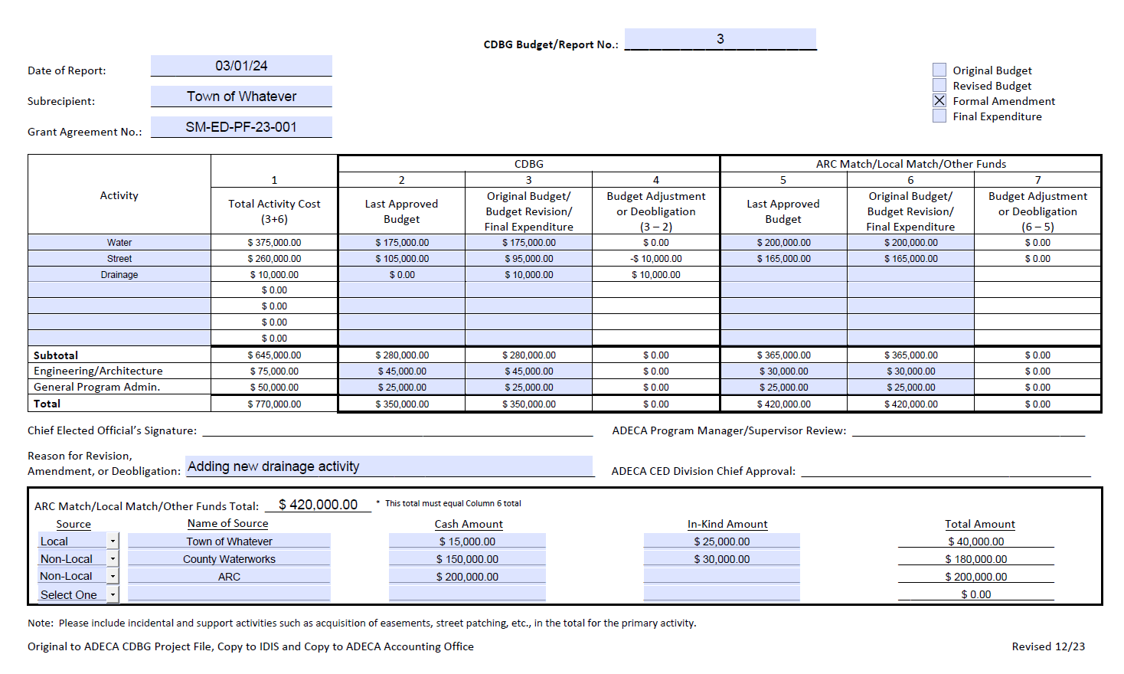

Slide 7
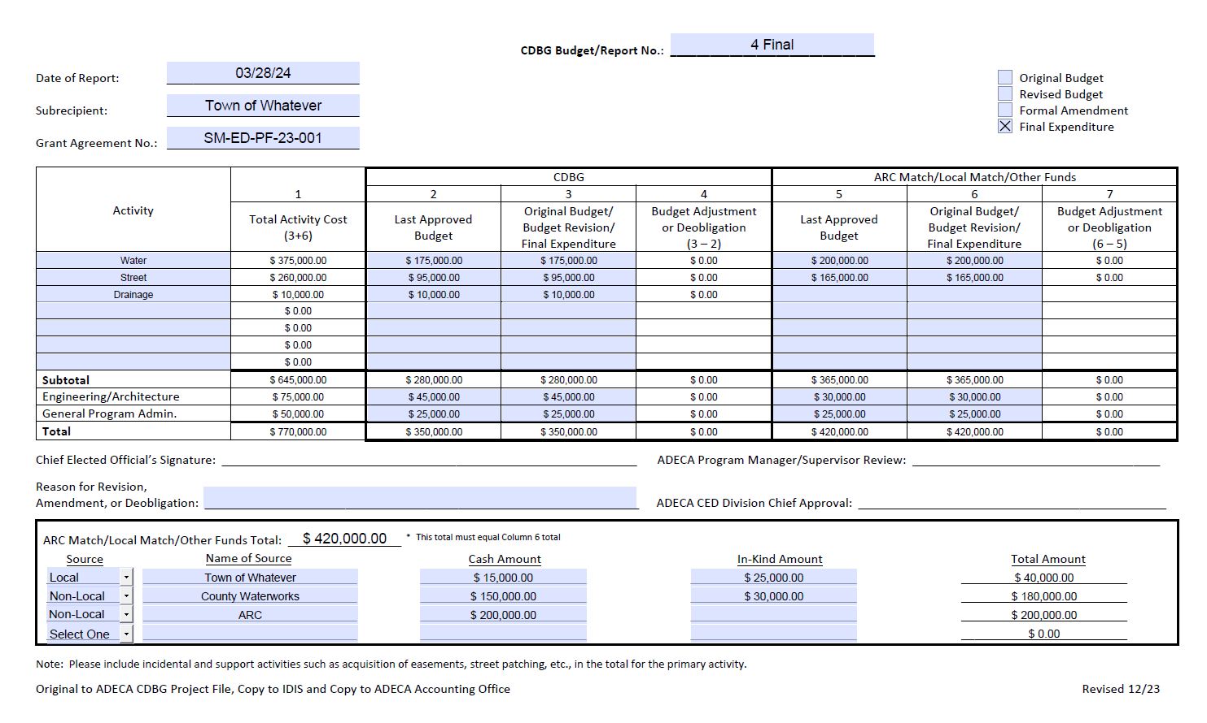

Slide 8
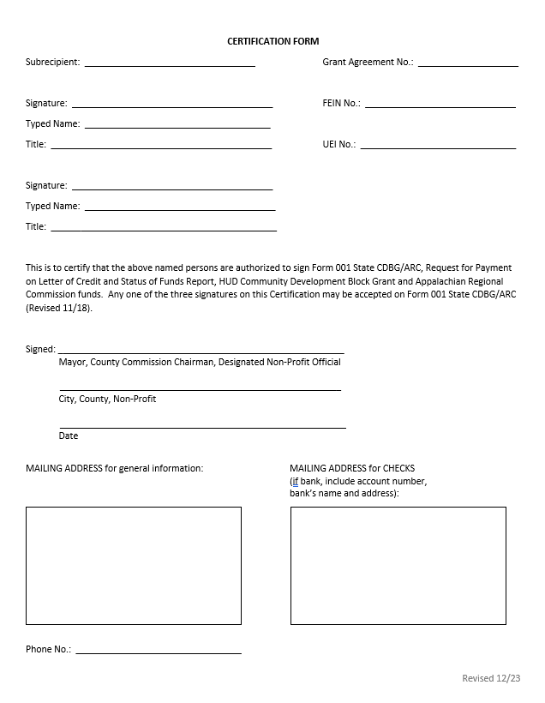
Certification Form revised 12/23
DUNS number removed; replaced by UEI number (Unique Entity Identification Number)
Signatures on certification must match signatures on financial documents
Mailing address for checks must agree to STAARS; could be a PO Box
Update form anytime an official or address changes
Ensure information in STAARS is correct
STAARS hotline: 334-353-9000

Slide 9
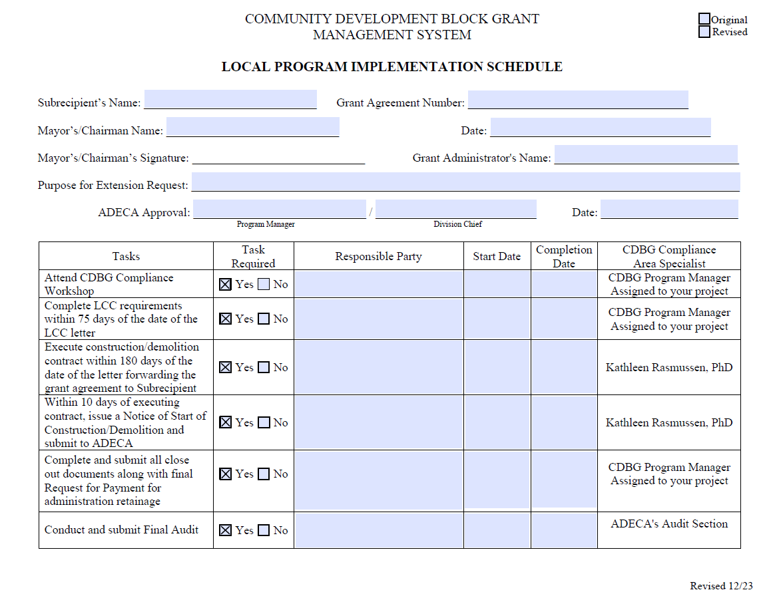

Slide 10
Request for Payment form revised 12/23
Fillable form with protected cells
Detailed match breakdown and project total cost
Signature and “checks payable to” must agree to certification
Budget amounts must agree to the signed budget
Project status narrative should be updated per payment request
Multi-year project must request oldest funds first

Slide 11
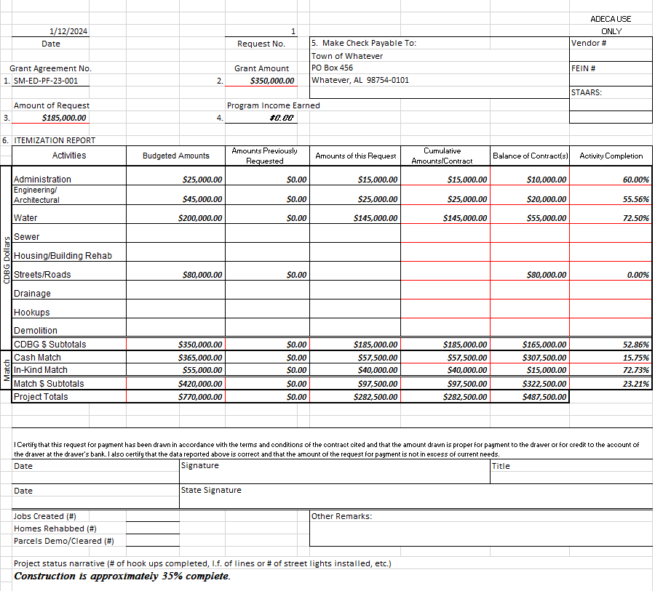
Address on Certification Form
Budgeted amounts come from current budget form
Enter cumulative jobs, rehab, or demo per request for payment
Signature must agree to certification

Slide 12
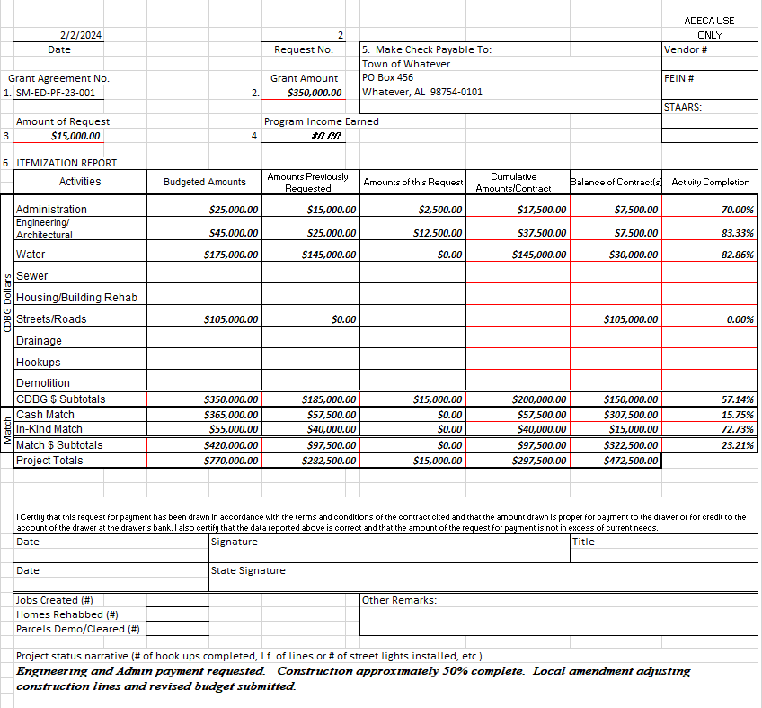
Amounts previously requested must agree to cumulative amounts on previous request for payment
Request #1 from previous slide

Slide 13
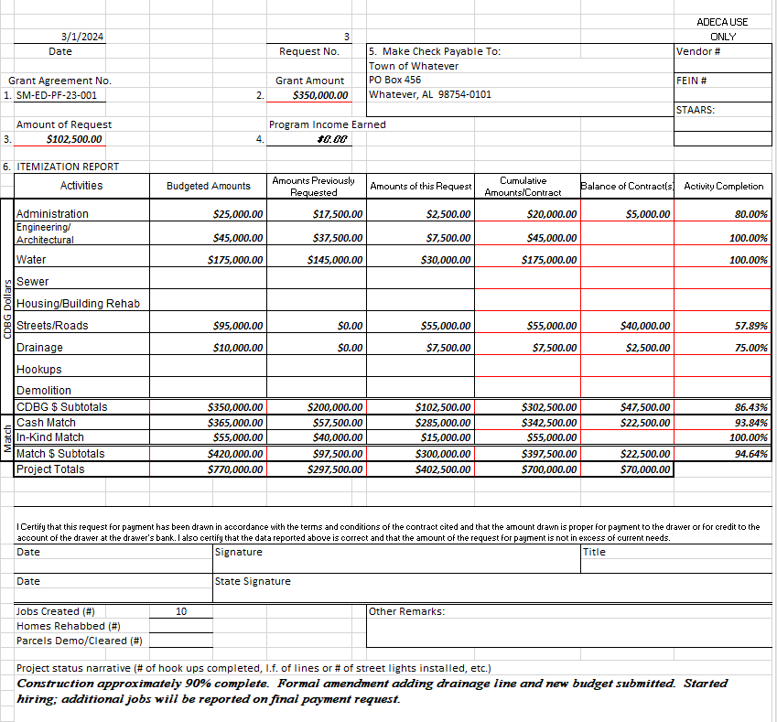
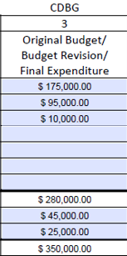
Budgeted Amounts changed to agree to budget #3
Budget #3 from previous slide
Note jobs created

Slide 14
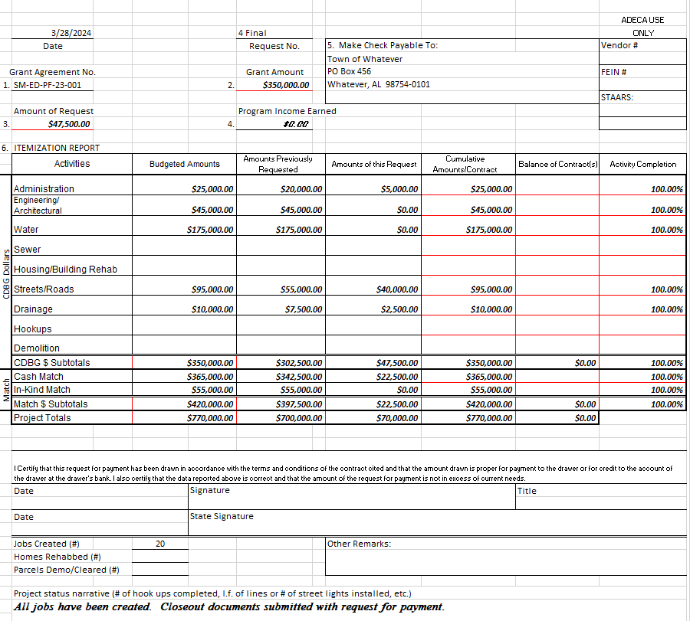
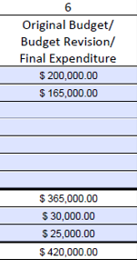
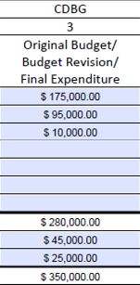
Cumulative amounts/contract will agree to final expenditure report (budget form)
Match from final expenditure report #4 from previous slide
Final expenditure report #4 from previous slide
Jobs created
is cumulative; increased from 10 to 20

Slide 15
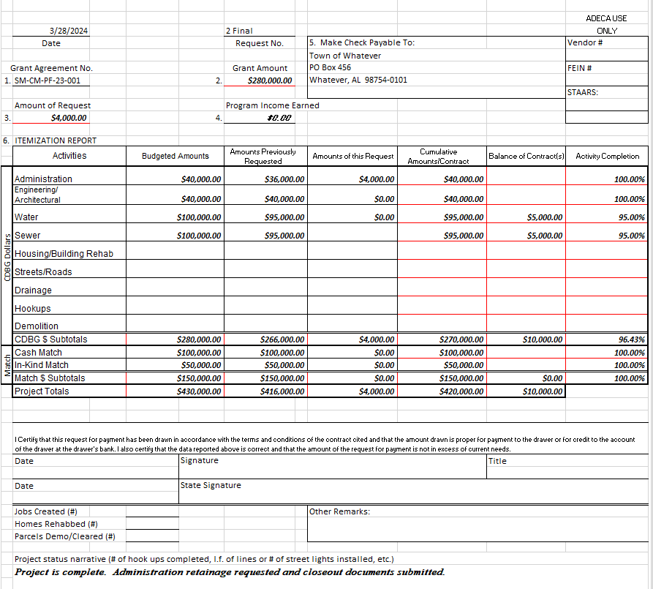
Balance of Contract will be deobligated on final expenditure report

Slide 16
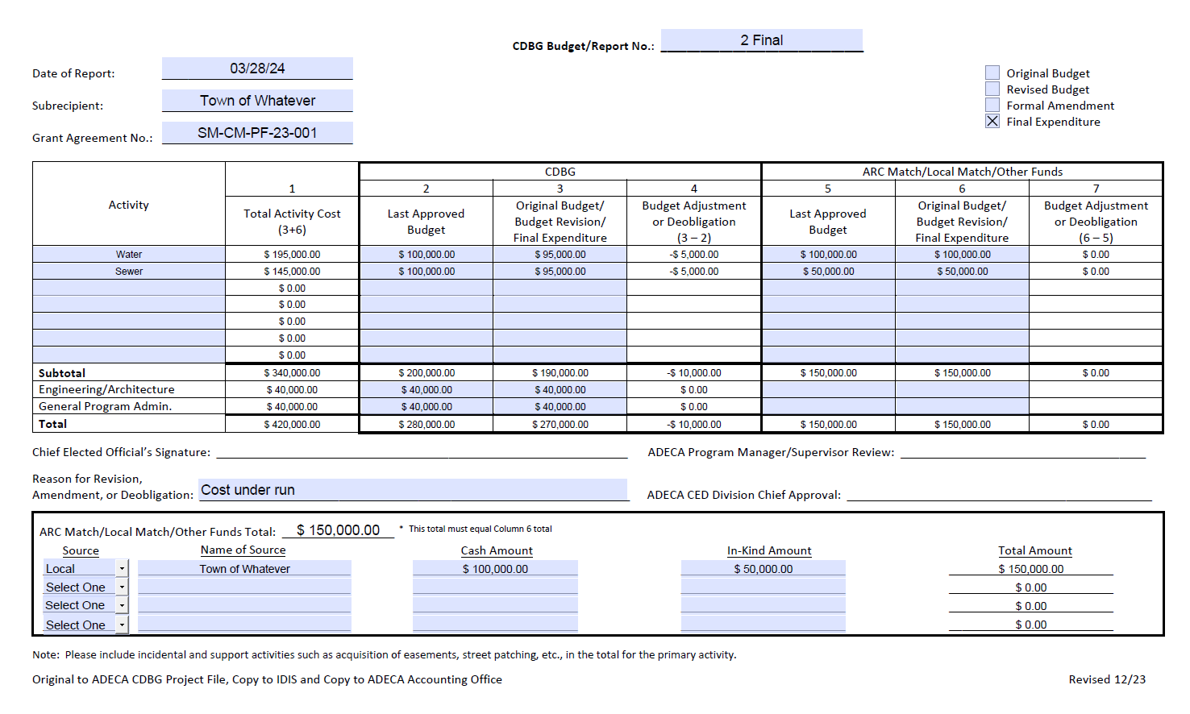

Slide 17
Budget Revisions that Require Amendments
Local Amendments are done when a project’s budget change amounts to less than 10% of the total project costs
Formal Amendments are done when a project’s budget change amounts to 10% or more of the total project costs
The total project costs include both the CDBG and matching funds
Always discuss with ADECA before adding new lines or additional scope changes and follow up with an email
ADECA may request to deobligate grant funds once construction is complete without an amendment

Slide 18
Economic Development Grants
Not competitive
Based on availability of funds
Must discuss with ADECA Director first
Soft commitment has 90-day limit to submit application
Jobs stated in the letter of commitment must be created
Pay funds back if jobs are not created

Slide 19
Other Federal Programs (ARC & DRA)
Appalachian Regional Commission (ARC)
Uses similar request for payment and budget forms
Processed through different federal system (ARCnet & ASAP)
Funds will process separately and no longer be combined into one check with CDBG funds
Delta Regional Authority (DRA)
Only reported as matching funds
ADECA doesn’t process DRA payments

Slide 20
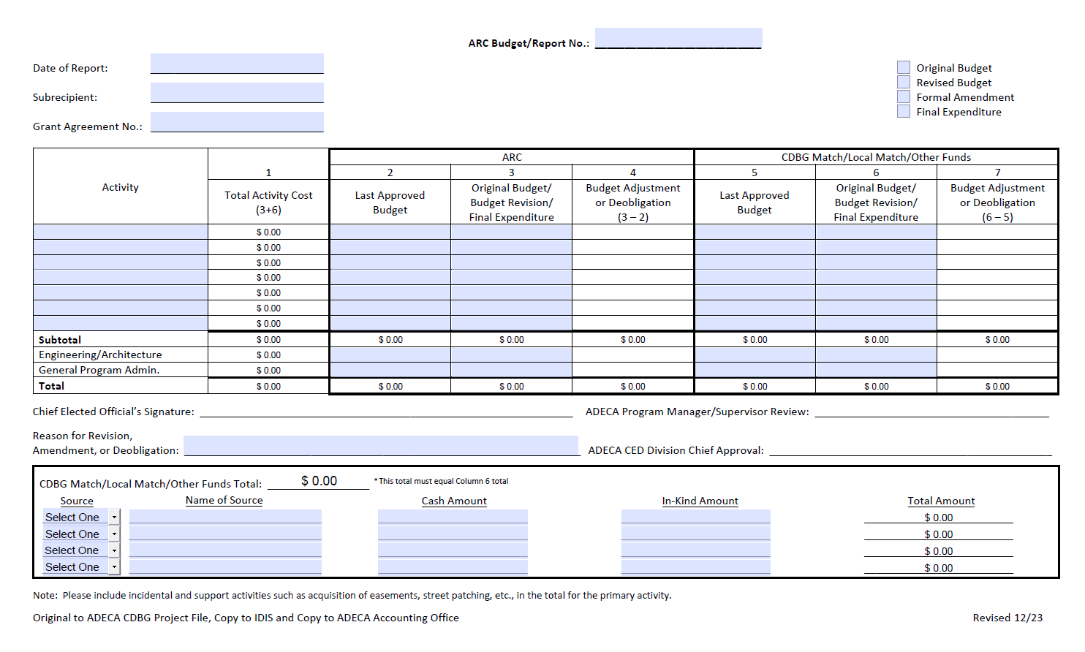

Slide 22
ARC request for payment form revised 12/23
Follows the same format as CDBG
Uses CDBG certification
CDBG Funds are reported as match on ARC request for payment

Slide 23
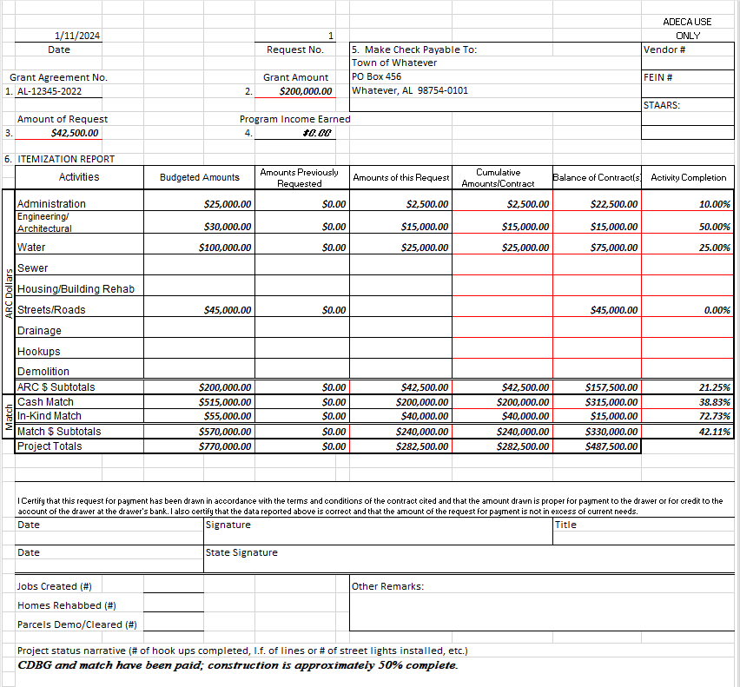

Slide 24
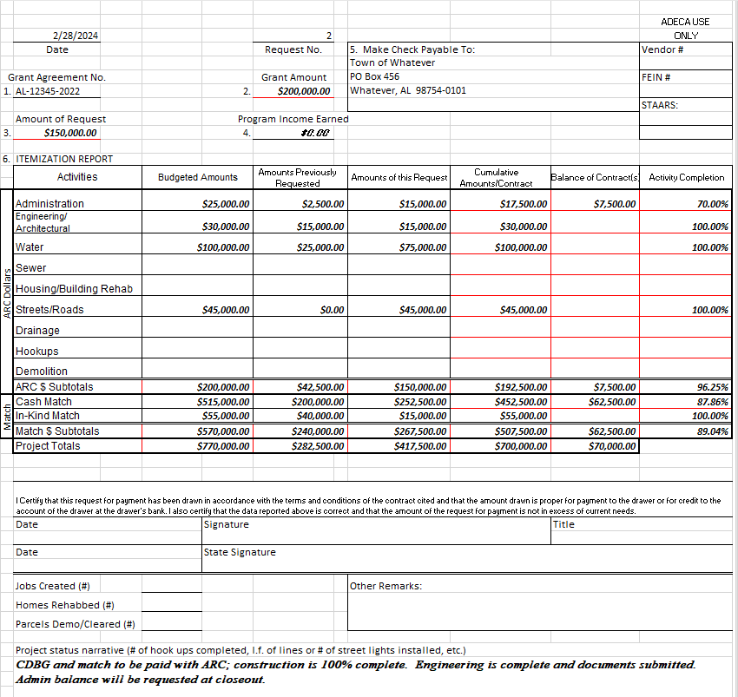

Slide 25
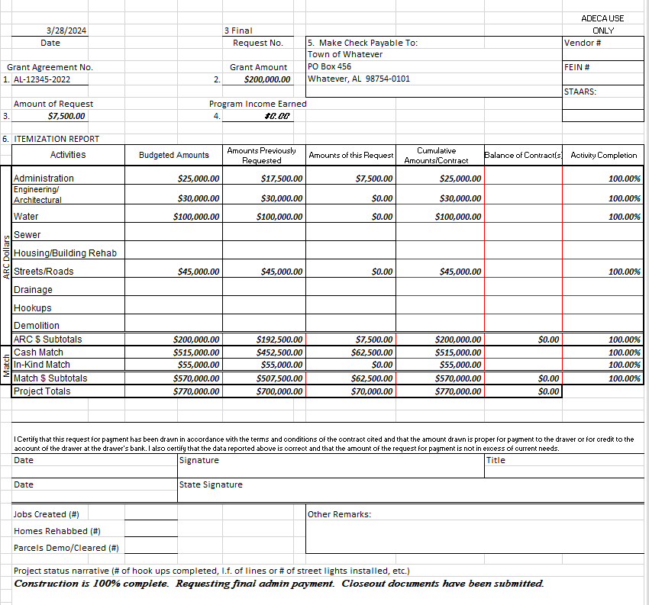

Slide 26
Final Reminders
Requests for payment are processed within 10 days once received in Financial Services
First requests for payment may take longer to process if locality is not setup in STAARS or ADECA’s financial system
ADECA’s payment request cutoff deadline: Alabama Department of Finance shuts down in September for fiscal year-end
CED Division will send out an email notification of the annual August submission deadline for requests for payment to be submitted
Financial Services will process requests for payment up to the date Finance shuts down in September
Finance will start processing requests for payment after October 1st

