Slide 1
Alabama First responders Wireless Commission
Quarterly Meeting
April 4, 2024

Slide 2
History
01

Slide 3
Because the availability of high-speed broadband services in unserved rural Alabama is essential for economic development, education, health care, and emergency services, on March 28, 2018, Governor Kay Ivey signed the Alabama Broadband Accessibility Act establishing the Alabama Broadband Accessibility Fund (ABAF). On May 30, 2019, Governor Ivey signed Act #2019-327, which provided numerous amendments to the original Act. On May 17, 2021, Governor Ivey signed the Connect Alabama Act, which created the Alabama Digital Expansion Authority, the Alabama Digital Expansion Division within ADECA, and the Alabama Digital Expansion Finance Corporation.
April 4, 2024 | 3

Slide 4
Alabama Broadband Accessibility Fund Basics
Funding
Fiscal Year 2019 - $7.4 million
Fiscal Year 2020 - $20 million
Fiscal Year 2021 - $20 million
Fiscal Year 2022 - $20 million
Fiscal Year 2023 - $25 million
Fiscal Year 2024 - Not Funded
April 4, 2024 | 4

Slide 5
Alabama Broadband Accessibility Fund Basics
Accountability Measures
Progressive completion: Measured on not more than a quarterly basis of the approved project. Grants for projects not showing progress may be rescinded by ADECA.
Reimbursement Program: ADECA awards funds to the successful applicants before the project commencement; however, ADECA only disburses funds after the project is completed and proposed service is verified.
Time Requirement: Recipients normally must complete projects within two years of award. Recipients who demonstrate that the project is progressing may request an extension for up to one year for project delays beyond their control.
April 4, 2024 | 5

Slide 6
Funded Projects
02

Slide 7
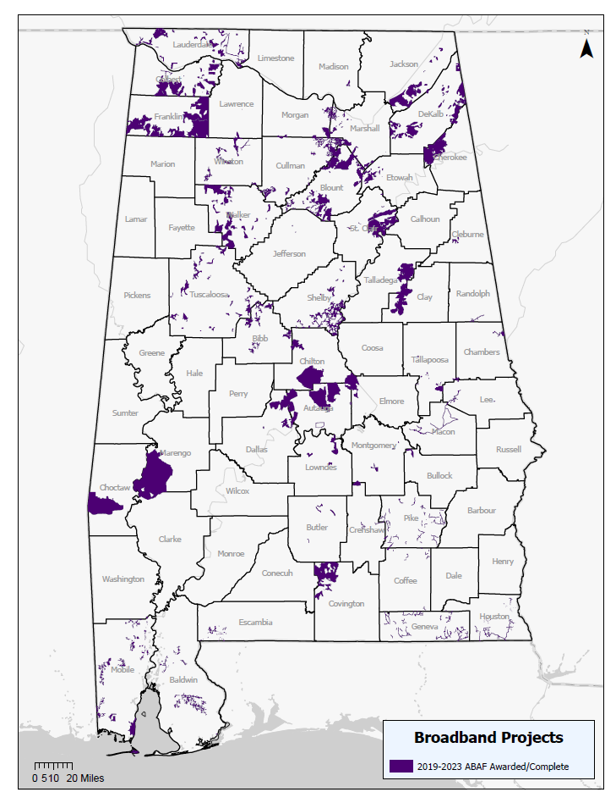
Alabama Broadband Accessibility Fund (ABAF)
Funding
In addition to the middle-mile projects already discussed, ADECA has administered the Alabama Broadband Accessibility Fund awarding 107 projects
Grant Amount: $82,069,667
Match Amount: $193,000,000
Estimated Number of Currently Unserved Households, Businesses, and Community Institutions With New Access to Highspeed Internet: 72,108
April 4, 2024 | 7

Slide 8
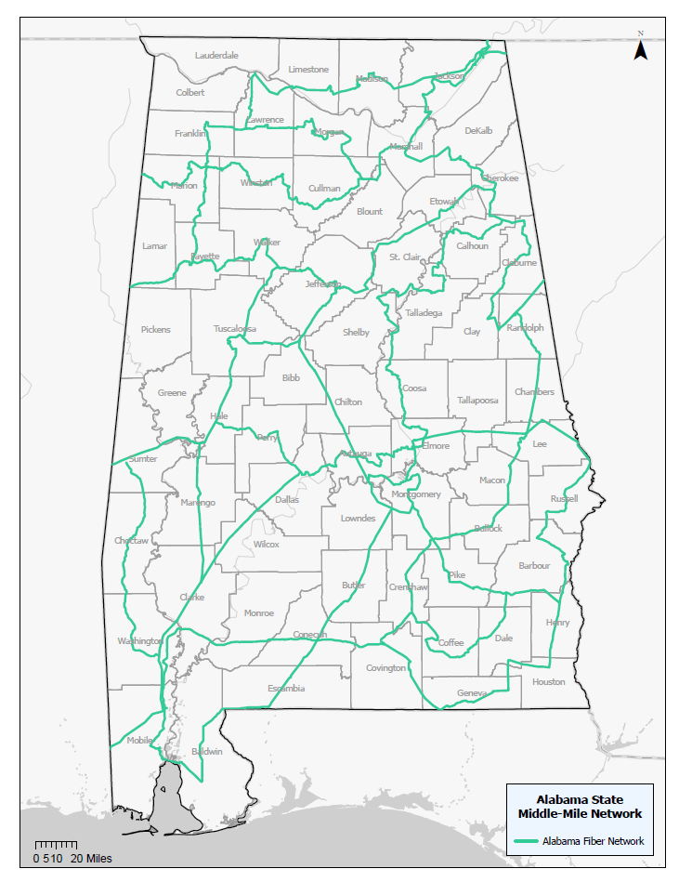
Alabama Statewide Middle-Mile Network (ASMMN) Grant Program
Funding
One project to serve 64 counties
Grant Amount: $82,450,000
Match Amount: $36,673,744
Estimated Route Miles: 3,000
This project is being supported, in whole or in part, by federal award number SLFRP2635 awarded to the State of Alabama by the U.S. Department of the Treasury.
April 4, 2024 | 8

Slide 9
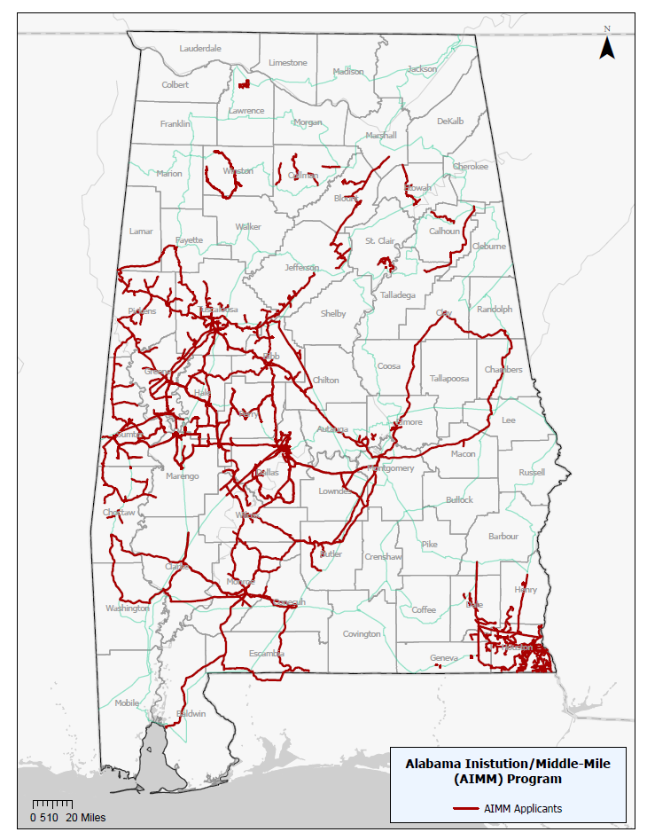
Alabama Anchor Institution/Middle-Mile (AIMM) Grant Program
Funding
21 projects awarded to 12 grantees
Grant Amount: $188,453,905
Match Amount: $58,109,315
Estimated Route Miles: 4,287.06
Estimated Anchor Institutions: 793
This project is being supported, in whole or in part, by federal award number SLFRP2635 awarded to the State of Alabama by the U.S. Department of the Treasury.
April 4, 2024 | 9

Slide 10
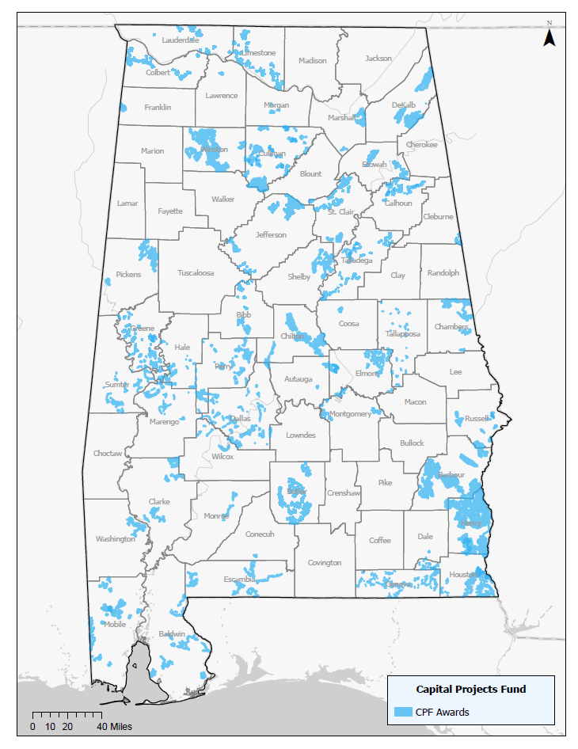
Alabama Capital Projects Fund
Funding
Sixty-six projects serving portions of 48 Counties throughout Alabama
Grant Amount: $148,339,141
Match Amount: $171,631,795
Estimated Route Miles: 5,429
Estimated Number of Currently Unserved Households, Businesses, and Community Institutions With New Access to Highspeed Internet: 53,892
This project is being supported, in whole or in part, by federal award number CPFFN0162 awarded to the State of Alabama by the U.S. Department of the Treasury.
April 4, 2024 | 10

Slide 11
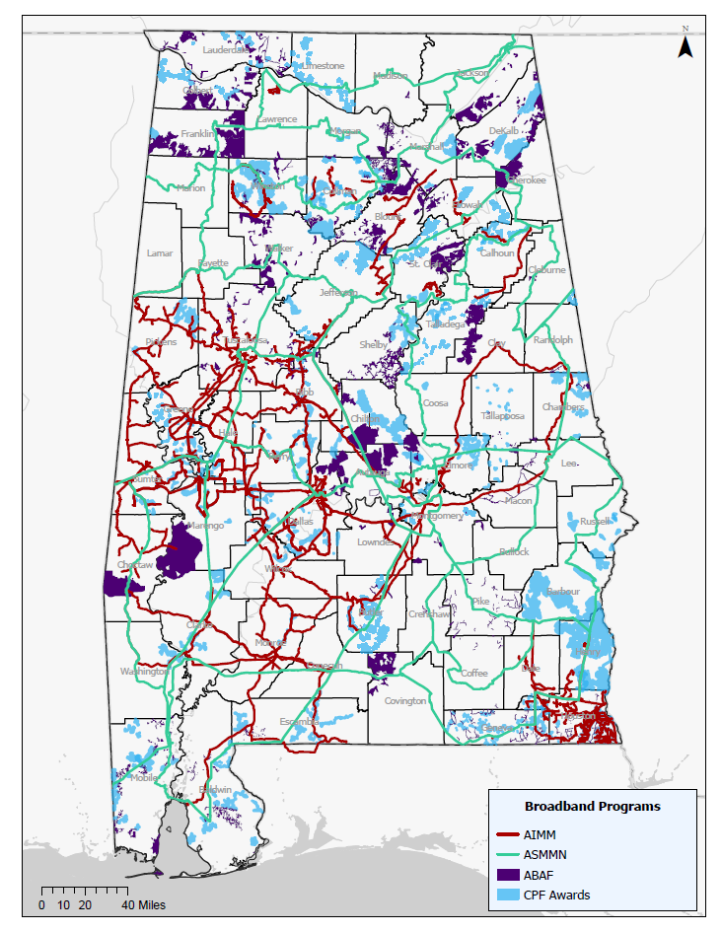
AIMM, ASMMN, ABAF, and CPF
Funding
In total, Alabama has awarded 195 middle-mile and last mile projects
Grant Amount: $501,312,714
Match Amount: $459,414,855
Estimated Number of Currently Unserved Households, Businesses, and Community Institutions With New Access to Highspeed Internet: 126,883
These projects are being supported, in whole or in part, by federal award numbers CPFFN0162 and SLFRP2635 awarded to the State of Alabama by the U.S. Department of the Treasury.
April 4, 2024 | 11

Slide 12
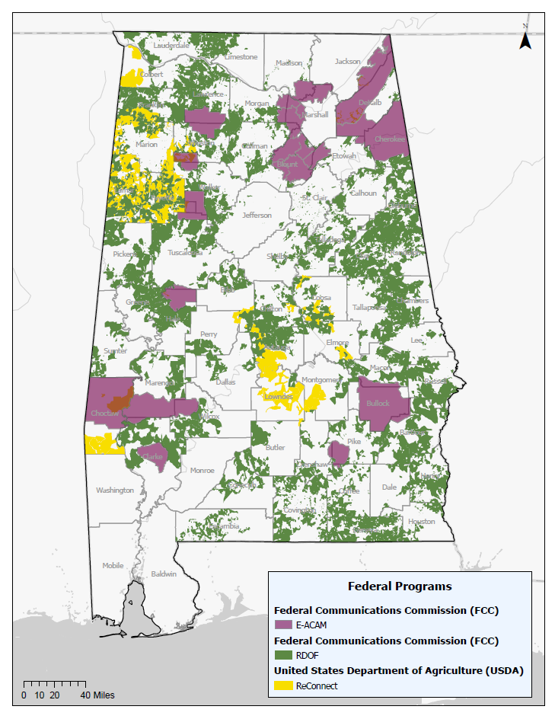
Federal Commitments for Broadband Deployment in Alabama
There are federal programs that have also made “enforceable commitments” for broadband deployment in Alabama. These areas are generally ineligible for other federal funds for broadband deployment.
These funds are administered by the federal entities that awarded them.
Federal Communication Commission (FCC) Rural Digital Opportunity Fund (RDOF) and Enhanced Alternative Connect America Cost Model (E-ACAM) commitments that prevent the use of CPF, or future BEAD funds.
U.S. Department of Agriculture (USDA) ReConnect commitments that prevent the use of CPF, or future BEAD funds.
April 4, 2024 | 12

Slide 13
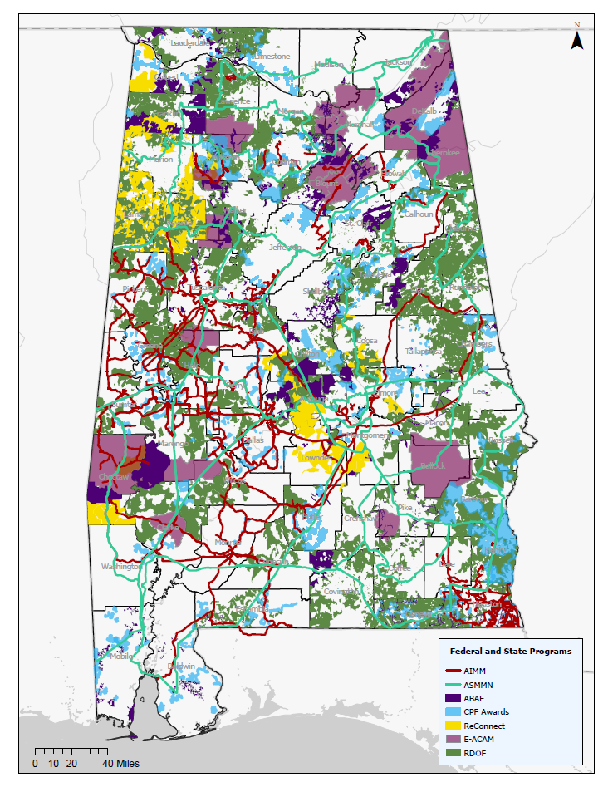
Federal and State Programs awarded broadband deployment projects throughout Alabama
As the map shows, there are many areas throughout Alabama that need connectivity.
We are proud of the work that has been done by our Legislature, under the leadership of Governor Kay Ivey to move the needle from being ranked as 47th in the nation for broadband connectivity to today’s ranking of 24th.
These projects are being supported, in whole or in part, by federal award numbers CPFFN0162 and SLFRP2635 awarded to the State of Alabama by the U.S. Department of the Treasury.
April 4, 2024 | 13

Slide 14
Completed Projects
03

Slide 15
Completed Projects
For all projects funded, we estimate total projects costs of approximately $251,972,402.12 with approximately $82,069,667.33 of that coming from ABAF grants. If completed, these projects represent connectivity availability for approximately 72,108 previously unserved addresses at an average grant cost per passing of $1,138.15.
For completed projects, $19,503,299.45 in ABAF grant funds have been expended. These completed projects represent connectivity options for approximately 27,475 previously unserved addresses at an average grant cost per passing of $709.86
The projected numbers and the actual numbers represent some differences. The final number of new services was lower than projected. Similarly, the total grant funds were approximately 25% less than projected and the grant cost per new service was approximately 6% lower than projected.
April 4, 2024 | 15

Slide 16
Completed Projects
Budget and Expenditures
Budgeted Funds | Awarded Funds | Expended Funds | Balance to Award | Balance to Expend
$92,400,000.00 | $82,069,667.33* | $19,503,299.45 | $2,310,000.00** | $72,896,700.55
*This does not include pending projects
**This balance is primarily for administration
April 4, 2024 | 16

Slide 17
Mapping and Resources
04

Slide 18
Alabama Broadband Map
2023 Update
ADECA has been working with ISPs, vendors, and contractors to update the Alabama Broadband Map. Additional data sources have been purchased to help with the map accuracy. Additionally, we have updated our list of ISPs to reach as many providers as we can. We worked with approximately 70 providers to update the map with our most accurate version yet at the end of 2023. We are preparing to begin our next update in the very near future. We have used the map to provide data for project development, to ensure we are not spending state funds in areas that already meet the definition of served, and to challenge the new Federal Communications Commission National Broadband Map. Our map can now be found on the new Be Linked Alabama website at: https://broadband.alabama.gov/broadband-maps/.
April 4, 2024 | 18

Slide 19
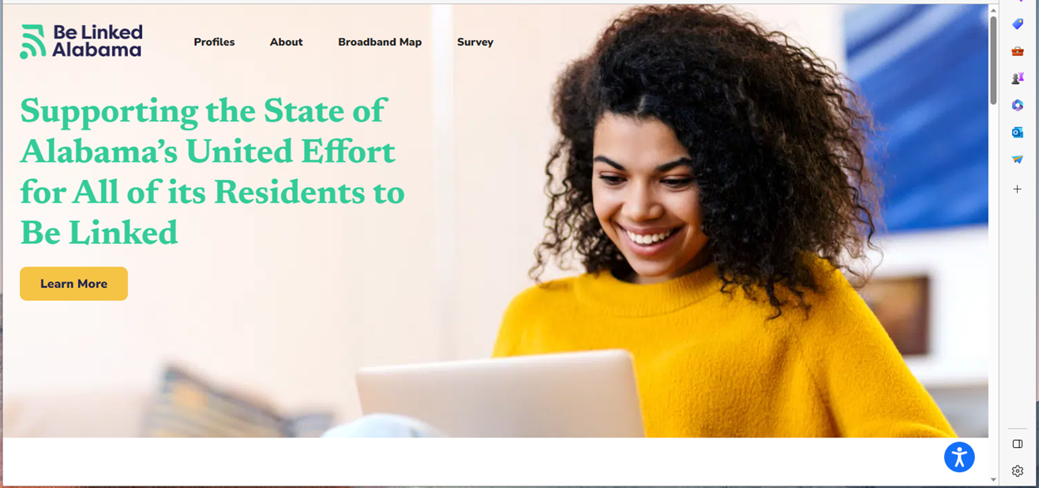
Alabama Broadband Map
Map’s New Location
April 4, 2024 | 19

Slide 20
Be Linked Alabama
Community Profiles - ADECA Broadband (alabama.gov)
April 4, 2024 | 20

Slide 21
What’s Next
05

Slide 22
What’s Next?
Programs Status
AIMM Round 2
Applications due April 10th
CPF Round 2
LOIs due April 11th and applications due May 2nd
Digital Opportunity Plan Approval
Our Alabama Statewide Digital Opportunity Plan has been Approved and is now available on our website
We have been notified that our year-1 allocation is just over $13 million for the Digital Equity Capacity Grant program
April 4, 2024 | 22

Slide 23
What’s Next?
Program Status
BEAD Initial Proposal Volume 1 Approval
We have received approval for our IPV1
This is the proposal that spells out our challenge process
The approved version is available on our website
Once NTIA issues guidance on how we are to fund the challenge process, we will move forward
BEAD Initial Proposal Funding Request
The funding request is still in the curing phase
We have responded to NTIA’s questions and now are awaiting guidance on some of our questions in order to move forward
BEAD Initial Proposal Volume 2
The grantee selection process is still in curing phase
Low-cost option
April 4, 2024 | 23

