Slide 1
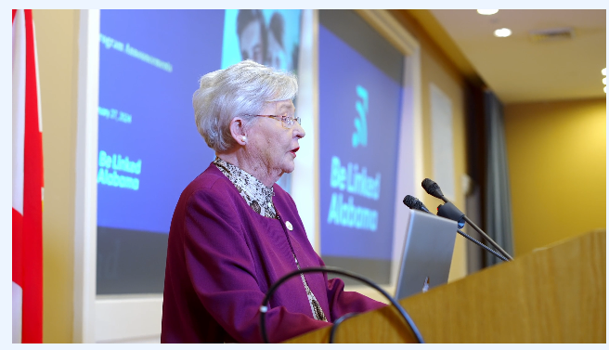
Capital Projects Fund – Phase 2
Application Workshop
March 28, 2024

Slide 2
General Information
Applicants must use the Alabama Capital Projects Fund – Phase 2 Application form, complete it in its entirety, and label attachments as instructed. The application must include all supporting documentation at the time of submission. Failure to comply with these requirements may result in a loss of points or the rejection of the application.
Applicants should not include confidential information in their applications. Applications are subject to public records requests in accordance with the Alabama Open Records Law and other applicable laws.
Applicants should review the Alabama Capital Projects Fund – Phase 2 Application Guide, Alabama Capital Projects Fund – Phase 2 Program Guide, Alabama Capital Projects Fund – Phase 2 Frequently Asked Questions, Alabama Capital Projects Fund – Phase 2 Rating Criteria, and Treasury’s federal Capital Projects Fund guidance for more information and relevant definitions for completing this application.
Capital Projects Fund - Phase 2 | 2

Slide 3
Letter of Intent
Before applying, CPF 2 applicants must submit a letter of intent to submit an application no later than 5:00 p.m. (Central) on April 11, 2024. The letter of intent will include the applicant’s contact information and the proposed project area in a shapefile format. The applicant’s shapefile must use a polygon format to represent the proposed project area. Other formats such as lines or points will not be accepted. The applicant must also ensure that the polygon format covers the rooftop locations of all locations in the proposed project area. Letters of intent must be submitted to ADECA by email to broadband.fund@adeca.alabama.gov.
Letters of intent will be posted on ADECA’s website and publicly available to promote coordination between CPF 2 applicants and with existing internet service providers regarding potentially overlapping service areas. A sample letter of intent as well as an internet service provider contact and communication form template can be found in Appendix A of the Alabama Capital Projects Fund – Phase 2 Application Guide.
Capital Projects Fund – Phase 2 | 3

Slide 4
Letter of Intent
Service providers are strongly encouraged to contact CPF 2 applicants regarding their letters of intent within 10 days of the posting of the letters on the ADECA website to ensure compliance with the grant program deadline. Minor changes to the project area between the time the letter of intent is submitted and the final application is submitted are allowed; however, applicants are instructed to clearly identify any changes in the final application map and narrative. An applicant may reduce the project area that was referenced in the letter of intent but may not increase the size. However, ADECA may request that the applicant revise the proposed project service area to include additional unserved locations reflected in the Alabama Broadband Map.
Capital Projects Fund – Phase 2 | 4

Slide 5
Application Submission
ADECA will accept CPF 2 applications beginning on April 11, 2024, and applications must be submitted no later than 5:00 p.m. (Central) on May 2, 2024. Any application received by ADECA after the deadline will not be considered. Applications and all supporting documentation must be submitted in PDF format to ADECA by email to broadband.fund@adeca.alabama.gov.
Capital Projects Fund – Phase 2 | 5

Slide 6
Application
Applicant Information: This section is informational. No points are associated with this section.
Please include the name of the county or counties and city (if applicable) where the project is located in the project title.
Note: Each CPF 2 applicant must obtain a Unique Entity Identifier (UEI) from the federal System for Award Management (SAM) and provide its UEI to ADECA as part of this application. No entity may receive a CPF 2 subaward from ADECA until the entity has provided its UEI to ADECA.
Each successful CPF 2 applicant will be required to complete and submit the Beason-Hammon Alabama Taxpayer and Citizen Protection Act Certification, a complete copy of its E-Verify Memorandum of Understanding, the State of Alabama Disclosure Statement, the Signatory Authority Form, and other documentation and certifications required by federal and state law.
Additionally, each successful CPF 2 applicant must register in the Alabama Buys eProcurement Portal, be eligible for federal grants, and obtain and maintain an active registration in SAM. The Taxpayer ID number, entity name, and entity address must match across all documents and with the information in Alabama Buys.
Capital Projects Fund – Phase 2 | 6

Slide 7
Application
Project Description: This section is worth up to 35 points. Twenty-five of those points will be awarded based on answers to the questions in this section. Bonus points are available based on existing connection to the internet at an average speed per customer of less than 25/3 Mbps.
Please complete the following table for the proposed project to include Number of Households to be Served,
Number of Businesses to be Served, and Number of Community Anchors to be Served
Applicants are strongly encouraged to conduct a field review to determine whether an area is served or may become served. If an area is identified as unserved at the time of the application but becomes served prior to the execution of a CPF 2 subaward agreement for the project, the project may not be eligible for funding.
Capital Projects Fund – Phase 2 | 7

Slide 8
Application
Application Budget: This section is informational. No points are associated with this section.
Technical Assistance: This section is worth up to 10 points. These points are available to previously unsuccessful Alabama Broadband Accessibility Fund (ABAF) and CPF 1 applicants that received technical assistance from ADECA regarding their prior ABAF or CPF 1 application.
Other Program Priorities: This section is worth up to 100 points. Each question is worth up to 10 points.
CPF Risk Assessment Questionnaire: This section is informational. No points are associated with this section.
Applicant Certifications and Assurances: This section is informational. No points are associated with this section.
Capital Projects Fund – Phase 2 | 8

