Slide 1

ALABAMA COMMUNITY BROADBAND TECHNICAL ASSISTANCE PROGRAM
FEBRUARY-MAY 2023

Slide 2
AGENDA
Broadband Technology Overview
Alabama Community Broadband Technical Assistance Program Overview
Funding and Programmatic Opportunities

Slide 3
DEFINITIONS AND CONCEPTS: BITS AND BYTES
These two are frequently confused but are distinct—both are measures of digital information, but one refers to speed and the other refers to amount of data
BITS PER SECOND
(SOMETIMES SHORTENED TO "BITS")
A “BYTE”
IS EQUAL TO 8 BITS
Used to describe a measure of speed—how fast data travel across a network (“bandwidth”)
The number of bits per second tells us how fast the communication is moving on the network
  In a roads analogy, “bits per second” are analogous to a car’s miles per hour
  Megabit = 1,000,000 bits
  Gigabit = 1,000 megabits
“My internet speed is really fast — it’s up to a gigabit per second.”
Used to describe the amount of data stored (memory capacity)
The number of bytes tells us how much information is involved
  In a roads analogy, “bytes” is analogous to the number of cars on the road
  Megabyte = 1,000,000 bytes
  Gigabyte = 1,000 megabytes
“My data plan with T-Mobile lets me send or receive a total of five gigabytes a month.”

Slide 4
HOW MUCH BANDWIDTH DO WE NEED?
Today we need more bandwidth than minimum 25/3 Mbps broadband speeds defined by FCC
Typical peak use for family of four
With augmented reality, other anticipated applications, and increased usage we will soon need much higher speeds

Slide 5
FEDERAL AND ALABAMA BROADBAND SPEED TARGETS
The FCC’s definition is 25 megabits per second
down and 3 megabits per second up (25/3 Mbps)
Congress set a new 100/20 Mbps standard in the American Rescue Plan Act and Infrastructure Investment & Jobs Act
Alabama set 100/20 as its definition of broadband and a 100/100 Mbps standard for future infrastructure funded by the State

Slide 6
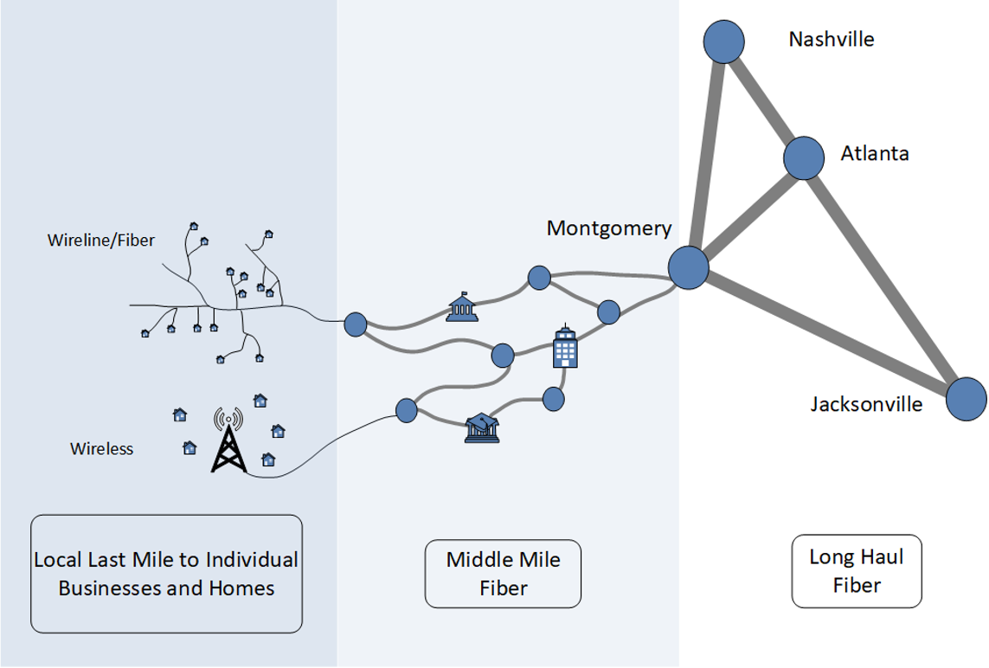
THE ELEMENTS
OF A BROADBAND NETWORK
Nashville
Long haul fiber
Middle mile fiber
Last mile
(wireline or wireless)
Atlanta
Wireline/
Fiber
Birmingham
Jacksonville
Wireless
Local Last Mile
to Homes and Businesses
Middle-Mile Fiber
Long Haul Fiber

Slide 7
TYPES OF BROADBAND INFRASTRUCTURE
Fiber-to-the-premises
Hybrid fiber-coaxial (cable)
Digital Subscriber Line (DSL)
frequently not at broadband speeds
Fixed wireless
sometimes not at broadband speeds
Mobile wireless
(4G and 5G)
Notes:
Satellite is another emerging option. High orbit links have too much latency (data transfer delay) to qualify for broadband speeds. Low orbit satellites can reach 100/20 speeds, but actual speeds depend on how many factors, including number of satellites, earth terminal stations, and subscribers.

Slide 8
TYPICAL SPEEDS: WIRELINE AND WIRELESS TECHNOLOGIES
Wireline
Fiber-to-the-Premises
Cable Modem DOCSIS 1 to 3.1
DOCSIS 4.0 / NG
DSL
Dial-up
50
100
500
1
5
10
50
100
200
500
1
10
100
kbps
Mbps
Gbps
Wireless
4G Fixed Wireless
5G Fixed Wireless
In most markets
mmWave Fixed Wireless
LEO Satellite (e.g., SpaceX)
In select markets
GEO Satellite
Developmental/early stage
4G Mobile
5G Mobile

Slide 9
HOW DID WE GET HERE?
Broadband has developed through the evolution of technology & industry investment
~1995: Dial-up
Telephone companies connect homes & businesses to the internet over copper telephone lines, at “narrowband,” slow speeds
~1999: DSL
Telephone companies use new technology to offer faster internet over copper wires -- but still with speed & capacity limitations
~2005: Fiber-to-the-premises
Very high speeds to end users, but only in select areas where companies – or the public sector -- invest
~1999: Cable modem
Cable companies use their last-mile video networks to connect customers to the internet, faster
54 Kbps
1 Mbps
1 Gbps

Slide 10
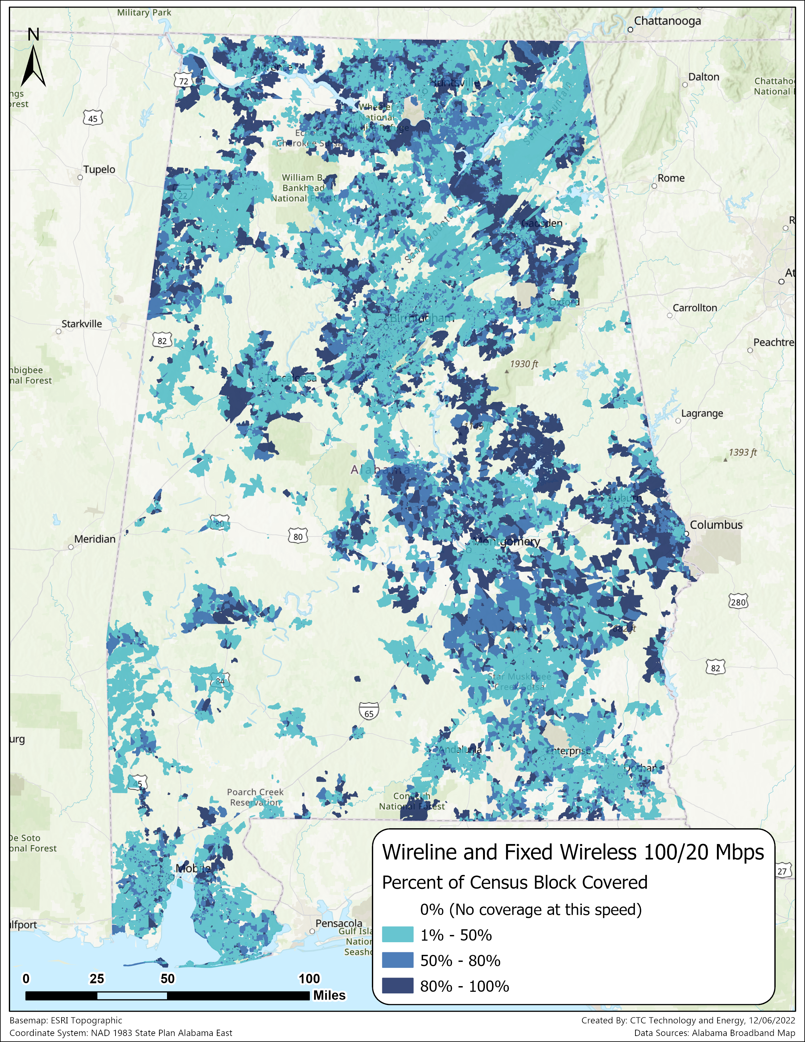
STATE BROADBAND MAP
ADECA invested in building a more accurate statewide broadband map
The map illustrates coverage areas for various speeds, ISPs, and technologies
Percentages refer to the portion of households covered within a census block
Map version 2.0 has been released
https://broadband.alabama.gov/broadband-maps/
https://broadband.alabama.gov/broadband-maps/
Notes:
Alabama map will align with upcoming FCC revisions to nationwide broadband map

Slide 11
WHAT IS “DIGITAL OPPORTUNITY AND EQUITY”?
Generally, experts have identified five elements of digital opportunity and equity:
Broadband Access:
Accessible and Inclusive Content:
Devices and Tech Support:
Privacy and Security:
Affordable, accessible, and reliable high-speed home internet service is available for all individuals
Public online content is inclusive and accessible by all individuals
Individuals have access to a computer or tablet and technical support
Individuals can protect their data privacy and online security
Digital Literacy and Skills:
Individuals have digital skills to support their ability to meaningfully use the internet in their daily lives

Slide 12
ALABAMA COMMUNITY BROADBAND
TECHNICAL ASSISTANCE PROGRAM
Program overview

Slide 13
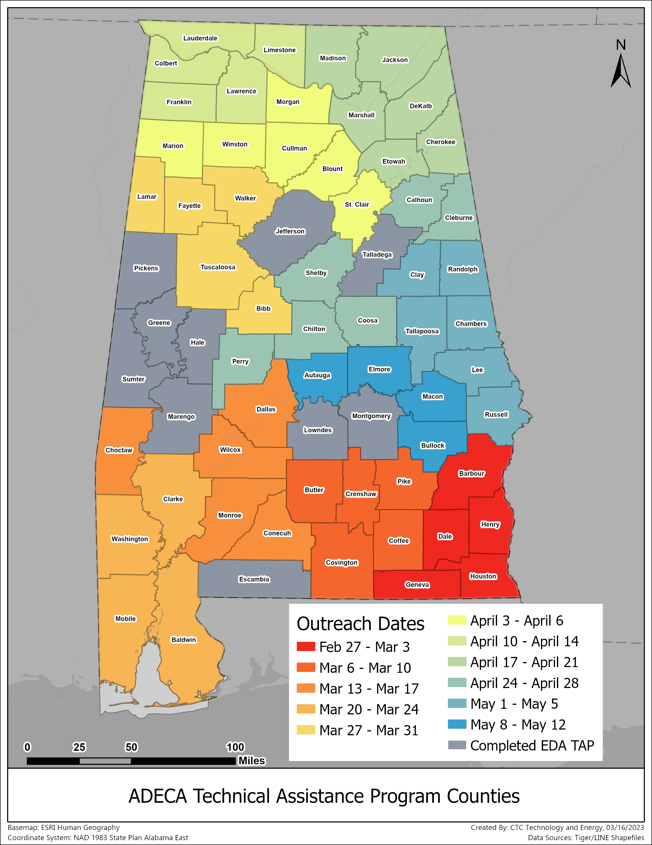
ALABAMA COMMUNITY BROADBAND TECHNICAL ASSISTANCE PROGRAM
The program helps communities:
  Conduct broadband planning to help prevent, prepare for, and respond to impacts of the pandemic
  Meet goals of the Alabama Connectivity Plan to improve broadband availability
  Understand broadband needs of residents, businesses, workers, and students in the county and develop plans for adequate broadband service
  Develop the capacity needed to support telehealth and business and employment opportunities
  Improve broadband adoption in communities of greatest need

Slide 14
TECHNICAL ASSISTANCE PROGRAM SERVICES
Advise on grant applications and public-private partnerships
Advise on digital opportunity and equity
Prepare County Broadband Profile
Strategize with community leaders
Assess the county's current broadband infrastructure and market
Evaluate current and future demand for broadband
Prepare a high-level design & cost estimate for deployment
Initial
engagement
Identify and engage key partners and identify assets
ENGAGEMENT
COLLABORATION
STRATEGY

Slide 15
FUNDING AND PROGRAMMATIC OPPORTUNITIES
Funding overview and timeline

Slide 16
FUNDING OPPORTUNITIES
Counties will benefit from these programs
Funding Source | Programs | Applicants | Relevance to Counties
Existing Federal | Rural Digital Opportunity Fund (RDOF) ReConnect | Alabama internet service providers (ISP) can apply for broadband-related projects | Programs fund network expansions to help close gaps in coverage. See map for RDOF and ReConnect awards in your county
New Federal | ARPA Fiscal Recovery Capital Projects Fund (CPF) Broadband Equity, Access & Deployment (BEAD) Digital capacity and competitive grants | State will administer subgrants to ISPs for broadband infrastructure and program providers for digital equity and opportunity | County profiles aid county planning and ADECA in grantmaking to ISPs for middle-mile and last-mile broadband deployment to unserved households
State | Alabama Broadband Accessibility Fund (ABAF) | Alabama ISPs can apply for broadband-related projects | Programs fund network expansions to help close gaps in coverage.
Notes:
ABAF
https://adeca.alabama.gov/wp-content/uploads/2023-ABAF-Program-Guide.docx
https://adeca.alabama.gov/wp-content/uploads/2022-Alabama-Broadband-Accessibility-Fund-FAQ.docx
– grant awards may not exceed the lesser of 80 percent of the project cost or $5 million
RDOF
https://www.fcc.gov/auction/904
ReConnect
Round 4, USDA announced in August 2022 budget $1.15 billion, grant window closed 11/2/22.
USDA announced $1.6 billion from the third round of ReConnect funding earlier in 2022.
Funding from October 2022 - $24,781,800 to Hayneville Telephone Company - This Rural Development investment will be used to deploy a fiber-to-the-premises network to connect 4,646 people, 154 farms, 96 businesses and three public schools to high-speed internet in Lowndes County, Alabama. Hayneville Telephone Company Inc. will make highspeed internet affordable by participating in the FCC's Affordable Connectivity and Lifeline programs. This project will serve socially vulnerable communities in Lowndes County.
Distance Learning and Telemedicine - https://www.rd.usda.gov/programs-services/telecommunications-programs/distance-learning-telemedicine-grants

Slide 17
BROADBAND, EQUITY, ACCESS, & DEPLOYMENT (BEAD)
National Telecommunications Information Administration grant program
Funding helps states connect unserved addresses, then underserved addresses, then ensure community anchors institutions can get gigabit internet connection.
Prioritizes fiber direct to end user for deployment of last-mile infrastructure, requires funded projects to offer low-cost options to eligible subscribers.
At least $100M to state plus allocation based on number of unserved addresses per FCC maps. States have challenged FCC maps with additional data.
State must submit broadband Five-Year Action Plan, Initial Proposal for deployment projects (20% funding upon NTIA approval), and Final Proposal to complete deployment (remaining allocation upon approval)

Slide 18
DIGITAL EQUITY FUNDING PRIORITIES AND TIMELINE
Alabama will develop a statewide plan for advancing digital equity, including for how to utilize upcoming federal funds
Program areas
Broadband Access: Individuals have more affordable, accessible, and reliable high-speed home internet service
Devices and Tech Support: Individuals have access to a computer or tablet and technical support
Digital Literacy and Skills: Individuals have digital skills to support their ability to meaningfully use the internet in their daily lives
Accessible and Inclusive Content: Public online content is inclusive and accessible by all individuals
Privacy and Security: Individuals can protect their data privacy and online security
Covered populations
Rural residents
Low-income individuals
Veterans
Seniors
Individuals with disabilities
English learners
Racial and ethnic minorities
Incarcerated individuals
Notes:
DTI will develop a statewide plan for expanding broadband to all Delaware addresses including through upcoming federal funds of at least $100 million
Priority 4 reflects Delaware’s priorities. Other state priorities may differ.

Slide 19
BROADBAND PROGRAM TIMELINE
2022
Q4
2023
Q1-2
2023
Q3-4
2024
Q1-2
2024
Q3-4
2025+
1
Technical Assistance Program
County Profiles
2
State Broadband Infrastructure
Plan & Program
5-Year Action Plan
Final Proposal
for Broadband Deployment
Oversight
Initial Proposal
State Digital Equity / Opportunity Plan
Digital Equity / Opportunity Strategic Plan
3
State Digital
Capacity Program
Digital Capacity Grants
Oversight
4

Slide 20
CONSIDERING AFFORDABILITY IN PROJECT DEVELOPMENT
ADECA places high priority on ISPs that document community engagement
Strong consideration is given to community input, adoption programs, and affordability
Activities supporting affordable options and digital adoption have significant scoring priority
Communities are encouraged to work with ISPs to develop projects that consider long term affordability and other adoption priorities
Strong consideration is given to workforce initiatives

Slide 21
LEVERAGING THE AFFORDABLE CONNECTIVITY PROGRAM
FCC subsidy program provides benefits for eligible households
  Up to $30/month internet service discount
  Up to $75/month internet service discount on qualifying Tribal lands
  One-time discount up to $100 for a device
  Some low-cost service plans can be entirely subsidized
Household income and federal assistance programs determine eligibility
  Apply for ACP: https://www.affordableconnectivity.gov
  ACP Enrollment Support: (877) 384-2575
Community partners can help increase enrollment by providing enrollment support
Notes:
Estimated __ percent of eligible households yet to enroll in _______ County
Instructions also in Spanish: https://www.affordableconnectivity.gov/help/tools/#instructions
Criteria:
Household income ≤%200 of federal poverty level
SNAP, Medicaid, WIC, supplemental security income, public assistance income, Pell grant recipiency, etc.
Various tribal support programs
Lifeline eligibility

Slide 22
SUBMITTING AN FCC CHALLENGE
Upcoming funding allocations will be determined by FCC's new map
  Map contains errors which can be remedied via a challenge process
Types of information to challenge
  Address fabric data (building locations and unit counts)
  Reported service coverage
Ways to challenge
  Challenge an individual address*
  Challenge bulk addresses** (requires individual address input)
What can my county do?
  Educate partners and residents
  Support coordination of bulk challenges
* https://help.bdc.fcc.gov/hc/en-us/articles/10475216120475-How-to-Submit-a-Location-Challenge-
** https://www.fcc.gov/news-events/events/2022/09/broadband-serviceable-location-fabric-bulk-challenge-process-webinar
Notes:
There is an FCC portal that captures individual stories; share during meetings and encourage this. It shows impact beyond the statistics.

Slide 23
STATEWIDE RESIDENT BROADBAND SURVEY
Alabama is conducting a statewide resident phone survey to assess digital connectivity participation
The survey data, along with partner interviews, will support the development of measurable objectives in the following areas:
  Broadband access and adoption
  Devices and technical support
  Digital skills and literacy
  Privacy and cyber security
Notes:
Statistically valid survey
Measures include:
Estimates of Broadband Adoption
Reasons for not adopting broadband
Frequency of Internet Use
Availability of a home computer
Levels of confidence in digital skills
Types of internet activity

Slide 24
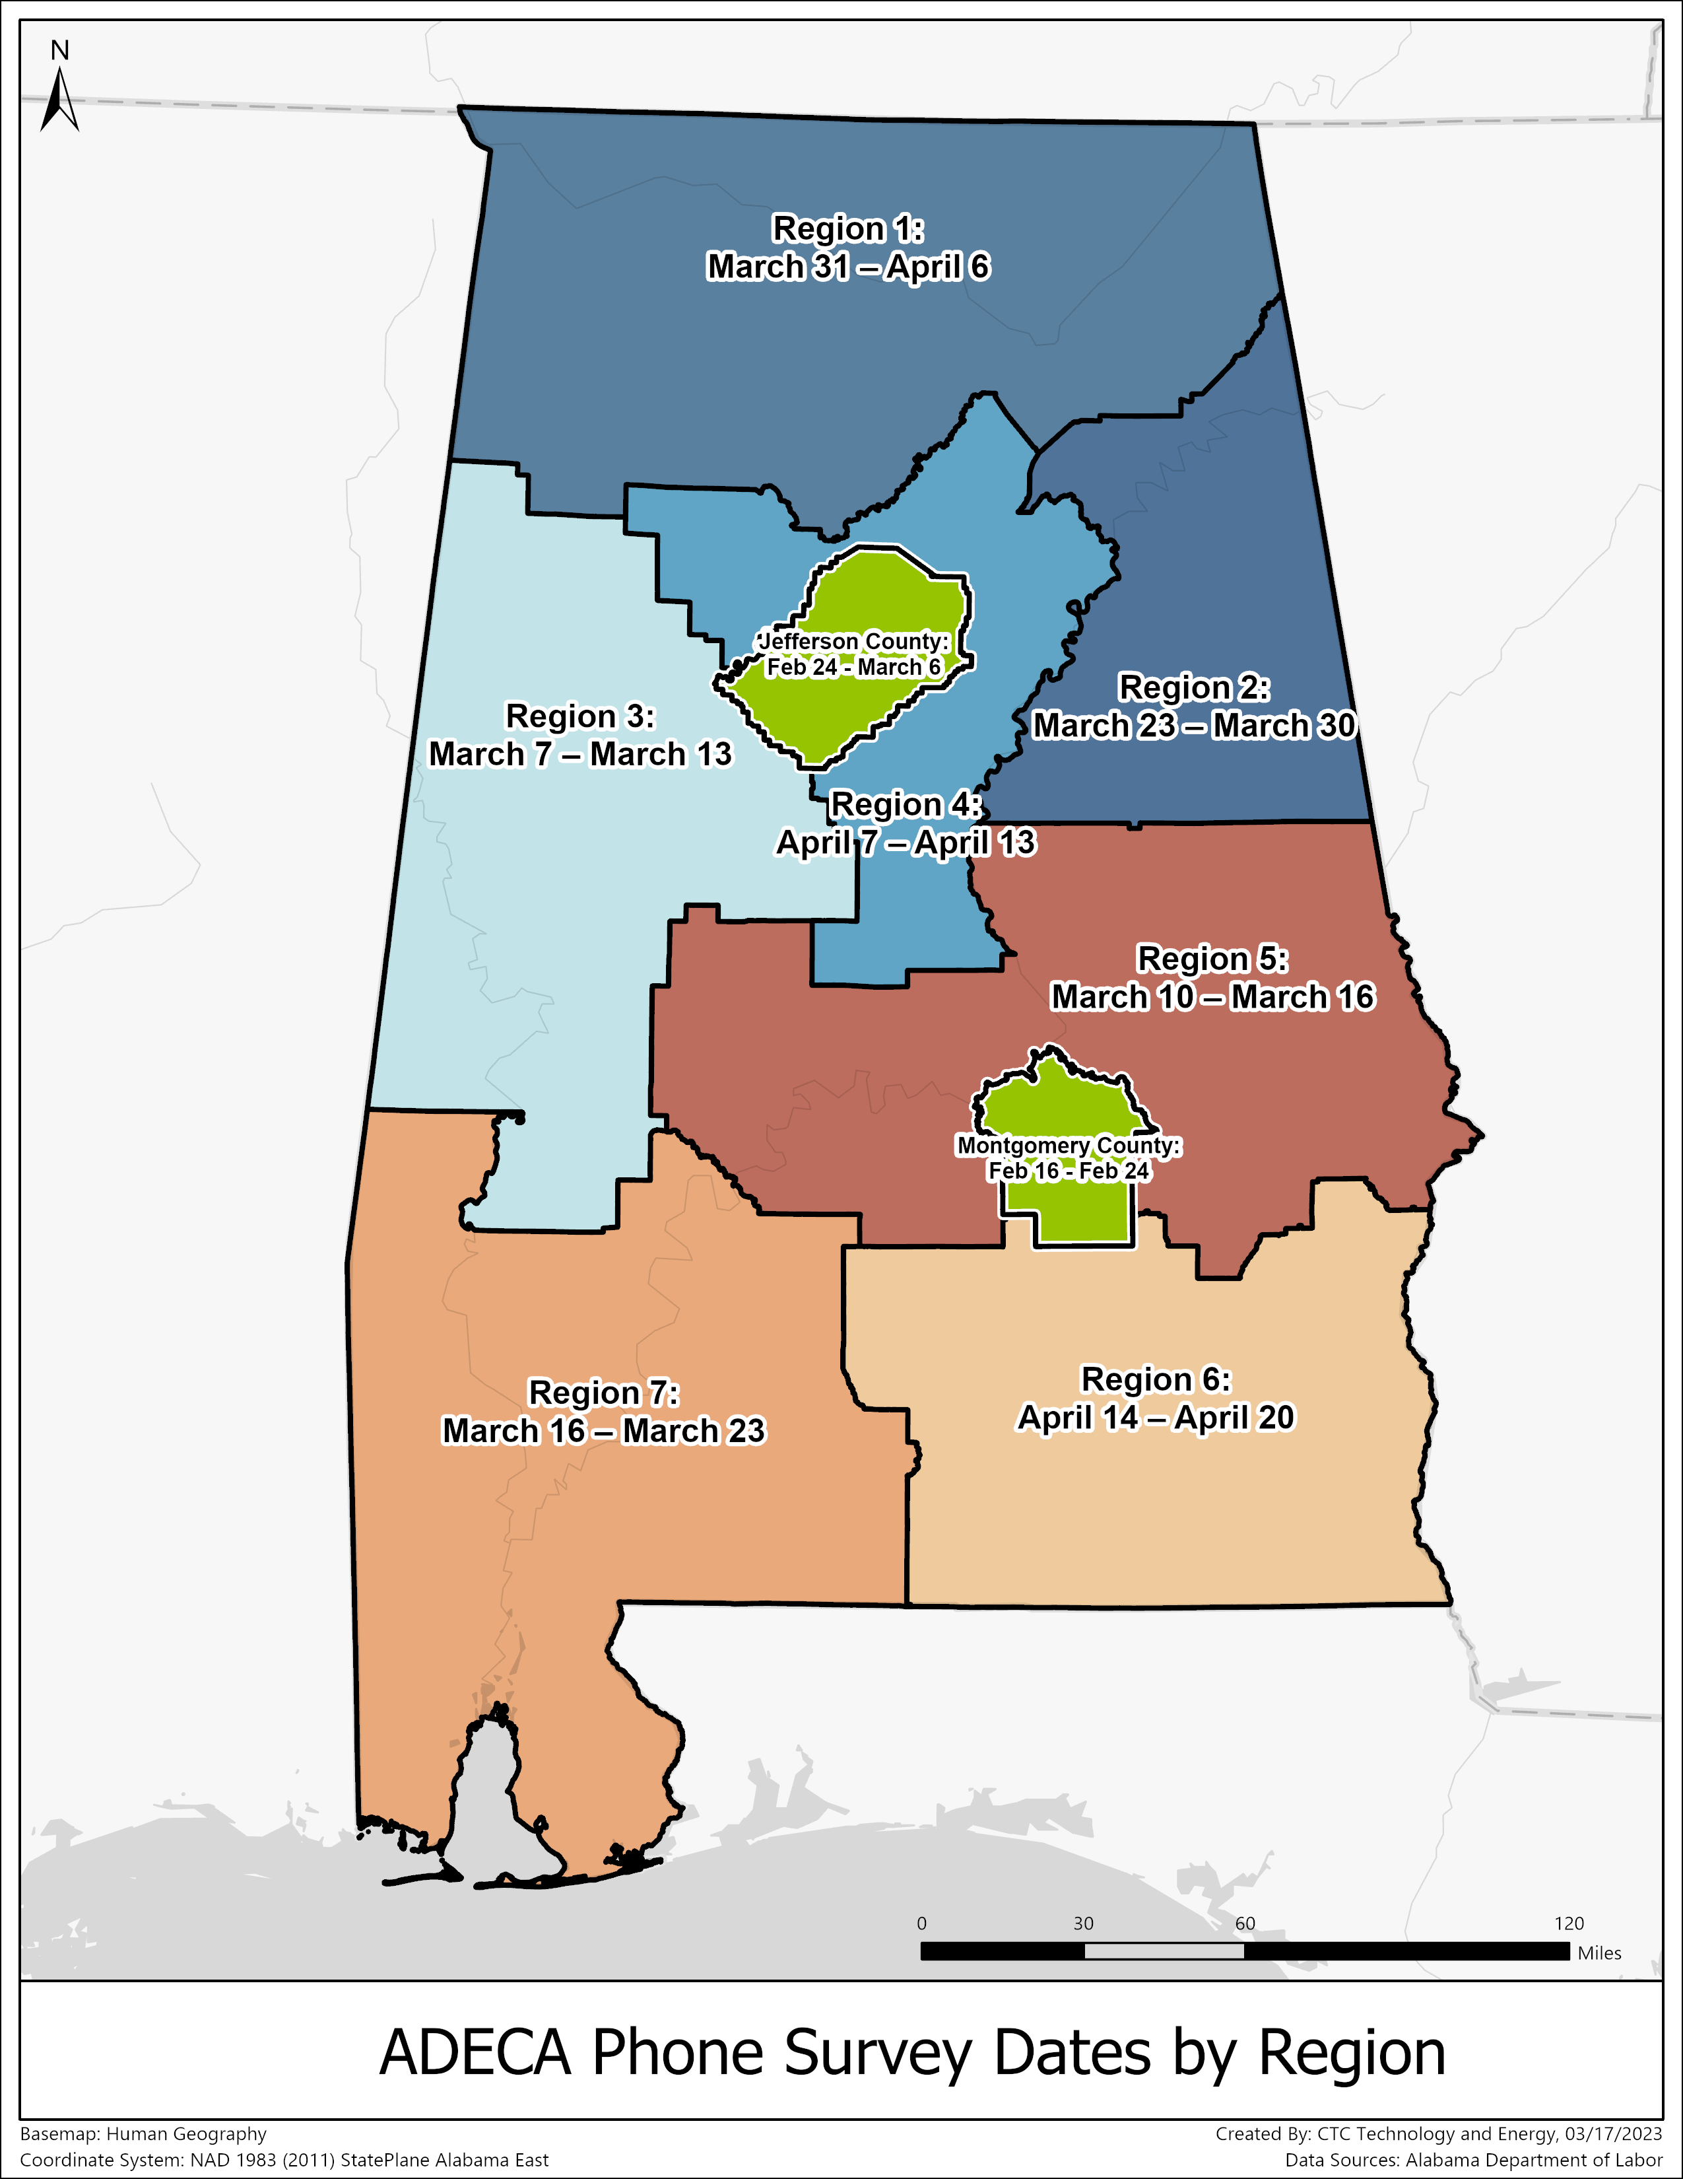
STATEWIDE RESIDENT BROADBAND SURVEY
ADECA has undertaken a telephone survey to gather information on internet accessibility and affordability. The survey is split into regions, with the exceptions of Montgomery County and Jefferson County, which have already completed their surveys.
This map provides estimated dates for when the survey will reach your region. Please encourage your community members to pick up the phone when they see “ADECA Broadband Survey” as the caller ID and take the quick survey. They will not be asked for any identifying information.

Slide 25
PARTNER QUESTIONNAIRES
For State planning for broadband deployment and digital capacity grant funds
Government and Digital Equity Asset Inventory
Community Anchor Programs and Connectivity
Internet Service Providers
Infrastructure-related assets, workforce programs, strategic planning, emergency communications, broadband program offerings and metrics
Barriers and obstacles to clients, facility access to broadband, criticality of internet to mission, workforce and broadband program offerings and metrics
Sources for hiring, workforce programs, ACP, internet skills and adoption, collaboration in community, deployment approaches, disaster recovery plans
Notes:
For State planning for broadband deployment and digital capacity grant funds

Slide 26
QUESTIONS FOR ELECTED OFFICIALS
What gaps and needs do you see in your county/community regarding broadband and digital opportunity?
What are the barriers and obstacles?
What are your goals for the future of broadband in your county/community?
What are your top priorities?
What broadband or other related planning work and other activity has been undertaken in your county and/or region?

Slide 27
QUESTIONS FOR INTERNET SERVICE PROVIDERS
What gaps and needs do you see in the county regarding broadband and digital opportunity?
What barriers and obstacles do you see to broadband deployment and digital opportunity?
What are your goals for the future of broadband in this county?
What are your top priorities?
What publicly owned physical and non-physical infrastructure assets would help your deployment efforts?
What programmatic assets such as subsidy programs do you have?
What workforce resources would you need to fulfill broadband deployment and service expansion in the county?

Slide 28
QUESTIONS FOR GOVERNMENT AND ORGANIZATIONS
What broadband challenges does your agency or organization see?
What do you hear from your partners and the public about their challenges with broadband access and opportunity?
What broadband planning work or other activities have been undertaken in the county and/or region?
What publicly owned infrastructure assets (hard and soft) could spur broadband deployment in the county?
What programmatic assets exist in the county?
What workforce resources exist in the county or region?

Slide 29
QUESTIONS FOR MEMBERS OF THE PUBLIC
What is your experience with accessing and using the internet?
What are the primary activities you use the internet for?
Does anyone face challenges with internet quality? Accessing a computer?
Do you feel confident in your skills to use the internet and computers to support you and your family?
Are there government services you regularly engage with online? How is that experience? Are there services you would like to access but can’t?
What local community organizations help you reach the internet? How is that experience?

Slide 30
CONTACTING ADECA
Email ADECA: Broadband.Fund@adeca.alabama.gov
Website: https://adeca.alabama.gov/broadband/

