Slide 1
Alabama Digital Expansion Division
CPF and AIMM Implementation Introduction Webinar
March 7 2024

Slide 2
Welcome
01

Slide 3
The Alabama Digital Expansion Division (ADED) is a division of the Alabama Department of Economic and Community Affairs (ADECA), under the Direction of Mr. Kenneth Boswell.
Alabama Digital Expansion Division | 3

Slide 4
Organization
Division Chief – Maureen Neighbors
Deputy Division Chief – J. Brad Currier
Grants Management and Compliance Unit
Unit Chief – Nancy Fitzpatrick
Grant Program Manager – Phillip Eubanks
Program Specialists – Janay Marcus, Teresa Green, Carol Reynolds
GIS Unit
Unit Chief – Ricarra Davis
Digital Opportunity Unit
Unit Chief – Angela Washington
Program Manager TBD
Legal and Administrative Unit
Unit Chief - J. Brad Currier
Staff Attorney – Lance Abbott
Portal Project Manager – Judy Wilson
Portal QA – Anjani Rohleder
Administrative Support Assistant – Cassandra Pierce
You can reach us all at broadband.fund@adeca.alabama.gov
Alabama Digital Expansion Division | 4

Slide 5
Letter of Conditional Commitment and Reporting
02

Slide 6
CPF LCC and Reporting
CPF Subrecipients will be reporting in Grants.Alabama.Gov – Pioneers or Crash Dummies
We will be holding a separate webinar for CPF subrecipient reporting immediately following this webinar.
You will be receiving a letter of conditional commitment (LCC) in the next two weeks.
If you have received a grant from us in the past, your LCC will look a little different.
You will be asked to log into https://grants.alabama.gov/.
Once logged in and registered, you will follow the prompts and instructions to complete your response to the LCC.
If your LCC has final curing instructions, you will submit any required changes in the Alabama Grants Portal.
At the end of the process, your CEO will receive an electronic copy of the subaward agreement to execute.
Within five days of final execution of the subaward agreement, subrecipients will be required to submit their initial report.
All subsequent reports, payment requests, and closeout documents will be submitted in the Alabama Grants Portal.
A demonstration and training webinar will be provided later today.
A specific ADED staff member will be assigned to your project to assist you throughout your grant implementation.
Alabama Digital Expansion Division | 6

Slide 7
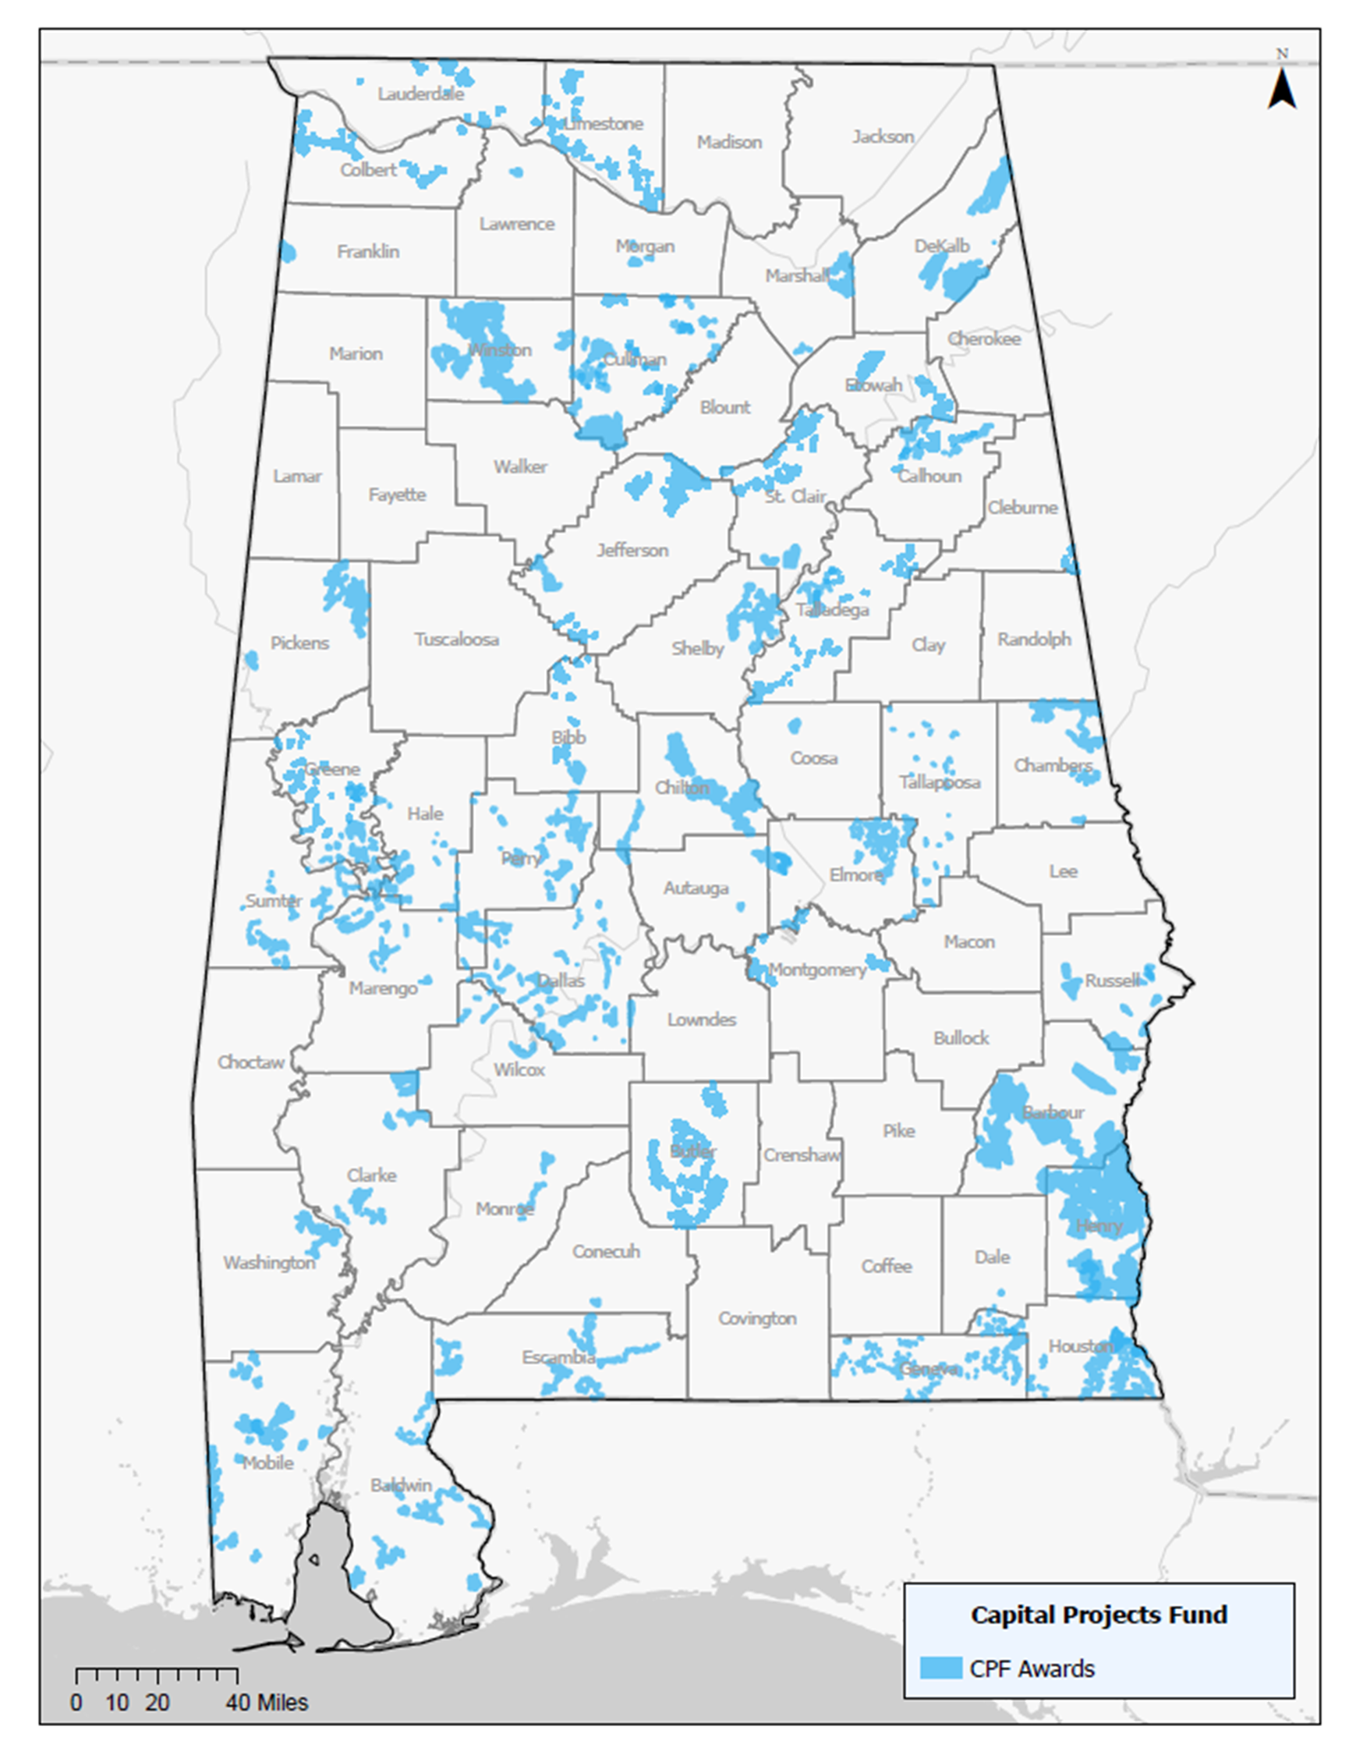
AIMM LCC and Reporting
AIMM Subrecipients will be reporting through email
You will be receiving a letter of conditional commitment (LCC) in the next two weeks.
If you have received a grant from us in the past, your LCC will look mostly the same.
CPF implementation documents and templates can be found at https://adeca.alabama.gov/alanchormiddlemile/.
If your LCC has final curing instructions, you will receive instruction about submitting responses.
At the end of the process, your CEO will receive a copy of the subaward agreement to execute with an original signature.
Within five days of final execution of the subaward agreement, subrecipients will be required to submit their initial report. The initial reporting template will be provided to you as an Excel spreadsheet to be submitted by email to Broadband.Fund@adeca.alabama.gov.
All subsequent reports, payment requests, and closeout documents will be submitted by email to Broadband.Fund@adeca.alabama.gov.
A specific ADED staff member will be assigned to your project to assist you throughout your grant implementation.
Alabama Digital Expansion Division | 7

Slide 8
Compliance
03

Slide 9
Compliance
Timing
CPF and AIMM subrecipients normally must complete their projects within (2) two years of the subaward grant or an extended timeframe requested by the subrecipient in its application and approved by ADECA.
Both programs require completion in 2026. In order to accommodate ADECA’s expenditure and closeout obligations, all projects must be fully expended and closed by October 31, 2026.
The effective date of your subaward agreement is the date of the Governor’s letter of conditional award. Your two-year clock is ticking.
You may obligate funds, but you do so at your own risk until the subaward agreement is fully executed.
No extension can be approved once your subaward has expired. All amendments for time extension must be submitted no less that 30 days prior to the expiration date of the agreement.
Alabama Digital Expansion Division | 9

Slide 10
Compliance
A reporting website is available at: https://adeca.alabama.gov/fraud/
Alabama Digital Expansion Division | 10

Slide 11
Compliance
Non-discrimination Laws
Some examples of non-discrimination compliance you will be subject to include:
Title VI of the Civil Rights Act of 1964, 42 U.S.C. § 2000d et seq., and Treasury’s implementing regulations, 31 C.F.R. Part 22;
Section 504 of the Rehabilitation Act of 1973, 29 U.S.C. § 794;
Title IX of the Education Amendments of 1972, 20 U.S.C. § 1681 et seq., and Treasury’s implementing regulations, 31 C.F.R. Part 28;
Age Discrimination Act of 1975, 42 U.S.C. § 6101 et seq., and Treasury’s implementing regulations, 31 C.F.R. Part 23; and
Title II of the Americans with Disabilities Act of 1990, 42 U.S.C. § 12101 et seq.
Subrecipients will ensure that their contractors and subcontractors for a project comply with all applicable nondiscrimination requirements.
In accordance with federal law, subrecipients will provide any documentation or assurances that Treasury or ADECA may require demonstrating their compliance with the nondiscrimination requirements.
Alabama Digital Expansion Division | 11

Slide 12
Compliance
Labor Laws
Some examples of labor compliance you need to be aware of include:
While the federal Davis-Bacon Act prevailing wage rate requirements generally do not apply to projects funded solely by the CPF or AIMM, Treasury and ADECA encourage applicants to ensure that projects incorporate strong labor standards and competitive wages to promote effective and efficient delivery of high-quality infrastructure projects and support economic recovery through strong employment opportunities for workers.
Subrecipients will be asked to provide information on their proposed project labor practices as part of their subaward reporting process.
Other labor requirements are part of your subaward agreement.
If an entity elects to certify compliance, it is important that you be able to document that compliance (payrolls, wage rate, etc.).
While we may accept your certification, federal monitors and auditors may not.
Alabama Digital Expansion Division | 12

Slide 13
Compliance
Environmental
The National Environmental Policy Act, 42 U.S.C. § 4321 et seq. (NEPA), normally does not apply to projects funded by CPF or AIMM. However, projects may still be subject to NEPA review if they are also funded by, require the approval of, or otherwise involve other federal programs or agencies.
If you project is on federal lands, you will need to comply with all permitting requirements.
If your project is on Tribal lands, additional requirements and approvals may be required.
All local permitting is required.
Alabama Digital Expansion Division | 13

Slide 14
Compliance
Prohibition on Certain Telecommunications and Video Surveillance Services or Equipment
CPF and AIMM subrecipients and their contractors or subcontractors must comply with all applicable provisions of Section 889(b) of the John S. McCain National Defense Authorization Act for Fiscal Year 2019, Pub. L. No. 115-232, which generally prohibits the use of federal grant funds to acquire certain services or equipment posing national security risks.
Subject to limited exceptions, subrecipients and their contractors or subcontractors must not use CPF or AIMM grant funds to: (a) procure or obtain; (b) extend or renew a contract to procure or obtain; or (c) enter into a contract (or extend or renew a contract) to procure or obtain equipment, services, or systems that use covered telecommunications and video surveillance services or equipment as a substantial or essential component of any system, or as critical technology as part of any system, as described in 2 C.F.R. §§ 200.216, 200.471.
Alabama Digital Expansion Division | 14

Slide 15
Compliance
Ownership of Project Property and Property Standards
The federal government will retain an interest in the real property or equipment acquired or improved under a CPF or AIMM grant until December 31, 2034 (Federal Interest Period).
Title to project property will vest in a subrecipient, so long as the subrecipient meets certain conditions during the Federal Interest Period.
The subrecipient must use the project property for the authorized purposes of the project in the same manner as they use comparable real property and equipment within their networks in the ordinary course of their business.
Please consider developing a property management system now. The Federal Interest Period is many years from now. Enforcement will continue through 2034.
If in doubt, please contact us.
Alabama Digital Expansion Division | 15

Slide 16
Compliance
Debarment & Suspension
A Subrecipient may not receive a subaward if either it or its principals (or any of its contractors, subcontractors, or affiliates) are presently debarred, suspended, proposed for debarment, declared ineligible, or voluntarily excluded from participating in the other grant programs by any federal agency or by any department, agency, or political subdivision of the State of Alabama.
ADECA will verify the suspension and debarment status of an applicant before granting a subaward. More information about the suspension and debarment process can be found on the SAM website at https://sam.gov/content/exclusions.
Subrecipients are responsible for verifying contractors and subcontractors are not on the debarment/suspended entity list.
Subrecipients are encouraged to maintain the debar checks they do on their contractors and subcontractors.
Failure to verify eligibility could result in the repayment of funds.
Alabama Digital Expansion Division | 16

Slide 17
Compliance
Records Access and Retention
Subrecipients must keep any and all records related to this Project for a minimum of six (6) years from the date of the closeout letter.
If an action related to this project is started during the record retention period, a longer record retention may be required.
At a minimum, ADECA will monitor your project records through desk reviews, quarterly and other reports, review of documents for payment requests, and closeout documents. Additionally, on site monitoring and field inspections may be utilized.
Other state and federal entities have the authority to monitor or audit your project records, issue findings, and impose corrective actions.
All subrecipients will be assessed for risk prior to the execution of the subaward agreement. Subsequent risk assessments will be conducted as needed if ADECA becomes aware of a change in status that could increase a risk score.
Additional monitoring and oversight may be required for high risk subrecipients.
Alabama Digital Expansion Division | 17

Slide 18
Financial Management
04

Slide 19
CPF Financial Management
CPF grants will be in the form of reimbursement of actual eligible expenses incurred by the subrecipient for the project. Subrecipient project costs eligible for reimbursement generally will be limited to construction and construction-related costs of broadband infrastructure, in accordance with applicable law, CPF program materials, and Treasury/ADECA guidance.
Some examples of eligible project expenses include: (a) the costs of repair, rehabilitation, construction, improvement, and acquisition of broadband infrastructure for the project; (b) costs of long-term leases (i.e., for terms greater than one year) of facilities required to provide broadband service for the project (including indefeasible right-of-use agreements and capital leases); and (c) personnel costs related to project deployment.
Operating costs for the project, including but not limited to short-term operating lease costs, are not eligible for reimbursement. Subrecipient indirect costs also are not eligible for reimbursement. In addition, subrecipient costs incurred before or after the term of the CPF subaward agreement will not be eligible for reimbursement without advanced ADECA approval. CPF grant funds may not be used for research and development costs and may not be used to cover costs that have been or will be reimbursed – or otherwise paid – by other federal or state funding sources.
The request for payment process will be conducted in the Alabama Grants Portal. Support documentation to demonstrate the eligibility of expenses will be required. For CPF, payments will only be made after the completion of the project as validated according to our program rules.
Alabama Digital Expansion Division | 19

Slide 20
AIMM Financial Management
AIMM grants will be in the form of payment of actual eligible expenses incurred by the subrecipient for the project through fixed progress payments.
Subrecipient project costs eligible for payment generally will be limited to construction and construction-related costs of broadband. infrastructure, in accordance with applicable law, AIMM Program materials, and Treasury/ADECA guidance. Some examples of eligible project expenses include: (a) the costs of repair, rehabilitation, construction, improvement, and acquisition of broadband infrastructure for the project; (b) costs of long-term leases (i.e., for terms greater than one year) of facilities required to provide broadband service for the project (including indefeasible right-of-use agreements and capital leases); and (c) personnel costs related to project deployment.
Operating costs for the project, including but not limited to short-term operating lease costs, are not eligible for reimbursement. Subrecipient indirect costs also are not eligible for reimbursement. In addition, subrecipient costs incurred before or after the term of the CPF subaward agreement will not be eligible for reimbursement without advanced ADECA approval. CPF grant funds may not be used for research and development costs and may not be used to cover costs that have been or will be reimbursed – or otherwise paid – by other federal or state funding sources.
The request for payment process will be conducted using the template available at https://adeca.alabama.gov/alanchormiddlemile/. Support documentation must be submitted as specified in the Payment Request Supporting Documentation Summary template.
Alabama Digital Expansion Division | 20

Slide 21
Questions
05

Slide 22
Contacts and Resources
06

Slide 23
Contacts and Resources
Email: Broadband.Fund@ADECA.Alabama.gov
Street Address: 401 Adams Avenue, Suite 592
Montgomery, Alabama 36104-4325
Mailing Address: Post Office Box 5690
Montgomery, Alabama 36103-5690
ADECA Website:
Address: http://adeca.alabama.gov/broadband
Be Linked Alabama
Website Address: https://broadband.alabama.gov/
Please Sign up
For our email
Notifications: https://adeca.alabama.gov/broadband-alabama-mailing-list/
Alabama Digital Expansion Division | 23

