Slide 1
Alabama Anchor Institution/Middle-Mile Grant Program
Program Announcements
February 5, 2024

Slide 2
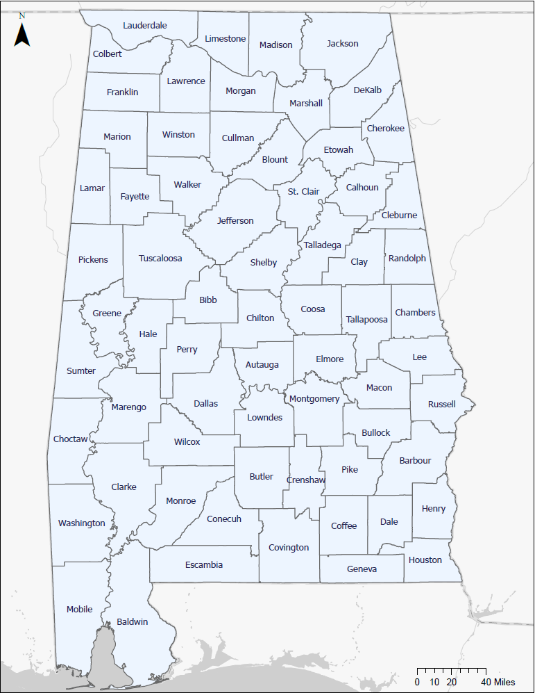
February 5, 2024 | 2

Slide 3
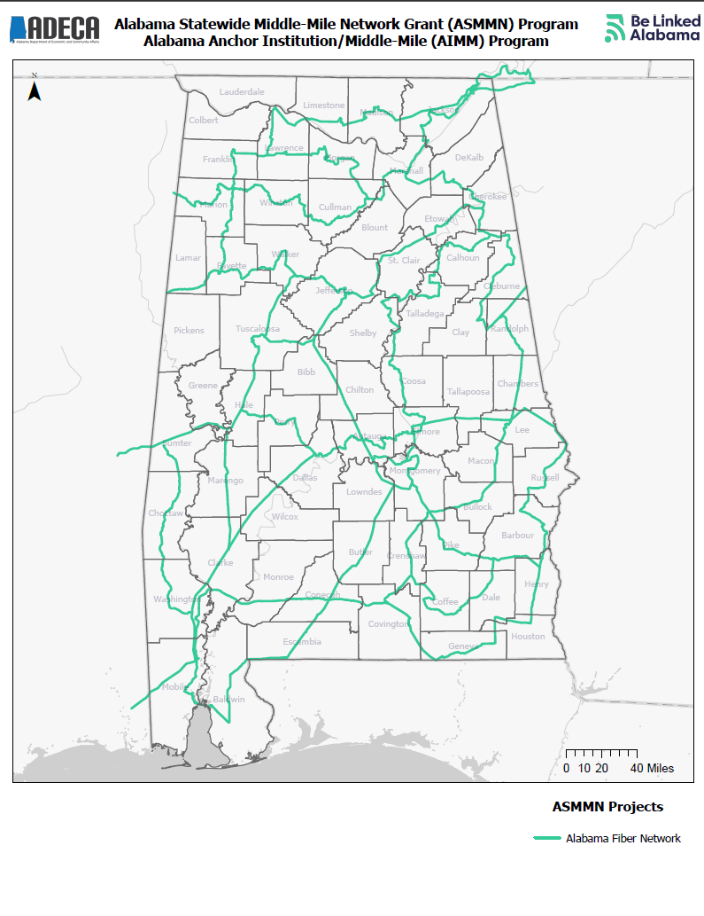
Alabama Statewide Middle-Mile Network (ASMMN) Grant Program
Alabama Fiber Network
One project to serve 64 counties
Grant Amount: $82,450,000.00
Estimated Miles: 3,000
This project is being supported, in whole or in part, by federal award number SLFRP2635 awarded to the State of Alabama by the U.S. Department of the Treasury.
February 5, 2024 | 3

Slide 4
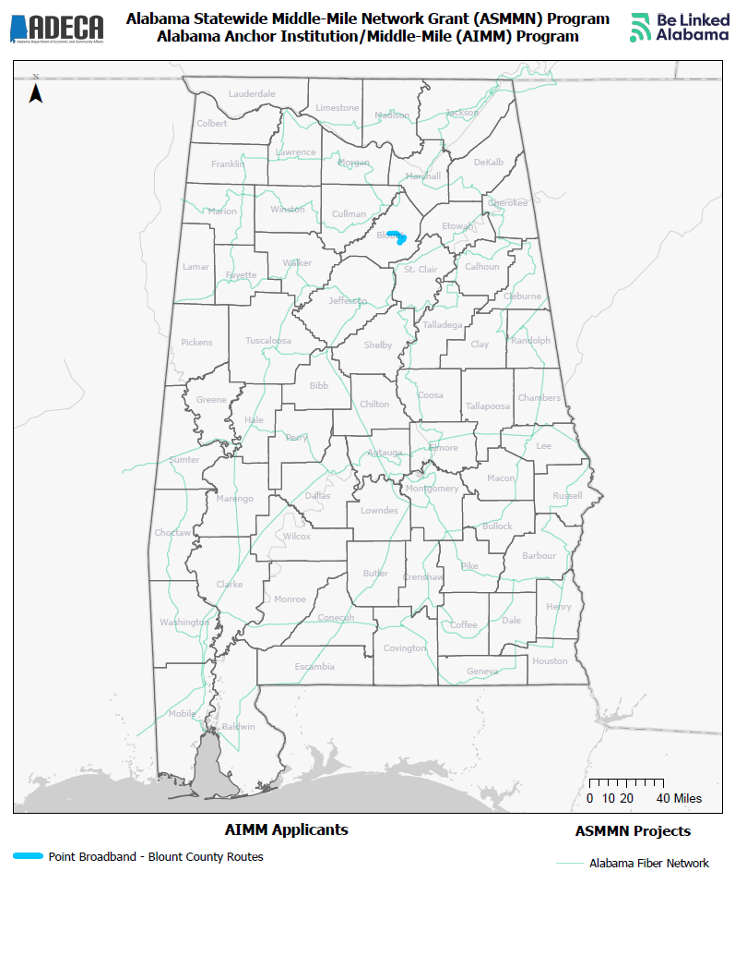
Alabama Anchor Institution/Middle-Mile Grant Program
Point Broadband
One project serving Blount County
Grant Amount: $411,341.62
Match Amount: $619,698.21
Estimated Miles: 12.43
Estimated Anchor Institutions: 21
This project is being supported, in whole or in part, by federal award number SLFRP2635 awarded to the State of Alabama by the U.S. Department of the Treasury.
February 5, 2024 | 4

Slide 5
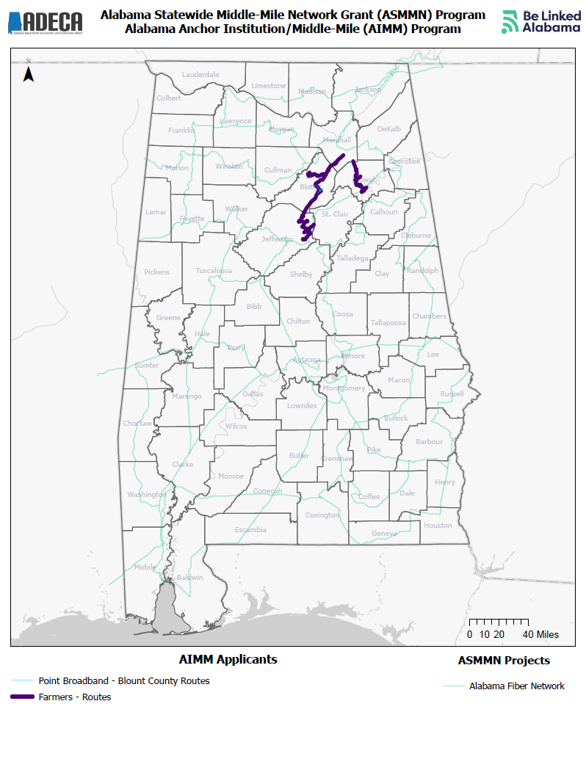
Alabama Anchor Institution/Middle-Mile Grant Program
Farmers Telecommunications Corporation
One project serving Blount, Etowah, Jefferson, and Marshall Counties
Grant Amount: $21,584,360.72
Match Amount: $5,396,090.18
Estimated Miles: 155.43
Estimated Anchor Institutions: 189
This project is being supported, in whole or in part, by federal award number SLFRP2635 awarded to the State of Alabama by the U.S. Department of the Treasury.
February 5, 2024 | 5

Slide 6
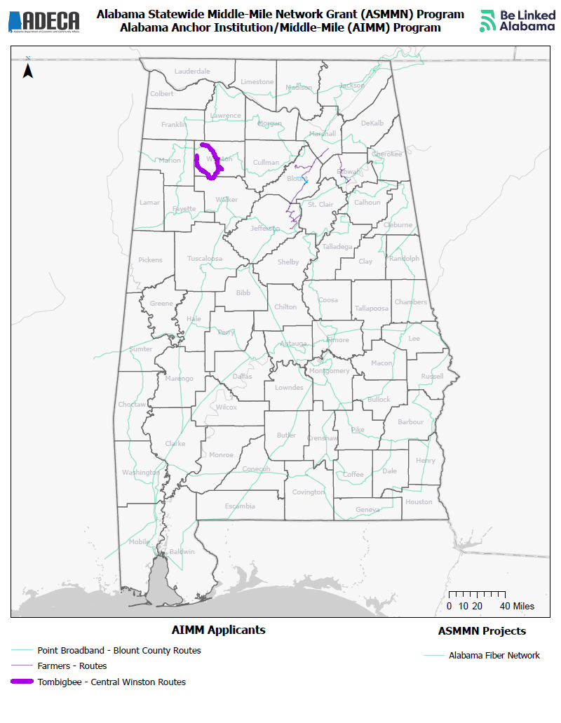
Alabama Anchor Institution/Middle-Mile Grant Program
Tombigbee Electric Cooperative, Inc.
One project serving Winston County
Grant Amount: $757,479.00
Match Amount: $252,493.00
Estimated Miles: 48.6
Estimated Anchor Institutions: 22
This project is being supported, in whole or in part, by federal award number SLFRP2635 awarded to the State of Alabama by the U.S. Department of the Treasury.
February 5, 2024 | 6

Slide 7
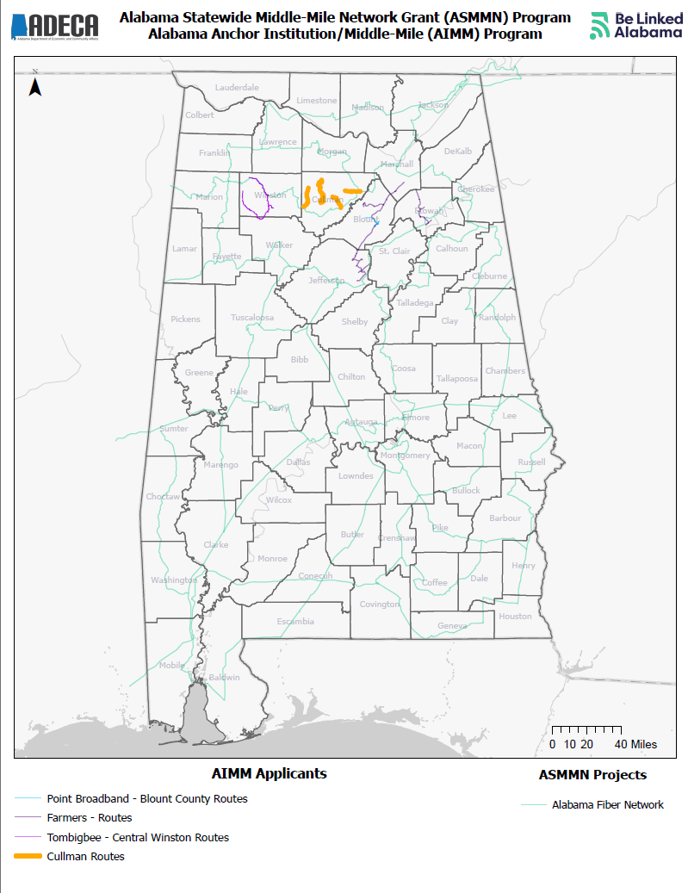
Alabama Anchor Institution/Middle-Mile Grant Program
Cullman Electric Cooperative
One project serving Cullman County
Grant Amount: $1,466,395.67
Match Amount: $366,598.92
Estimated Miles: 106.5
Estimated Anchor Institutions: 15
This project is being supported, in whole or in part, by federal award number SLFRP2635 awarded to the State of Alabama by the U.S. Department of the Treasury.
February 5, 2024 | 7

Slide 8
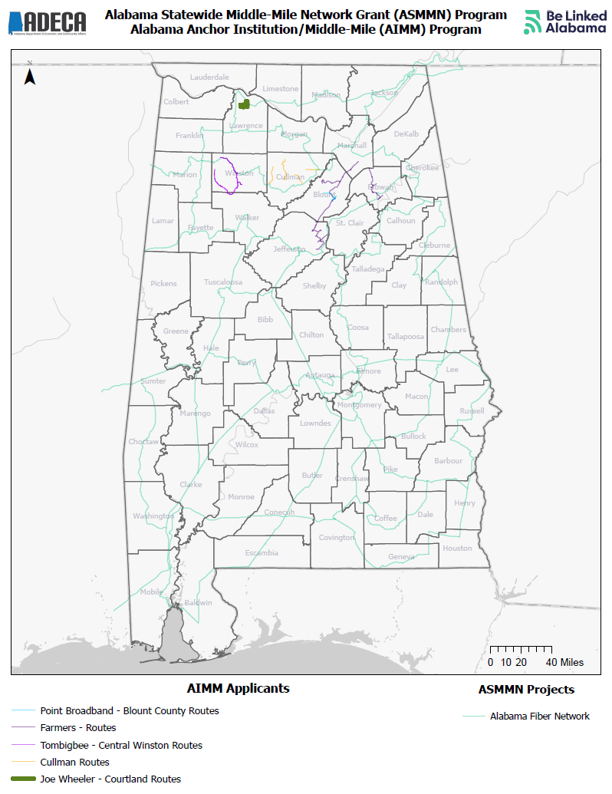
Alabama Anchor Institution/Middle-Mile Grant Program
Joe Wheeler Electric Membership Corp.
One project serving Lawrence County
Grant Amount: $5,251,083.68
Match Amount: $1,312,770.92
Estimated Miles: 20.27
Estimated Anchor Institutions: 16
This project is being supported, in whole or in part, by federal award number SLFRP2635 awarded to the State of Alabama by the U.S. Department of the Treasury.
February 5, 2024 | 8

Slide 9
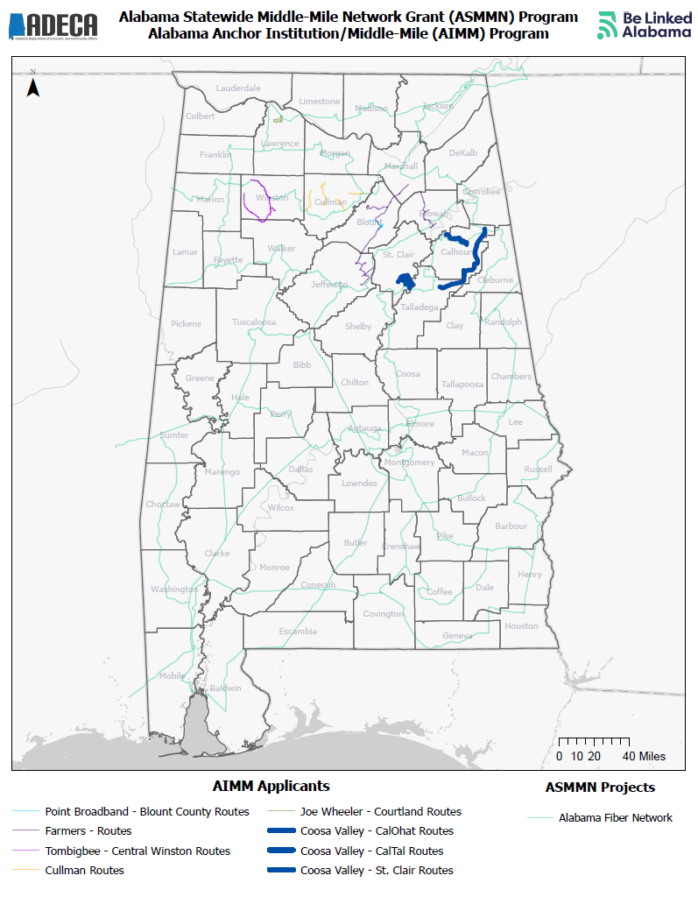
Alabama Anchor Institution/Middle-Mile Grant Program
Coosa Valley Technologies, Inc.
Three projects serving Calhoun, St. Clair, and Talladega Counties
Grant Amount: $7,041,612.00
Match Amount: $4,694,408.00
Estimated Miles: 110
Estimated Anchor Institutions: 17
This project is being supported, in whole or in part, by federal award number SLFRP2635 awarded to the State of Alabama by the U.S. Department of the Treasury.
February 5, 2024 | 9

Slide 10
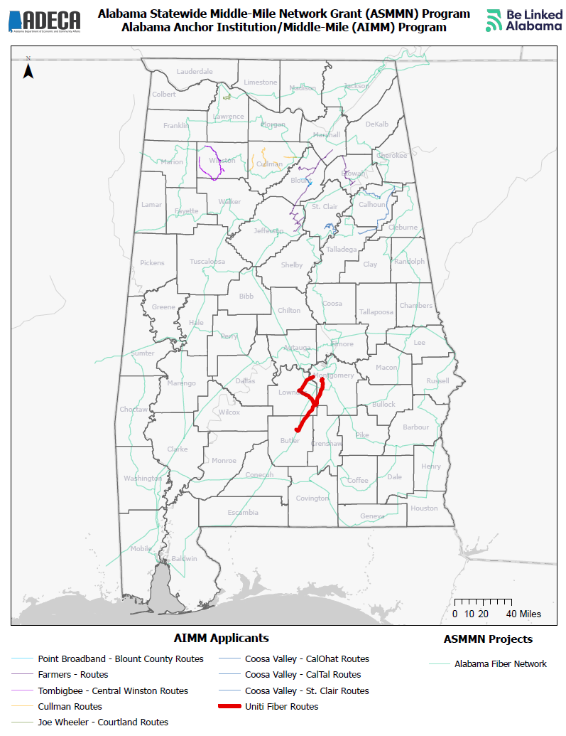
Alabama Anchor Institution/Middle-Mile Grant Program
Uniti Fiber
One project serving Butler, Lowndes, and Montgomery Counties
Grant Amount: $4,240,000.00
Match Amount: $1,060,000.00
Estimated Miles: 63.7
Estimated Anchor Institutions: 4
This project is being supported, in whole or in part, by federal award number SLFRP2635 awarded to the State of Alabama by the U.S. Department of the Treasury.
February 5, 2024 | 10

Slide 11
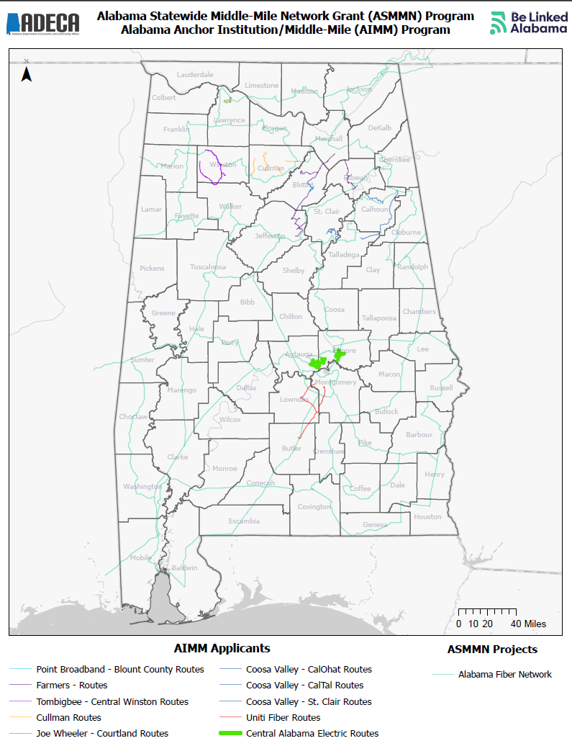
Alabama Anchor Institution/Middle-Mile Grant Program
Central Alabama Electric Cooperative
One project serving Autauga and Elmore Counties
Grant Amount: $2,692,179.00
Match Amount: $909,906.00
Estimated Miles: 38
Estimated Anchor Institutions: 33
This project is being supported, in whole or in part, by federal award number SLFRP2635 awarded to the State of Alabama by the U.S. Department of the Treasury.
February 5, 2024 | 11

Slide 12
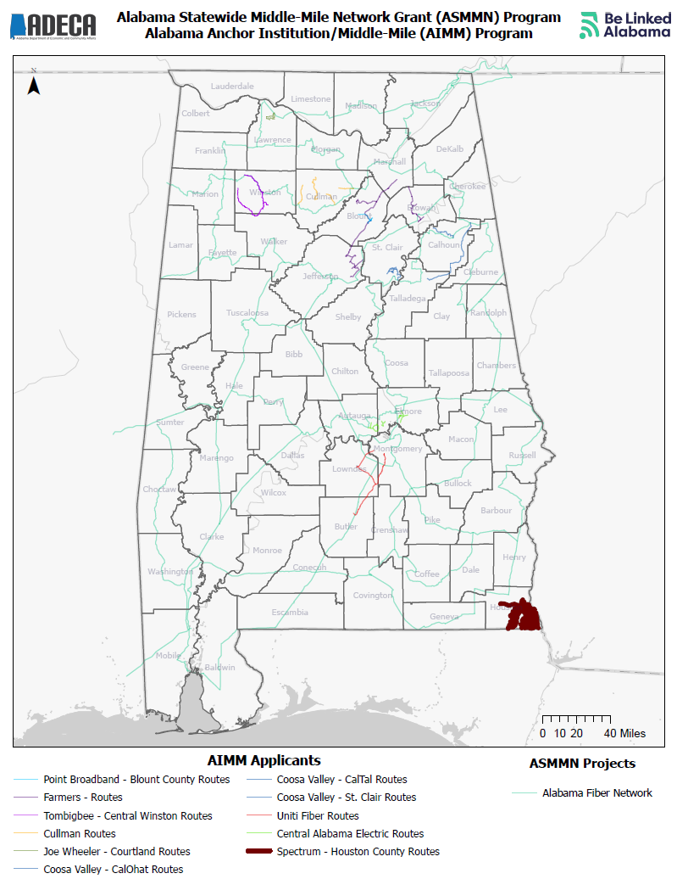
Alabama Anchor Institution/Middle-Mile Grant Program
Spectrum Southeast, LLC
One project serving Houston County
Grant Amount: $7,308,580.00
Match Amount: $1,827,145.00
Estimated Miles: 167.13
Estimated Anchor Institutions: 8
This project is being supported, in whole or in part, by federal award number SLFRP2635 awarded to the State of Alabama by the U.S. Department of the Treasury.
February 5, 2024 | 12

Slide 13
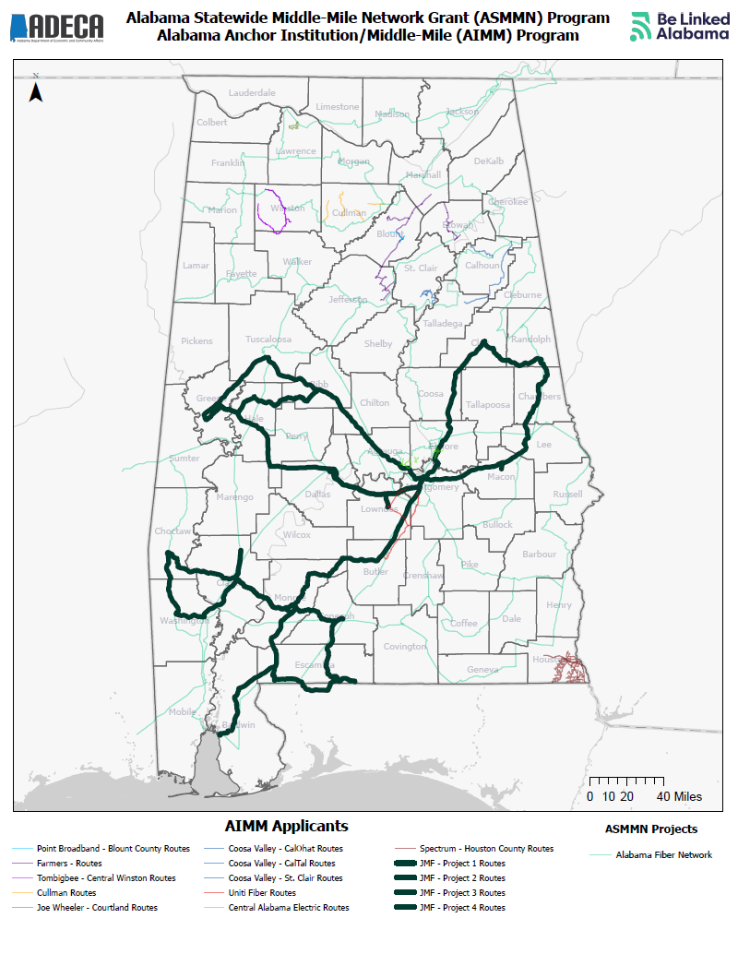
Alabama Anchor Institution/Middle-Mile Grant Program
JMF Solutions
Four projects serving Bibb, Choctaw, Clarke, Clay, Conecuh, Dallas, Escambia, Greene, Lowndes, Macon, Monroe, Randolph, and Washington Counties
Grant Amount: $6,301,240.00
Match Amount: $1,575,385.00
Estimated Miles: 1,169
Estimated Anchor Institutions: 24
This project is being supported, in whole or in part, by federal award number SLFRP2635 awarded to the State of Alabama by the U.S. Department of the Treasury.
February 5, 2024 | 13

Slide 14
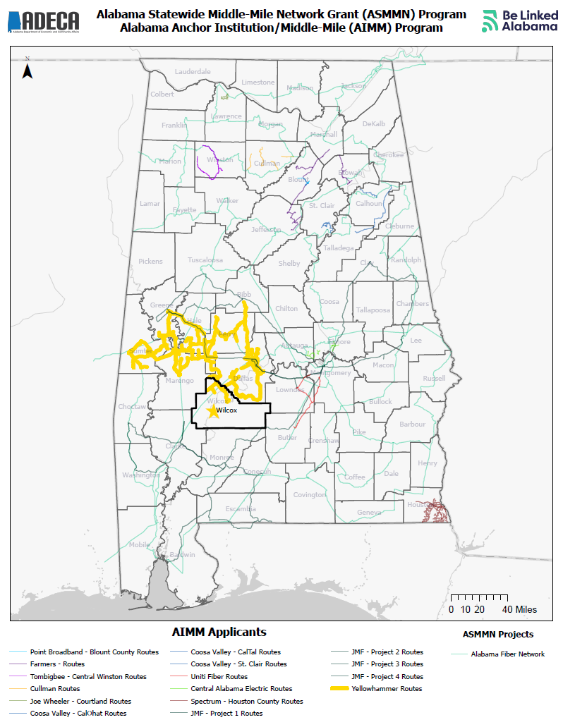
Alabama Anchor Institution/Middle-Mile Grant Program
Yellowhammer Networks, LLC
One project serving Bibb, Dallas, Greene, Hale, Marengo, Perry, Sumter, and Wilcox Counties
Grant Amount: $2,521,440.00
Match Amount: $840,480.00
Estimated Miles: 620
Estimated Anchor Institutions: 6
This project is being supported, in whole or in part, by federal award number SLFRP2635 awarded to the State of Alabama by the U.S. Department of the Treasury.
February 5, 2024 | 14

Slide 15
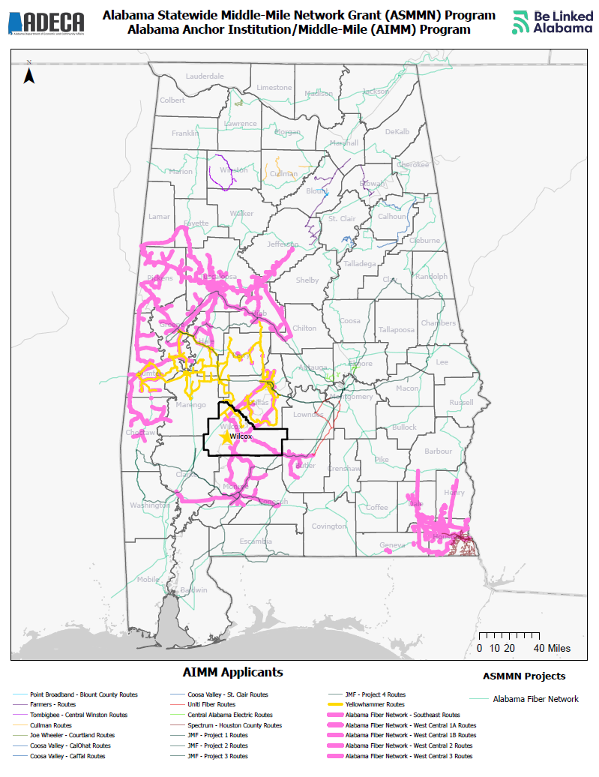
Alabama Anchor Institution/Middle-Mile Grant Program
Alabama Fiber Network
Five projects serving Bibb, Butler, Chilton, Choctaw, Conecuh, Dale, Dallas, Geneva, Greene, Hale, Henry, Houston, Jefferson, Marengo, Monroe, Perry, Pickens, Sumter, Tuscaloosa, and Wilcox Counties
Grant Amount: $128,877,894.00
Match Amount: $39,254,340.00
Estimated Miles: 1,776
Estimated Anchor Institutions: 438
This project is being supported, in whole or in part, by federal award number SLFRP2635 awarded to the State of Alabama by the U.S. Department of the Treasury.
February 5, 2024 | 15

Slide 16
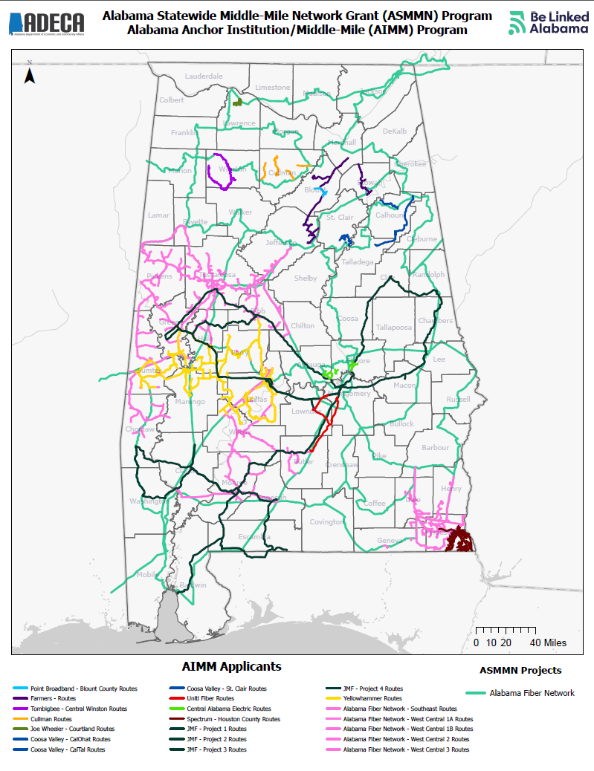
Alabama Anchor Institution/Middle-Mile Grant Program
Funding
21 projects awarded to 12 grantees
Grant Amount: $188,453,905.69
Match Amount: $58,109,315.23
Estimated Miles: 4,287.06
Estimated Anchor Institutions: 793
This project is being supported, in whole or in part, by federal award number SLFRP2635 awarded to the State of Alabama by the U.S. Department of the Treasury.
February 5, 2024 | 16

Slide 17
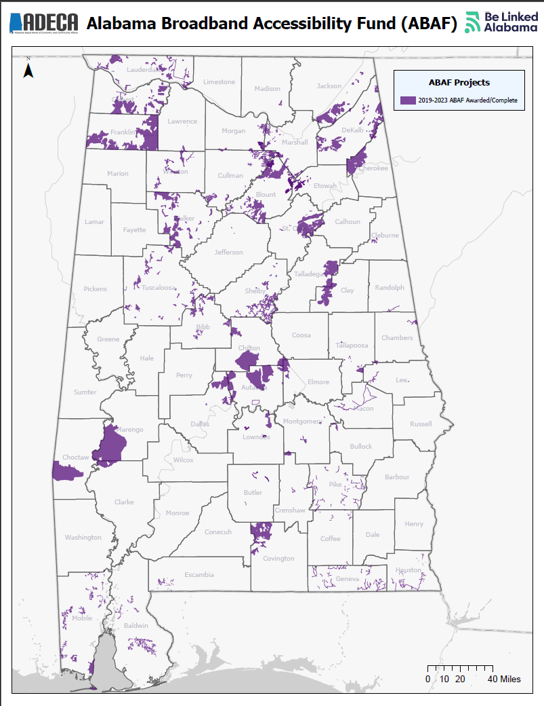
Alabama Broadband Accessibility Fund
Funding
In addition to the middle-mile projects already discussed, ADECA has administered the Alabama Broadband Accessibility Fund
Total Projects: 107
Total Grants: $82,069,667.33
Estimated Match: $193,000,000.00
Estimated New Services: 72,108
February 5, 2024 | 17

Slide 18
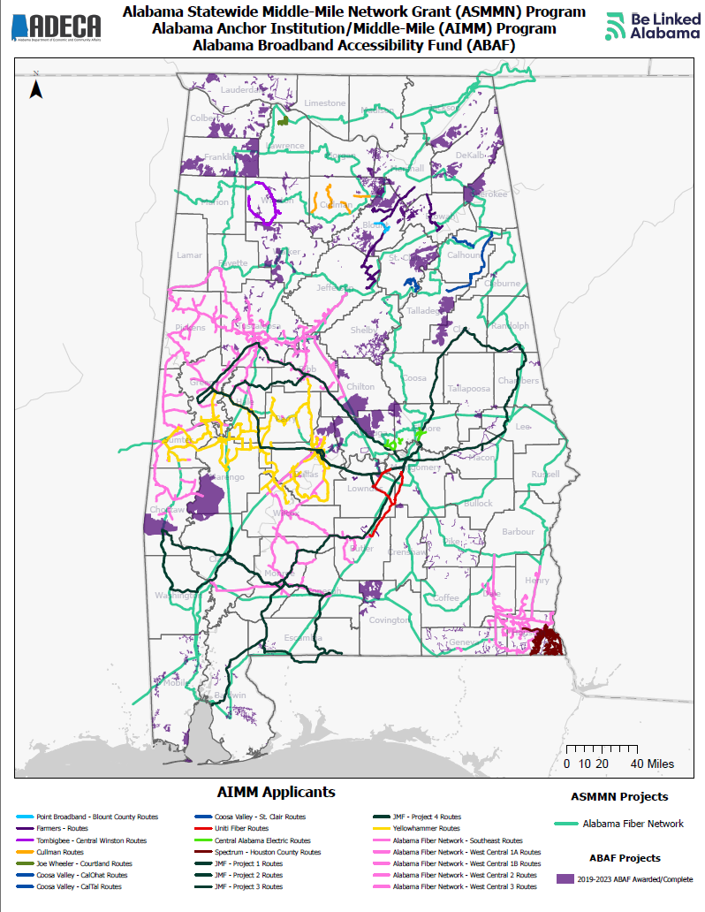
AIMM, ASMMN, and Alabama Broadband Accessibility Fund
Funding
In addition to the middle-mile projects already discussed, ADECA has administered the Alabama Broadband Accessibility Fund
Total Projects: 128
Total Grants: $270,523,573.02
Estimated Match: $251,109,315.23
Estimated New Services: 72,901
This project is being supported, in whole or in part, by federal award number SLFRP2635 awarded to the State of Alabama by the U.S. Department of the Treasury.
February 5, 2024 | 18

