Slide 1
Alabama BEAD Initial Proposal & Alabama Statewide Digital Opportunity Plan Update and Review
November 2023

Slide 2
Agenda
Overall status and timeline
Update on funding and planning
Update on input from community engagement
The Alabama Statewide Digital Opportunity Plan
The Alabama BEAD Initial Proposal
Next steps and questions
2

Slide 3
1
Overall status and timeline
3

Slide 4
Overall status and timeline
2023 Q1-2
2023 Q3-4
2024 Q1-2
2024 Q3-4
2025 >
1
Community engagement
Continues through planning and execution cycles
2
Digital Opportunity planning and programs
Planning and Digital Opportunity Plan
Federal grants
3
BEAD planning
5-Year Action Plan and Initial Proposal
Final Proposal to federal gov’t
4
BEAD grant
program
Map Challenge Process and grant program
5
BEAD deployment
Deployment
We’re here: Public comment on the
Alabama BEAD Initial Proposal and the
Alabama Statewide Digital Opportunity
Plan
4

Slide 5
2
Update on funding and planning
5

Slide 6
Overview: current funding and planning
ADECA is currently administering the CPF and AIMM, while also developing two sets of plans — one for infrastructure and one for Digital Opportunity — that will unlock additional federal funds.
CPF and AIMM grant programs
Broadband Equity, Access, and Deployment (BEAD) plans
Alabama Statewide Digital Opportunity Plan
Using funds from the American Rescue Plan Act, ADECA is administering two grant programs:
The Alabama Capital Projects Fund (CPF) for last-mile broadband infrastructure
The Alabama Anchor Institution/Middle-Mile (AIMM) for deploying middle-mile and connecting Anchor Institutions
A plan and proposals that will be submitted to the federal government to access Infrastructure Act funding for construction of new broadband infrastructure.
A plan that will be submitted to the federal government to access funding for programs to help Alabama households afford, adopt, and use broadband.
Aug. 28: Five-Year Action Plan submitted to federal government
Nov. 15 to Dec. 14: Initial Proposal Volumes I & II (IPV1 and IPV2) public comment period
Dec. 27: Deadline for submitting Initial Proposal to federal government
Oct. 23 to Nov. 23: Public comment period
Dec. 14: Deadline to submit to federal government
Oct. 13: Application period closed for both programs. (Applications are currently under review.)
6

Slide 7
Overview of the BEAD program
In June, Alabama was allocated $1.4 billion of federal BEAD funds that will become available following completion of the federal planning cycle.
Funds are prioritized for serving unserved locations first (those that cannot get internet service of 25/3 Mbps) and underserved second (those that can only get internet service between 25/3 and 100/20 Mbps).
ADECA has submitted the BEAD Five-Year Action Plan to the federal government.
The Alabama BEAD Initial Proposal Volume 1 and Volume 2 are in the public comment period.
BEAD planning Challenge Process and provisional grant program Deployment
2023
2024
2025
7

Slide 8
BEAD planning deliverables
5-Year Action Plan
Submitted Aug. 28
Initial Proposal
Volumes 1 & 2 open for public comment
Final Proposal
Likely to be submitted in early 2025
The Initial Proposal has two volumes that describe the proposed grant program elements, design, and rules. Following federal approval, ADECA will begin the grant program, likely in early 2024
After final award plans are submitted to the federal government and approved, construction can begin
This is the framework and plan for universal broadband. The plan includes input from state and local partners
8

Slide 9
BEAD grant program timeline
NTIA approval required
2023
2024
Activity
Oct
Nov
Dec
Jan
Feb
Mar
Apr
May
Jun
Jul
Aug
Sep
Oct
Nov
Dec
IPV1 + IPV2 public comment
30 days
Revision and finalization
Submit IPV1 + IPV2 to NTIA
NTIA review
Challenge Process
90-120 days
Grant program
120 days
Negotiations
Final Proposal
9

Slide 10
3
Update on input from community engagement
10

Slide 11
Public comment timeline
2023 Q1-2
2023 Q3-4
2024 Q1-2
2024 Q3-4
2025 >
Digital Opportunity Plan
Digital Opportunity Plan
1
BEAD Program Initial Proposals
Five-Year Action Plan and Initial Proposal
Final Proposal
2
Public comment opportunity
11

Slide 12
Local and partner input
2022 and 2023 interactions to ensure
local and partner input…
…continues into 2024 and 2025
grant cycle
In-person meetings in every county and virtual meeting with each county
Publication of 67 detailed county broadband profiles and online presentations to local officials in each county
Phone survey of thousands of Alabama households
Facilitated sessions or one-on-one meetings with ISPs, agencies, nonprofits, and other partners
Partner program questionnaires and inventories
Public comments on Digital Opportunity Plan and Initial Proposal Volumes 1 and 2
Targeted outreach
Challenge Process information and opportunity
Statewide information sessions/webinars
Public comment opportunities
12

Slide 13
Findings and themes
Deployment
Affordability
Digital skills
Lack of reliable broadband access creates barriers for communities to achieve economic development goals
In rural areas of Alabama, low density of homes creates an obstacle to deployment that means many locations are unserved or underserved
Workforce opportunities abound, as the new federal funds will create new jobs in broadband construction and maintenance
Many low-income households struggle to afford broadband services
Affordable Connectivity Program enrollment helps many households afford and maintain broadband connectivity
Growing and expanding successful device lending programs would support affordability
Multiple organizations across the state offer digital skills training and opportunity exists to expand those programs
A wide range of partner organizations are engaged in supporting development of digital skills
Digital skills challenges are frequently experienced by lower-income individuals and seniors
13

Slide 14
4
The Alabama Statewide Digital Opportunity Plan
14

Slide 15
ADECA conducted extensive outreach to communities, Tribes, nonprofits, institutions, and the public.
The draft Digital Opportunity Plan is open for public comment until Nov. 23 and will be submitted to the federal government by Dec. 14.
To access the public comment form, please click here.
Federal approval of the plan will be part of how Alabama accesses related federal funds next year.
Digital Opportunity Plan status
Elements of Digital Opportunity
Broadband access
Affordable, accessible, and reliable high-speed home internet service is available for all.
Accessible and inclusive content
Public online content is accessible by all.
Devices and tech support
Individuals have access to a computer or tablet and technical support.
Privacy and security
Individuals can protect their data privacy and online security.
Digital skills
Individuals have digital skills to use the internet in their daily lives.
15

Slide 16
Alabama’s Digital Opportunity vision:
5 critical elements
Availability of affordable, reliable internet connectivity at home
A computing device and the opportunity to maintain it
Opportunity to learn digital skills
Tools and information to be safe online
Online resources that are accessible and usable
16

Slide 17
Strategies to address critical barriers (1/2)
Critical barrier | Strategies
Lack of broadband availability | Increase access to residential broadband infrastructure Enable gigabit services at anchor institutions
Low-income households struggle to afford broadband services, devices, and technical support | Increase Affordable Connectivity Program enrollment among eligible households Increase low-cost service offerings Expand access to computing devices and tech support Develop data and informational resources to enable application of a digital opportunity lens to infrastructure and program decisions
17

Slide 18
Strategies to address critical barriers (2/2)
Critical barrier | Strategies
Low-income households and aging individuals lack digital skills | Enable digital skills development through training courses Expand opportunity to learn online safety and privacy Expand accessibility of information
Local communities lack resources and expertise for digital opportunity efforts | Build collaboration among state, local, and nonprofit entities Support and develop local capacity Sustain and grow the state’s efforts in digital opportunity
18

Slide 19
5
Overview of the Alabama BEAD Initial Proposal
19

Slide 20
Overview of the Initial Proposal
The Initial Proposal describes how ADECA plans to administer the BEAD grant program
Initial Proposal Volume 1
Initial Proposal Volume 2
Public comment period is currently open and closes Dec. 14
Describes how ADECA will run a “Challenge Process” in 2024 to finalize the list of locations eligible for funding
To access the public comment form, click here
Public comment period is currently open and closes Dec. 14
Describes how ADECA will structure the grant application and process, as well as the scoring criteria and rules for participation
To access the public comment form, click here
20

Slide 21
6
The Initial Proposal Volume 1
21

Slide 22
Initial Proposal Volume 1: 4 key sections
All are eligible for comment through December 14
Existing broadband funding
Unserved and underserved locations
Current sources of federal and state funding to deploy broadband and close the digital divide in Alabama
How ADECA developed lists of the locations that are unserved or underserved and thus eligible for BEAD-funded deployment
Community anchor institutions
Challenge Process
Discussion of criteria used to identify CAIs that lack access to 1 Gbps symmetrical services and a preliminary list of qualifying CAIs
Rules to define a transparent and fair Challenge Process to meet the goals of the BEAD program
22

Slide 23
Issues for comment: Location classifications
1
2
Federal rules allow states to propose to change “served” locations to “underserved” if sufficient data exist for the wholesale change, thus moving the burden of proof from communities to ISPs to establish the correct status of those locations.
ADECA proposes to treat locations that the National Broadband Map shows to have available qualifying broadband service (i.e., a location that is “served”) delivered via DSL as “underserved,” and are eligible for BEAD funding.
Potential issues for comment:
Is the proposed pre-challenge modification to the FCC map appropriate?
Should other pre-challenge modifications be proposed?
23

Slide 24
Issues for comment: Community anchor institutions
Federal rules require states to define “community anchor institution” in the Initial Proposal and then develop a list of defined anchors that do not have symmetrical 1 Gbps service so that challenges can be filed in the BEAD Challenge Process next year.
ADECA proposes to define this category to include:
Schools
Libraries
Health clinics, health centers, hospitals,
or other medical providers
Institutions of higher education
Public housing organizations
Public safety entities
Community support organizations that facilitate greater use of broadband service by vulnerable populations
Some government buildings such as county courthouses
Potential issues for comment:
Does the Initial Proposal Volume I define “community anchor institution” appropriately?
Should other categories of community anchor institutions be included and, if so, why?
24

Slide 25
Issues for comment: Structure of the challenge process
Federal rules require states to allow challenges to the FCC map early in 2024 to make final determinations of the locations that will be eligible for BEAD grant funding.
Who can challenge:
Permissible challenges:
Nonprofits
ISPs
Local and Tribal governments
Where an enforceable funding commitment exists
Where service is planned
Incorrectly classified locations as unserved or underserved
Incorrectly identified and/or service determination for an anchor institution
Potential issues for comment:
Is the process appropriately structured to enable nonprofits/ISPs/Local and Tribal governments to challenge the addresses they believe are misclassified?
Is the process appropriately structured to enable anchor institutions to challenge their address classification?
What other considerations should ADECA take into account?
25

Slide 26
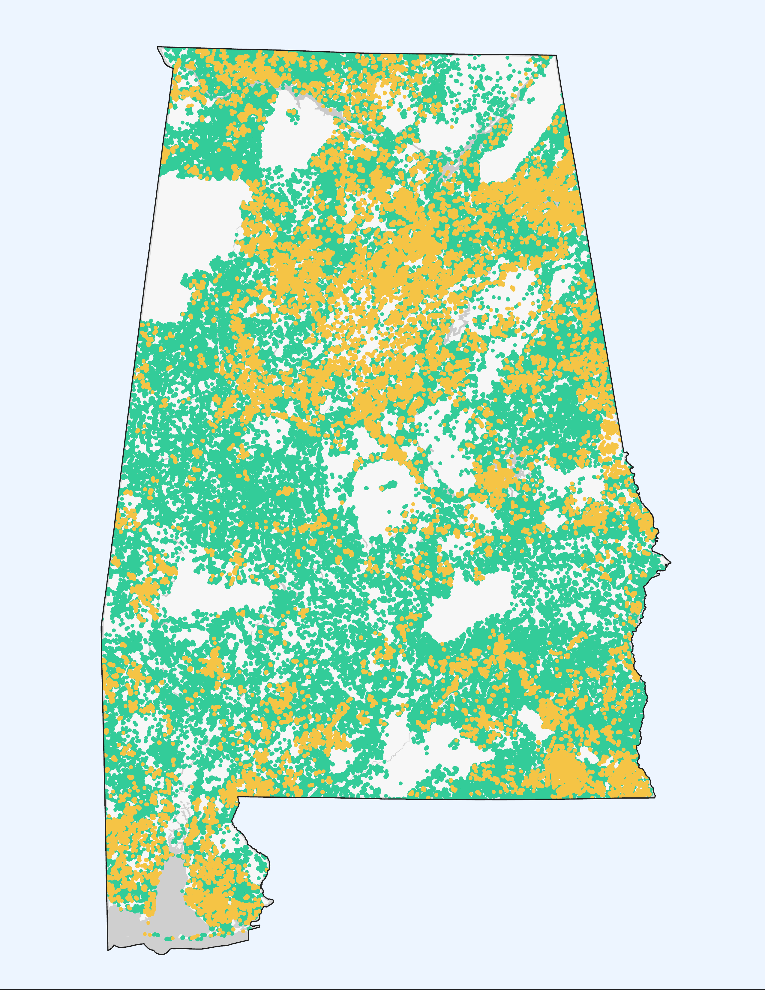
Preliminary map of eligible locations
Based on the current FCC map, which is changing on an ongoing basis, Alabama has 331,209 unserved and 96,641 underserved Broadband Serviceable Locations.
Under federal rules, the FCC map will be the basis for determining what locations are eligible for BEAD funding.
ADECA’s Challenge Process will happen in early 2024.
In the meantime, communities and the public can file challenges of inaccurate map data with the FCC; if filed soon, this will help improve the map for 2024 grant decisions.
https://broadbandmap.fcc.gov/home
Unserved locations
Underserved locations
26

Slide 27
ADECA Challenge Process timeline
The Challenge Process is expected to begin in early 2024, using an online portal.
1
2
3
Challenge
Rebuttal
Determination
Challenger has 30 days to submit a challenge once process is opened
ISPs have 30 days from notification of a challenge to provide a rebuttal
ADECA has 30 days to make a final determination
NTIA must approve the completed Challenge Process in ADECA’s Initial Proposal Volume 1 before the grant program can begin.
27

Slide 28
7
The Initial Proposal Volume 2
28

Slide 29
Initial Proposal Volume 2
All are eligible for public comment through December 14
Grant program structure
Scoring criteria
Describes how ADECA plans to structure and manage the grant program, including how grant funding areas will be determined
Describes how ADECA plans to award points for each application, based on federal requirements for scoring and the state’s priorities
Mandatory low-cost service offering
Application requirements
Describes how ADECA plans to require awardees to comply with the federal requirement that all awardees offer a low-cost option to low-income households
Describes the information and certifications that ADECA will require in all applications, to align with the federal and state requirements
29

Slide 30
Background: Federal rules frame & contain state decision making
All states are obligated to develop a solution for 100% of unserved locations
Unserved locations are first priority for funds
Fiber must be prioritized, with other technologies funded only if fiber is too costly in a given area
Cost is a major, mandatory factor in scoring
Timeline is compressed
Structure of the grant program is left to states to determine, subject to federal approval
States must require awardees to offer a low-cost service offering for low-income households
30

Slide 31
ADECA's proposed grant structure
1
2
3
4
5
Application preparation
Scoring
“Extremely High Cost Per Location Threshold”
Negotiation
Provisional awards
ADECA will score all priority (fiber) and non-priority (non-fiber) applications based on the relevant scoring rubric
ADECA will prioritize bids that propose to serve 100% of locations with fiber at costs under the EHCPLT
ADECA will negotiate to develop solutions for counties and areas that did not receive any bids or for which costs exceed the EHCPLT
ADECA will provisionally award projects
ADECA will prepare the Final Proposal to NTIA to seek approval of the provisional awards
The Final Proposal will be released for public comment for 30 days before submission to NTIA
Applicants will select the counties they want to serve
Applicants will be required to propose a cost to build broadband to unserved and underserved locations in the county
Applicants may apply to serve 100% of locations or fewer
ADECA will set the cost Threshold above which non-priority (non-fiber) bids can be funded, given federal fiber preferences
31

Slide 32
Priority Project scoring rubric
Primary scoring criterion (all are mandatory under NTIA rules) | Points available
Minimum BEAD Program outlay (cost) | 40
Affordability of services of 1/1 Gbps | 20
Fair labor practices | 15
Primary Criteria subtotal | 75
Secondary Criteria
Speed to deployment (mandatory under NTIA rules) | 1
Community/Local government/Tribal government support | 10
Percentage of unserved locations | 10
Lower-cost residential service | 4
Secondary Criteria subtotal | 25
Total | 100
32

Slide 33
Other Last-Mile Broadband Deployment Project scoring rubric
Primary scoring criterion (all are mandatory under NTIA rules) | Points available
Minimum BEAD Program outlay (cost) | 40
Affordability of services of 100/20 Mbps | 20
Fair labor practices | 15
Primary Criteria subtotal | 75
Secondary Criteria
Speed to deployment (mandatory under NTIA rules) | 1
Speed of network and other technical capabilities (mandatory under NTIA rules) | 10
Community/Local government/Tribal government support | 10
Lower-cost residential service | 4
Secondary Criteria subtotal | 25
Total | 100
33

Slide 34
Issues for comment: Application scoring
Federal rules prescribe how applications can be scored, assigning 75% of points to
Cost
Affordability of service
Compliance with labor standards
Federal rules also require inclusion in scoring for speed to deployment and, for “non-Priority” (non-fiber) projects, technology capability.
ADECA can propose how it will score with the remaining points.
Potential issues for comment:
Has ADECA proposed the appropriate criteria for the points states can select?
Should any element of ADECA’s scoring criteria and weighting be revised?
34

Slide 35
Issues for comment: Design for grant areas
1
2
Federal rules allow states to design grant areas themselves or enable applicants to propose their own grant areas.
ADECA proposes to require applicants to submit applications for each county, either for 100% of unserved and underserved locations, or for a lower percentage.
Applicants will be permitted to propose to serve less than a full county if they choose – but would be cautioned that excessive exclusions will result in a lower score. In addition, ADECA will prioritize applications that propose to serve 100% of locations if possible. ADECA will allow applications to be submitted by consortia.
Potential issues for comment:
Is the county-based approach appropriate?
Is there an alternative approach ADECA should consider for achieving the goal of receiving well-priced proposals that would ensure coverage to all unserved and underserved locations statewide?
35

Slide 36
Issues for comment: Required low-cost service offering
1
2
Federal rules require states to define a mandatory low-cost service offering that grant awardees must offer to low-income households.
ADECA proposes to require recipients of BEAD funds to offer a 100/20 service offering priced at $70 or less per month for low-income households. Consistent with federal requirements, this product would be available to households earning up to 200% of the federal poverty line and would be effectively reduced to $40 for households that make use of the federal Affordable Connectivity Program subsidy of $30 per month.
Potential issues for comment:
Is the proposed service fee structure appropriate for low-income Alabama households?
Is the eligibility level (200% of federal poverty level) appropriate?
36

Slide 37
8
Next steps
37

Slide 38
Upcoming activities
Following submission of the plans in 2023, 2024’s activities will involve executing the Challenge Process and grant program
1
2
3
Submission of Initial Proposal
Challenge Process
Grant program
Both Volumes 1 and 2 will be submitted to the federal government by the end of the year, following public comment
The Challenge Process will launch in early 2024 when the federal government approves Volume 1
The grant program will launch in 2024 when the federal government approves Volume 2
38

Slide 39
Connect with us
Website: http://adeca.alabama.gov/broadband
Email: broadband.fund@adeca.alabama.gov
Phone: (334) 353-0767
Stay informed: adeca.alabama.gov/broadband-alabama-mailing-list/

