Slide 1
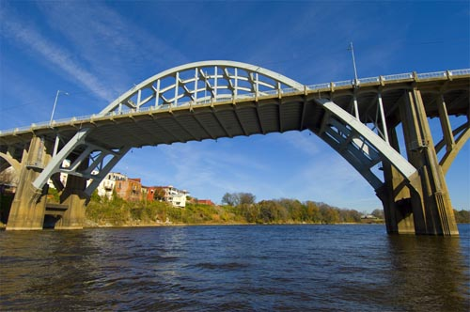
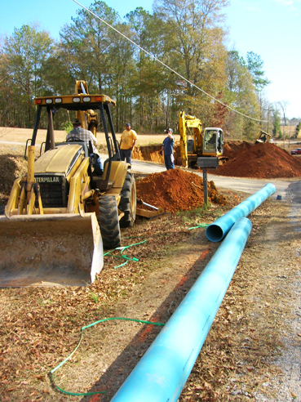
Community and Economic Development (ced) Division CDBG PLANNING GRANTS
Kathleen A. Rasmussen, Ph.D.
Division Chief
Kathleen.rasmussen@adeca.alabama.gov
(334)353-0323

Slide 2
CDBG Planning Grants
The CDBG Planning Fund’s allocation will be awarded to those local governments who demonstrate the need for local planning.
Eligible applicants for Planning Grant funds include the non-entitlement local governments that meet the eligibility requirements listed under the “Thresholds” section in the 2024 CDBG Grant Application Manual.

Slide 3
CDBG Planning Grants
Purpose: To assist communities having a need for comprehensive planning or other planning. Eligible plans include comprehensive plans, elements of comprehensive plans, downtown revitalization plans, or other strategies and studies important to sound and effective community growth and development.
Maximum grant amount: $40,000, although grant applications may request a smaller amount.
Cash match: 20% of the project cost is required.
Note: Cash match for jurisdictions of 1,000 or less population (as determined by the 2020 Census) may be waived.

Slide 4
CDBG Planning Grants
Evaluation Considerations
The Planning Fund grant awards will be evaluated based on the following 6 evaluation criteria:
Criteria 1. How the proposed project’s planning activities will contribute to one of two National Objectives (either principally benefiting persons of low-income and moderate-income/LMI, or how the proposed project’s planning activities will contribute to aiding in the prevention of slums and blight).
Criteria 2. The need of the proposed project’s planning activities that is stated in the grant application.
Note: ADECA reserves the authority to not fund a Planning Fund grant application if the need is not clearly demonstrated, and if the amount requested is not appropriate for the plan or the size of the planning area involved.

Slide 5
CDBG Planning Grants
Criteria 3. How the proposed project’s planning activities will contribute to the development of a planning process which will serve as a guide for orderly and/or consistent growth and community development.
Criteria 4. How the proposed project’s planning activities will aid in, or contribute to, the involvement or creation of various community groups, advisory councils, planning/zoning districts, redevelopment authorities, etc., in the local government’s ongoing planning process.

Slide 6
CDBG Planning Grants
Criteria 5. The amount of grant funds requested relative to: the size of the community,
the complexity of the proposed elements,
the final product.
This consideration will be particularly important where larger grant amount requests are involved (up to $40,000).
Criteria 6. The local government’s prior years of CDBG grants received, as well as the local government’s implementation of its prior planning efforts.

Slide 7
CDBG Planning Grants
If a planning grant is for downtown revitalization, regional development, or orderly area growth, then:
“Planning” activities can include:
Developing Comprehensive Plans
Developing individual elements or sections within a Comprehensive Plan
Developing Downtown Revitalization
Plans
Developing Regional Strategies

Slide 8
QUESTIONS?
CED Division Chief
Kathleen A. Rasmussen, Ph.D.
Kathleen.rasmussen@adeca.alabama.gov
(334) 353-0323
CED Statewide Initiatives Unit Chief
and CDBG Program
Kathleen A. Rasmussen, Ph.D.
Kathleen.rasmussen@adeca.alabama.gov
(334) 353-0323

