Slide 1
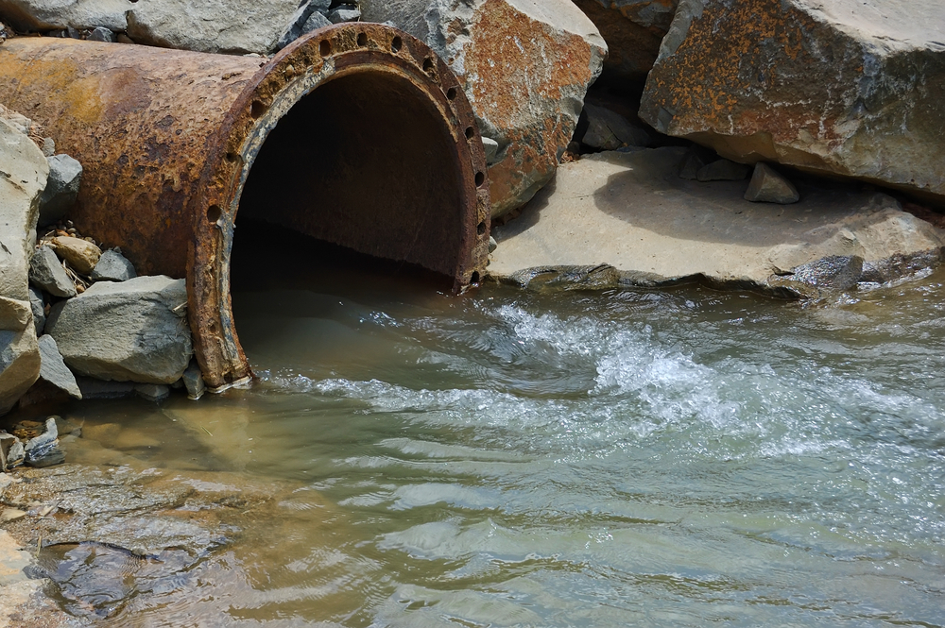
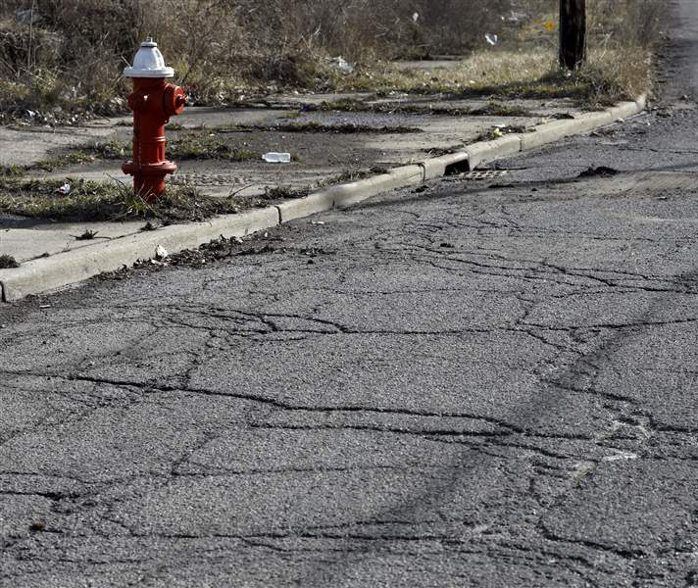
2024 Application Workshop Engineering
Chris Perkins, PE
CED Engineer/Environmental Specialist
334-353-1028
christopher.perkins@adeca.alabama.gov
Notes:
Hello everyone. My name is Chris Perkins, and I am the Engineer for the CED Division. My contact information is seen here on this slide. Feel free to contact me.

Slide 2
Environmental Considerations
Radon must be considered in the Site Contamination analysis
Applies to CEST and EA levels of review only AND involve structures occupied for 4 hrs minimum
Check for exemptions in HUD’s Notice CPD-23-103
Licensed Professional
State/Local Health Departments
DIY Kits
Scientific Data Review (National Environmental Public Health Tracking, Radon Testing) (see CPD-23-103 for requirements)
Notes:
The Preliminary Engineering Report or PER is what I look for in the application. Within the PER I expect you to describe to me the Existing Conditions of the Project Area, your proposed solutions to fix the problems indicated, project maps or drawings and lastly a cost estimate.

Slide 3
Buy American Preference Applies to
Iron & Steel (began with 2023 funding)
Specifically Listed Construction Materials (starts with 2024 funding)
Non-ferrous metals
Lumber
Plastic- and polymer-based composite building materials, pipes and tubes
Notes:
The Preliminary Engineering Report or PER is what I look for in the application. Within the PER I expect you to describe to me the Existing Conditions of the Project Area, your proposed solutions to fix the problems indicated, project maps or drawings and lastly a cost estimate.

Slide 4
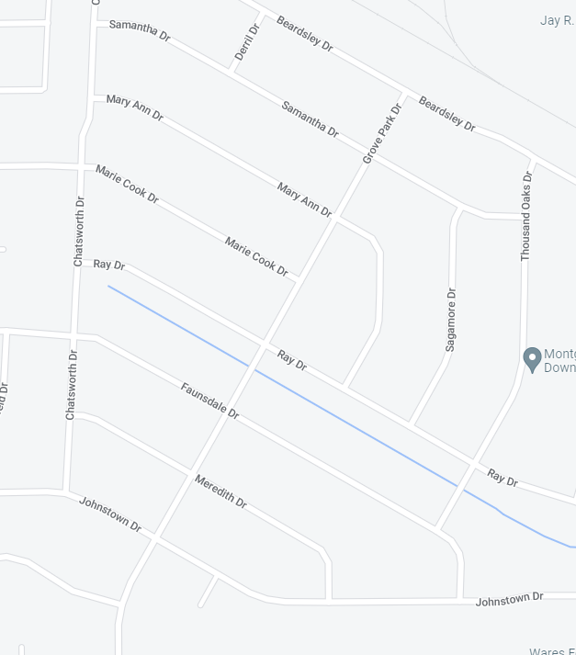
Project Description Location Issues
32.396, -86.233
Method 1: Project is located along Chatsworth Dr from Johnstown Dr to Marie Cook Dr, along Ray Dr from Chatsworth Dr to Thousand Oaks Dr and along Grove Park Dr from Johnstown Dr to Beardsley Dr.
529
251
32.394, -86.239
204
Method 2: Project is located from 25 - 251 Chatsworth Dr, from 204 - 802 Ray Dr and from 101 - 529 Grove Park Dr.
32.395, -86.239
32.393, -86.236
32.391, -86.239
Method 3: Project is located from along Chatsworth Dr (32.391, -86.239 to 32.395, -86.239), along Ray Dr (32.394, -86.239 to 32.393, -86.236) and along Grove Park Dr (32.390, -86.238 to 32.396, -86.233).
101
802
25
32.390, -86.238

Slide 5
Preliminary Engineering Report (PER)
Existing Conditions
Proposed Solutions
Project Maps/Drawings
Cost Estimate
Notes:
The Preliminary Engineering Report or PER is what I look for in the application. Within the PER I expect you to describe to me the Existing Conditions of the Project Area, your proposed solutions to fix the problems indicated, project maps or drawings and lastly a cost estimate.

Slide 6
Existing Conditions
Brief description of entire system
Description of the issue or problem
Current Pictures that show the problem and the problem area
Charts/Graphs that help visualize the problem
Aerial photos of the problem area (the higher the quality the better)
Etc.
Notes:
When reviewing the existing conditions please give a very brief description of the system in its entirety. But what I’m really looking for is a description of what the actual issue or problem is. Things that you can include in the PER to help illustrate the problems include pictures showing things like, crushed drainage pipes, broken drainage inlets, potholes and cracks in asphalt, root protrusions in sewer lines, corroded or clogged water lines and aerial photos of the problem areas. Other useful items may include charts or graphs that can help in visualizing the data.

Slide 7
Proposed Solutions
Description of the solution
What the plan is to correct the situation
How the plan alleviates the situation
Life expectancy of the solution
Alternatives to the selected solution considered and reason for non-selection
Multi-phased projects
Optional methods of construction
Optional construction materials
Notes:
The second thing I look for is the description of the solution; what is your plan to alleviate the problem and how does this plan fix the issues indicated. You should provide the life expectancy of the solution that you have presented. Also, include alternatives to the plan that you’ve selected and why you chose not to use those alternatives. The most common alternatives explored include multi-phase projects, different methods of construction and different construction materials.

Slide 8
Project Maps/Drawings
Project location/vicinity map
Project Site Limits map
Existing conditions drawing (superimposed on an aerial photo if possible)
Proposed construction drawing (superimposed on an aerial photo if possible)
Consider showing the proposed construction drawings on project area photos
Project limits outlined on an aerial photo/drawing
Important for Environmental Reviews
Project area photo location and direction map (descriptions w/photos)
Consider adding GPS coordinates for the project
Notes:
Now not everyone submits stellar maps or drawings so let’s talk about them for a few minutes. I mention this now since a lot of times the Engineers are the ones that provide these items. At this point in your project’s development not many Engineer’s have devoted the resources to having a set of plan drawings created and that’s perfectly understandable. But, if you want to be sure that we not only understand your project but completely comprehend what you intend to do and where exactly you intend to do it, then please spend a little bit of time on getting your maps and drawings in tip top shape. I’ll give you some examples in a minute. These are some of the types of maps you may want to include in your application.

Slide 9
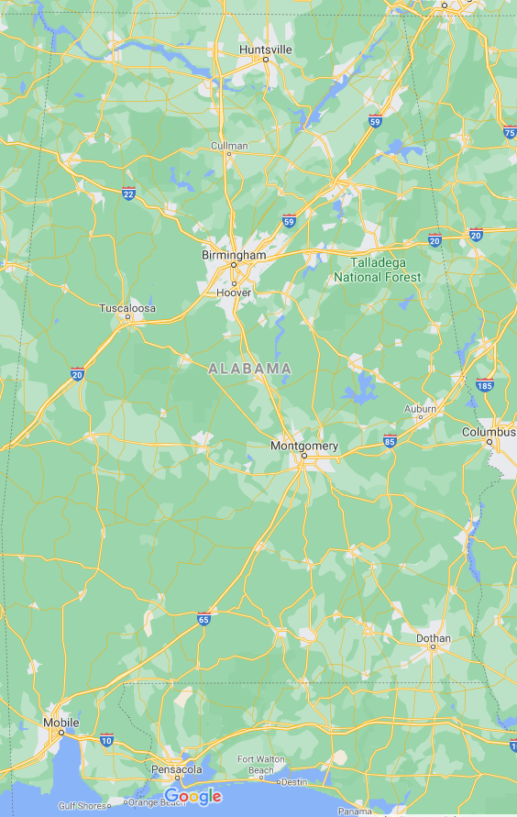
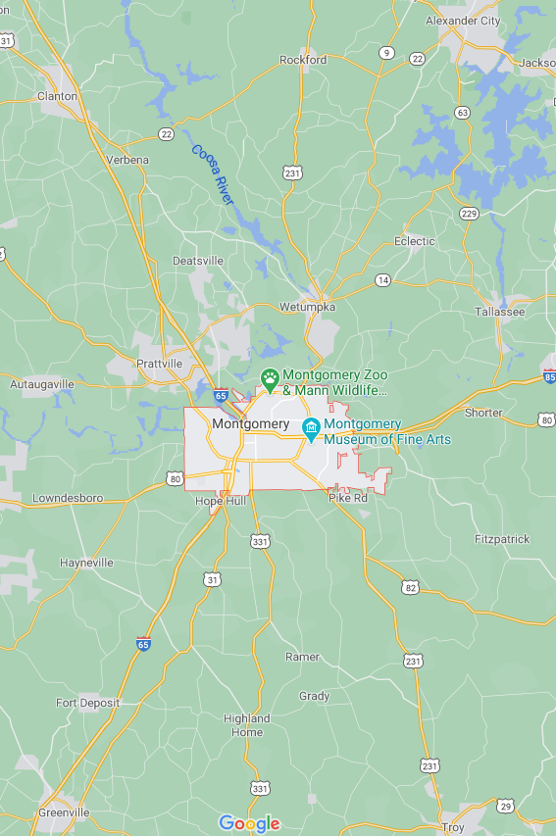
Project Location
Project Location
Notes:
These are examples of project vicinity or location maps that we get a lot of times. These indicate that this project is in the City of Montgomery. Well, we know that because it’s on the cover page. Now for smaller towns that might be a little lesser known, these types of maps are fine for at least getting us looking in the correct part of the state. Just don’t let this be the only project vicinity map you include.

Slide 10
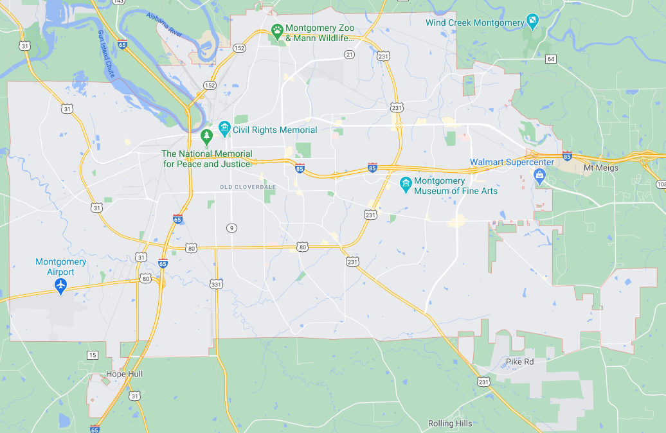
Project Vicinity Map
Project Location
Notes:
In this example of a project vicinity map we can at least tell that the project is in the southern portion of the city but we’re still not crystal clear on where the project is exactly. Remember that we aren’t necessarily sitting at a computer and can call up Google Maps to make sense of what you’ve written. The easier you make it on us the better for everyone.

Slide 11
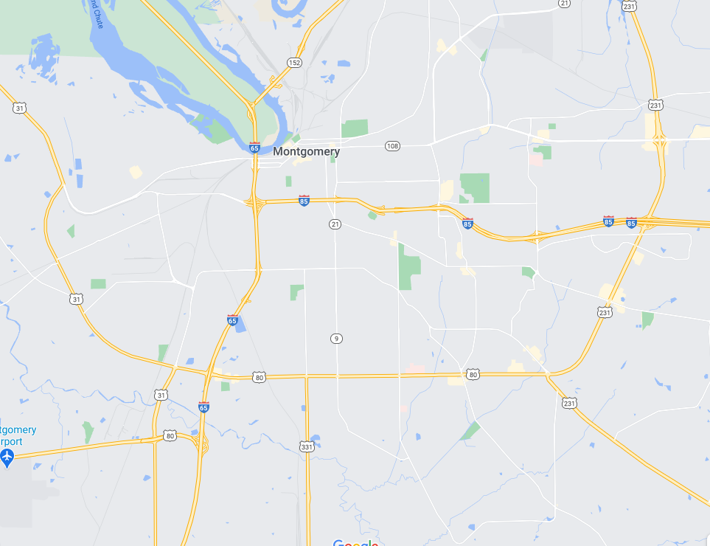
Minority Population
LMI Area
Notes:
This is typically what we are given for Minority Population, LMI Areas and even Limited Clientele Location maps. These are not very specific and leave a lot of room for interpretation and that’s not always a good thing.

Slide 12
LMI & Minority Population Location Map
N
Minority Population
Project Area
LMI Area
Notes:
This example gives a much more exact indication of where those locations are found. And our favorite part about this map is that it shows where the project is located with respect to the Minority Population and LMI Areas. This example shows that the project area is completely contained within the LMI and Minority Population areas. This isn’t always the case. In those instances, your project area shape will extend beyond those area lines.

Slide 13
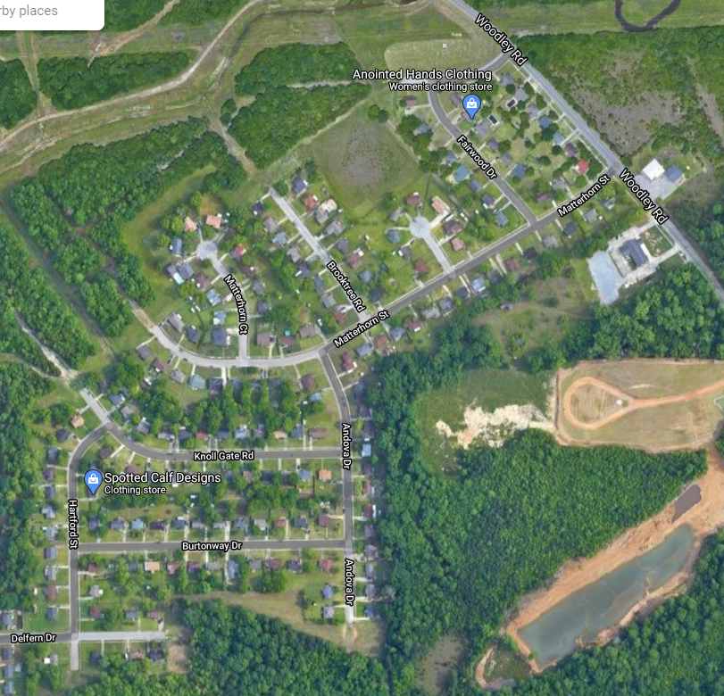
Project Site Limits & Activity Map
Project Location
N
32.3003, -86.2485
Legend
- Project Limits
- Street to be resurfaced
Notes:
In addition to the maps that we’ve already reviewed, with a project location map like this, we can tell exactly what the limits of the project are, which streets and houses are included in the project limits, which direction is North and the centroid coordinates just in case we want to look it up on the computer. One quick note about street names. Please make sure that the names are included on your maps or drawings and that they are legible. Sometimes they aren’t shown, or the street has multiple names, or a street splits and picks up somewhere else in the city.

Slide 14
Project Site Limits & Activity Map
Project Location
Sheet 1
Sheet 2
Sheet 3
Sheet 4
N
32.3003, -86.2485
Legend
- Project Limits
- Street to be resurfaced
Sheet 5
Notes:
Now, if the scale on your map or drawing is too large, or small, depending on how you see it, consider breaking the project site up into multiple maps using matchlines to help indicate which map shows which part of the project area.

Slide 15
Project Area Photo Location Map
Project Location
Pic 1
Pic 2
Pic 3
N
32.3003, -86.2485
Pic 4
Legend
- Project Limits
- Street to be resurfaced
Notes:
This next map isn’t required but it does assist us in locating where the pictures that you provided in the application were taken. It is what I call a project area photo location map. It indicates exactly where you took the photos that you’ve provided and which direction you were looking. Especially helpful in locating potholes and drainage overflow areas. So consider adding this one to your application.

Slide 16
Cost Estimate
Reasonable
Sufficiently Detailed
Update Estimates if Resubmitting
Separation of Activities or Work Areas
New Fee Schedule – See new “Engineering/Architectural Service Requirements”
Engineering – 20% Max (includes inspection, based on total construction cost)
Architectural – 12% Max (includes inspection, based on total construction cost)
Eligible Additional Services (Eng/Arch)
DO NOT include in the construction costs
Notes:
Ok. Enough about maps and drawings. Let’s talk money. The last thing I look for in the PER is the cost estimate. A Cost Estimate should be sufficiently detailed and the estimated costs should be reasonable for the time of year construction is planned as well as the quantities estimated.
If you are resubmitting an application, please update the cost estimate, there have been several events take place that either have had or will have an affect on prices going forward.
If you want to separate your estimate based on work areas or activities that’s fine just don’t calculate any fees based on those subtotals. Use the total construction cost.
Eligible Additional services are allowed and if your application is selected for funding the Engineer must provide a report detailing how this additional service differs from the required basic service and how you calculated your fee. This information should accompany your Engineering Service Agreement submittal.

Slide 17
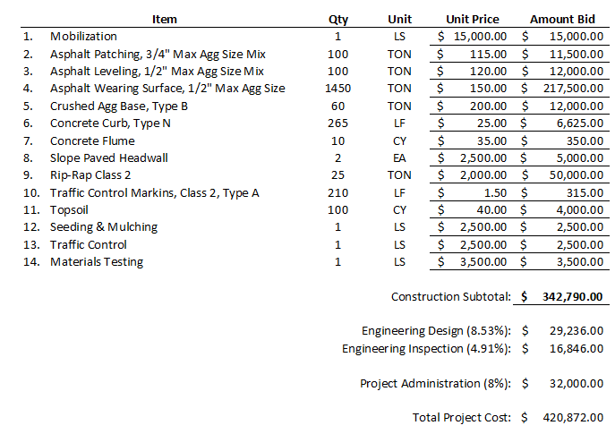
Cost Estimate
Preferred Format
Check your math
Horizontally and Vertically
Grant Writers, double check the Engineer’s Math
Engineering (20%):
68,558
443,348

Slide 18
SUMMARY
4 Parts to the PER – Existing Conditions, Proposed Solution, Maps/Drawings & Cost Estimate
Tell your Story
Use Maps and Pictures to Emphasize your Story
Assist with Environmental Reviews when Possible
Notes:
To summarize, there are 4 parts to the PER that I look for, the existing conditions, proposed solution, maps or drawings and the cost estimate. Tell us your story and be sure to use maps and pictures to emphasize your points. And Engineers, when possible, help with the environmental reviews since I’m basing the required level of review off what you are telling me in the PER.

Slide 19
Notes:
That’s my time and if you have any questions be sure to email me. Good Luck.

