Slide 1
BEAD and Digital Opportunity Planning
October 2023

Slide 2
Agenda
BEAD and Digital Opportunity planning efforts
Community input on BEAD and Digital Opportunity plans
Next steps: the Initial Proposal and Challenge Process
Bibb County | 2

Slide 3
1
BEAD and Digital Opportunity planning efforts
3

Slide 4
Overview: BEAD and Digital Opportunity planning
ADECA is currently administering the CPF and AIMM, while also developing two sets of plans – one for infrastructure and one for Digital Opportunity – that will unlock additional federal funds.
CPF and AIMM Grant Programs
Broadband Equity, Access, and Deployment (BEAD) plans
Digital Opportunity Plan
Using funds from the American Rescue Plan Act, ADECA is administering two grant programs:
Capital Projects Fund (CPF) for last-mile broadband infrastructure
Anchor Institution/Middle Mile (AIMM) for deploying middle-mile and connecting Anchor Institutions
A series of plans that will be submitted to the federal government to access Infrastructure Act funding for construction of new broadband infrastructure.
A plan that will be submitted to the federal government to access funding for programs to help Alabama households afford, adopt, and use broadband.
Aug. 28: Five Year Action Plan submitted to federal gov’t
Nov.: Initial Proposal Volumes I & II public comment periods will open for 30 days
Oct. 13: Application periods close for both programs
Mid-Oct. to mid-Nov.: Public comment period
Nov. 30: Submit to federal gov’t
4

Slide 5
Overview of the BEAD program
In June, Alabama was allocated $1.4 billion of federal BEAD funds that will become available following completion of the federal planning cycle.
Funds are prioritized for unserved locations first—those that cannot get internet service of 25/3 Mbps– and underserved second--those that can get internet service between 25/3 and 100/20 Mbps only.
ADECA has submitted to the federal government the first of four BEAD plans, with others currently in preparation.
BEAD planning Challenge Process and provisional grant program Deployment
2023
2024
2025
5

Slide 6
BEAD plan status
5-Year Action Plan
Submitted Aug. 28
Initial Proposal
In preparation
Final Proposal
Likely to be submitted in late 2024 or early 2025
The Initial Proposal has two volumes that describe the proposed grant program elements, design, and rules. Following federal approval, ADECA will begin the grant program, likely in early 2024
After final award plans are submitted to the federal government and approved, construction can begin
This is the framework and plan for universal broadband. The plan includes input from State and local partners
6

Slide 7
Digital Opportunity plan status
ADECA conducted extensive outreach to communities, Tribes, nonprofits, institutions, and the public.
The draft plan will open for public comment later this month and will be submitted to the federal government by Nov. 30.
Federal approval of the plan will be part of how Alabama accesses related federal funds next year.
Elements of Digital Opportunity
Broadband Access
Affordable, accessible, and reliable high-speed home internet service is available for all.
Accessible and Inclusive Content
Public online content is accessible by all.
Devices and Tech Support
Individuals have access to a computer or tablet and technical support.
Privacy and Security
Individuals can protect their data privacy and online security.
Digital Skills
Individuals have digital skills to use the internet in their daily lives.
7

Slide 8
BEAD and Digital Opportunity overall timeline
2023 Q1-2
2023 Q3-5
2024 Q1-2
2024 Q3-4
2025 >
1
Community engagement
Continues through planning and execution cycles
2
Digital Opportunity planning and programs
Planning and Digital Opportunity Plan
State grants
Federal grants
3
BEAD planning
5-Year Action Plan and Initial Proposal
Final Proposal to federal gov’t
4
BEAD grant
program
Grant program
5
BEAD deployment
Grant execution
8

Slide 9
Public comment timeline
2023 Q1-2
2023 Q3-4
2024 Q1-2
2024 Q3-4
2025 >
Digital Opportunity plan
1
BEAD infrastructure plan
Initial Proposal
Final Proposal
2
Public comment opportunity
9

Slide 10
2
Community input and perspectives
10

Slide 11
Local and partner input
2022 and ‘23 interactions to ensure
local and partner input…
…continues into ‘24 and ‘25
grant cycle
In-person meetings in every county
Publication of 67 detailed county broadband profiles and 67 online presentations to local officials in all counties
Phone survey of thousands of Alabama households
Facilitated sessions or one-on-one meetings with ISPs, agencies, nonprofits, and other partners
Partner program questionnaires and inventories
Public comments on Digital Opportunity Plan and Initial Proposal Volume 1 (coming up)
One-on-one responsive meetings
Targeted outreach
Challenge process information and opportunity
Conferences and presentations
Statewide information sessions
Public comment opportunities
11

Slide 12
Findings and themes
Deployment
Affordability
Digital Skills
Lack of reliable broadband access creates barriers for communities to achieve economic development goals
In rural areas of Alabama, low density of homes creates an obstacle to deployment that means many locations are unserved or underserved
Workforce opportunities abound, as the new State and federal funds will create new jobs in broadband construction and maintenance
Many low-income households struggle to afford broadband services
Affordable Connectivity Program use helps many households afford and maintain broadband connectivity
Growing and expanding successful device lending programs would support affordability
Multiple organizations across the state offer digital skills training and there exists opportunity to expand those programs
A wide range of partner organizations is engaged in supporting development of digital skills
Digital skills challenges are frequently experienced by lower-income individuals and seniors
12

Slide 13
3
Next steps: The Initial Proposal and
Challenge Process
13

Slide 14
Initial Proposal
The Initial Proposal describes how ADECA plans to administer the BEAD grant program
Initial Proposal Volume I
Initial Proposal Volume II
Is currently in preparation and will be available for public comment in coming weeks
Describes how ADECA will run its Challenge Process in 2024 to finalize the list of locations eligible for funding
Describes how ADECA has defined “Community Anchor Institution” and lists those that lack service
Is currently in preparation and will be available for public comment later in the fall
Describes how ADECA will structure the grant application and process, as well as the scoring criteria and rules for participation
14

Slide 15
Initial Proposal Volume I: 4 key sections
Will be available for public comment in November
Existing Broadband Funding
Unserved and Underserved Locations
Current sources of federal and state funding to deploy broadband and close the digital divide in Alabama
How ADECA developed lists of the locations that are unserved or underserved and thus eligible for BEAD-funded deployment
Community Anchor Institutions
Challenge Process
Discussion of criteria used to identify CAIs that lack access to 1Gbps symmetrical services and a preliminary list of qualifying CAIs
Rules to define a transparent and fair Challenge Process to meet the goals of the BEAD program
15

Slide 16
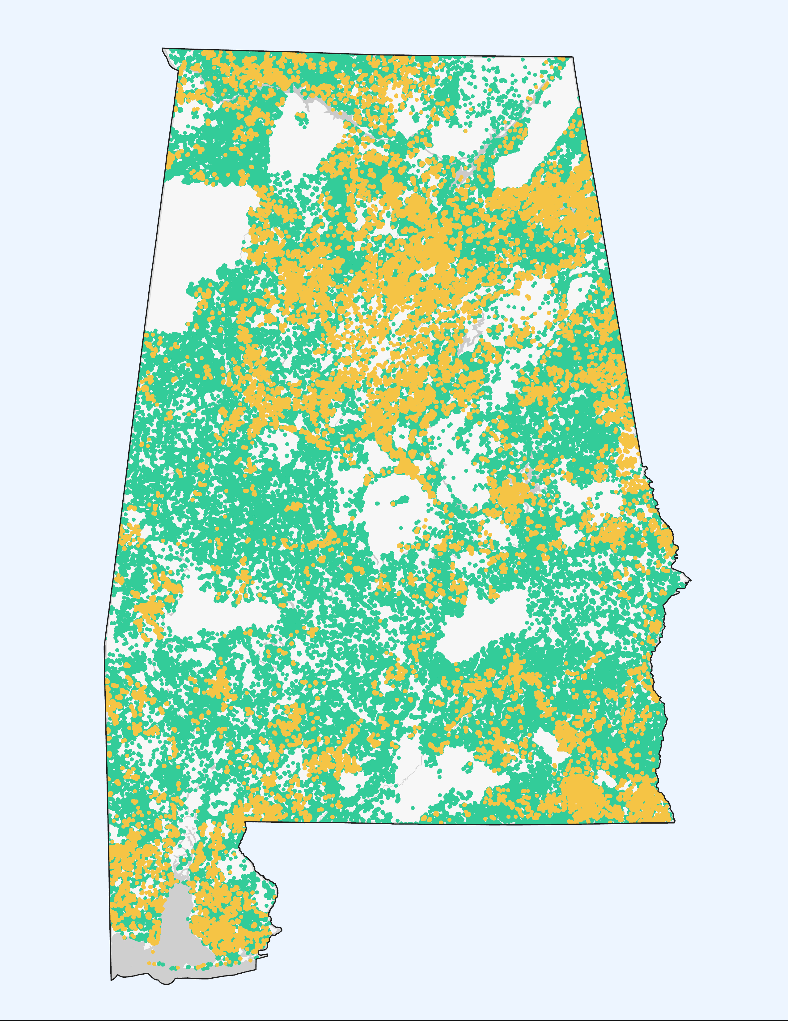
Preliminary map of eligible locations
Alabama has 190,157 unserved and 76,338 underserved Broadband Serviceable Locations.
Under federal rules, the FCC map will be the basis of determinations of what locations are eligible for BEAD funding.
ADECA’s challenge process will happen in early 2024.
In the meantime, communities and the public can file challenges with the FCC to inaccurate map data; if filed soon, this will help improve the map for 2024 grant decisions.
https://broadbandmap.fcc.gov/home
Unserved locations
Underserved locations
16

Slide 17
ADECA challenge process timeline
The Challenge Process is expected to begin in January or February 2024, using an online portal.
1
2
3
Challenge
Rebuttal
Determination
Challenger has 30 days to submit a challenge once process is opened
ISPs have 30 days from notification of a challenge to provide a rebuttal
ADECA has 60 days to make a final determination
NTIA must approve the completed Challenge Process in Initial Proposal Volume I before the grant program can begin.
17

Slide 18
Initial Proposal Volume II: key sections
Will be available for public comment in November
Subgrantee Selection Process
Low-cost Service Offering
How the grant program will be structured and administered, including proposed scoring for grant evaluation
How ADECA will require grantees to provide an affordable option for lower-income consumers served over grant-funded infrastructure
Barriers and Obstacles
Grant Oversight
How the state will address any potential obstacles to deployment related to utility pole access, rights-of-way, and permitting
How ADECA will monitor grantees, verify compliance with grant contract requirements, and enforce grant obligations
18

