Slide 1
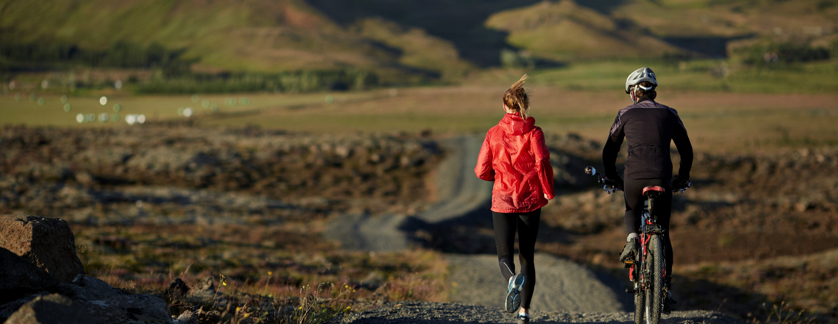
Recreational Trails Program
FY 2023
z

Slide 2
- Program Updates - General Program Eligibility - Application Process - Open Discussion and Questions and Answers
z

Slide 3
Program Updates
z

Slide 4
The RTP was created in 1998 to assist in acquiring, developing, and/or improving trail and trail related resources. The funds are appropriated by Congress to the U.S. Department of Transportation, Federal Highway Administration (FHWA), and FHWA allocates the funds through state agencies as a grants program to subrecipients.
Program Information
Estimated Funds Available for RTP | Approximately $1,600,000.00
Maximum Grant-Non-motorized (varies by trail type and activity) | $200,000.00 - $400,000.00
Maximum Grant-Motorized | $524,937.00
Federal Share | 80%
Allowable Matching Source | Cash and/or In-kind
FY 2023 Application Due Date | 12 Noon, September 12, 2022
Project Selection Process | Competitive

Slide 5
www.adeca.alabama.gov/trails/
All forms & information available at:
z

Slide 6
General Program Eligibility
z

Slide 7
Eligible Applicants
All applicants must be currently registered in SAM.gov with a Unique Entity Identifier (UEI). Applications from project sponsors not meeting this criterion will be deemed ineligible and will not be reviewed. Eligible applicants include:
Local Governments
State Agencies
Federal Agencies

Slide 8
Maximum Grant Size
The maximum grant amount is:
$200,000 for non-motorized, single-use trail activities
$400,000 for non-motorized, diverse-use trail activities
$524,937 for motorized, diverse-use trail activities
$87,489 for educational projects which promote safety and environmental protection
At least 30 percent of Alabama’s RTP funds must be used for motorized trail uses, at least 30 percent for non-motorized trail uses, and at least 40 percent for diverse trail uses. Diverse motorized projects (such as ATV and motorcycle use) or diverse non-motorized projects (such as pedestrian and equestrian use) may satisfy two of these categories at the same time. The State encourages applicants to consider projects that benefit both motorized and non-motorized users, such as common trailhead facilities.

Slide 9
Matching Requirement
The Federal share for the RTP is up to 80% of the total eligible project costs up to the grant ceiling. The non-Federal share (at least 20% or the remaining project cost) may come from state, local, and/or private sources.
Other Federal shares cannot be used as a source of match unless specific legislation allows funds to be used for the matching share (e.g., HUD Community Development Block Grants (P.L. 93-383), Public Works Employment Act of 1976 (P.L. 94-369).
Federal agency applicants and applicants wishing to use other Federal funds to match the RTP funds should contact Recreation and Conservation Programs’ staff prior to applying.

Slide 10
Permissible Uses
z

Slide 11
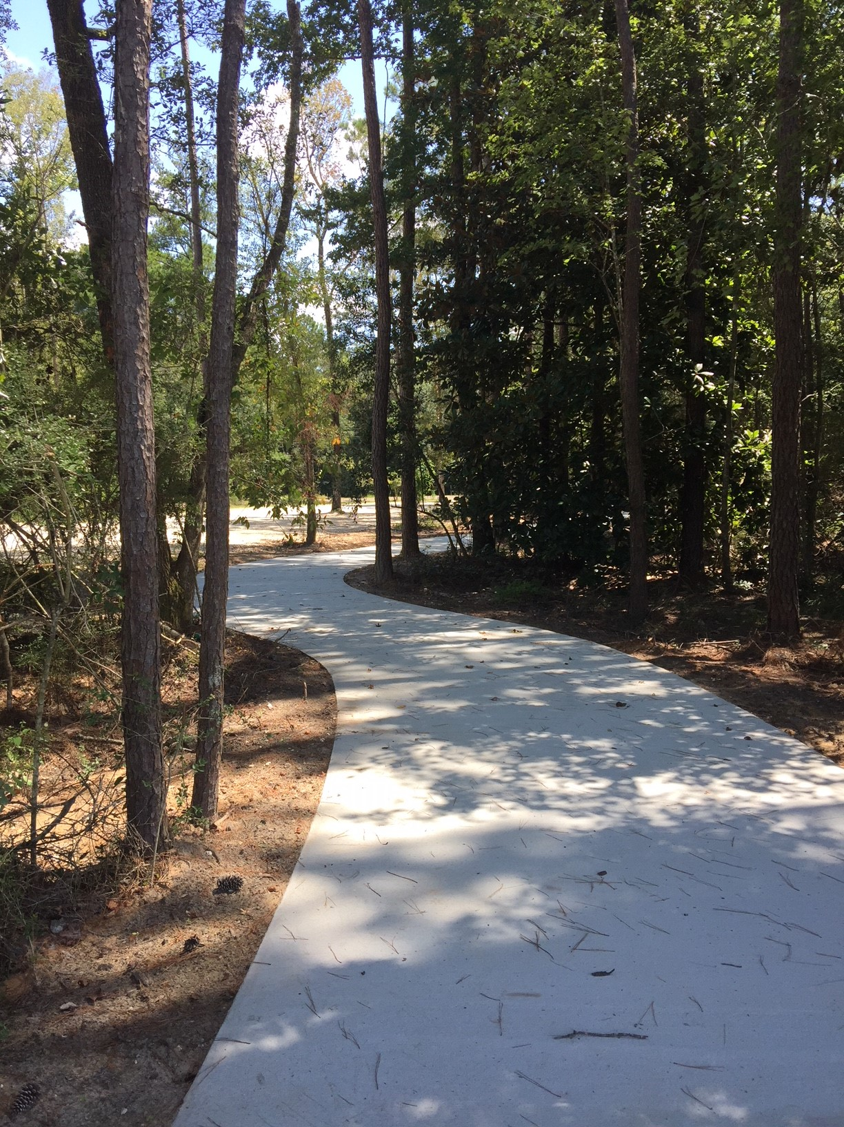
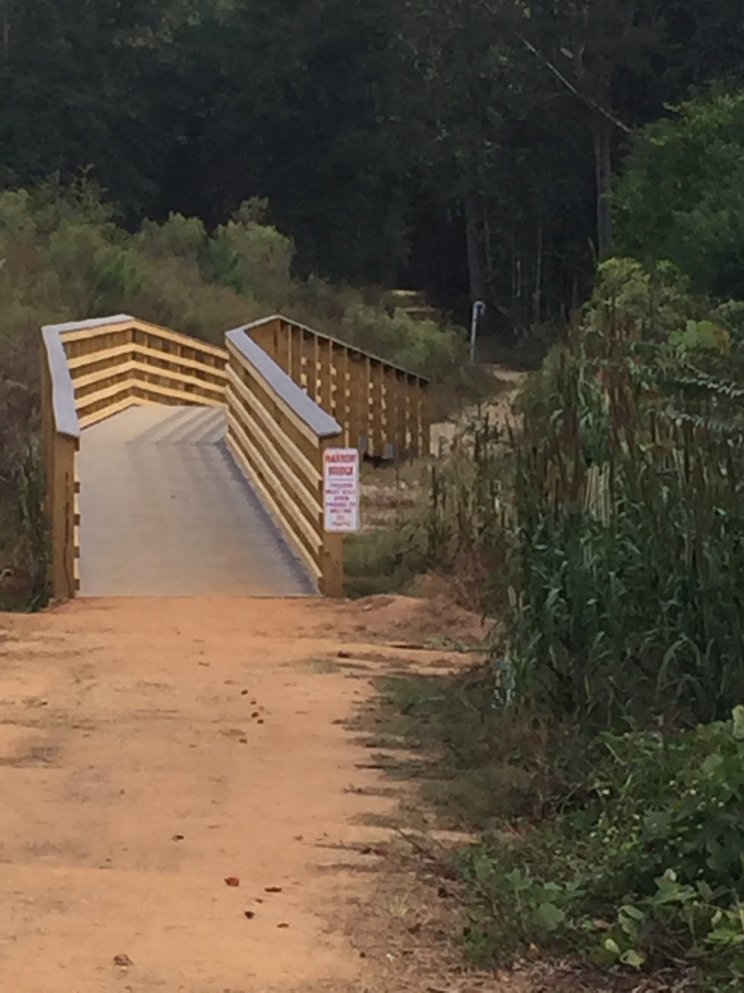
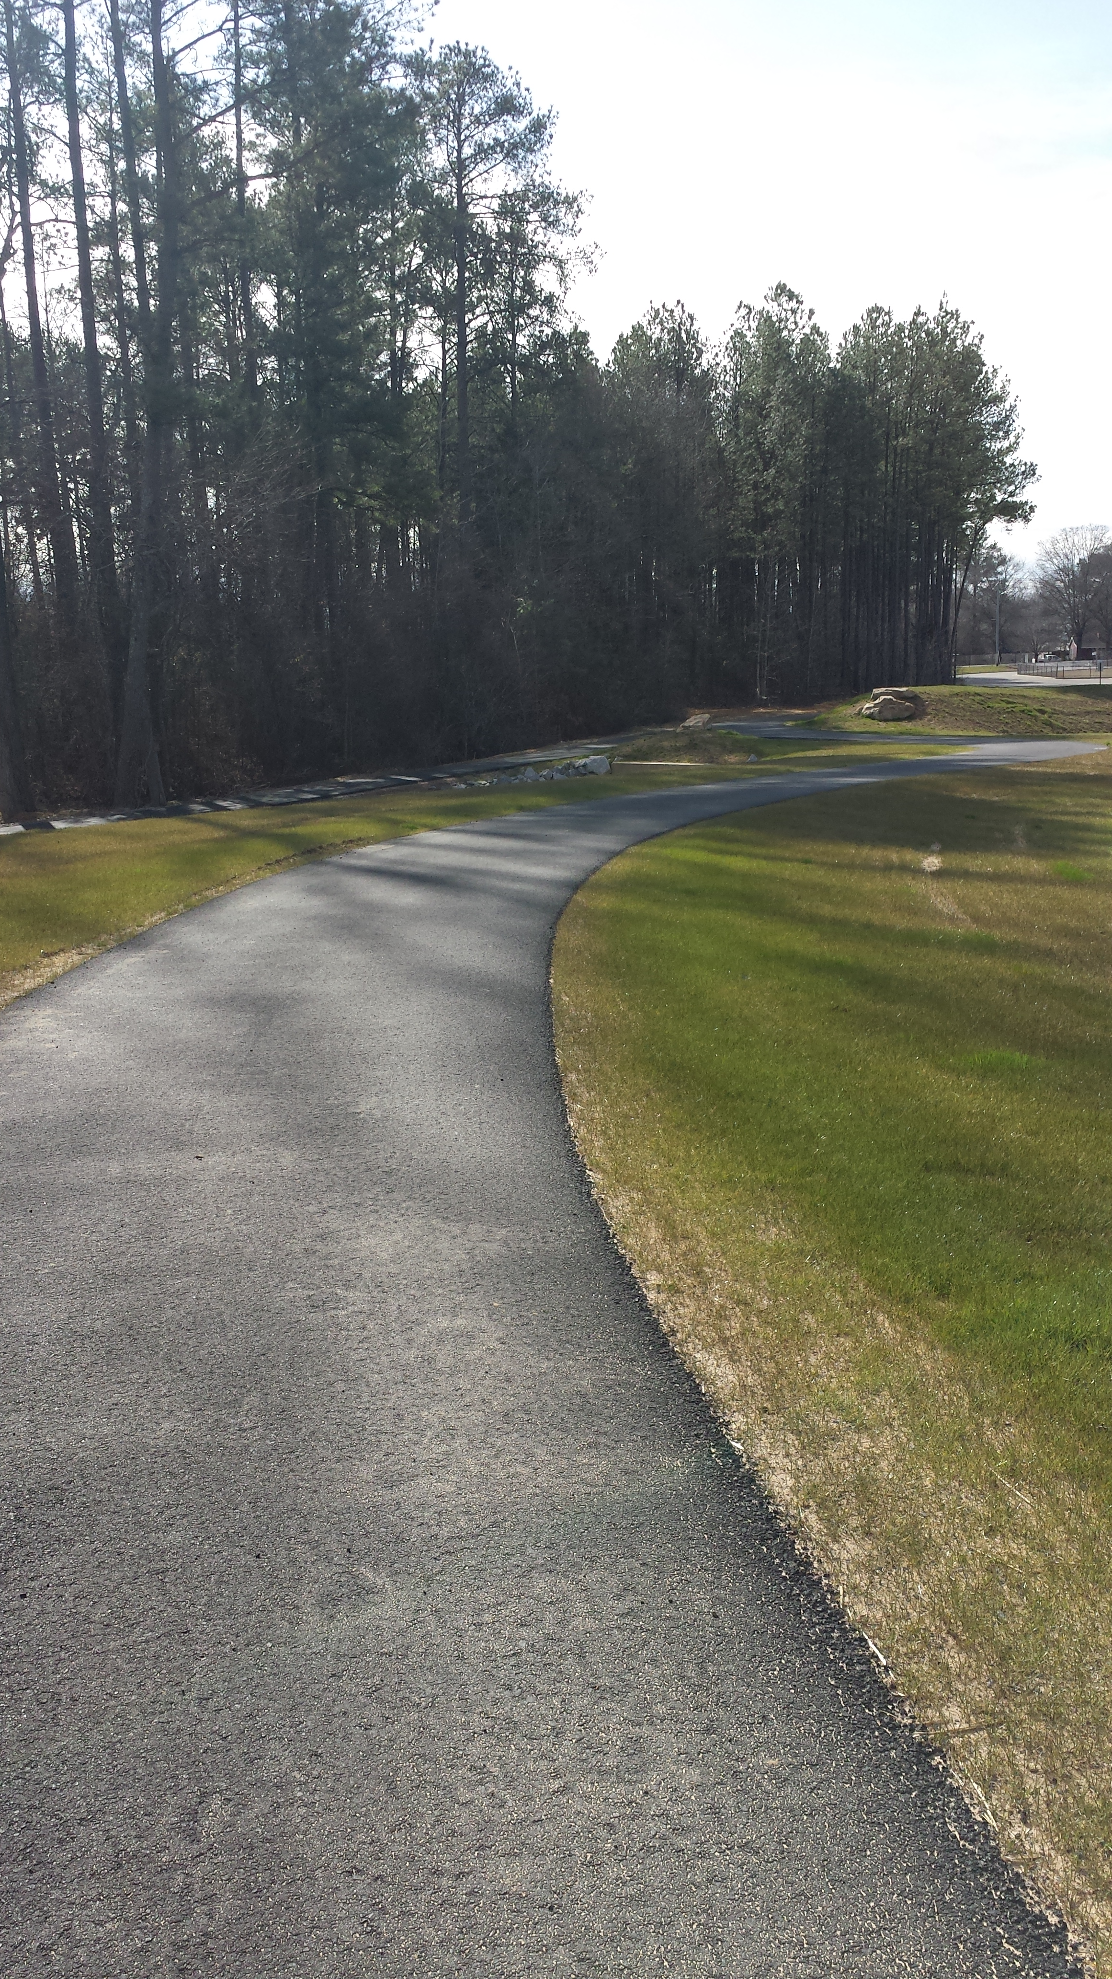
Construction of new recreational trails
z

Slide 12
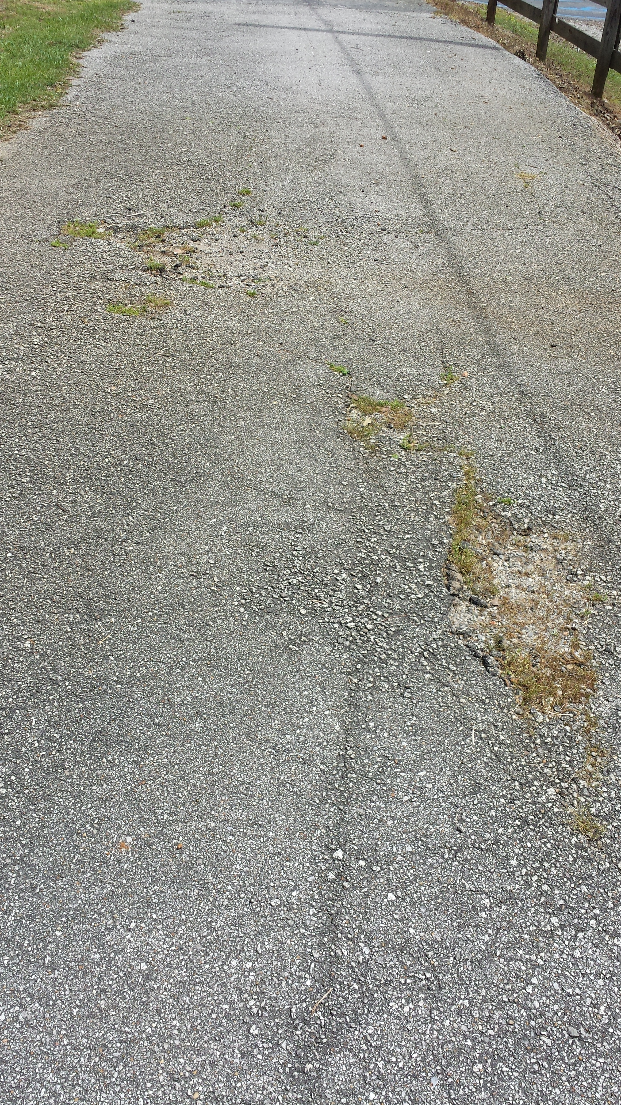
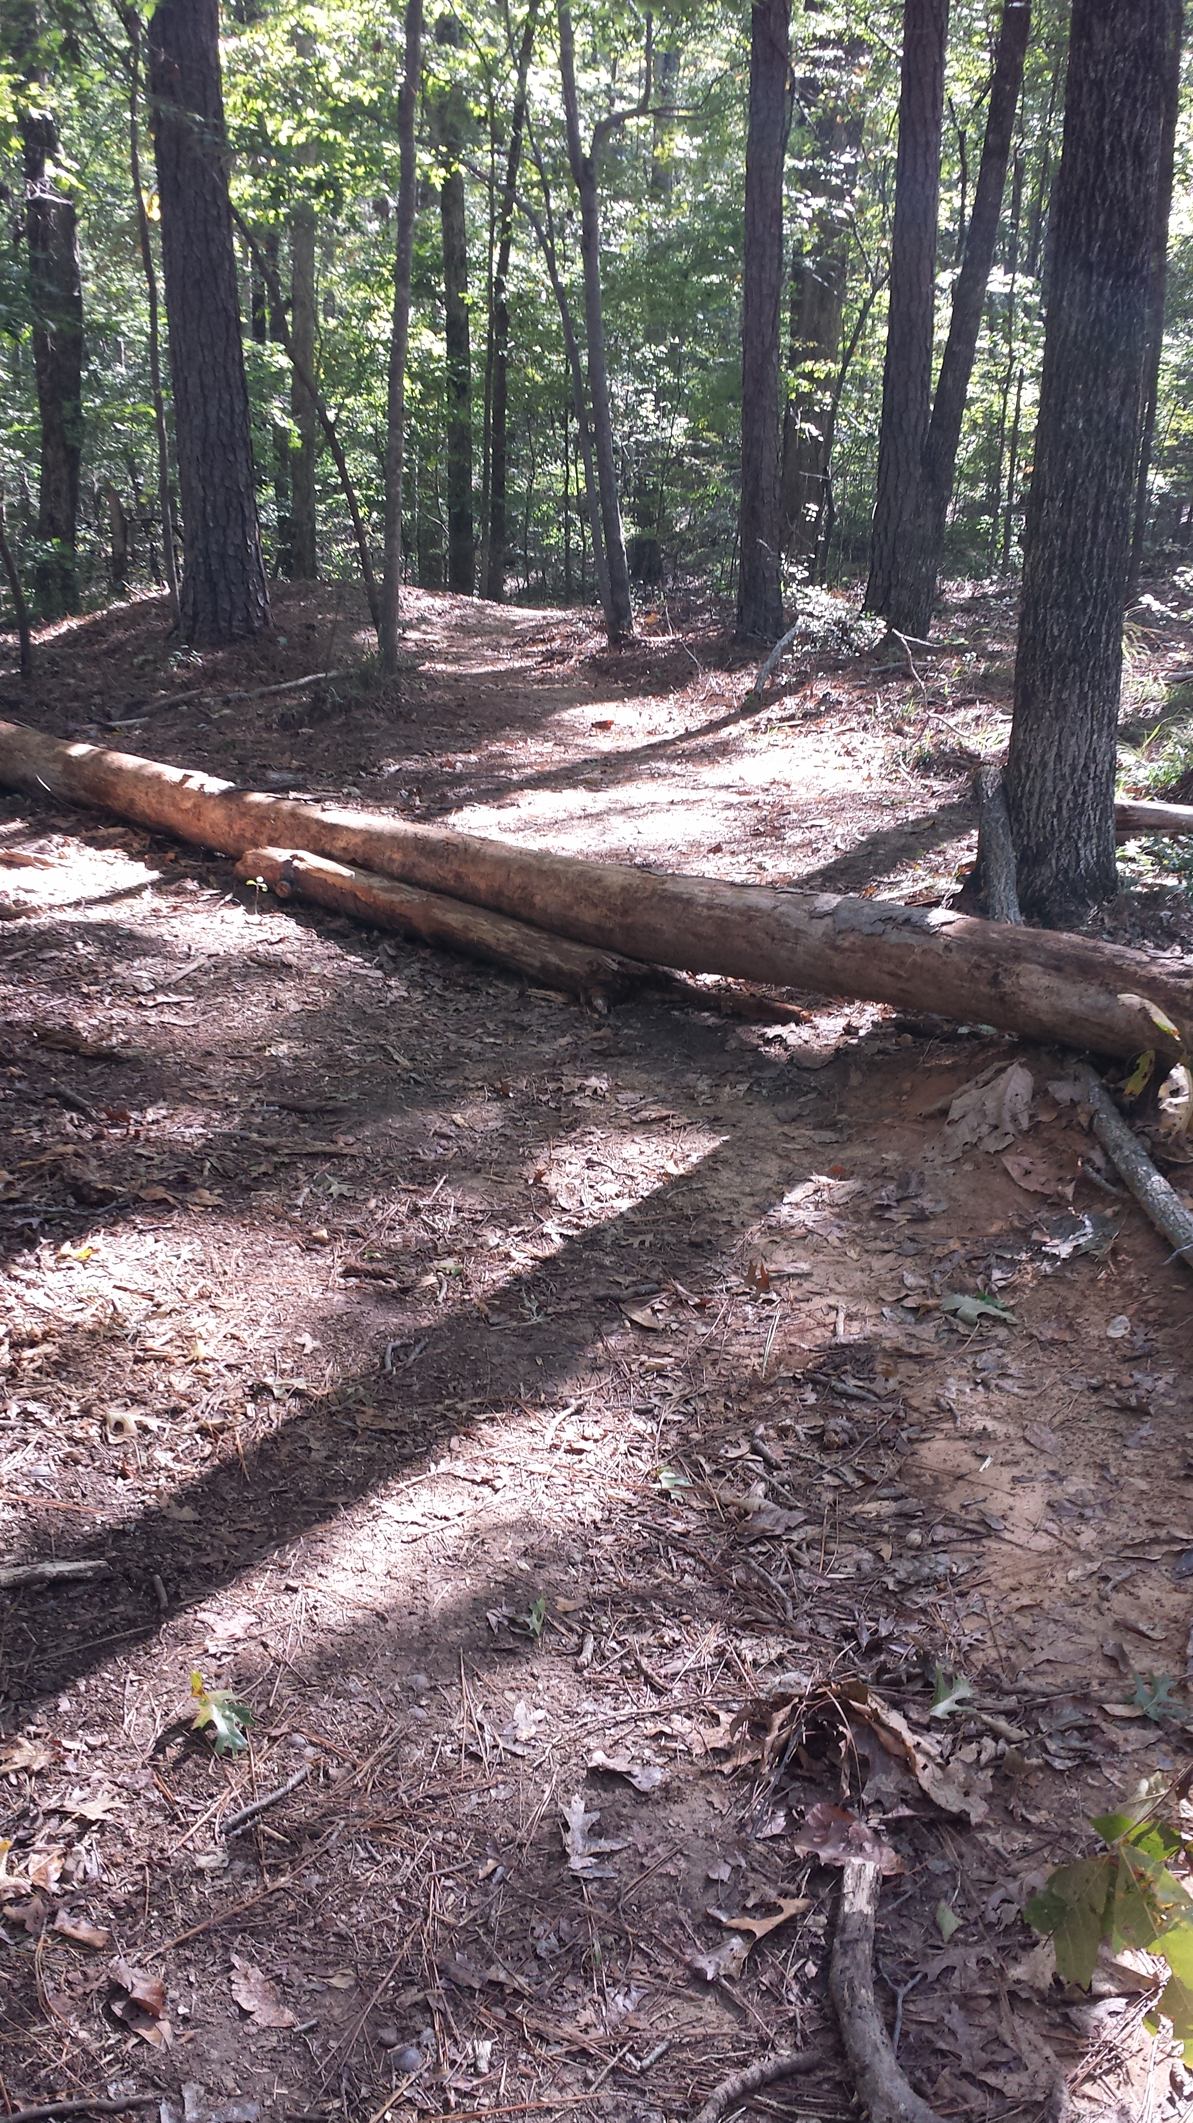
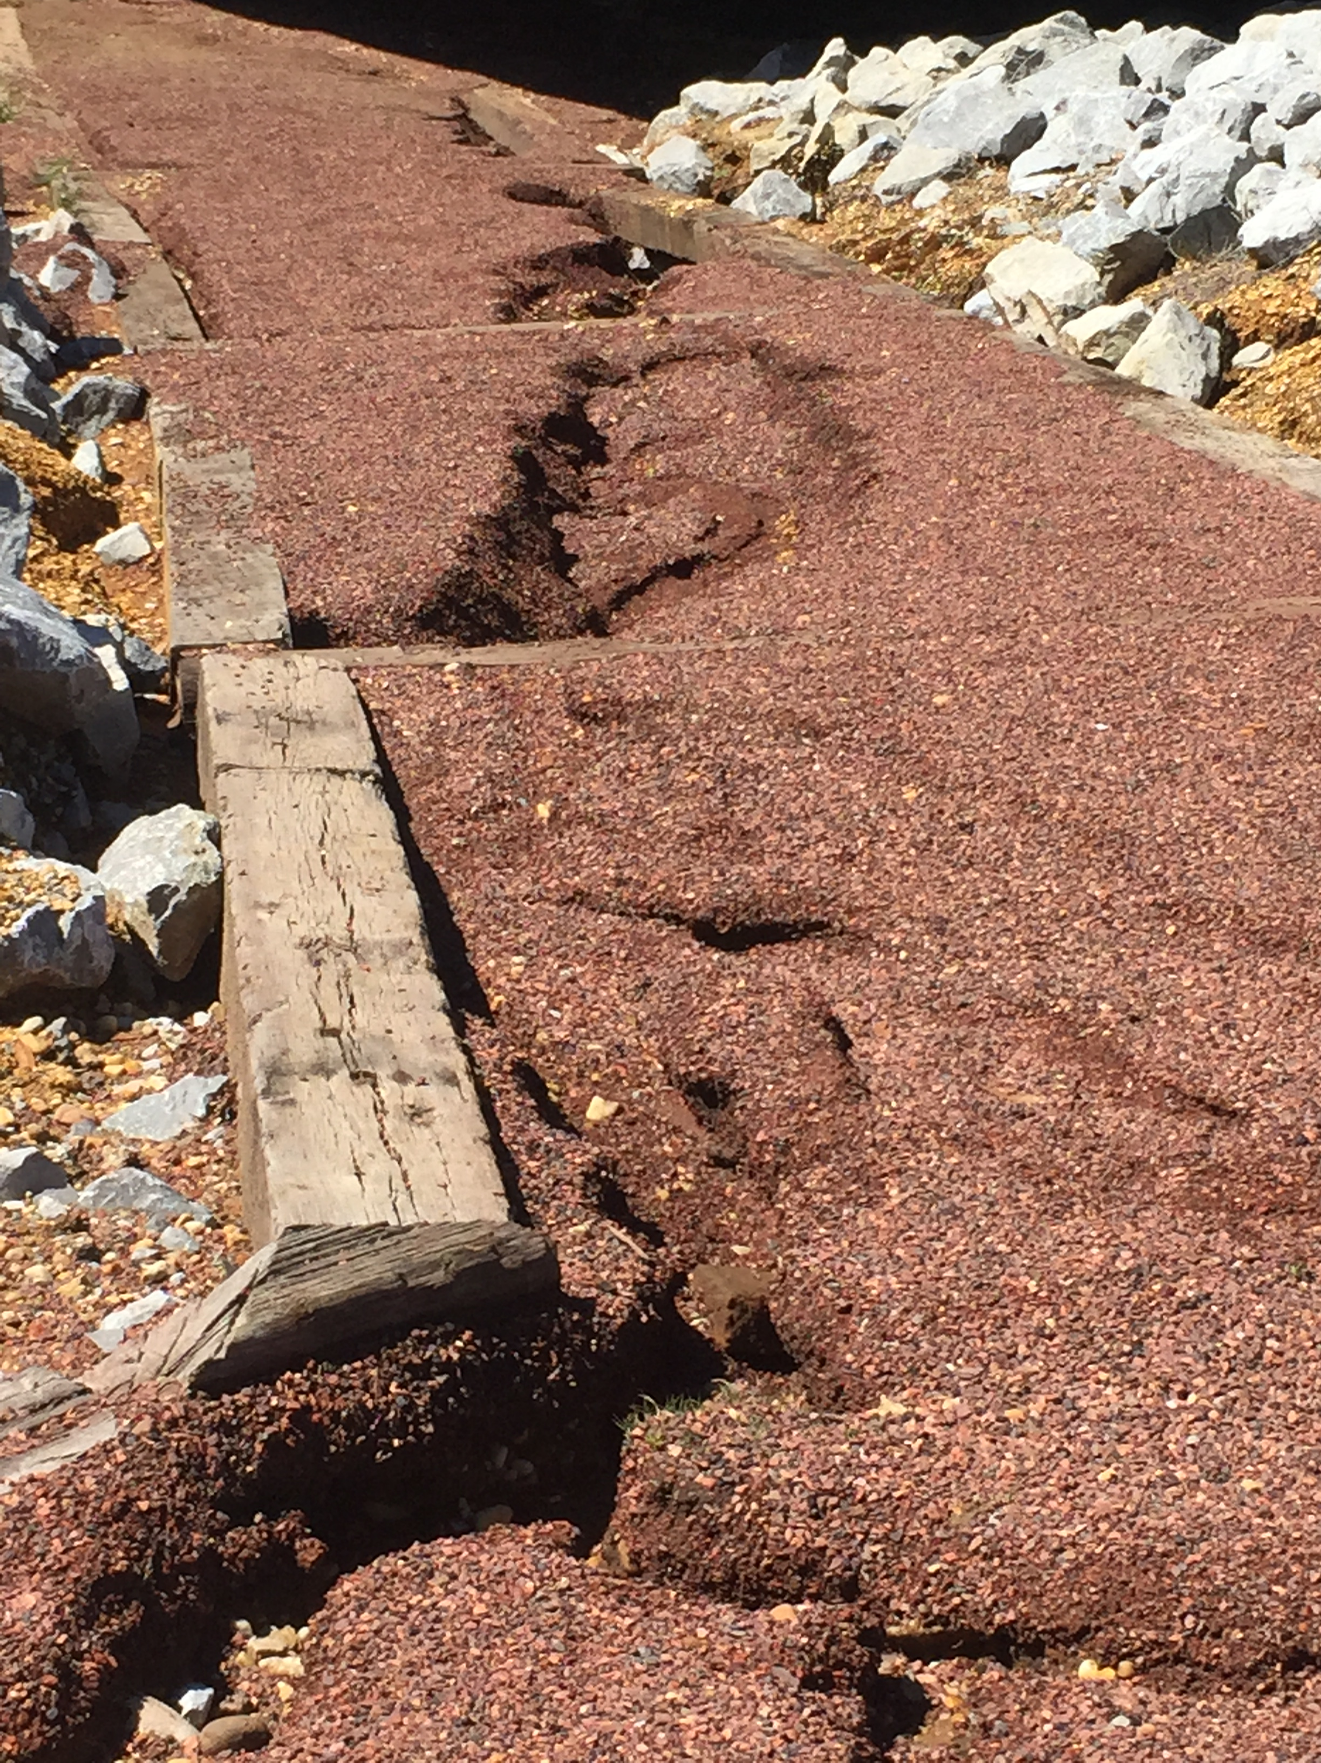
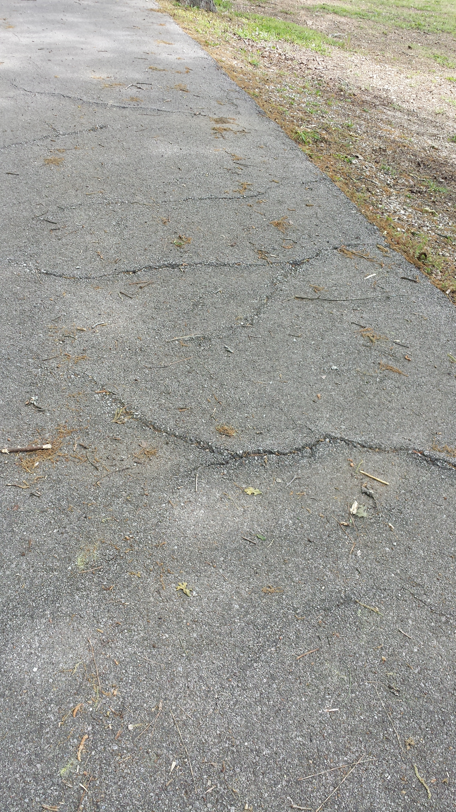
Maintenance and restoration of existing recreational trails
z

Slide 13
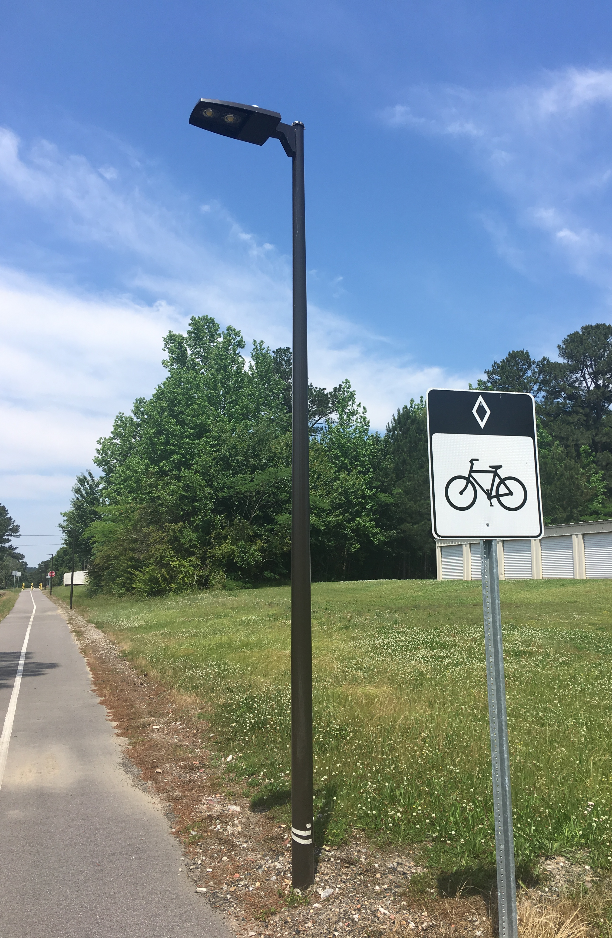
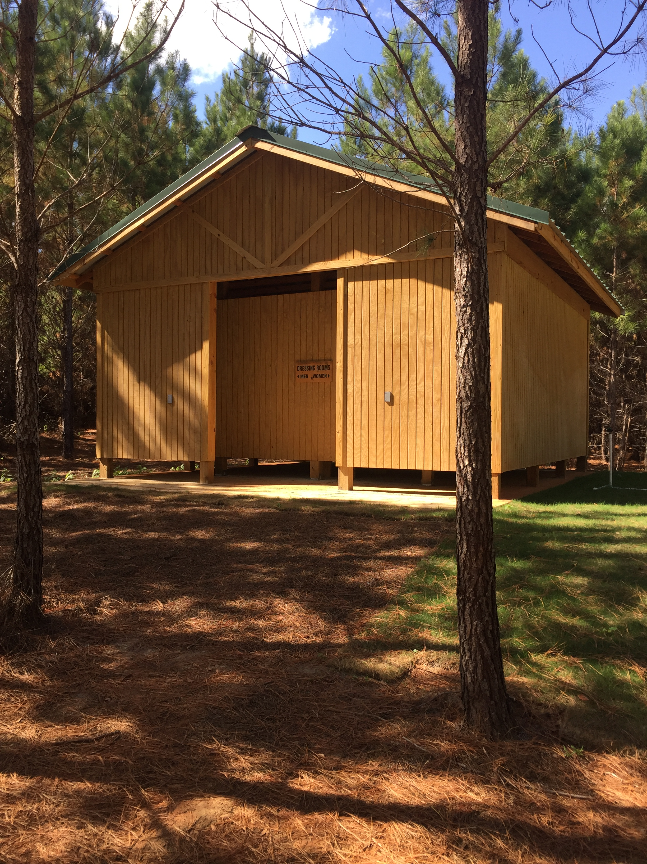
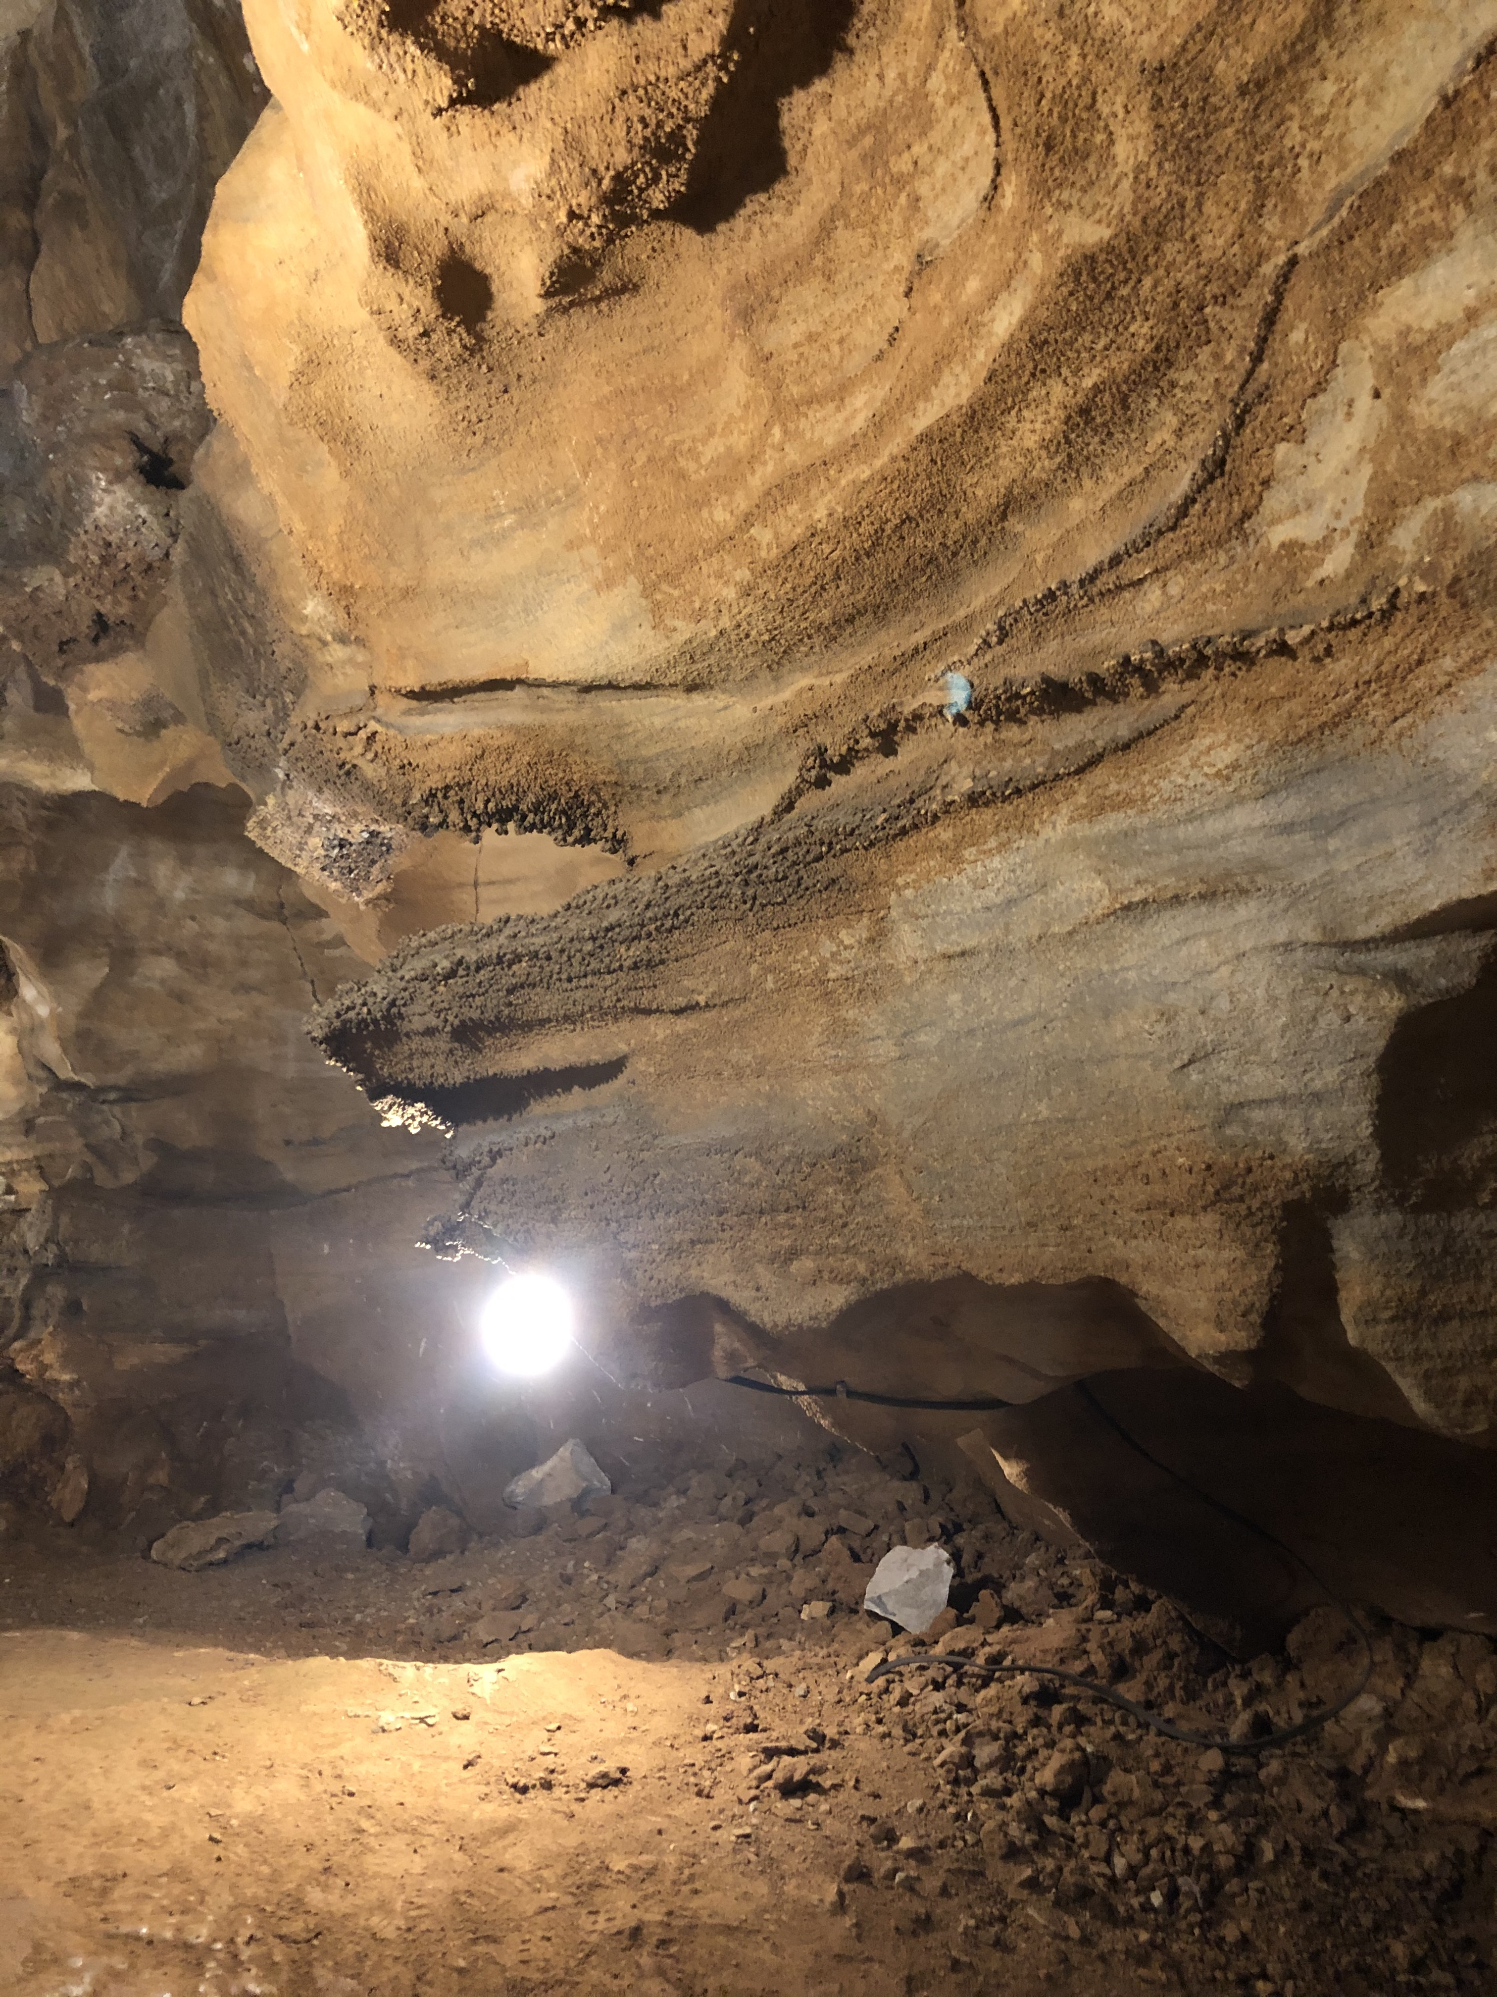
Development and rehabilitation of trailside and trailhead facilities (may include, but are not limited to, the following: 1) Drainage, 2) Crossings, 3) Stabilization, 4) Parking, 5) Signage, 6) Controls, 7) Shelters, and 8) Water, Sanitary, and Access Facilities) and trail linkages for recreational trails
z

Slide 14
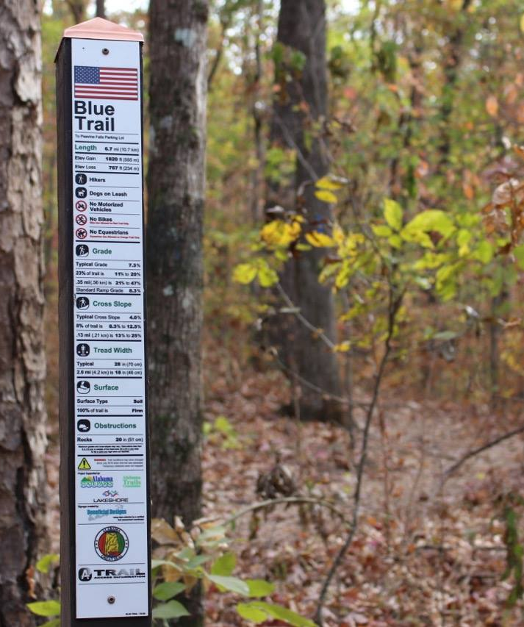
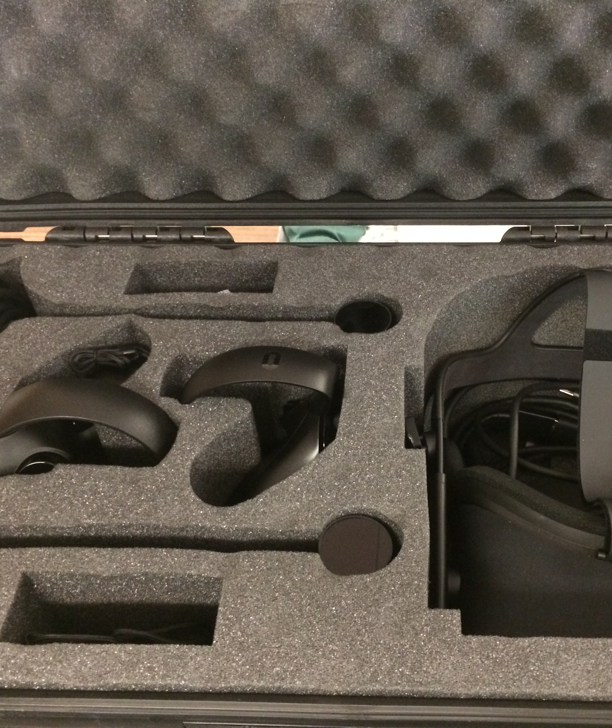
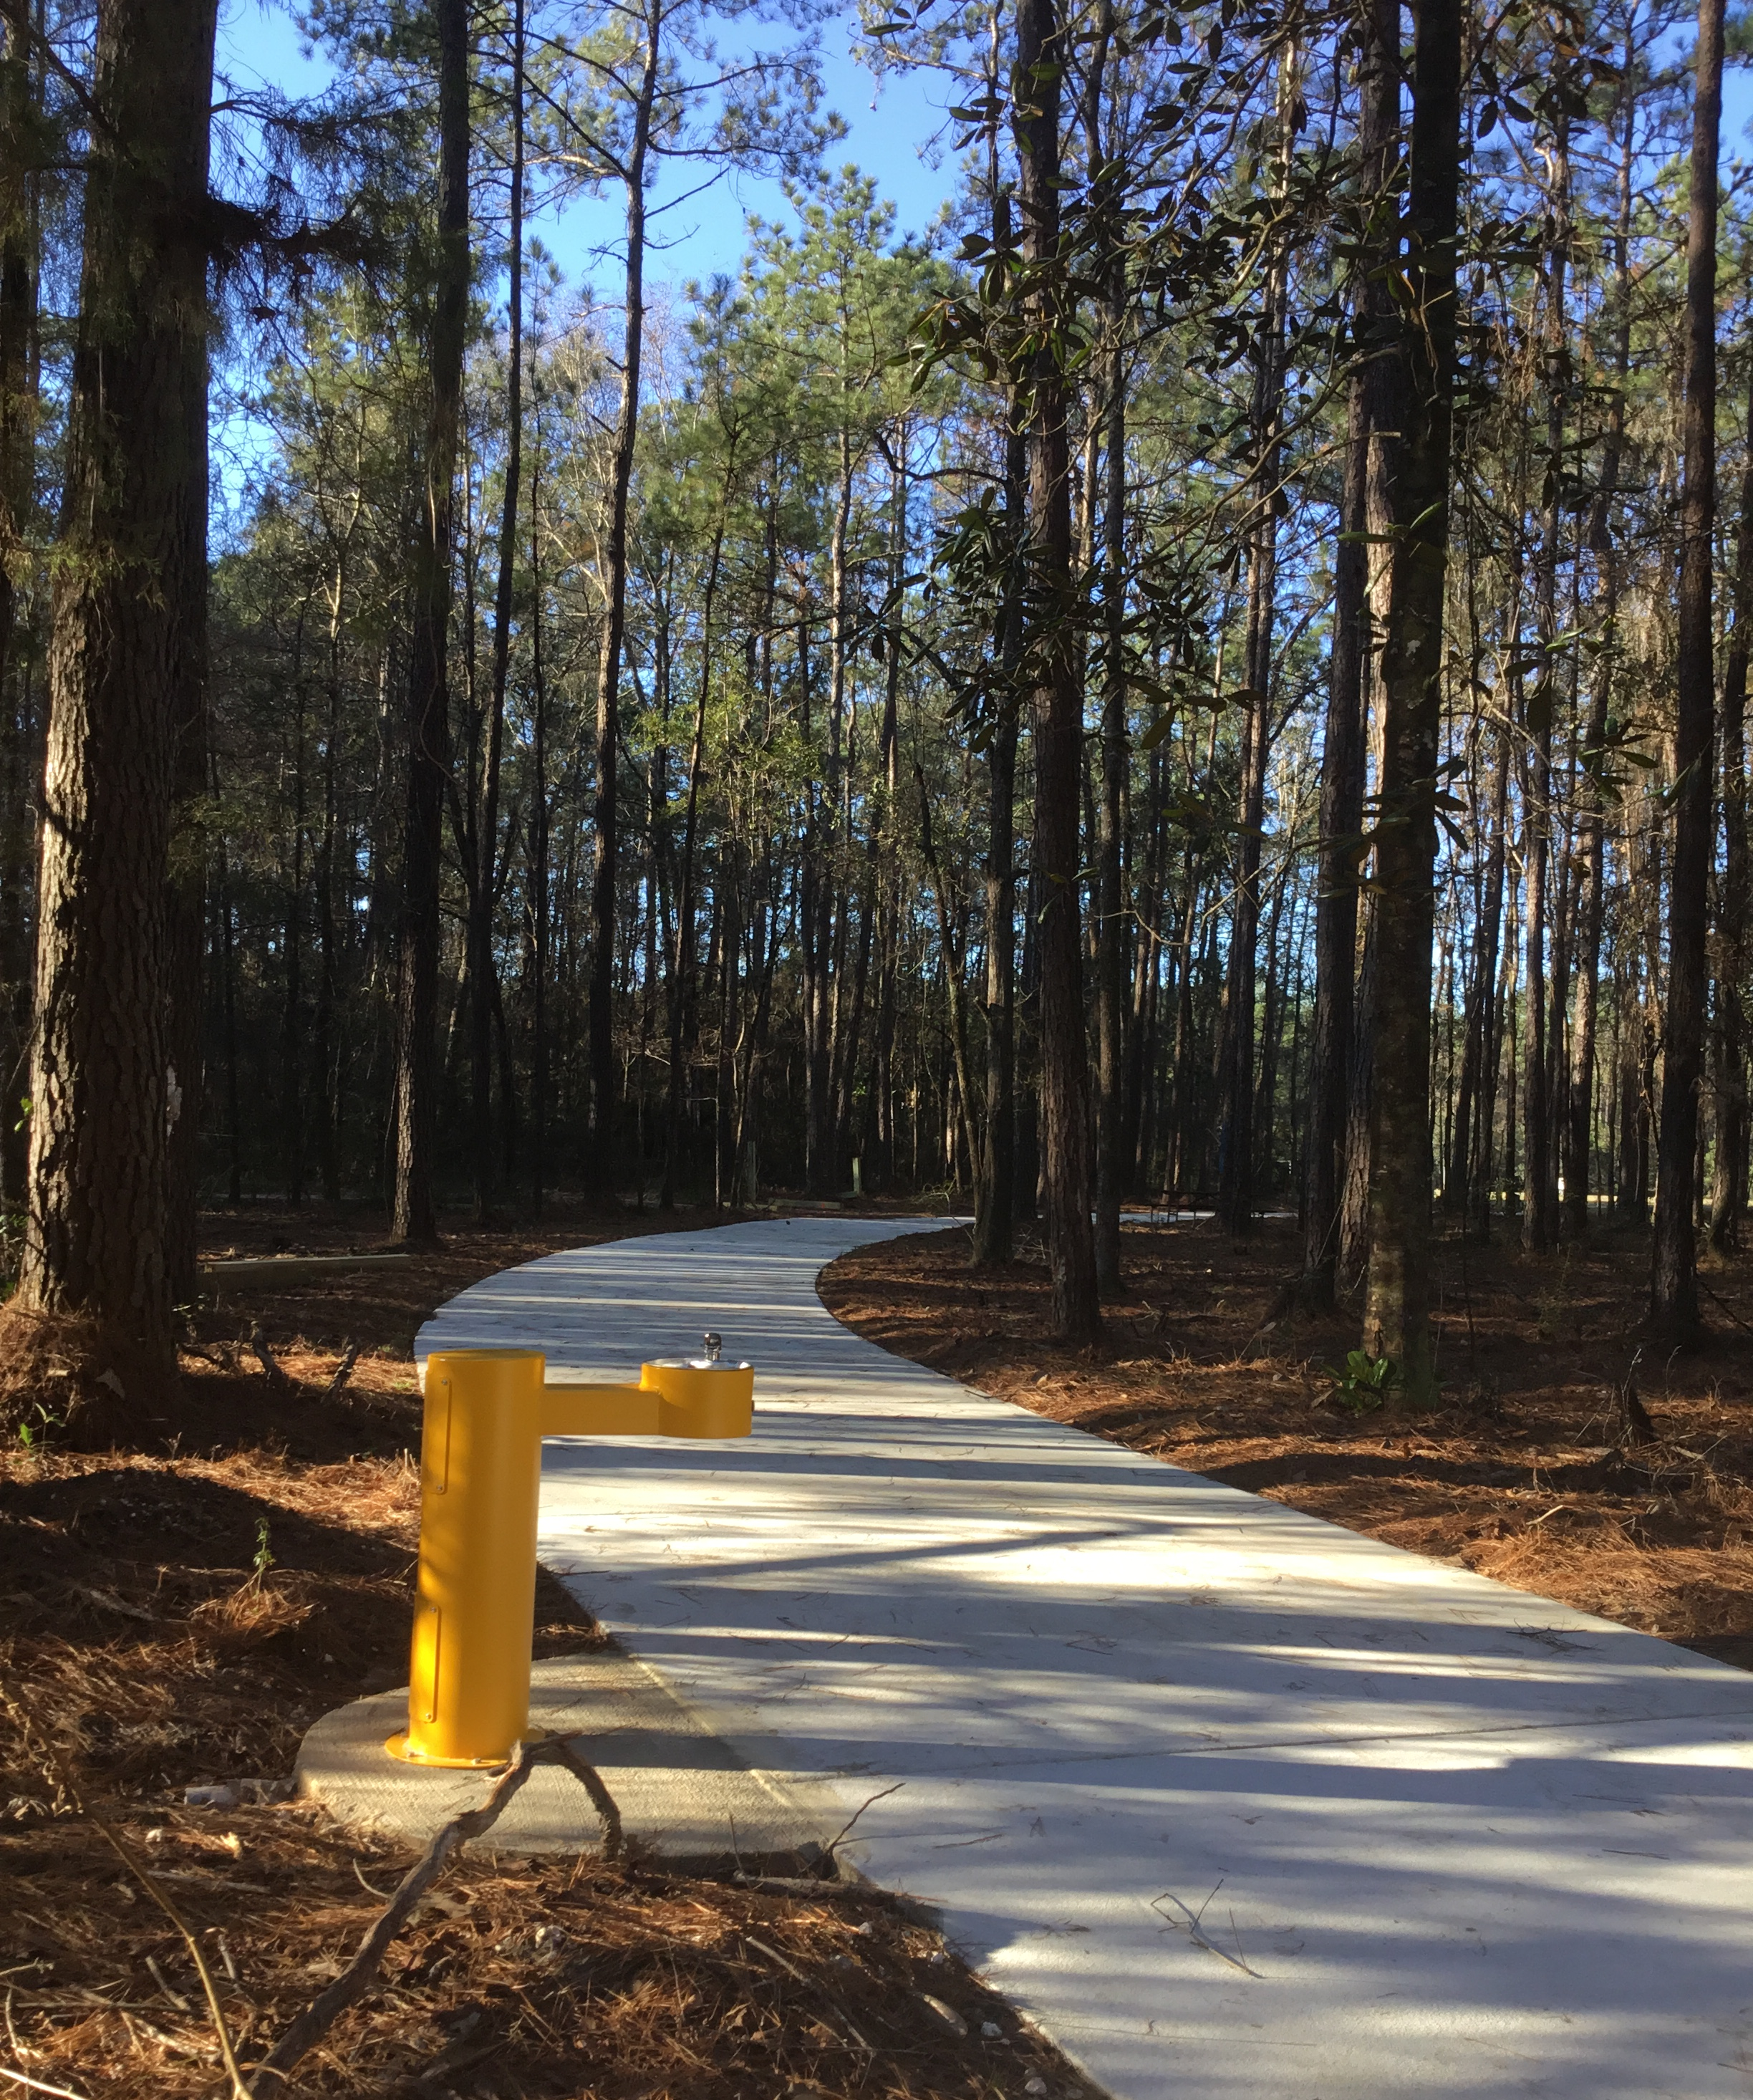
Provision of features which facilitate the access and use of trails by persons with disabilities
z

Slide 15
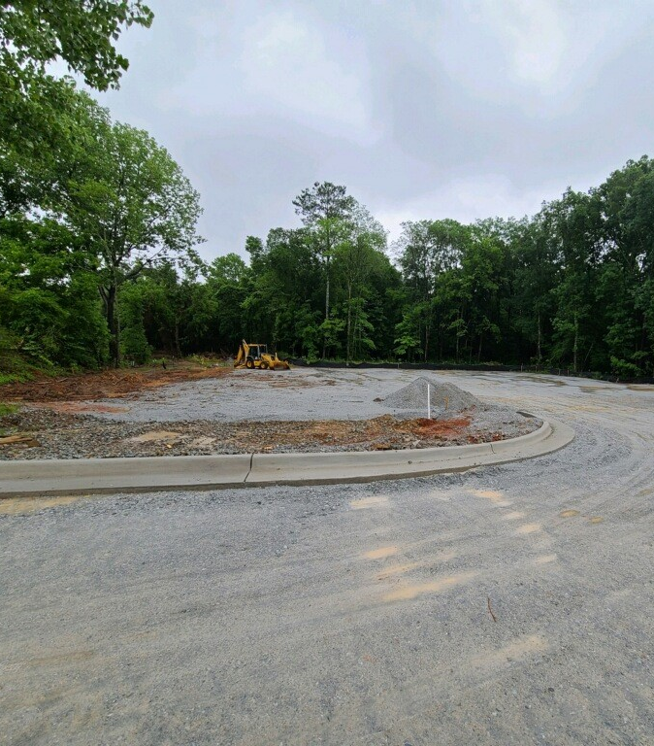
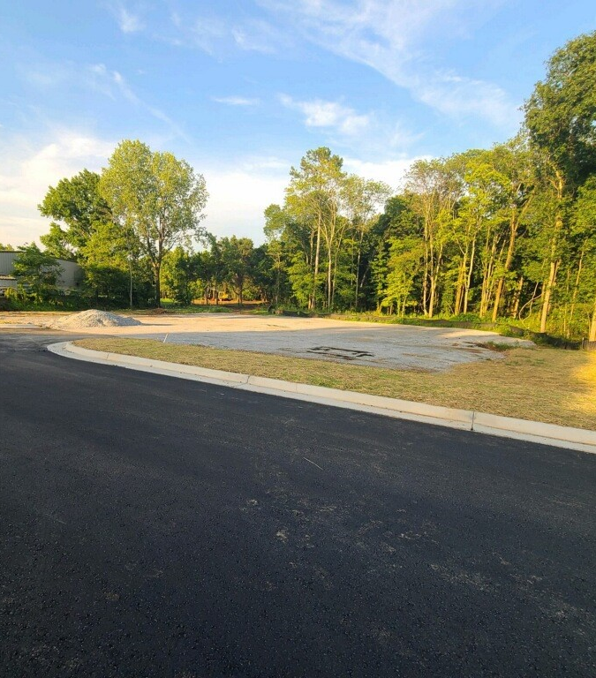
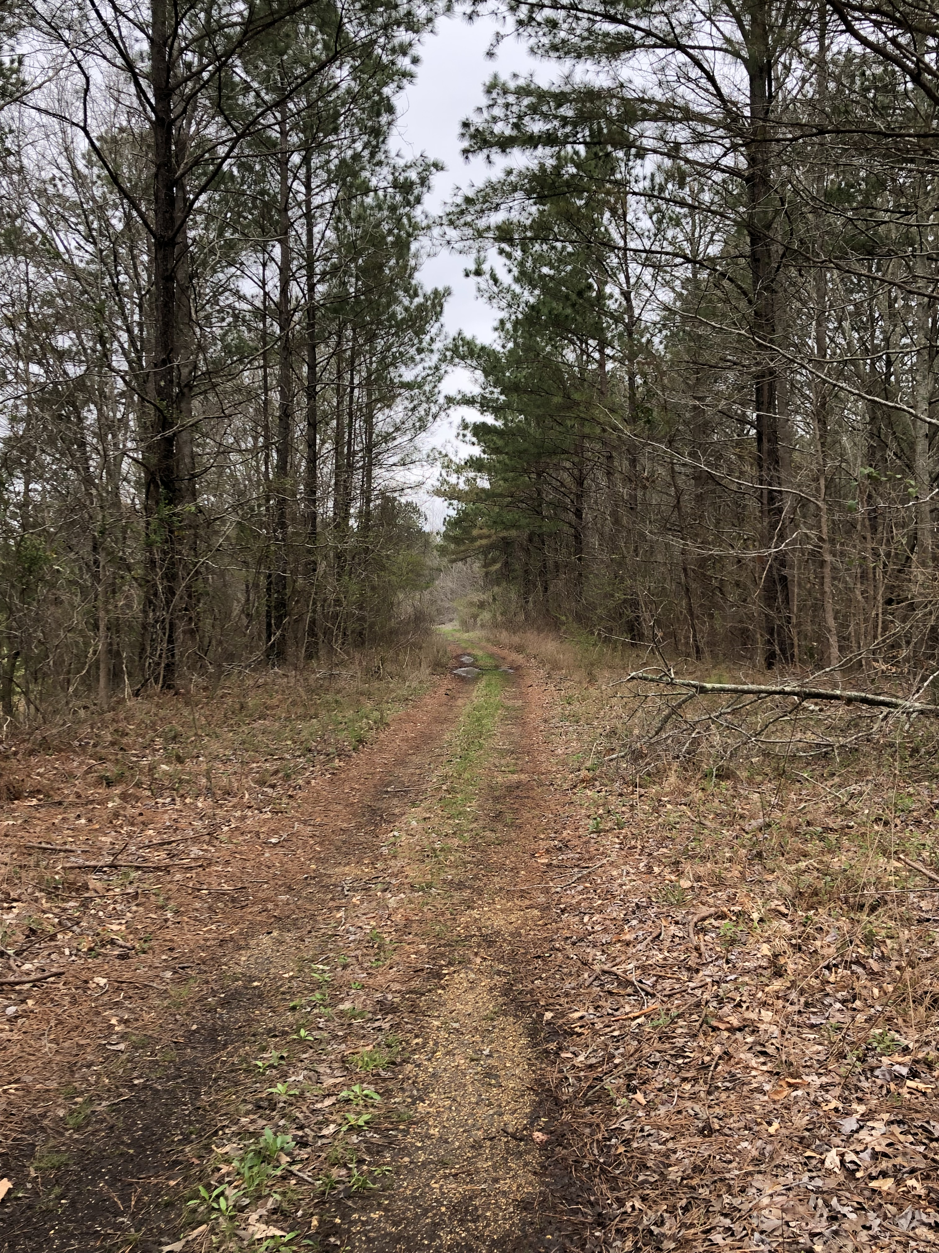
Acquisition of easements and fee simple title to property for recreational trails or recreational trails corridors identified in a state trail plan
z

Slide 16
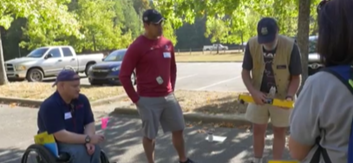
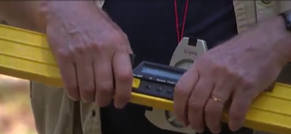
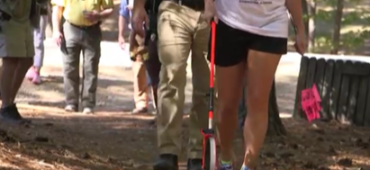
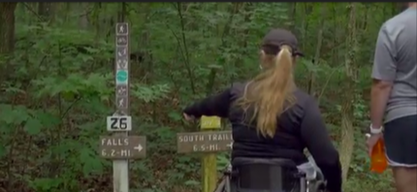
The assessment of trail conditions for accessibility and maintenance
z

Slide 17
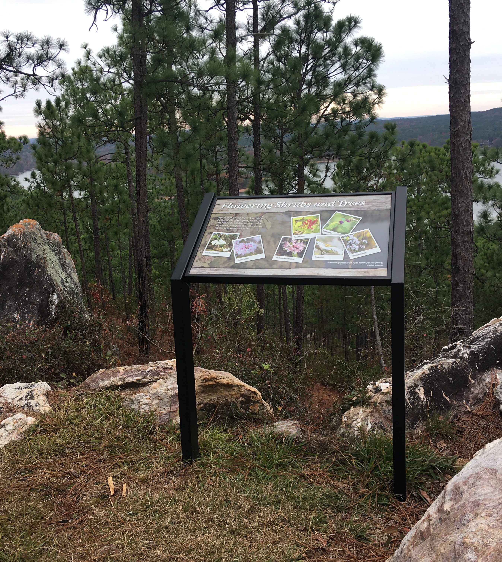
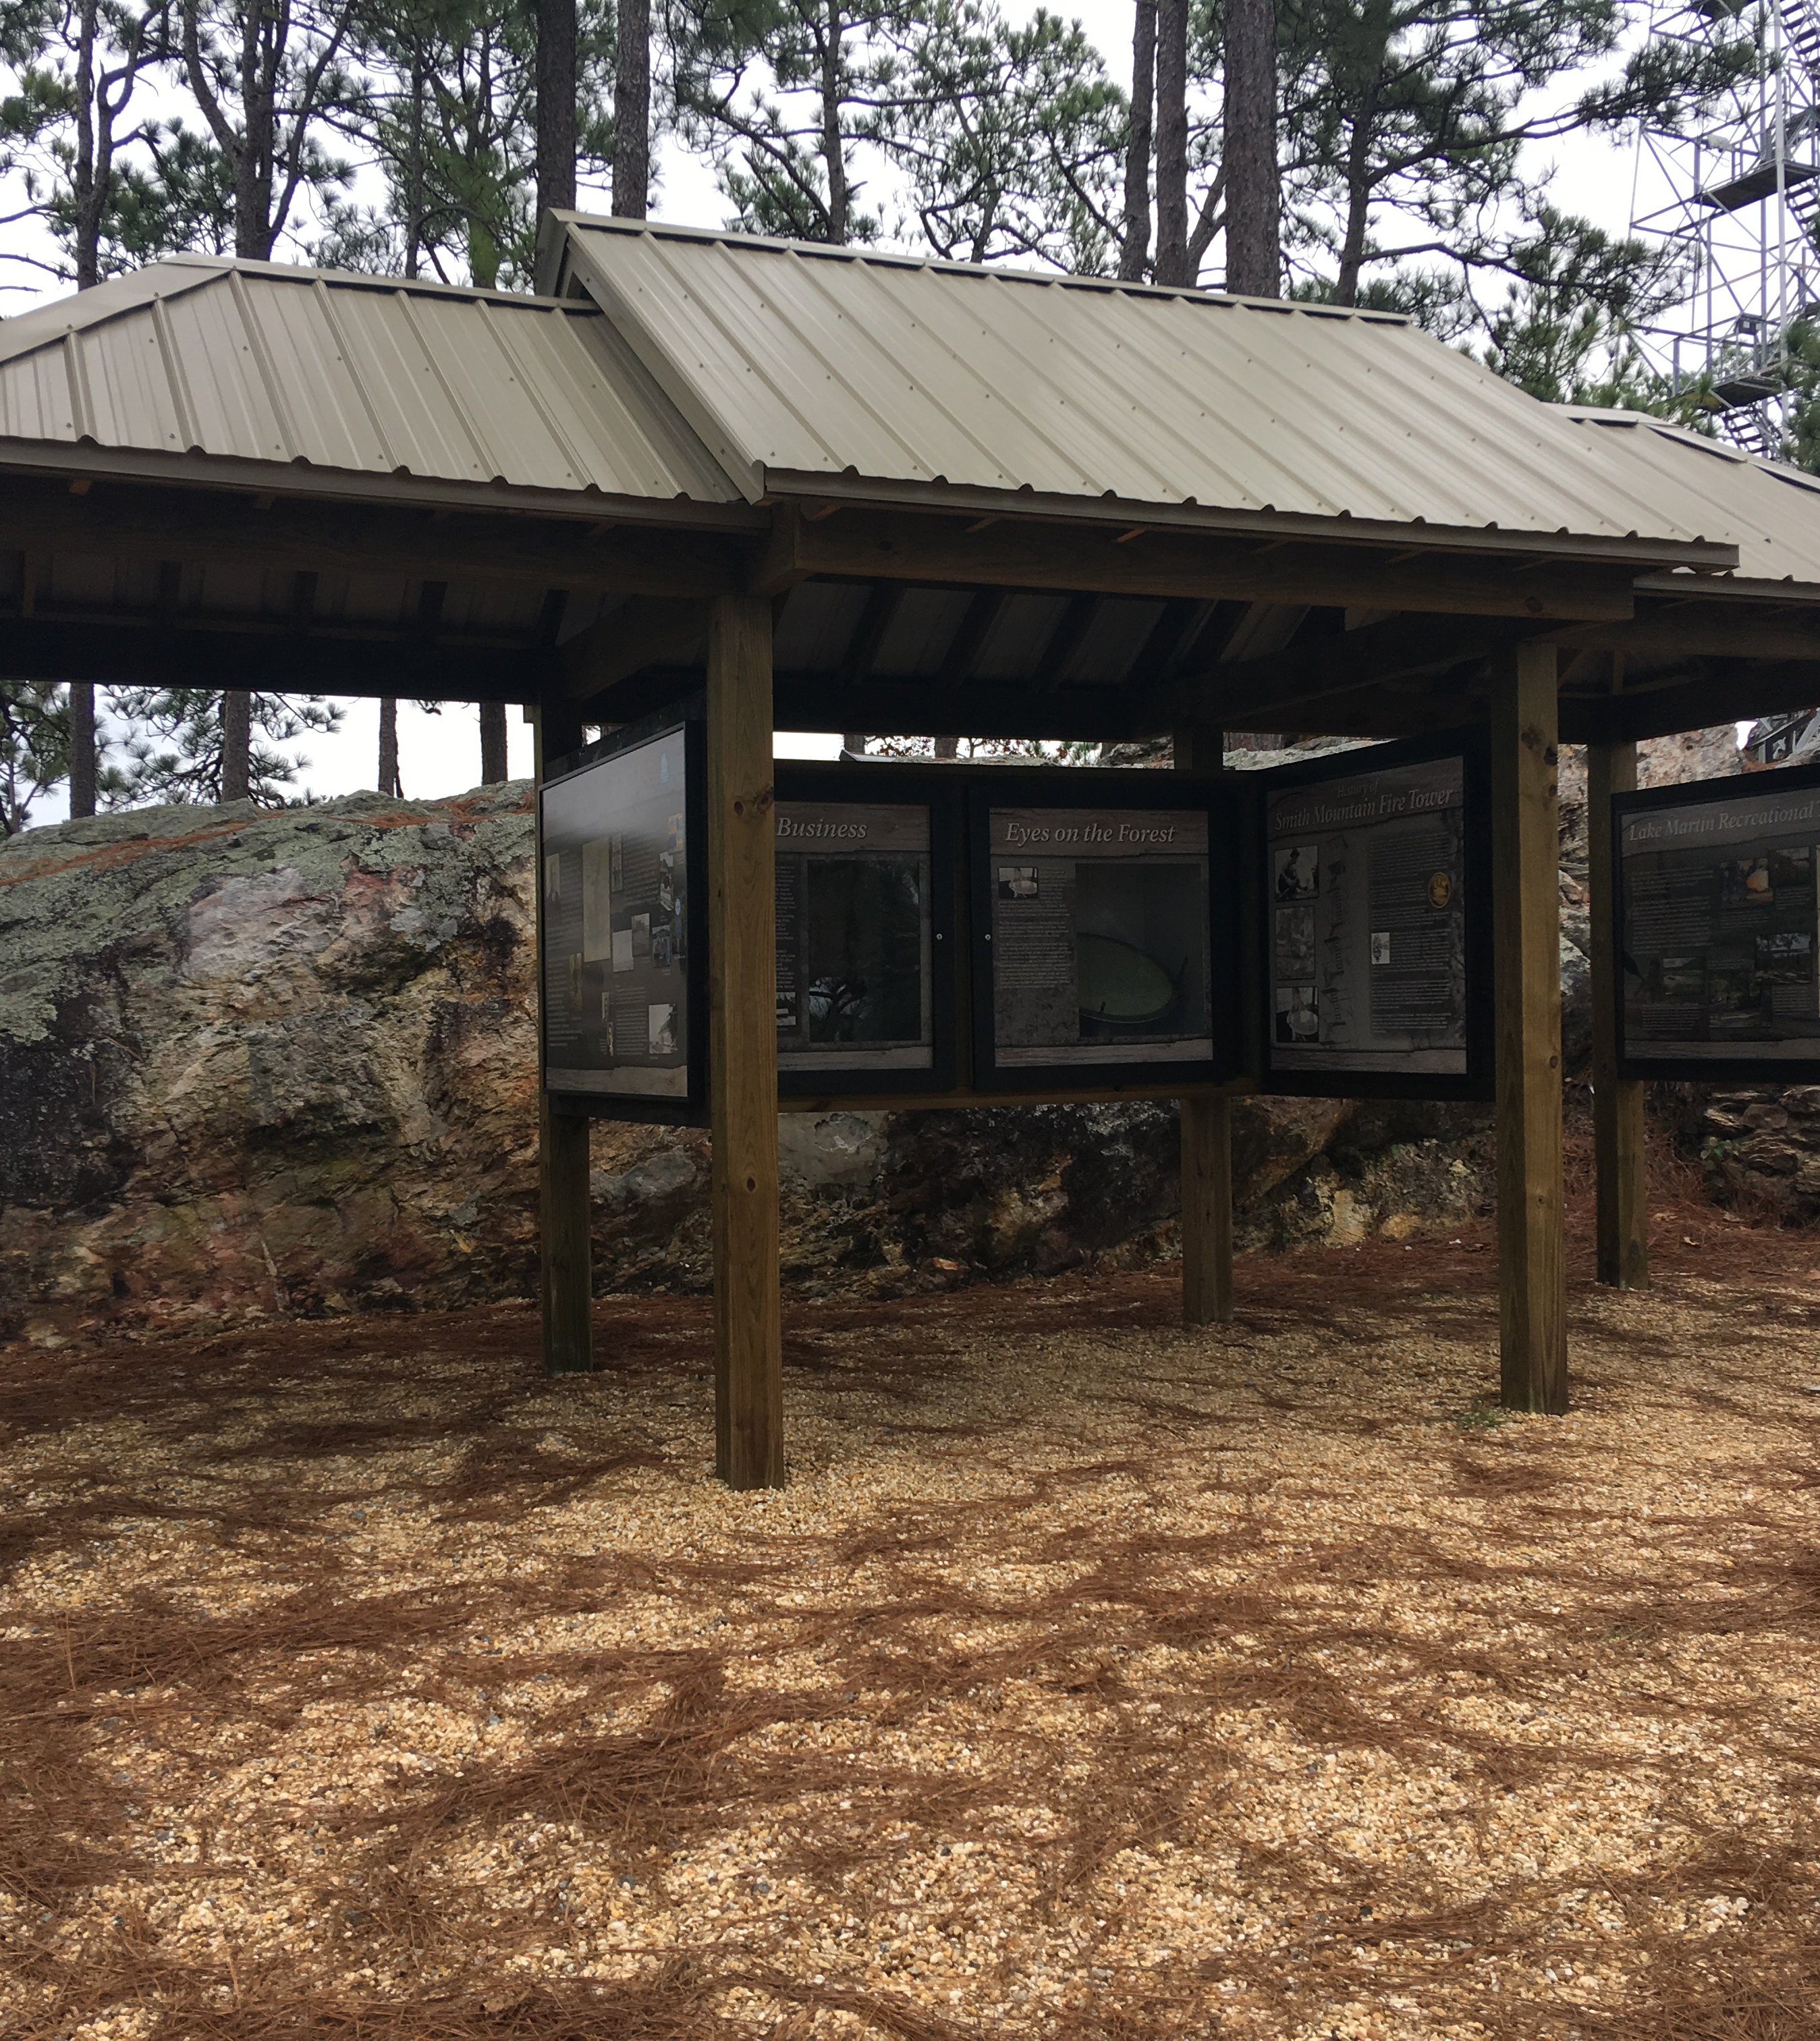
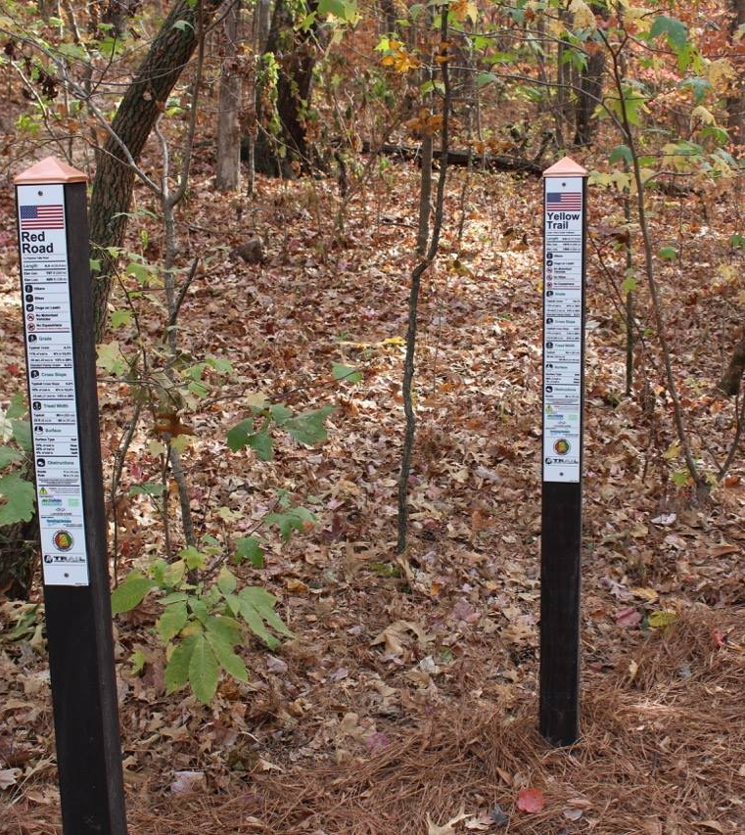
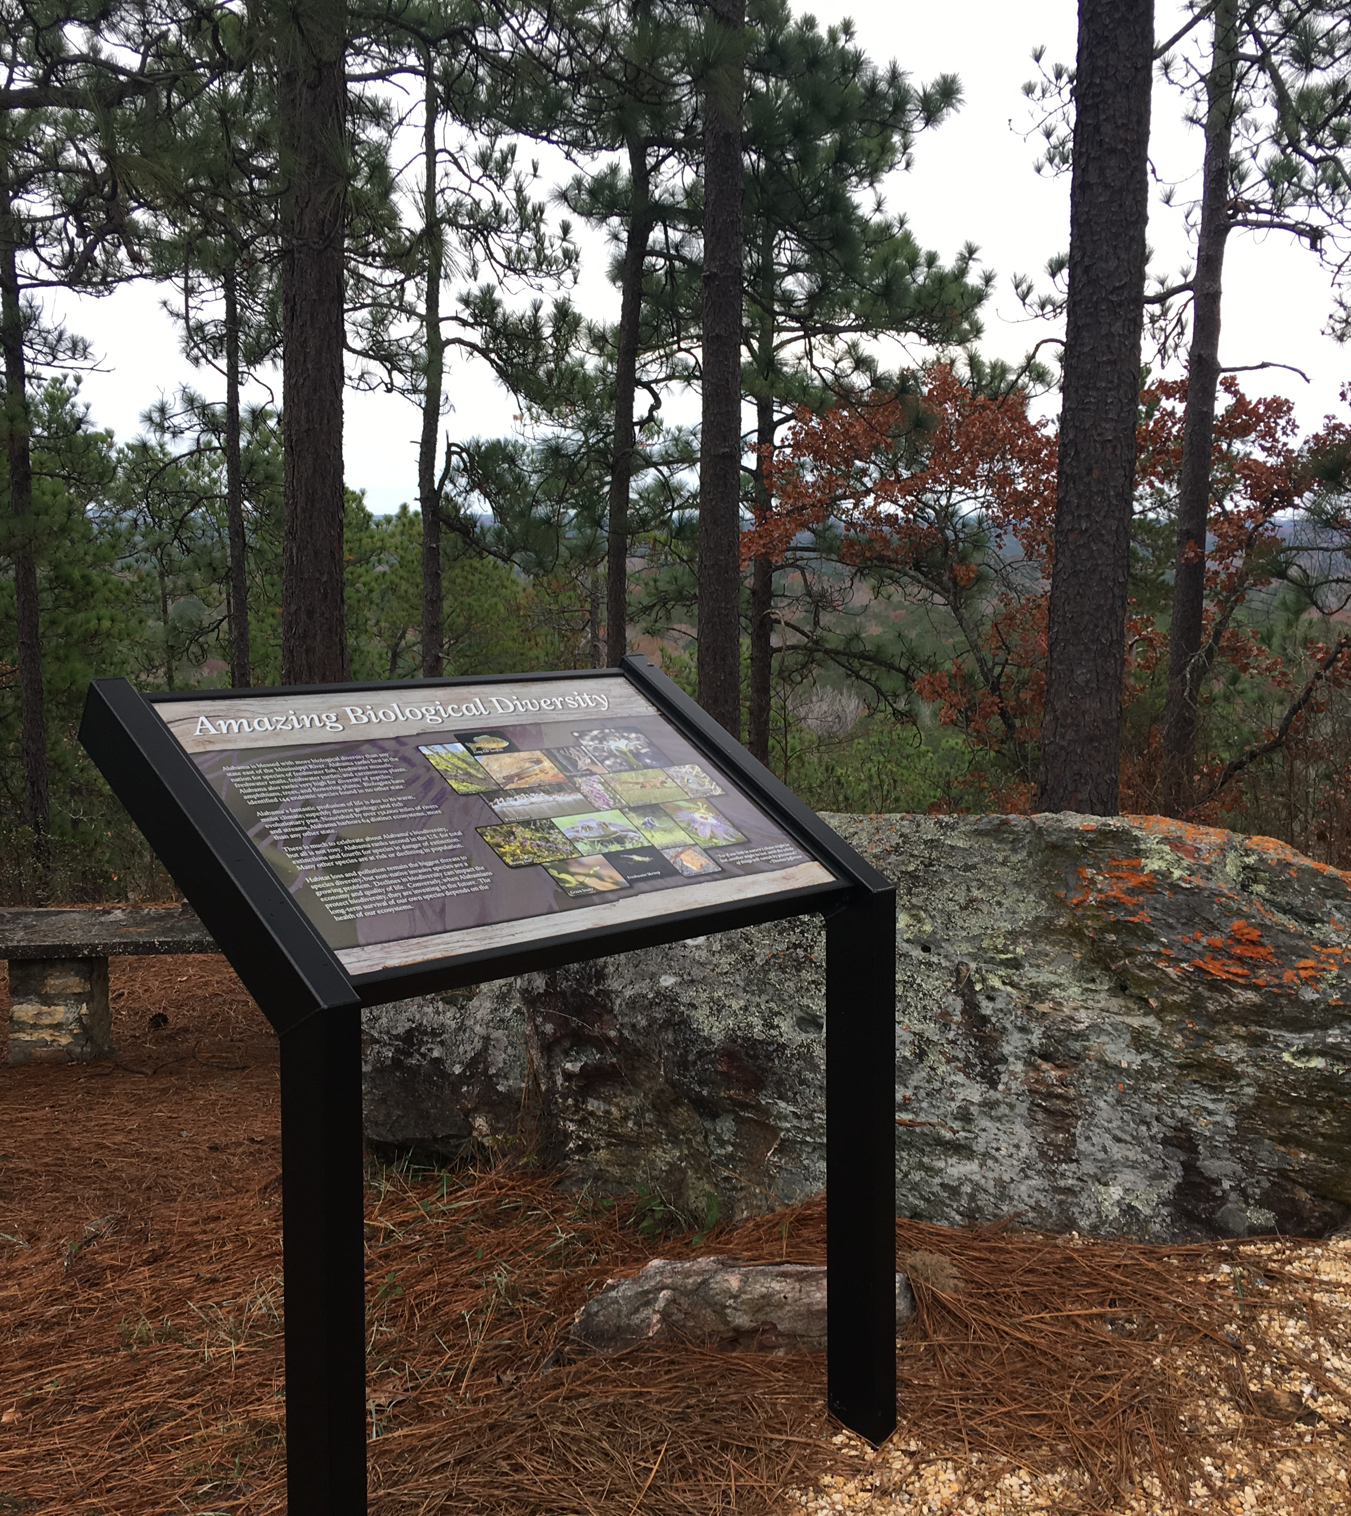
Development and dissemination of publications and the operation of educational programs to promote safety and environmental protection related to recreational trails
z

Slide 18
Types of Trail Projects
Non – Motorized for a Single Use
Intended to benefit only one mode of non-motorized recreational trail use such as pedestrian only or equestrian only
Includes trailhead and trailside improvements for non-motorized, single use trails (such as lighting)
Maximum Federal Share: $200,000.00
Non – Motorized for Diverse Use
Intended to benefit more than one mode of non-motorized recreational trail use such as walking, skating, and bicycling; pedestrian and equestrian use; equestrian and bicycle use; etc.
Maximum Federal Share: $400,000.00

Slide 19
Types of Trail Projects
Motorized for Diverse Use
Intended to benefit more than one mode of motorized recreational use such as motorcycle and ATV use; ATV and 4x4 OHV (truck) use; etc.
May be classified in this category if the project also benefits some non-motorized uses (it is not necessary to exclude non-motorized uses), but the primary intent must be for the benefit of motorized use
Maximum Federal Share: $524,937.00

Slide 20
Types of Trail Projects
Educational Projects
Intended to benefit groups disseminating educational publications and operating educational programs which promote safety and environmental protection
Typical education projects may include:
Development and operation of trail safety education programs
Development and operation of trail-related environmental education programs
Development and delivery of training on trail accessibility and sustainability
Production of trail-related educational materials, including information displays, in print, video, audio, interactive computer displays, etc.
Maximum Federal Share: $87,489.00
Interested parties MUST consult with ADECA’s Recreation and Conservation Programs staff PRIOR to submitting an educational grant application.

Slide 21
Thresholds
Prospective applicants are not eligible to apply if:
The entity has an open Land and Water Conservation Fund (LWCF) or RTP grant as of September 12, 2022
The entity has unresolved compliance issues from a previous LWCF or RTP grant
The entity did not respond in writing to a LWCF or RTP inspection report which contained deficiencies and the entity has not obtained approval of a Correction Action Plan for previous compliance issues

Slide 22
Application Process

Slide 23
Application Checklist

Slide 24
Application Cover Sheet
Applicant’s Information
Project Information
Project Location
District Information
Contact Information

Slide 25
Project Information
Name of the Project
Length of Trail (lf)
Width of Trail
Trail Surface Type
Application Type (motorized, educational, etc.)
Type of Applicant
Project Costs
Brief Project Description

Slide 26
Application Evaluation Criteria

Slide 27
Describe the degree to which the project’s scope and feasibility meet the project area’s recreational needs.
Describe the ways in which the project provides for the greatest number of compatible recreational purposes.
Describe the ways in which the project provides a new, unique, or more effective means for making trail opportunities available to the public.
Describe the ways in which the project facilitates the access and use of trails by persons with disabilities, older adults, economically disadvantaged, and other special populations or groups.

Slide 28
Describe the ways in which the project creates opportunities for new partnerships between trail users, private interest groups, and public agencies within the project area. Describe the ways in which the project provides for the greatest number of compatible recreational purposes.
Describe the ways in which the project uses the grant funds to leverage other public or private investments (in the form of services and materials as well as dollars).
Describe the degree of commitment to continue operation and maintenance of the project. Include an operation and maintenance plan detailing the amount of money needed to operate and maintain the trail/facility after project completion and identify who will be responsible for these activities.

Slide 29
The degree to which community involvement is addressed: i.e., (A) Project idea originated with trail users or a community group that has substantial knowledge, and (B) The private sector (including individual citizens, community groups, and/or local business enterprises) has participated in the development of the proposed idea and has made commitments of labor, money, or materials to support project implementation. Describe the ways in which the project uses the grant funds to leverage other public or private investments (in the form of services and materials as well as dollars).
Describe in detail how the trail will be managed. Include a discussion on season length, hours of operation, limitations on use, enforcement provisions, and scheduling.

Slide 30
Identify and describe the service area of the project. Approximately how many people do you propose to serve with this project? Identify other trail resources in the service area by trail type (motorized, non-motorized, multi-use), distance, location in relation to the proposed trail, and ownership.

Slide 31
Project Cost Estimate

Slide 32
Project Cost Estimate
Acquisition
Construction Contracts
Equipment Rental
Labor
Signage
Supplies/Materials
Administration
Engineering

Slide 33
Environmental Screening Form

Slide 34
Environmental Resources
No Impacts or Not Applicable
Negligible Impacts
Minor Impacts
Impacts Exceed Minor (EA/EIS required)
More Data Needed to Determine (EA/EIS required)

Slide 35
Mandatory Criteria and Categorical Exclusion
Yes
No
To be determined

Slide 36
Environmental Reviewers
Provided input in the completion of the environmental screening form
Name
Title
Agency
Field of Expertise
Conducted a site inspection to verify field conditions
Name of Inspector(s)
Title
Agency
Date(s) of Inspection
Signature of Chief Elected Official

Slide 37
Environmental Checklist
Project Information
Applicant Information
Concurrence Documentation
Property Information

Slide 38
Proposed Timeline
12 Noon, Monday, September 12, 2022
Applications (1 digital copy) due to ADECA
September - December 2022
Recreation and Conservation Programs staff and the Alabama Recreational Trails Advisory Board review applications for priority rankings based on evaluation criterion, make recommendations for funding to the ADECA Director, complete site inspections, and forward copies of the selected applications to the FHWA
January - March 2023
Applicants will be notified

Slide 39
Application Submission Instructions

Slide 40
DEADLINE – 12:00 Noon on Monday, September 12, 2022
Emailed to: latoya.Edwards@adeca.alabama.gov and crystal.talley@adeca.alabama.gov
Regardless of the submission method chosen, the application must be received by the CED Division by the time and date above. Applications received on September 12, 2022, will be time stamped upon receipt.
Recommend a read receipt on your email or check with ADECA to make sure they have it.

Slide 41
DEADLINE – 12:00 Noon on Monday, September 12, 2022
Only need one copy
Mailed to:
ADECA
CED Division – Recreational Trails Program
Attention: Ms. LaToya Edwards
Post Office Box 5690
Montgomery, Alabama 36103-5690

Slide 42
DEADLINE – 12:00 Noon on Monday, September 12, 2022
Only need one copy
Delivered to:
ADECA
CED Division – Recreational Trails Program
Attention: Ms. LaToya Edwards
401 Adams Avenue, Room 524
Montgomery, Alabama 36104

Slide 43
State Contacts
Shabbir Olia CED Division Chief shabbir.olia@adeca.alabama.gov (334) 242-5468
Crystal G. Talley Community Services Unit Chief crystal.talley@adeca.alabama.gov (334) 353-2630
LaToya Edwards RTP Program Manager latoya.edwards@adeca.alabama.gov (334) 242-5382
Joe Ponder LWCF Program Manager joseph.ponder@adeca.alabama.gov (334) 242-5612

Slide 44
Open Discussion Questions and Answers
z

