Slide 1
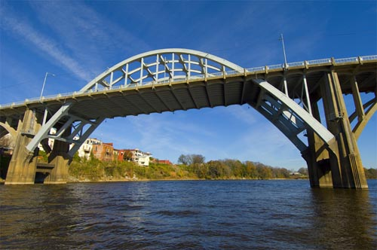
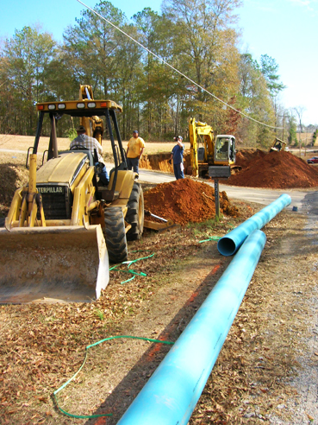
Community and Economic Development (ced) Division Community Development Block Grant (CDBG) ProgRam
Kathleen A. Rasmussen, Ph.D.
Division Chief
Kathleen.rasmussen@adeca.alabama.gov
(334)353-0323

Slide 2
Community & Economic Development Programs
A wide range of programs are included in
the category of “community and economic development.” These programs exist to improve Alabama’s communities in very specific ways. One such program is the Community Development Block Grant (CDBG) Program, from which Alabama receives federal grant funds from the U.S. Department of Housing and Urban Development (HUD).

Slide 3
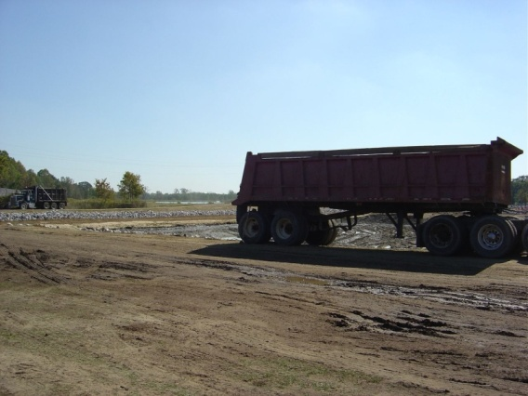
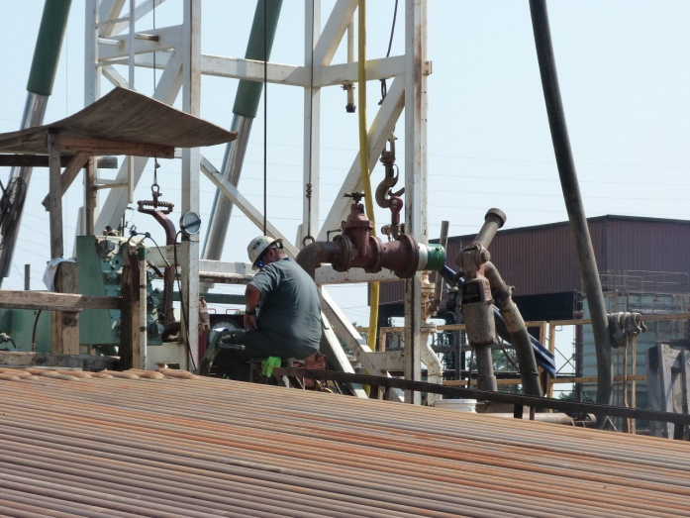
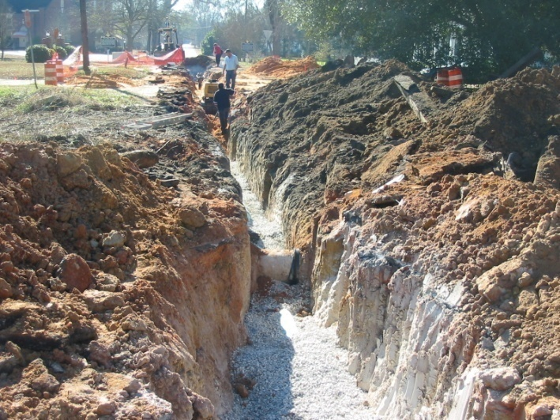
Community Development Block Grant (CDBG) Program
Livingston – Large City
Sewer Lagoon Improvements
Marion – Large City
Water Well
Hurtsboro – Small City
Sewer Rehabilitation

Slide 4
CDBG Program
Established as a federal grant program by Congress, administered annually by ADECA since 1982
Alabama’s Non-Entitlement Communities may apply to ADECA for federal CDBG grant funds
CDBG Program has three National Objectives:
Benefit at least 51% Low-Income and Moderate-Income (LMI) persons in project area
Clearance of Slum and Blighted Areas
Address an Urgent Need in a Community
ADECA received over $1 Billion in CDBG funds from 1982 to 2023, and funded over 4,500 local projects
ADECA’s 2023 CDBG Allocation = $23,271,036

Slide 5
CDBG Program Grant Fund Categories
Competitive Fund: Small City, Large City, and County CDBG projects may provide for “Essential Community Needs” including water, sewer, road paving, drainage improvements, and housing/residential rehabilitation.
Community Enhancement Fund: Small City, Large City, and County CDBG projects may provide for “Quality of Life” activities including fire stations, senior centers, community centers, storm shelters, and parks and recreation facilities.
Economic Development Fund: Small City, Large City, and County CDBG projects may provide for “Infrastructure Improvements” including water, sewer, rail spurs, and access roads. Each project must have a committed business that will create or retain jobs for LMI persons.
Planning Fund: Small City, Large City, and County CDBG projects may provide for “Plans” to develop downtown revitalization, regional development, and orderly community growth.

Slide 6
CDBG Program Grant Ceilings for Program Year 2023
Small City Fund, Large City Fund, and County Fund (competitive funds):
$400,000 maximum grant amount for Small City projects
$500,000 maximum grant amount for Large City projects
$500,000 maximum grant amount for County projects
Community Enhancement Fund:
$400,000 maximum grant amount for Small City, Large City, and County projects
Economic Development Fund:
$400,000 maximum grant amount (amount may be waived by ADECA Director)
Local matching funds requirement = 20% of CDBG grant amount requested
Planning Fund:
$40,000 maximum grant amount for Small City, Large City, and County projects

Slide 7
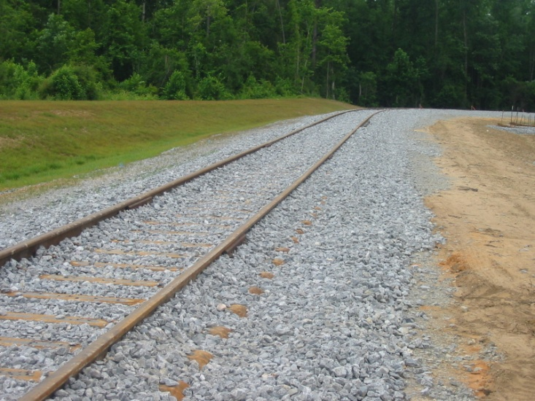
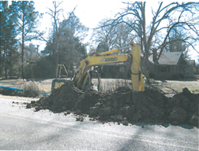
Examples of CDBG Projects 1982-Present
Autaugaville – Small City Water System Improvements
Marion – Large City Water Well Drilling
Jackson – Large City
Economic Development -
Rail Spur for SET Enterprises

Slide 8
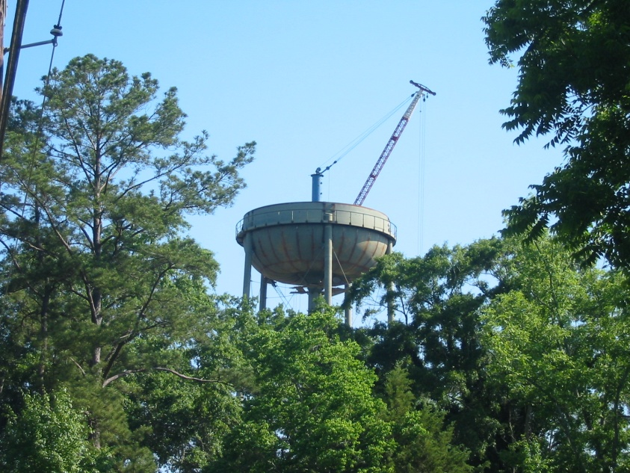
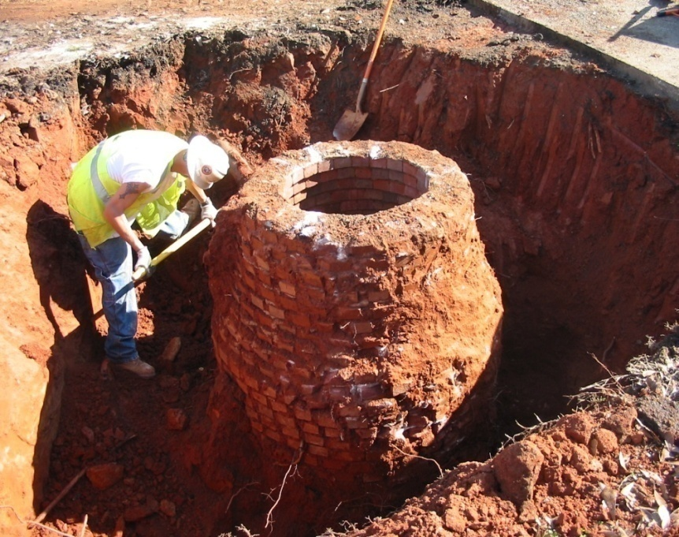
CDBG Program Small City Fund, Large City Fund, and County Fund (competitive funds)
“Essential Needs” projects include water, sewer, roads, and drainage improvements.
Georgiana – Small City
Water Tank
Dadeville – Large City
Sewer Rehabilitation

Slide 9
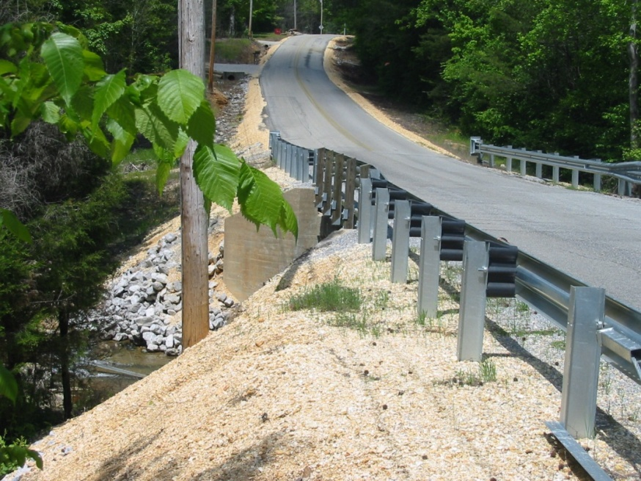
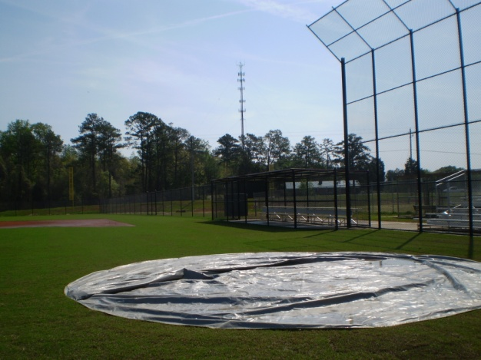
CDBG Program Community Enhancement Fund
“Quality of Life” projects include fire stations, senior centers, community centers, storm shelters, and parks and recreation facilities.
Russell County –
Sports Complex Multi-purpose
Ball Field
Colbert County -
Bridge Replacement

Slide 10
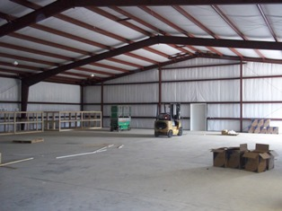
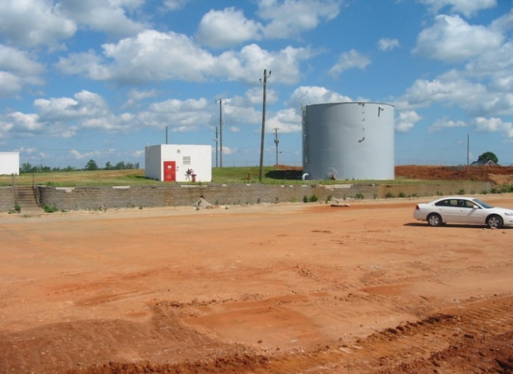
CDBG Program Economic Development Fund
Dallas County
-
Castle Rock Industries $700,000 Float Loan
for a
Westfalia centrifugal separator with
self-cleaning bowl
Opp – Large City
-
Custom Collars
New building and
water and
sewer mains in
East Industrial Park
Hackleburg – Small City
-
Wrangler (VF Jeanswear) Building pad, water storage tank, and pumping station
as part of
tornado recovery efforts

Slide 11
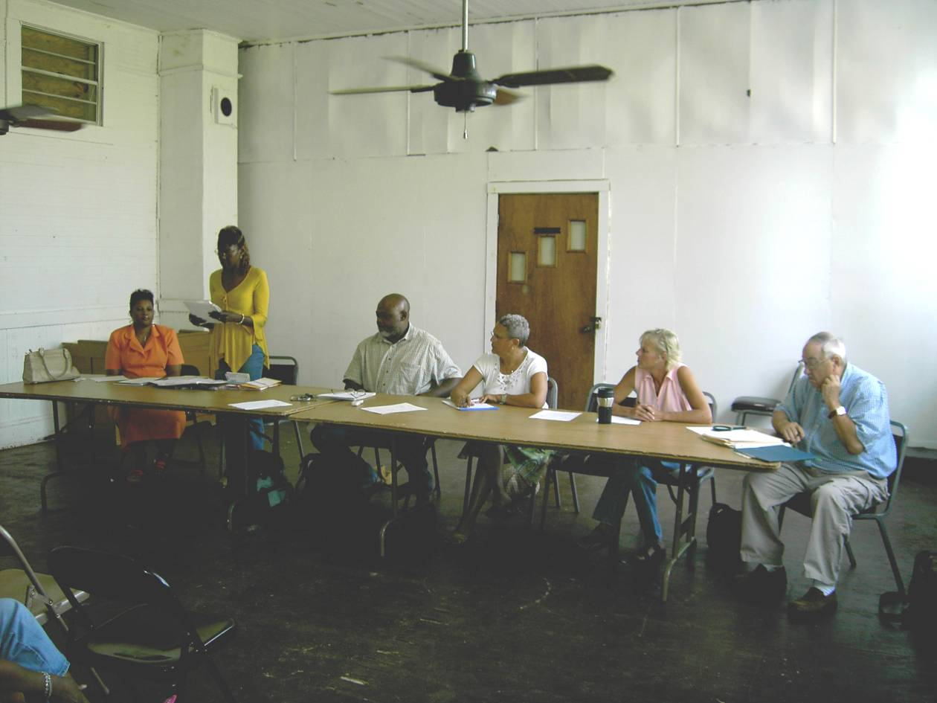
CDBG Program Planning Fund
Plans for downtown revitalization, regional development, and orderly area growth
“Planning” activities include:
Developing Comprehensive Plans
Developing individual elements or sections within a Comprehensive Plan
Developing Downtown Revitalization
Plans
Developing Regional Strategies
Epes – Small City
Adoption of Town’s first
Comprehensive Plan

Slide 12
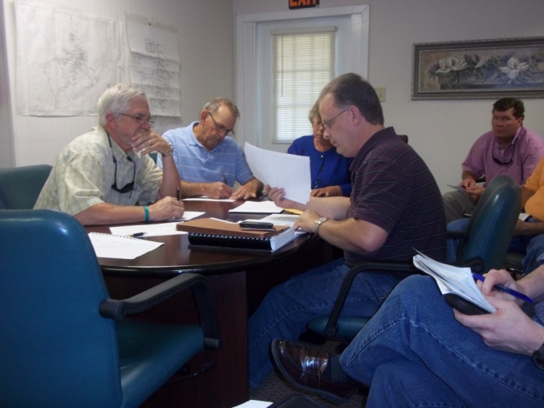
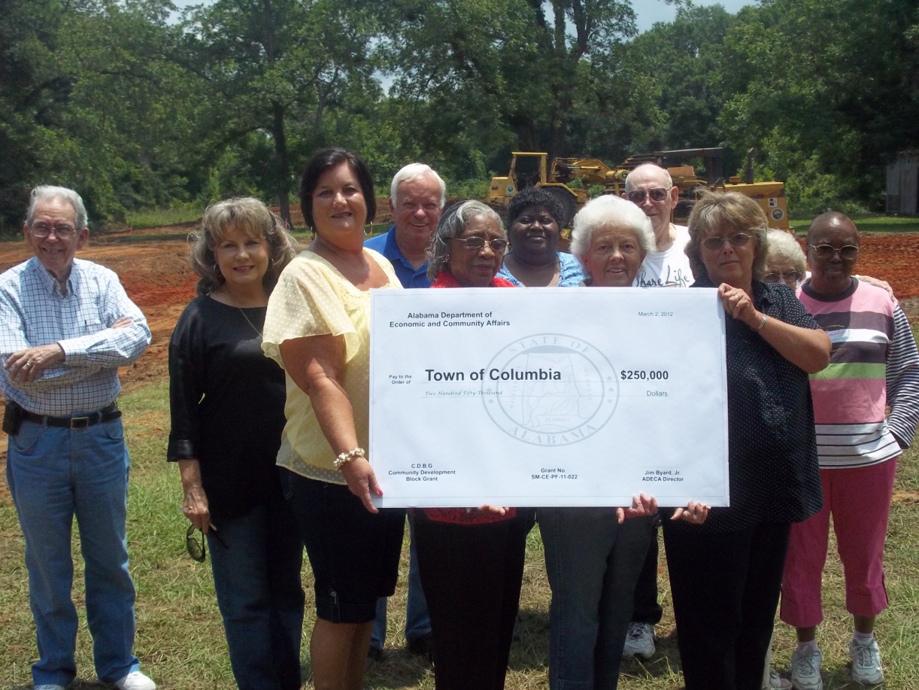
CDBG Program Success Story: Town of Columbia
Columbia – Small City
Bid opening for construction of a Senior Center
Columbia – Small City
Groundbreaking ceremony for the
Senior Center construction

Slide 13
Making things Happen!

Slide 14
Contact Us
ADECA Director
Kenneth W. Boswell
Kenneth.boswell@adeca.alabama.gov
(334) 242-5591
ADECA Deputy Director
Elaine Fincannon
Elaine.fincannon@adeca.alabama.gov
(334) 353-5765
CED Division Chief
Kathleen A. Rasmussen, Ph.D.
Kathleen.rasmussen@adeca.alabama.gov
(334) 353-0323
CED Statewide Initiatives Unit Chief
and CDBG Program
Kathleen A. Rasmussen, Ph.D.
Kathleen.rasmussen@adeca.alabama.gov
(334) 353-0323
Antoinette Djonret, Assistant to CED Division Chief,
Statewide Initiatives Unit, and CDBG Program
Antoinette.djonret@adeca.alabama.gov
(334)242-0492

