Slide 1
Alabama Digital Expansion Division Annual Report
Kenneth W. Boswell,
ADECA Director
Maureen Neighbors
Alabama Digital Expansion
Division Chief

Slide 2
Topics
Annual Report
History
Alabama Broadband Accessibility Fund Basics
Funded Projects
Current Applications
Technical Assistance Program, BEAD and Digital Equity
Middle Mile
Mapping

Slide 3
History
2017
Governor Ivey issued Executive Order 704, establishing ADECA as the agency to assume all powers, duties, responsibilities, authority, and obligations belonging to the Office of Broadband Development
2018
Governor Kay Ivey signed the Alabama Broadband Accessibility Act establishing the Alabama Broadband Accessibility Fund (ABAF)
2019
Governor Ivey signed Act #2019-327, amending the original Alabama Broadband Accessibility Act
2021
2022
Governor Ivey signed amendments to both the Alabama Broadband Accessibility Act and the Connect Alabama Act
Governor Kay Ivey signed the Connect Alabama Act that created the Alabama Digital Expansion Authority and the Alabama Digital Expansion Division of ADECA

Slide 4
Alabama Broadband Accessibility Fund Basics
Eligibility
Accountability
Eligible Areas - Unserved with broadband speeds greater than 100/20 in rural areas outside any incorporated city or town with a population of greater than 25,000.
Eligible Entities - Entities that are cooperatives, corporations, limited liability companies, partnerships, other private business entities, or units of government, which provide broadband services. An entity is not eligible for a grant unless the entity has submitted, within the one-year period preceding the awarding of the grant, the entity’s broadband service availability information to Alabama’s broadband mapping program.
Progressive Completion: Measured on not more than a quarterly basis, of the approved project. Grants for projects not showing progress may be rescinded.
Reimbursement Program: ADECA awards funds to the successful applicants before the project commencement; however, ADECA only disburses funds after the project is completed and verified.
Time Requirement: Recipients must complete projects within two years of award. Recipients who demonstrate that the project is progressing may request an extension for up to one year for project delays beyond their control.

Slide 5
Funded Projects
Year | Applications Funded | Grant Amount | Match Amount | Total Passings | Grant Cost per Passing
2018 | 13 | $2,225,918.20 | $8,903,672.82 | 2,933 | $758.92
2019 | 2 | $137,234.68 | $548,938.72 | 237 | $579.05
2020 | 38 | $17,183,136.58 | $37,170,528.11 | 21,713 | $791.38
2021 | 38 | $17,954,128.34 | $42,009,313.52 | 21,434 | $837.65
2022 | 9 | $26,468,966.18 | $36,994,116.33 | 13,589 | $1,947.82
Total | 100 | $63,969,383.98 | $125,626,569.5 | 59,906 | $1,067.83

Slide 6
Funded Projects (continued)
In order to promote the deployment of grant funds in an inclusive manner that is consistent with the racial, gender, geographic, urban, rural, and economic diversity of the state, ADECA gave additional scoring consideration (10 points) to applicants that provided documentation of certification by the Office of Minority Business Enterprise or otherwise as a Disadvantaged Business Enterprise. To date, five projects have been awarded points in this category.
Additionally, to encourage grant applicants to use vendors and subcontractors that have been certified by the Office of Minority Business Enterprise or that are Disadvantaged Business Enterprises, ADECA provided additional scoring consideration (10 points) for applicants identifying such businesses as part of the project. To date, two projects have been awarded points in this category

Slide 7
Funded Projects (continued)
48 Completed Projects | Projected | Actual | Percent Change
Grant Costs | $15,637,051.18 | $13,839,562.54 | -11.50%
New Services | 20,710 | 22,433 | 8.32%
Grant Cost/Service | $755.05 | $619.93 | -18.29%

Slide 8
Current Applications
Letters of Intent: The deadline for submitting letters of intent was November 3, 2022. We received 105 eligible LOIs.
Applications: The deadline for submitting applications was January 3, 2023. We received 61 applications by the deadline.
Internet Service Providers:
Applications were received from 22 different ISPs. Awards for the $25 million are expected in the first week of March

Slide 9
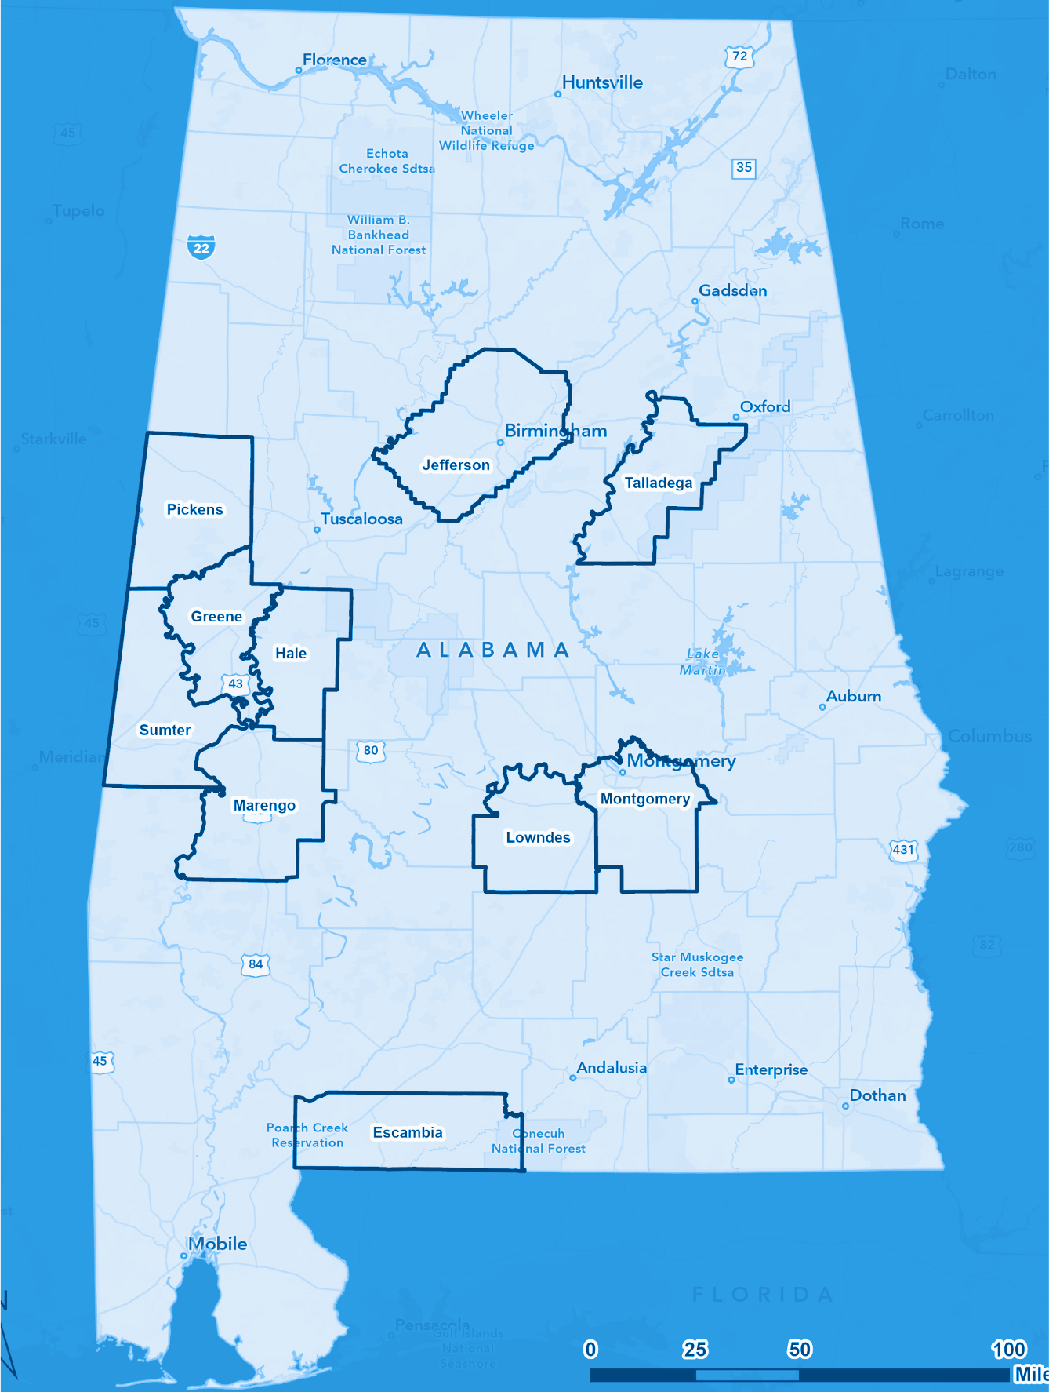
Technical Assistance Program, BEAD and Digital Equity
ADECA received a $1 million grant from EDA to provide broadband technical assistance to 10 counties and their cities and towns. Through the Broadband Equity, Access, and Deployment Program and the Digital Equity Program funds from the National Telecommunications and Information Administration, we will reach the remaining 57 counties. These activities will result in county profiles that will inform our required planning documents to NTIA and will allow us to access 100s of millions in additional funding.

Slide 10
Middle Mile
Additionally, Governor Ivey announced the award of $82.45 million for Alabama’s Statewide Middle Mile Network program.

Slide 11
Mapping
CTC has completed the 2022 update of the Alabama Broadband Map. Some additional updates will be added by the end of this month. We have a new layer that shows unserved addresses. We leveraged the hard work on the map to assist in challenging the new FCC map.

Slide 12
Mapping and the BEAD Allocation Process
The number of unserved addresses relative to other states will determine how much funding Alabama receives
Alabama Broadband Map
FCC map challenge process
Updated on December 31
Will continue with twice-yearly updates to enable informed grant-making
Widespread, helpful participation by ISPs
Important tool for vetting the FCC map
FCC Broadband Map
Released in the fall, with considerable challenges
Missing addresses
Incorrect (overstated) data regarding broadband service
Even with inaccuracies, the map appears to favor Alabama
Challenges to the missing addresses in the “fabric”
Challenges had to be submitted by October 30 to impact allocations
ADECA submitted 6,331 challenges in unserved areas, based on review of satellite data
The FCC informed us that most of these were accepted into the updated fabric
Challenges to incorrect data regarding service
Challenges must be submitted by Friday to (possibly) impact allocations
Many states have asked for extensions

Slide 13
Summary of TAP, BEAD, & Digital Equity Timelines
2023
Q1-2
2023
Q3-4
2024
Q1-2
2024
Q3-4
2025 +
1
Technical Assistance Program
Planning process
State programs
2
Digital equity planning & programs
Federal grants
3
BEAD planning
5-Year Plan & Initial Proposal
BEAD grant program
Grant program execution
Final proposal
4
5
BEAD deployment

Slide 14
The full annual report can be found on the ADECA website.
broadband.fund@adeca.alabama.gov
https://adeca.alabama.gov/broadband/

