Slide 1
Application Workshop PY2021 ALABAMA CDBG PROGRAM
Presented by Tammy Perdew
County, Large City, Small City and Community Enhancement
IMPACT
Notes:
Like Project Development, the Impact section of the application is one of the greatest point carriers – 45 points – but like Needs Assessment, it is often lacking. CDBG projects are about who is benefitting and is this the best use of federal funds. This section really can help a rater determine if this project is meeting the most needs.

Slide 2
Criteria for Rating Competitive Grant Applications
Impact
Description of qualitative and quantitative project impact in addressing the needs of the project area or community
Number of beneficiaries / LMI beneficiaries
Directness of benefit
Urgency and/or criticalness of the project
Evidence of secondary benefits
Life expectancy of improvements
Cost/Benefit Ratio (Fund Usage & Benefit Table)
Notes:
Application Raters for Small City, Large City and County Funds specifically look for the following six criteria in detailed form. I will also briefly discuss the Cost/Benefit Ratio since that involves beneficiaries.
Please keep in mind that although Community Enhancement is rated on a different point scale, the same information is expected to be included in those projects in order to bring the strongest ones to the top of the final rating selection. More often in Community Enhancement applications, the beneficiaries are Limited Clientele as mentioned earlier or considered a town-wide project.

Slide 3
Impact
Description of qualitative and quantitative project impact in addressing the needs of the project area or community
Notes:
How does this project impact the beneficiary’s life, well-being, health, safety, time, finances? Be specific. The remaining 5 criteria support, clarify and back up what’s stated in this section.

Slide 4
Impact
Number of beneficiaries / LMI beneficiaries
Tab 4 – Policy Letter Number 22 (Establishment of LMI Benefit)
HUD Adjusted Census Data – Area Wide
HUD Low and Moderate Income Summary Data (Tab 3)
HUD Adjusted Census for Counties and Cities (Excel file)
Income Survey – Individual Project Area
CDBG Beneficiary Survey Form (Tab 4)
2020 (and 2021) HUD Income Limits https://www.hudexchange.info/resource/5334/cdbg-income-limits/
NOTE: ADECA will email when 2021 HUD Income Limits are available.
Notes:
Policy Letter Number 22 explains how to establish LMI.
If the project is town-wide and your community is at least 51% LMI (per the HUD LMI Summary Data for Alabama Cities and Counties found in Tab 3 of the manual) then you can use the HUD Adjusted Census Data to determine the beneficiaries. Keep in mind that you will need to then use the Excel document found on the CDBG website to determine the breakdown of very low, low, moderate, and high incomes for the Project Beneficiary Table. I will address the Project Beneficiary Table in more detail later.
If it is believed that the community is at least 51% LMI and that is not what is listed in the table then an Income Survey can be done.
An Income Survey is also required for individual project areas, which are not considered town-wide. Keep in mind that if there is more than one project area and these are not adjacent then each area must meet the 51% LMI threshold. I will give some examples of project areas in a few minutes.

Slide 5
HUD Low and Moderate Income Summary Data for Alabama Cities and Counties
Notes:
As just mentioned, Tab 3 includes the 2020 HUD chart of LMI percentages for each Alabama City, Town and County.
For example, the two highlighted in green meet the 51% LMI threshold and an income survey is not required.
The two pink cities are close enough that an Income Survey might show that the current population does meet the 51% LMI threshold. There might be some that are even lower that could qualify if an Income Survey is conducted.

Slide 6
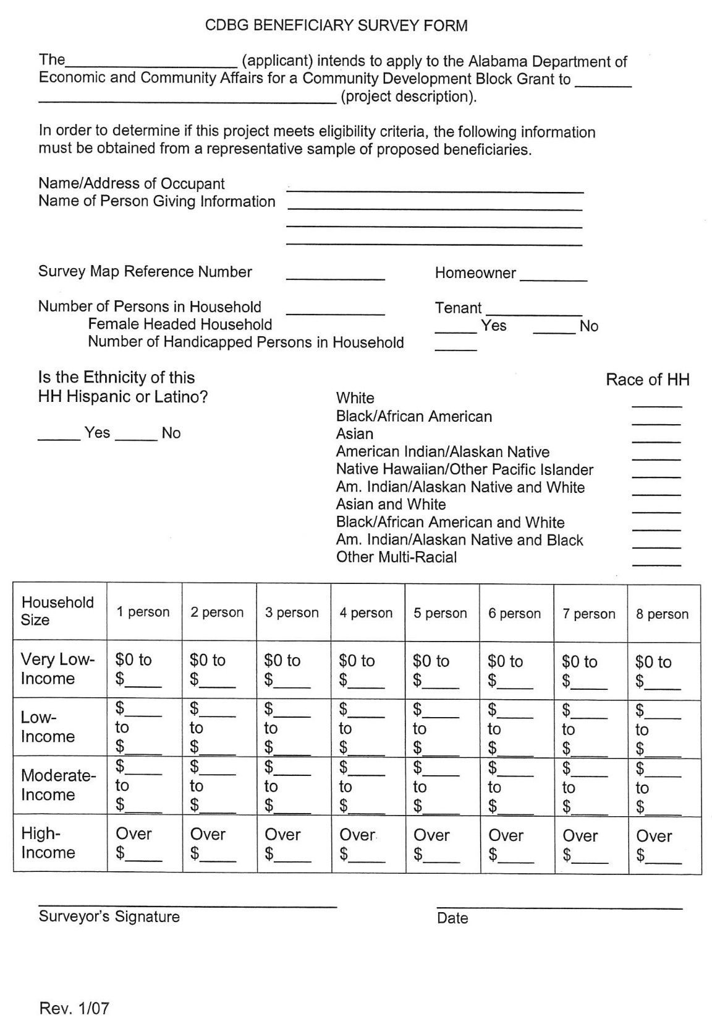
CDBG Beneficiary Income Survey
Notes:
Keep in mind that if an application has been previously submitted, those income surveys can still be used up to three years, but these should be checked again for any changes in possible beneficiaries and adjustments made to the current application. There could be more vacant houses or more/fewer beneficiaries.
For 2021 Applications that do not have a previous survey, the 2020 CDBG Income Limits may be used until the 2021 CDBG Income Limits become available.
The Income Survey shown in this slide is under Tab 4. There are other helpful forms located in this section as well.

Slide 7
2020 HUD CDBG Income Limits
Notes:
NOTE: This is the 2020 information, and it is greatly condensed to fit on this slide. The limits go up to an 8-person household. Also, please make sure to use the CDBG income limits (not Section 8 or Home).
When looking at the Income Limits, you will see, there are 4 income categories. For our survey purposes, delete the 60% Limits columns.
Then make the following changes:
Lim30 = Very Low Income
Lim50 = Low Income
Lim80 = Moderate Income
Over Lim80 = High Income

Slide 8
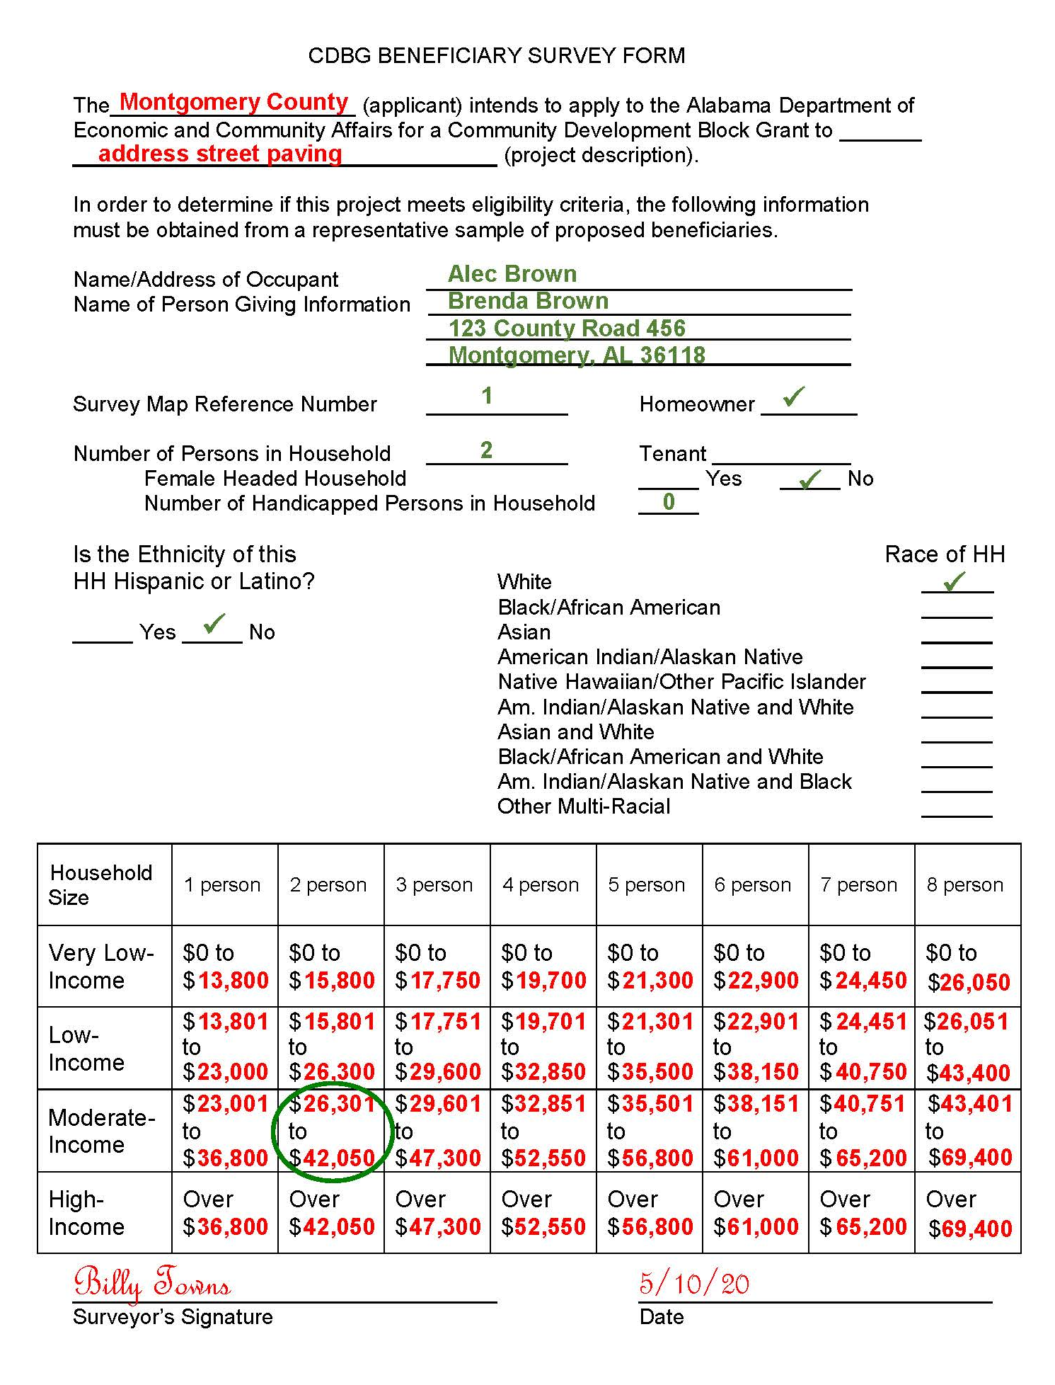
CDBG Beneficiary Income Survey
Sample Income Survey using 2020 CDBG Income Limits
Notes:
Once Income Surveys are completed, collected and tallied, please refer to Policy Letter Number 22 to decide if you must utilize a Methodology to determine your final beneficiary numbers in order to complete the Project Beneficiary Table. Include your Survey Methodology in the application.
For Limited Clientele activities, please include how you determined the number of beneficiaries. For example, a Community Enhancement application for building a new Senior Center states 100 beneficiaries. Is that the number of Seniors registered at the old Senior Center? Is that the number of seniors in the City determined by the HUD Adjusted Census?
Before we get to the Project Beneficiary Table, let’s look at a few examples of project areas when determining beneficiaries.

Slide 9
Criteria for Rating Competitive Grant Applications
Impact
Description of qualitative and quantitative project impact in addressing the needs of the project area or community
Number of beneficiaries / LMI beneficiaries
Directness of benefit
Urgency and/or criticalness of the project
Evidence of secondary benefits
Life expectancy of improvements
Cost/Benefit Ratio (Fund Usage & Benefit Table)
Notes:
When looking at the upcoming examples of project areas, keep in mind that we are also trying to determine the Directness of Benefit and the Evidence of Secondary Benefits.

Slide 10
Notes:
So you have this quaint little town that is growing or simply needs some help in order to continue to provide its residents with a good quality of life.
You have the Ball Fields, a Public Park, a Senior Center, Churches, government buildings, area businesses, and several neighborhoods.
The town has several potential projects from sewer to water to street paving.
So let’s look at some scenarios from which you will obtain your beneficiaries and make the project stronger.

Slide 11
Notes:
This example is pretty straight forward. If Park Place is your target street even if you do more than one activity, when you look at potential beneficiaries, it is merely the residents on the right and lefts sides of the street. Might not fair well in rating. So …

Slide 12
Notes:
Can you add another street and keep it within the project budget? Can the community put enough match in to cover any costs beyond any required match or CDBG funds?
If so, look what was just added … residential direct beneficiaries were increased by about a third and quite a few secondary beneficiaries were added such as area businesses and the Senior Center. This makes for a much more appealing project and a better investment of CDBG funds.
Note that although Boardwalk Boulevard runs next to the apartments, these residents cannot be counted as beneficiaries because access to the apartment complex is achieved by another street, and water and sewer lines are also parallel to the other street.

Slide 13
Notes:
Let’s take this further. Perhaps two more streets could be added to the project area.
Now that you’re working on Application Avenue and Olia Avenue, numerous secondary beneficiaries are added to the project area, including that apartment complex you might have tried to add to the last example. This scenario really can make the most of the funds if this is within the overall project budget.

Slide 14
Notes:
Let’s look at one more example. So far, all of the project areas were adjacent and, therefore, meeting the 51% LMI threshold is simpler.
However, if you have two potential projects areas, EACH must meet the 51% LMI threshold. Once done, please refer to the Application Manual for more information on final beneficiary calculations.
Note of caution… location of beneficiaries is important. For example, a City water system wants to extend water lines that go into a rural area. At least 70% of the beneficiaries must be located in the incorporated area for it to be a City application. If more than 30% of beneficiaries are outside the incorporated area, it should be submitted as a joint application with the County -- meaning both the City and County are required to meet the 51% LMI threshold. Whichever has the majority of beneficiaries must submit the application.
Although it’s the City’s system, the beneficiaries extend into the rural County… it’s not who supplies the benefit, it’s who receives it that counts.

Slide 15
Impact
Evidence of secondary beneficiaries
Public agencies and services such as Town Hall, Police or Fire
Public Facilities like Parks, Senior Center or Library
Area businesses or churches
Evidence of secondary benefits
Improved fire service or ISO ratings
Reduction in cost of repairs to public and private vehicles
Reduced residential water bills or city repair bills
Increased access to public services and facilities
Notes:
Do not gloss over any additional beneficiaries or benefits that could impact your project especially if the beneficiary count is not very high.
Be sure to include survey maps and tally sheets that correspond CORRECTLY from names and addresses to street names! We do review these closely if a site visit is warranted.

Slide 16
Notes:
Next, the Project Beneficiary Table.
Note that this form is for DIRECT Beneficiaries ONLY. Do not include secondary beneficiaries – such as church members or business employees – on this form.
The key is to remember that the TOTAL PEOPLE in the top table must equal the total of the TOTAL PEOPLE per activity in the bottom table.

Slide 17
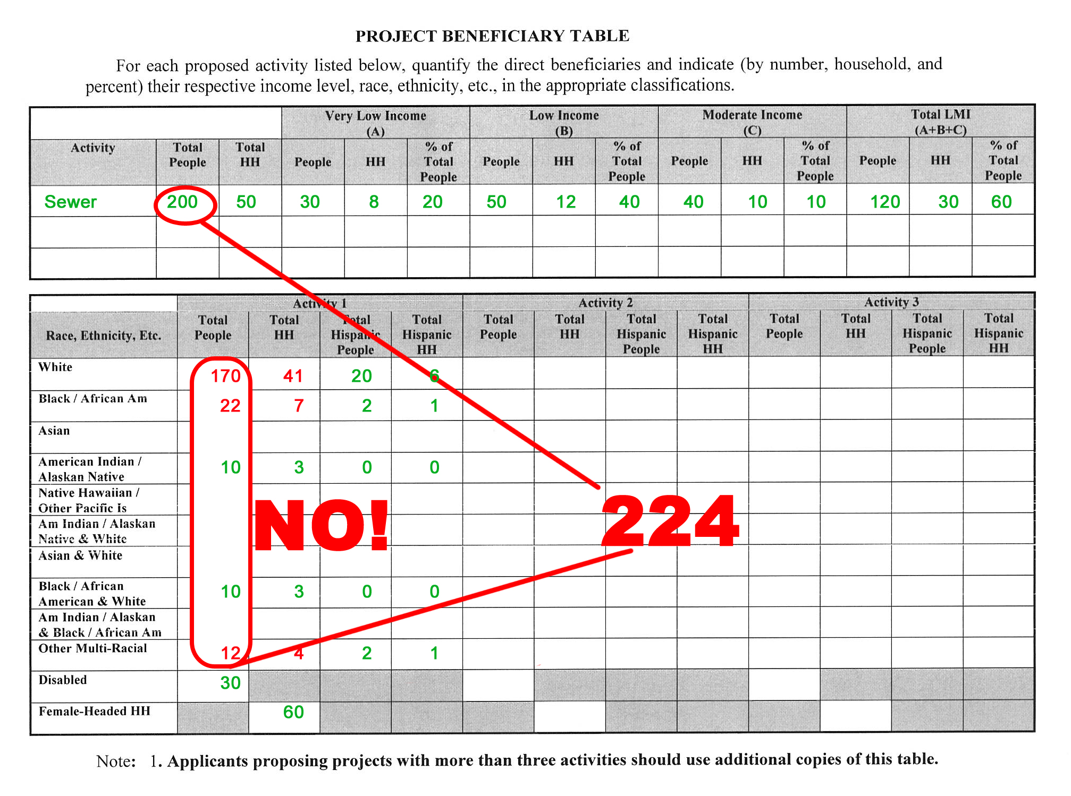
Notes:
Remember, Hispanic is an ethnicity and not a race. This number is PART of the total race count and not added to the total number of each race.
Also Female Head of Household is defined as: A married or unmarried female who maintains a household for a dependent, or non-dependent relative, and provides more than half of the dependent's financial support. Dependent: A member of the family (except foster children and foster adults) other than the family head or spouse, who is under 18 years of age, or is a person with a disability, or is a full-time student. Therefore, if a household has only one female resident, there is NO female head of household, because there are no dependents in the home.
Do not forget to include Number of Disabled.

Slide 18
Notes:
Before moving on from the Project Beneficiary Table, here is an example of one with multiple activities. Even if the sewer and water activities are taking place in the same project area, meaning some beneficiaries are getting both benefits, be sure to list them separately since they are different activities.

Slide 19
Criteria for Rating Competitive Grant Applications
Impact
Description of qualitative and quantitative project impact in addressing the needs of the project area or community
Number of beneficiaries / LMI beneficiaries
Directness of benefit
Urgency and/or criticalness of the project
Evidence of secondary benefits
Life expectancy of improvements
Cost/Benefit Ratio (Fund Usage & Benefit Table)
Notes:
Now let’s briefly discuss the Urgency or Criticalness of the project as well as life expectancy:

Slide 20
Impact
Urgency and/or Criticalness of the Project
Under Consent Order by ADEM
Sewage or Water backing up into homes / yards
Private Water Wells / Septic Tanks Failing
Water Source Contaminated
Life Expectancy
Information should be available in Preliminary Engineering Report
Should coincide with types of materials used and project type
Notes:
The Urgency and Criticalness really do matter. A couple of examples of critical need: residents who do not have access to potable water; residents who have sewage backing up into their homes.
On site visits, we are observant. If the project involves drainage because storm water is flooding people’s homes, and we view the project area and find the drainage system overgrown or full of debris and litter, we will question: 1) if lack of maintenance caused the problem and 2) will it be an ongoing problem if the project is funded. The condition and amount of potholes in streets may raise similar maintenance questions. We need to know that the communities seeking help are doing the most with what they have and will appreciate the CDBG funds if awarded.
Life expectancy is important. We need to know that this project will have the longevity expected. An engineer with know this and include it in the Preliminary Engineering report.

Slide 21
Criteria for Rating Competitive Grant Applications
Impact
Description of qualitative and quantitative project impact in addressing the needs of the project area or community
Number of beneficiaries / LMI beneficiaries
Directness of benefit
Urgency and/or criticalness of the project
Evidence of secondary benefits
Life expectancy of improvements
Cost/Benefit Ratio (Fund Usage & Benefit Table)
Notes:
Finally, a quick overview of what is expected when completing the Fund Usage & Benefit Table

Slide 22
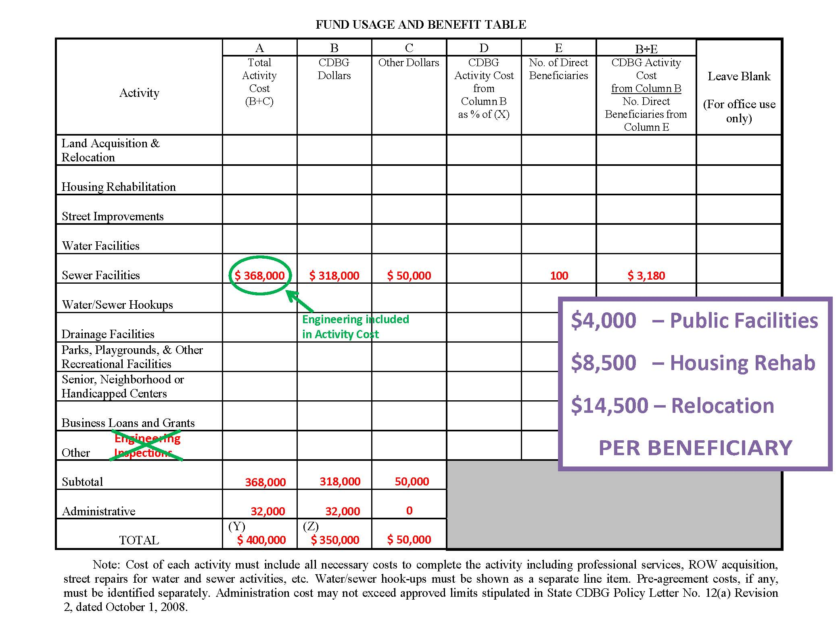
Notes:
CDBG raters make the final decision on whether or not a project becomes Comprehensive when it involves more than two activities. It depends on costs of activities and whether or not one is a necessary part of another activity. For example, street repairs might be secondary to sewer rehab. Therefore, if your projects involves multiple activities, list each in its respective line item.
Also, Engineering is a separate line item in Budgets, Estimates, etc. However, for the purpose of this form only, Engineering is included in the Total Activity Cost in order to figure the Cost/Benefit Ratio. It is NOT to be included in the “other” line which is used for things such as demolition, streetscape, etc.
For CDBG Activity Cost, a level ratio base of $4,000 for all public facilities, $8,500 for housing, and $14,500 for relocation has been established. Applicants with ratios at or below these levels for each activity will receive maximum rating points.

Slide 23
Criteria for Rating Competitive Grant Applications
Impact
Description of qualitative and quantitative project impact in addressing the needs of the project area or community
Number of beneficiaries / LMI beneficiaries
Directness of benefit
Urgency and/or criticalness of the project
Evidence of secondary benefits
Life expectancy of improvements
Cost/Benefit Ratio (Fund Usage & Benefit Table)
Notes:
So we have covered all criteria.
The Application Manual can be found online. Please be patient as we will be updating the website to the 2021 information as soon as possible.
We will be sure these presentations are published online, as well.
For the Impact section, please refer to Tabs 3 and 4 then, of course, the applicable tab for the type of application you will be submitting will be found in Tab 5, 6, 7 or 8.

Slide 24
Questions or Comments?
Thank You!
~~~~~~~~~~~~~~~~~~~~~~~~~~~~~~
Tammy Perdew
tammy.perdew@adeca.alabama.gov
334.353.3266
ADECA Website:
www.adeca.alabama.gov

